Slide 1
Traffic Safety Improvement Program
Funding Recommendation
FY 2021

Slide 2
Background
Established in 1987 by Iowa Legislature
Iowa Code Section 312.2 and Administrative Rules 761 Chapter 164
0.5% of Road Use Tax Fund
Purpose: Implement traffic safety features in order to reduce fatalities and serious injuries
Available to all public entities responsible for public roads and streets
Now including state parks and institutional roads
Unique program among state DOTs

Slide 3
Funding Categories
Site-Specific Improvements
Construction projects to improve traffic safety and operations
Annual funding varies, generally $6-$7 million
Traffic Control Devices
For purchase of traffic control device materials
Annual funding = $500,000
Studies & Outreach
Traffic safety research, studies, and public information initiatives
Annual funding = $500,000
Listing of applications can be found at this link:
https://iowadot.gov/traffic/Traffic-and-Safety-programs/TSIP/TSIP-Program

Slide 4
Application Review/Scoring
Demonstrated relationship to traffic safety
Safety benefit
Project cost
Type of countermeasure(s) proposed
Risk factor(s) addressed
Safety engineering analysis
Multi-agency committee input
Funding subject to agreement execution

Slide 5
Application/Funding Summary
Application Summary
Applications received: 42
Total project costs: $30,504,196
TSIP funds requested: $9,698,743
Available Funding
FY 2021 TSIP estimated appropriation: $7,356,000
Site-Specific: $6,356,000
TCD: $500,000
Studies & Outreach: $500,000
Total funding recommended: $7,351,000

Slide 6
Site-Specific Improvements Funding Recommendation
PROJECT NAME | SPONSOR | SCORE | TOTAL PROJECT COST | REQUESTED AMOUNT (% of Total Project Cost) | RECOMMENDED AMOUNT (% of Total Project Cost)
US 69 at Magazine Rd – turn lanes | City of Ankeny | High | $329,000 | $239,000 (73%) | $239,000 (73%)
Greenhill Rd at Cedar Heights Dr – roundabout | City of Cedar Falls | High | $2,553,650 | $500,000 (20%) | $500,000 (20%)
13th Ave N – lane conversion | City of Clinton | High | $1,100,000 | $490,000 (45%) | $490,000 (45%)
IA 13 – lane conversion | City of Manchester | High | $3,080,609 | $500,000 (16%) | $382,000 (12%)
Alburnett Rd at Echo Hill Rd – roundabout | City of Marion | High | $990,000 | $500,000 (51%) | $500,000 (51%)
US 175 – lane conversion | City of Onawa | High | $1,189,745 | $500,000 (42%) | $500,000 (42%)
Jump to applications not recommended for funding

Slide 7
Site-Specific Improvements Funding Recommendation
PROJECT NAME | SPONSOR | SCORE | TOTAL PROJECT COST | REQUESTED AMOUNT (% of Total Project Cost) | RECOMMENDED AMOUNT (% of Total Project Cost)
Ashworth Dr at Warrior Ln – roundabout | City of Waukee | High | $1,727,070 | $500,000 (29%) | $500,000 (29%)
E-59 – edge/centerline treatments | Crawford County | High | $2,983,424 | $500,000 (17%) | $500,000 (17%)
S Duff Ave at US 30 EB Offramp – turn lanes/signal | City of Ames | Med | $1,089,240 | $500,000 (46%) | $500,000 (46%)
IA 100 at 31st St – turn lanes/signal | City of Marion | Med | $502,108 | $500,000 (99%) | $500,000 (99%)
US 69 at 280th St – turn lanes | Iowa DOT - District 1 | Med | $802,000 | $500,000 (62%) | $500,000 (62%)
T-14 – edge treatments | Marion County | Med | $966,985 | $500,000 (52%) | $500,000 (52%)
Jump to applications not recommended for funding

Slide 8
Site-Specific Improvements Funding Recommendation
PROJECT NAME | SPONSOR | SCORE | TOTAL PROJECT COST | REQUESTED AMOUNT (% of Total Project Cost) | RECOMMENDED AMOUNT (% of Total Project Cost)
W-61 – edge treatments | Washington County | Med | $3,996,159 | $500,000 (13%) | $500,000 (13%)
IA 32 at John F Kennedy Rd – turn lanes/signal | City of Dubuque | Low | $160,715 | $132,715 (83%) | $105,000 (65%)
7th Ave at 35th St – turn lanes/signal | City of Marion | Low | $528,600 | $257,000 (49%) | $140,000 (26%)
Jump to applications not recommended for funding

Slide 9
Traffic Control Devices Funding Recommendation
PROJECT NAME | SPONSOR | SCORE | TOTAL PROJECT COST | REQUESTED AMOUNT (% of Total Project Cost) | RECOMMENDED AMOUNT (% of Total Project Cost)
Signal Replacement | City of Norwalk | High | $1,982,400 | $200,000 (10%) | $130,000 (7%)
Install New Traffic Signal | City of Orange City | High | $450,423 | $296,810 (66%) | $200,000 (44%)
Sign Replacement Program | Iowa DOT - Traffic & Safety Bureau | High | $100,000 | $100,000 (100%) | $100,000 (100%)
Portable Temporary Traffic Signals | Mahaska County | Med | $50,000 | $50,000 (100%) | $60,000 (120%)
Install Stop Sign Beacons | Humboldt County | Low | $4,077 | $4,077 (100%) | $5,000 (123%)
Jump to applications not recommended for funding

Slide 10
Studies & Outreach Funding Recommendation
PROJECT NAME
REQUESTED AMOUNT
RECOMMENDED AMOUNT
Non-motorized Traffic Monitoring (Phase 4) | $39,664 | $40,000
Applications of the Iowa Curve Database | $150,000 | $150,000
ICAT Training (Phase 3) | $70,000 | $30,000
MDST Facilitator Program | $50,000 | $50,000
Iowa Roundabout Conference | $50,000 | $50,000
Inventory of Three-Lane Road Characteristics, Origins, and Impacts | $40,000 | $40,000

Slide 11
Studies & Outreach Funding Recommendation
PROJECT NAME
REQUESTED AMOUNT
RECOMMENDED AMOUNT
Work Zone Sign Package Program Extension | $60,000 | $60,000
Railroad Crossing Safety Education Support | $42,000 | $20,000
Traffic Safety Outreach Videos | $50,000 | $40,000
Statewide Bicycle Safety Media Campaign | $20,000 | $20,000

Slide 12
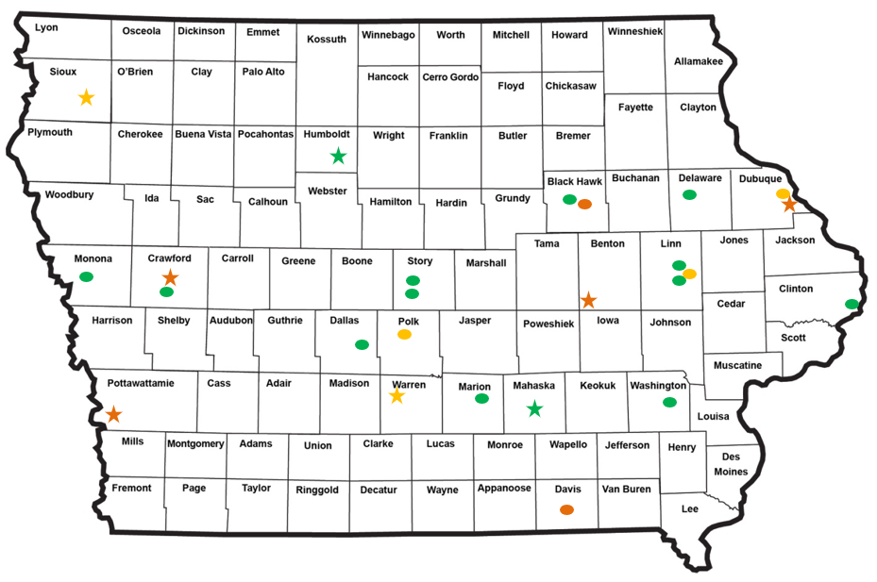
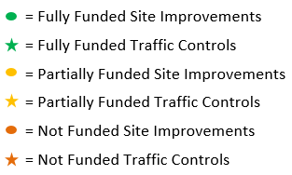
Map of Applications Received

Slide 13
QUESTIONS?
Jan Laaser-Webb, Traffic and Safety Bureau
jan.laaser-webb@iowadot.us
515-239-1349

Slide 14
Site-Specific Improvements Applications Not Recommended for Award
REQUESTED AMOUNT
(% of Total Project Cost)
RECOMMENDED AMOUNT
(% of Total Project Cost)
PROJECT NAME
SPONSOR
SCORE
TOTAL PROJECT COST
Independence Ave at Vinton St – turn lanes/signal | City of Waterloo | Low | $205,000 | $200,000 (98%) | $0
212th St - guardrail | Davis County | Low | $75,000 | $75,000 (100%) | $0
Return to Recommendation Summary

Slide 15
Traffic Control Devices Applications Not Recommended for Award
REQUESTED AMOUNT
(% of Total Project Cost)
RECOMMENDED AMOUNT
(% of Total Project Cost)
PROJECT NAME
SPONSOR
SCORE
TOTAL PROJECT COST
Traffic Signals | City of Denison | Med | $247,800 | $120,200 (49%) | $0
Traffic Signals | Pottawattamie County | Med (Application Withdrawn) | $275,000 | $275,000 (100%) | $0
Traffic Signals | City of Belle Plaine | Low | $27,277 | $27,277 (100%) | $0
Traffic Mgmt Hardware | City of Dubuque | Low | $3,366,250 | $200,000 (6%) | $0
City and County Bridge Sign Posting Program | Iowa DOT - Local Systems Bureau | Low | $500,000 | $500,000 (100%) | $0
Return to Recommendation Summary

Slide 16
Studies & Outreach Applications Not Recommended for Award
PROJECT NAME
REQUESTED AMOUNT
RECOMMENDED AMOUNT
Evaluating the Impact of Stop Bars on Stopping Behavior | $60,000 | $0
Evaluating TIM Plans Using Probe Data | $100,000 | $0
Purchase and Distribute Hardcopies of 2020 MUTCD | $90,000 | $0
Safety Improvements Database | $175,000 | $0
Work Zone Safety Training | $35,000 | $0

