Slide 1
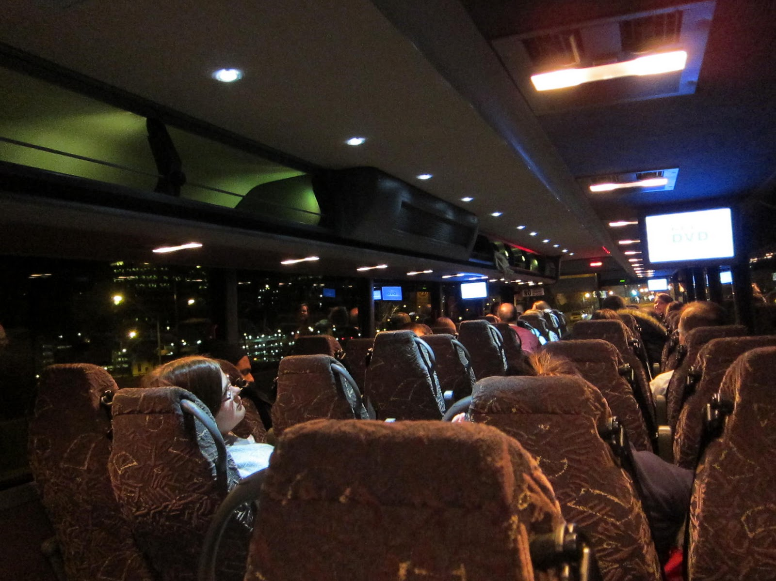
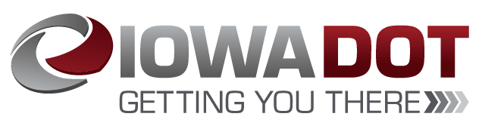
CY 20 Intercity Bus Program

Slide 2

Intercity Bus Program
CY20 Intercity Bus Program
Purpose: Support intercity bus services that includes stops at non-urbanized locations and makes meaningful connections to nationwide network
Available to private intercity bus companies, companies wishing to start bus service, public transit agencies either operating of proposing to operate bus service, and local communities wishing to support intercity connections to their community

Slide 3
Funding Priorities
CY20 Intercity Bus Program
Iowa’s program has four components in priority order:
Base level support of existing services ($0.20 per revenue mile)
Start-up support for new services (three years at $0.50 per revenue mile)
Support for marketing of intercity bus services and interlined services (maximum $7,500 for existing routes per agency and $12,000 per each new route with 20% local match required)
Support for intercity bus capital improvements (over the road coaches, vertical infrastructure, vehicle renovations/improvements, ADA improvements to vehicles and facilities). Vehicles require a 15% local match while all other capital projects require 20% local match.

Slide 4
Available Funding and Application Summary
CY20 Intercity Bus Program
Available Funding
Total Intercity Bus Funds Available: $2,321,680
15% of federal non-urbanized (FTA Section 5311) transit funding
Includes $207,039 in carryover funds
Application Summary
Total number of projects: 11
Total project costs: $11,029,621
Total amount requested: $2,586,070

Slide 5
CY20 Intercity Bus Program
List of Recommended Projects
PROJECT NAME | SPONSOR | TOTAL PROJECT COST | REQUESTED AMOUNT (% of Total Project Cost) | RECOMMENDED AMOUNT (% of Total Project Cost)
Operational Assistance | Burlington Trailways | $5,402,457 | $268,112 (5%) | $268,112 (5%)
Marketing | Burlington Trailways | $7,346 | $5,877 (80%) | $5,877 (80%)
Capital Funding for Des Moines Bus Station Operations | Burlington Trailways | $100,000 | $80,000 (80%) | $0
Des Moines Bus Station Staff | Burlington Trailways | $200,000 | $160,000 (80%) | $0
OTR Motor Coach | Burlington Trailways | $548,445 | $466,178 (85%) | $466,178 (85%)

Slide 6
List of Recommended Projects, continued
CY20 Intercity Bus Program
PROJECT NAME | SPONSOR | TOTAL PROJECT COST | REQUESTED AMOUNT (% of Total Project Cost) | RECOMMENDED AMOUNT (% of Total Project Cost)
Operation Assistance | Jefferson Lines | $2,806,855 | $154,554 (5.5%) | $154,554 (5.5%)
Marketing | Jefferson Lines | $9,375 | $7,500 (80%) | $7,500 (80%)
3 - OTR Motor Coaches | Jefferson Lines | $1,645,393 | $1,398,584 (85%) | $1,398,584 (85%)
Travel Information Center Operations | Jefferson Lines | $291,000 | $30,265 (10.4%) | $5,875 (2%)

Slide 7
List of Recommended Projects, continued
CY20 Intercity Bus Program
PROJECT NAME | SPONSOR | TOTAL PROJECT COST | REQUESTED AMOUNT (% of Total Project Cost) | RECOMMENDED AMOUNT (% of Total Project Cost)
Marketing | City of Dubuque | $9,375 | $7,500 (80%) | $7,500 (80%)
Marketing | City of Fort Dodge | $9,375 | $7,500 (80%) | $7,500 (80%)

Slide 8
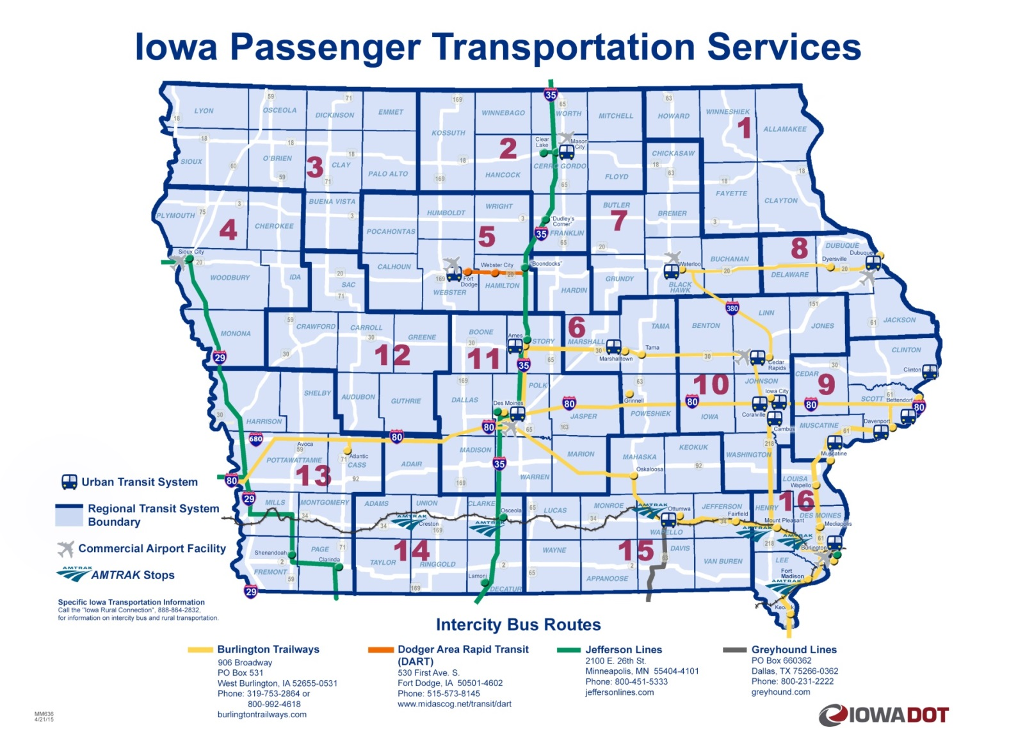
Intercity Bus Map
CY20 Intercity Bus Program

Slide 9
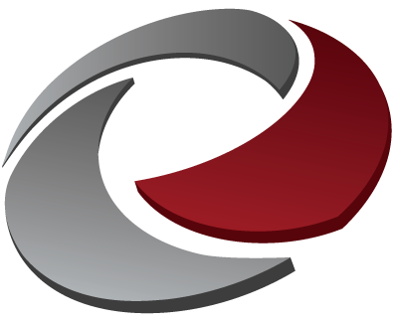
QUESTIONS?
For more information on Iowa’s public transit and intercity bus programs, visit
www.iowadot.gov/transit

