Slide 1
Des Moines Integrated Corridor Management - Update
November 10, 2020
Iowa Transportation Commission
Notes:
Last came to Commission with ICM
May 2019 – set the groundwork for what is ICM – Integrated Corridor Management and what it can look like.
April 2020 – presented the near term strategies and first phases of implementation – which we’ve started on some of the near term – early win type of projects
Today:
Review what is ICM and how it fits with Des Moines. Preview of the online PIM that is going online in Mid-November.
Dig deeper into the traffic issues in the DM area and what the needs are and where.
What recommendations the team has for ICM in Des Moines – both as a big picture strategy and show some of the more detailed recommendations.
We believe investing in Integrated Corridor Management will save $$ that we would have to otherwise invest in infrastructure and additional highway capacity.

Slide 2
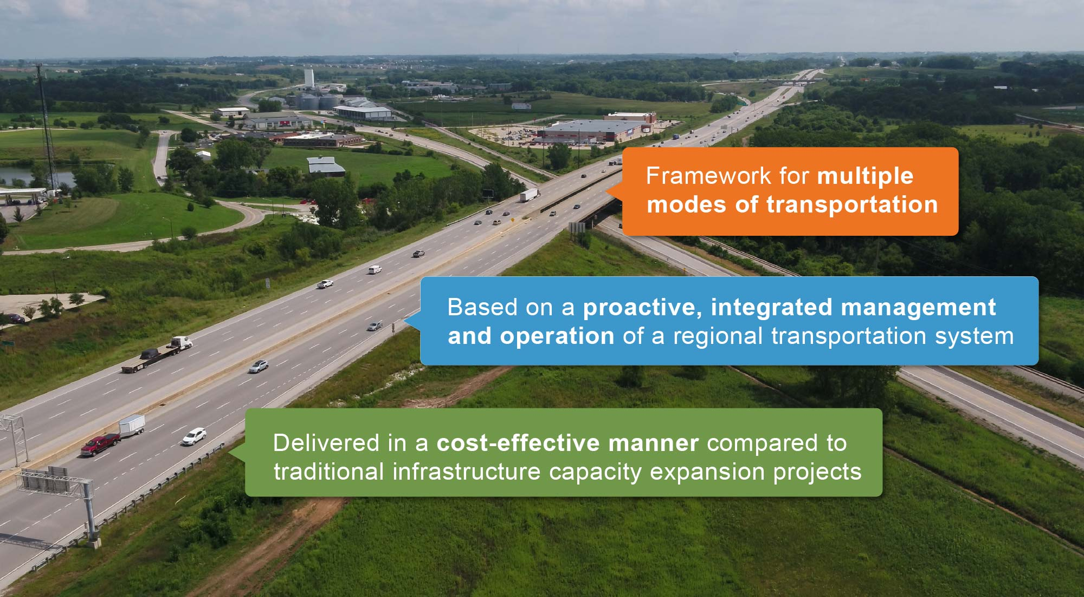
What is Integrated Corridor Management (ICM)
Notes:
An ICM approach is approved means to proactively manage and operate transportation systems in a region.
Roadways and other transportation options (such as transit) are operated, controlled and treated as an integrated system, rather than as individual components.
In other words, ICM helps us:
use our EXISTING INFRASTRUCTURE to provide the MOST SERVICE out of what we ALREADY HAVE.
Framework for multi-modal, multi-jurisdictional coordination to deliver a safer, more reliable, and more convenient transportation system for all users
Based on proactive, integrated management and operation of a regional transportation system
Delivered in a cost-effective manner compared to traditional infrastructure capacity expansion projects

Slide 3
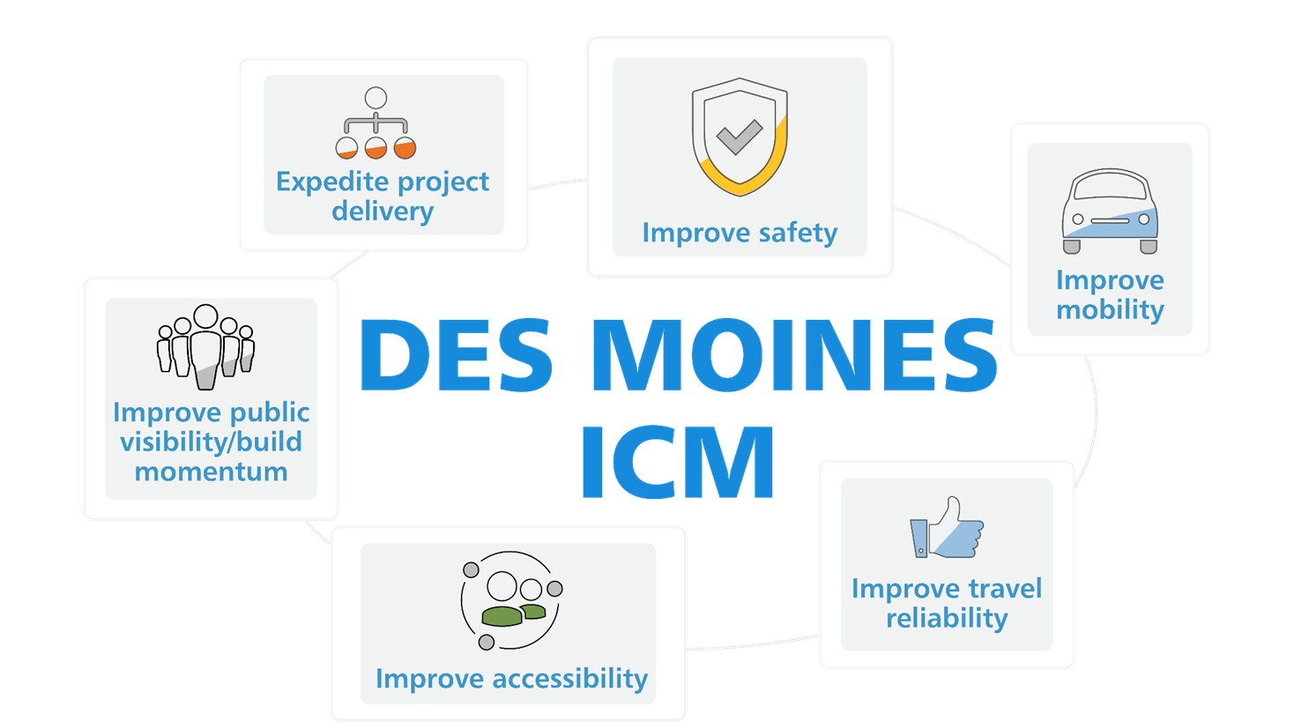
ICM Goals
Notes:
Some of our goals for the ICM project include improving:
-Safety - Reduce fatalities and serious injuries on public roads in the region
-Mobility - Provide options to travelers that minimize time spent traveling
-Travel Time Reliability - Improve efficiency and predictability of travel in the region
-Accessibility - Improve traveler’s overall ability to reach key destinations such as jobs, schools, libraries, health care, shopping, and entertainment
-Improve public visibility and build support/momentum for the project
-Project delivery time – Be able to deliver identified strategies in a timely manner

Slide 4
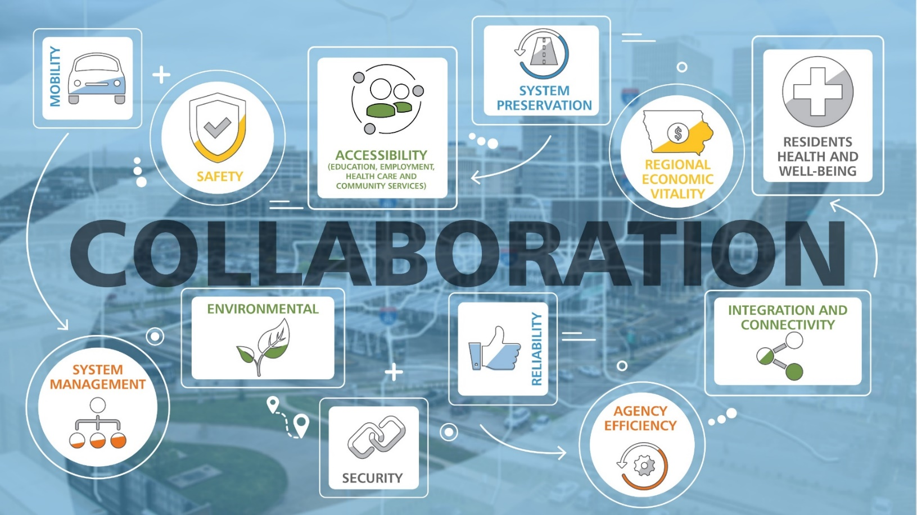
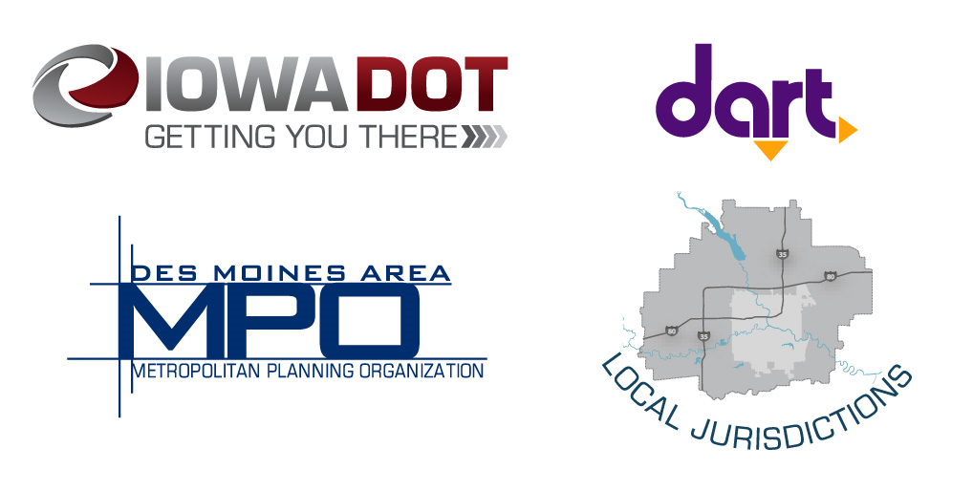
Partnerships
Notes:
We are taking a collaborative approach to this study with stakeholders from:
-DART
-Local Jurisdictions
-MPO
-Business groups
-Federal Highways
Collaboration really is the key to making this project a success.
Currently 11 Cities and 3 Counties are involved in the ICM effort.
Additional goals worth mentioning that require collaboration:
Regional Economic Vitality – Use the regional transportation system to foster a thriving, competitive regional economy.
Integration and Connectivity - Provide transportation that allows traveler to make efficient and seamless multi-modal trips throughout the region
Systems Management – Improve the efficiency of the surface transportation system
System Preservation -Maintain transportation infrastructure in a state of good repair

Slide 5
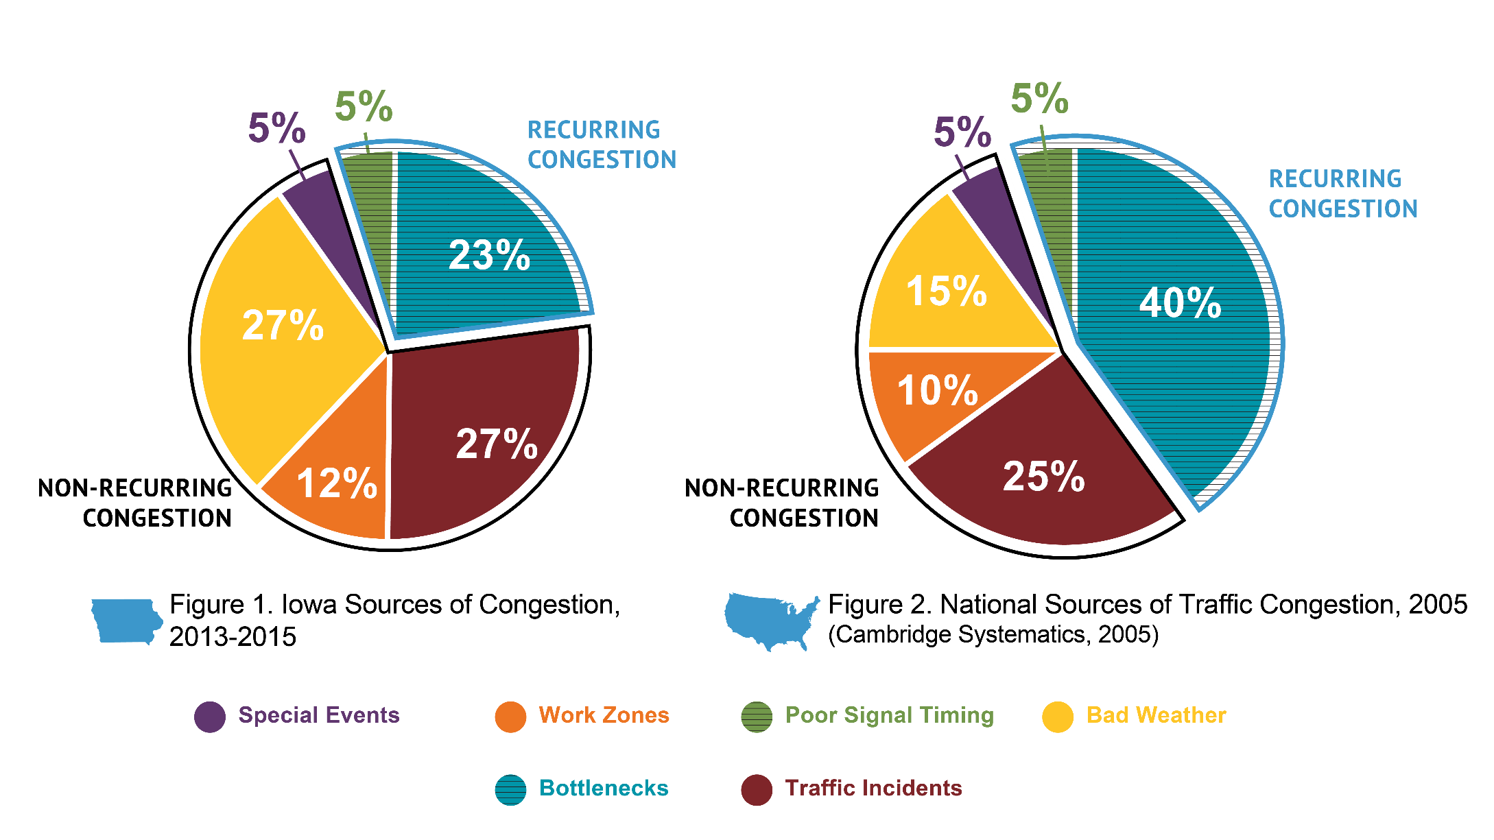
Why ICM for Des Moines Metropolitan Area?
Notes:
Traditional widening project focus too narrowly on recurring congestion.
When national research has show that non-recurring congestion makes up more than half of all congestion.
As we can see bad weather and traffic incidents, as part of non-recurring congestion, are larger culprits in Iowa than nationwide.
ICM strategies are more suited for dealing with this non-recurring congestion.
Furthermore:
The Des Moines Metro area is one of the fastest growing metros in the State
We can no longer afford to always build our way out of congestion
We need to find a more sustainable solution to handle the increased traffic demand
ICM provides beneficial solutions to address traffic issues while being cost effective.

Slide 6
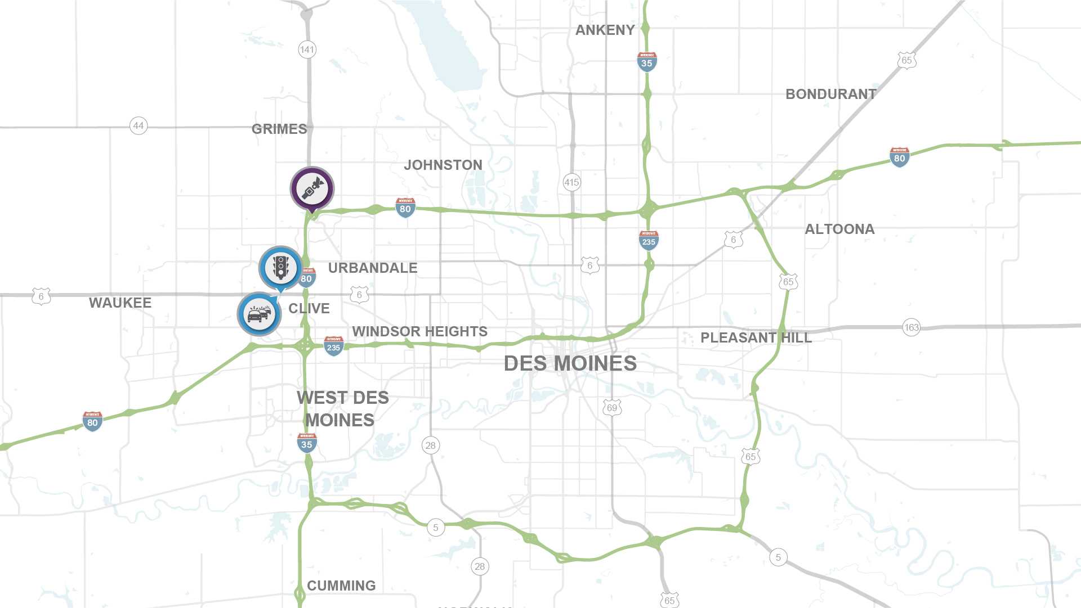
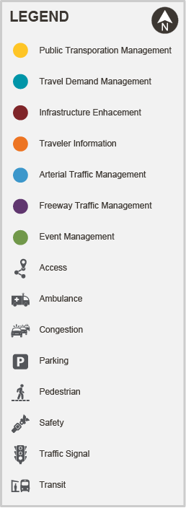

Northwest
Notes:
Safety was noted as a primary issue with high speed traffic around the Urban Loop at IA 141. This will be helped with the new interchange at that location.
US 6 is a hot spot for the northwest area with both high levels of congestion and need for inter-jurisdictional traffic signal optimization

Slide 7
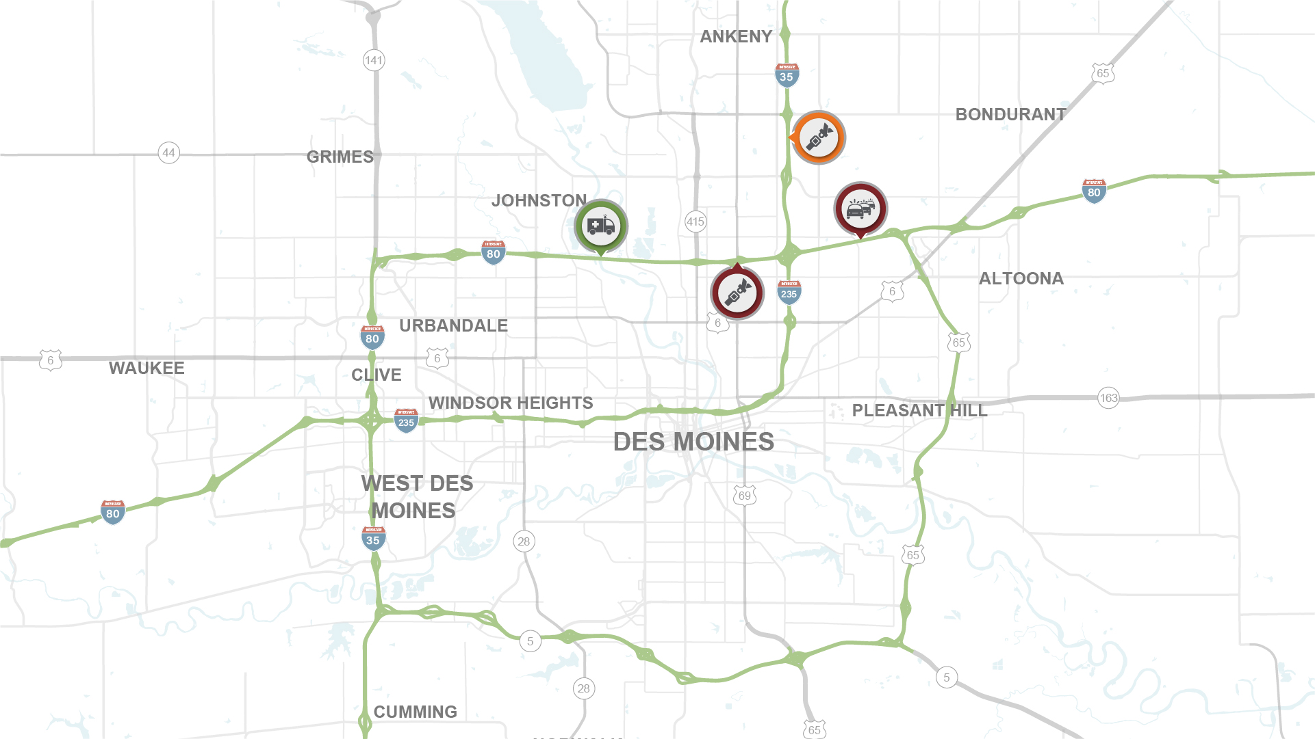
Northeast
Notes:
Northeast
Emergency response access is hampered by the continuous median barrier, complex interchanges, and long stretches without interchange access.
Safety concerns were noted on both I-35 / I-80 and I-35,
need to warn drivers of stopped traffic on the ramp and in the other to better separate entrance and exit ramp traffic
To the east, significant congestion was noted on the I-80 exit to US 65, requiring a new dedicated deceleration lane

Slide 8
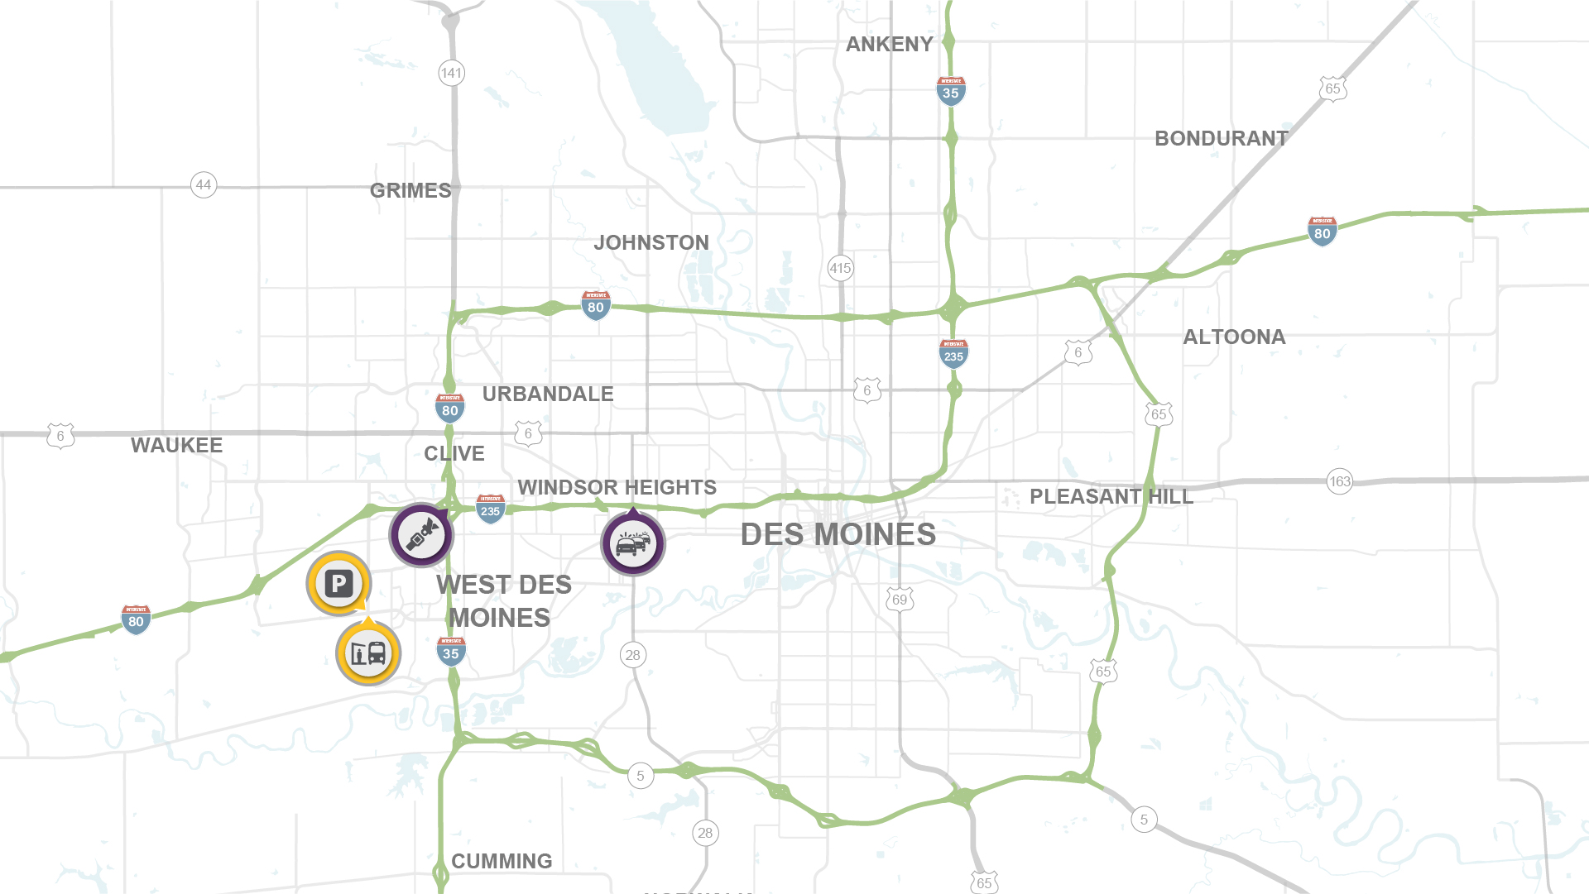
Southwest
Notes:
Southwest
Congestion on I-235 is very heavy due to the lane drops at the IA 28 interchange
Safety is a major concern due to tight weaving areas in the Southwest Mixmaster system interchange
Also, more public transportation service is needed to access the jobs at the Jordan Creek Town Center area – including new park and ride opportunities.

Slide 9
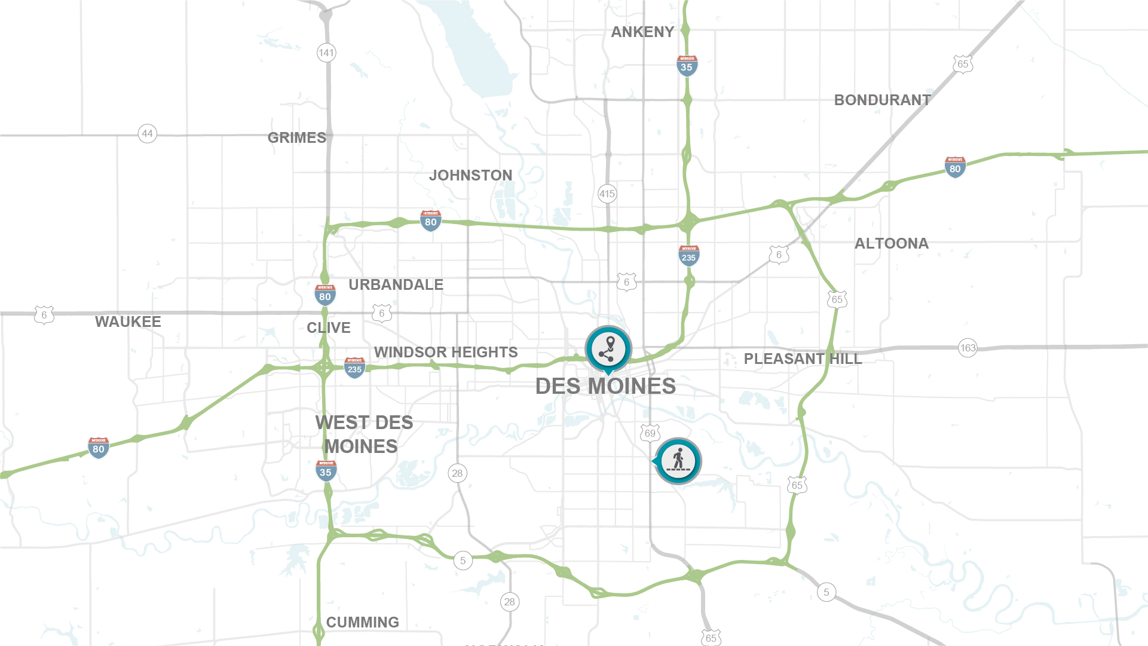
Southeast
Notes:
Southeast
The downtown grid is in need of improved accessibility by travelers
Also, US 69 provides access to the East Village, but has multiple pedestrian infrastructure gaps (sidewalk).

Slide 10
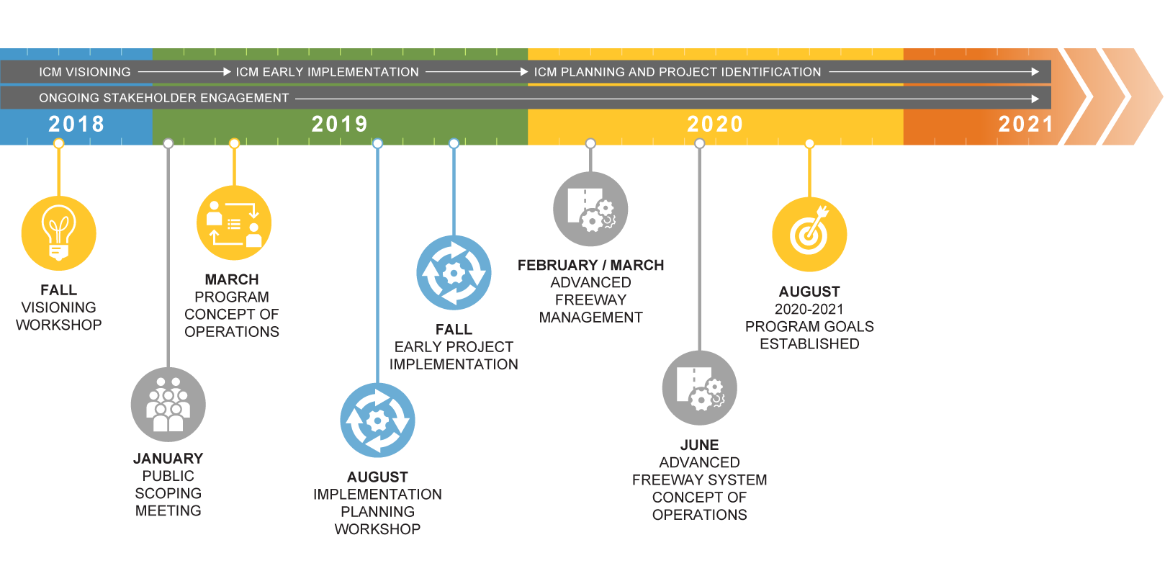
Developing the ICM Approach
Notes:
Stakeholder and Partner Engagement is essential to the DM ICM project.
This is the timeline for developing our ICM approach
Two years ago we held our first stakeholder visioning workshop
We started off last year with a public meeting followed by developing the Program Concept of Operation, which led into planning workshops and early project implementation
This year we are developing our advanced freeway strategies
Going forward
PIM
working groups on the program goals.

Slide 11
Preferred ICM Approach
Notes:
This next section I will talk about our Preferred ICM Approach

Slide 12
ICM Approach
$112 M – ICM
$2.65 B – DOT Capacity Expansion
$2.76 B - Total
$457 M – ICM
$387 M – DOT Capacity Expansion
$844 M - Total
$229 M – ICM
$72 M – DOT Capacity Expansion
$301 M - Total
$258 M – ICM
$2.04 B+ – DOT Capacity Expansion
$2.30 B - Total
$406 M – ICM
$72 M – DOT Capacity Expansion
$478 M - Total
Time horizon: 2020-2050
Notes:
We worked with our stakeholders to develop and evaluate different packages of ICM strategies.
A set of 5 bundles were developed with varying levels of investment in the different ICM strategies.
The costs are shown at a very high level of estimate, and are for implementation through the year 2050- so these are long term scenarios.
The steering committee recommends a version of Bundle 2 – which includes some capacity expansion and a high level of investment in technology and operational management to improve the efficiency of the existing transportation network..
Our ICM Approach is most closely aligned with Bundle 2 – this is a better way forward than an aggressive freeway build out or balanced (business as usual + ICM). We need to focus more heavily on ICM because our regional analysis shows it brings the best benefits with a significant cost reduction.
I also want to point out the dollar figures shown on this slide are for complete build out for the design year of 2050. (Investments over the next 30 years)
DOT could build out – Bundle 1 (Mostly freeways) or Bundle 4 (some freeways, but then added arterial widening
OR
Invest strategically in managing the system and significantly reduce the cost to expand the roadway network. – Bundle 2
Steering Committee largely selected Bundle 2, with minor modifications.
DOTs current plans for capacity expansion are on the high end compared to this approach due to past planning / design work, but long term the focus should help reduce spending on adding lanes for utilizing management practices
There are solutions we can do without full reconstruction and adding lanes. This will require investment and upkeep, but overall provide mobility but at a lower cost than the full build.
These are effective solutions that are cost effective too.

Slide 13
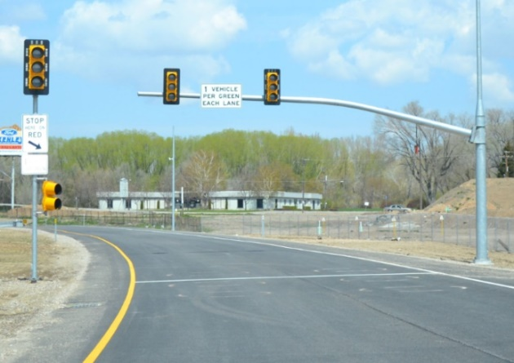
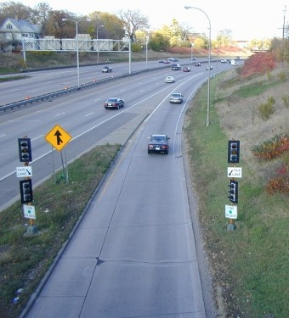
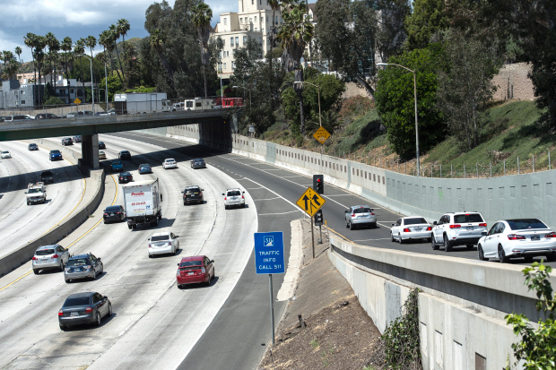
Ramp Metering
Notes:
Examples of transportation management strategies.
Ramp Metering
The use of traffic signals installed on freeway on-ramps balance demand and capacity, maintain optimal operations, and improve safety. On-ramp traffic is metered based on mainline speeds, volumes, and density and ramp conditions. Ramp signals can be roadside or overhead.

Slide 14
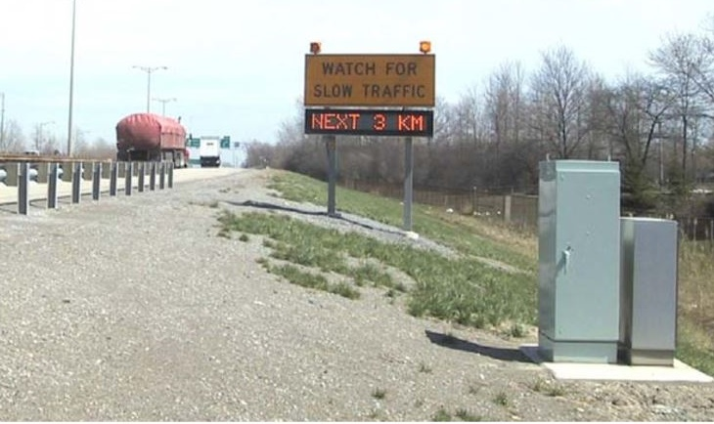
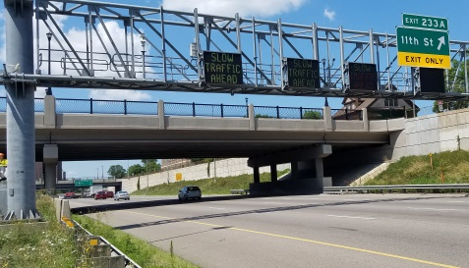
Queue Warning
Notes:
Description
The use of electronic signs to warn drivers of slowing and/or stopped vehicles ahead. The signs can be portable/temporary or fixed/permanent depending on the need (temporary construction versus recurring congestion). Dependent on the roadway configuration, signs can be roadside or overhead. Queue warning is often implemented with lane use control and/or dynamic speed advisories.

Slide 15
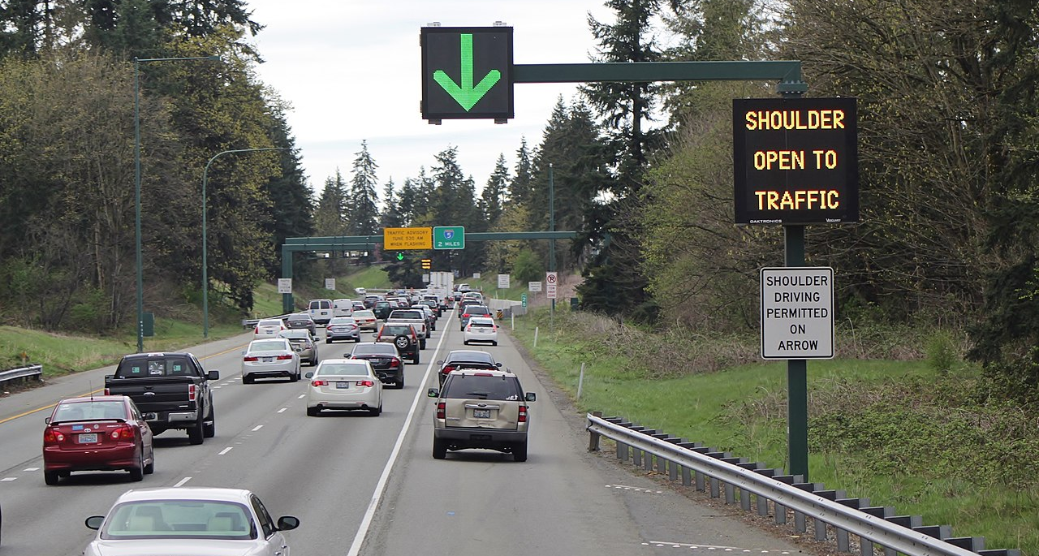
Dynamic Shoulder Use
Image: By SounderBruce - Own work, CC BY-SA 4.0, https://commons.wikimedia.org/w/index.php?curid=77935973
11
Notes:
Dynamic shoulder use is a management strategy that temporarily allows more traffic to travel along a congested highway to reduce the impact of physical bottlenecks. Iowa's Traffic Management Center would operate the shoulder to first confirm the shoulder is available and then clear the shoulder for use until traffic volumes have decreased or until the shoulder is needed for a refuge area or emergency response.

Slide 16
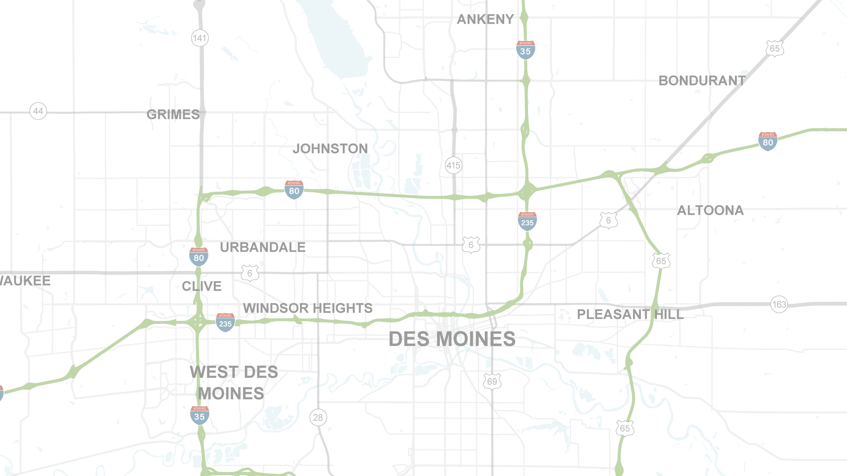
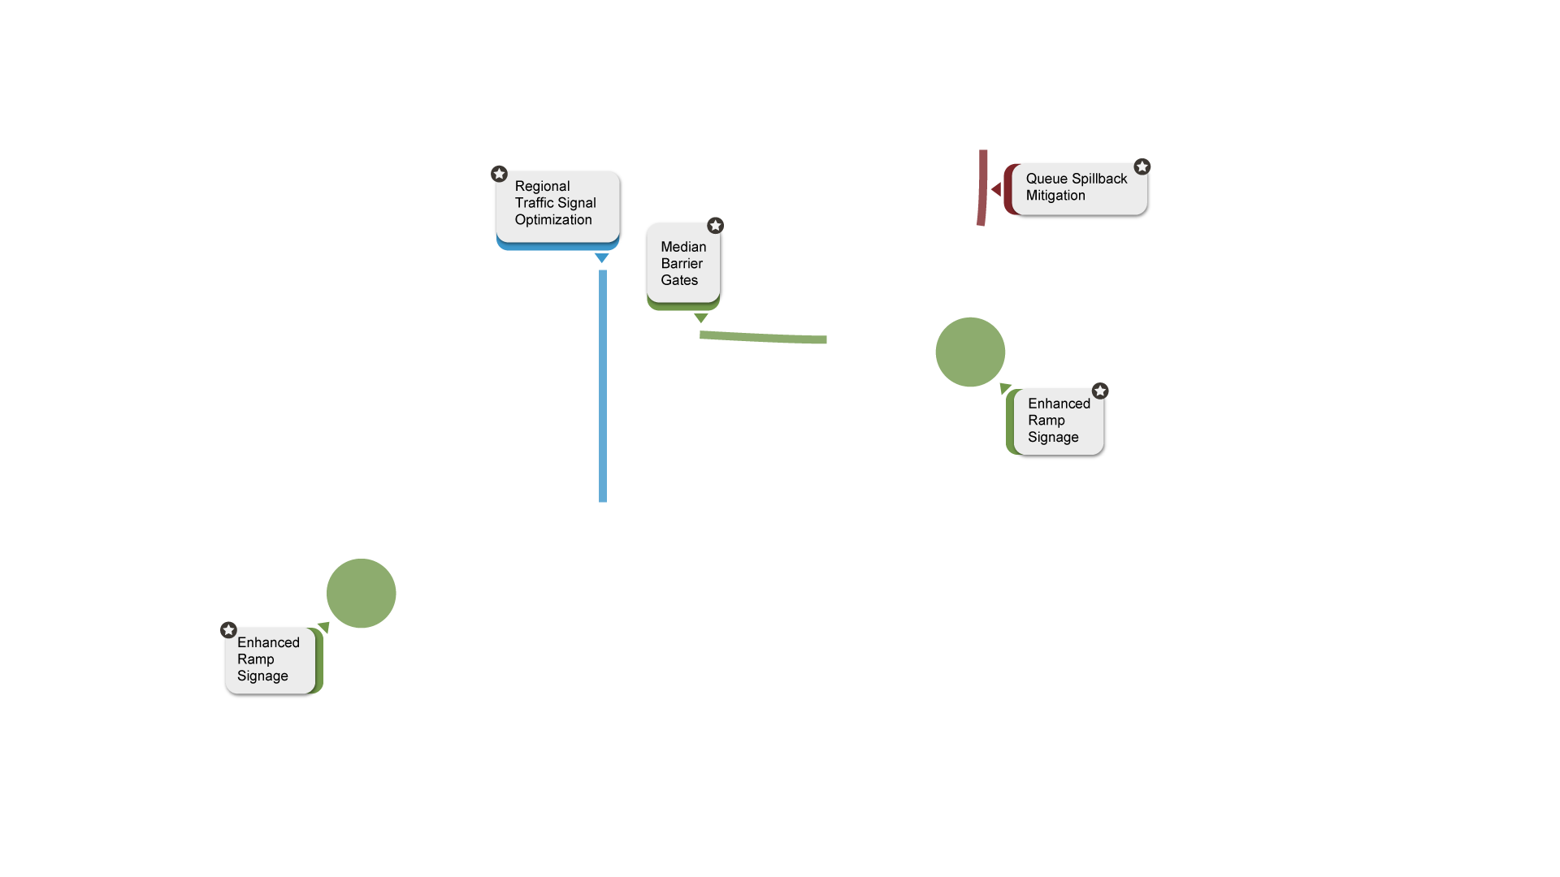
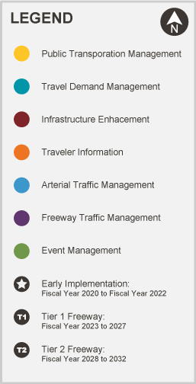
Recommended
ICM Implementation
Early Implementation
Proposed ICM projects have overlapping boundaries and are offset for readability.
Notes:
Early Implementation – FY 2020-Fy 2022
The stars – T1s – T2s give the general progression of projects
The colors tie back to the ICM program areas

Slide 17
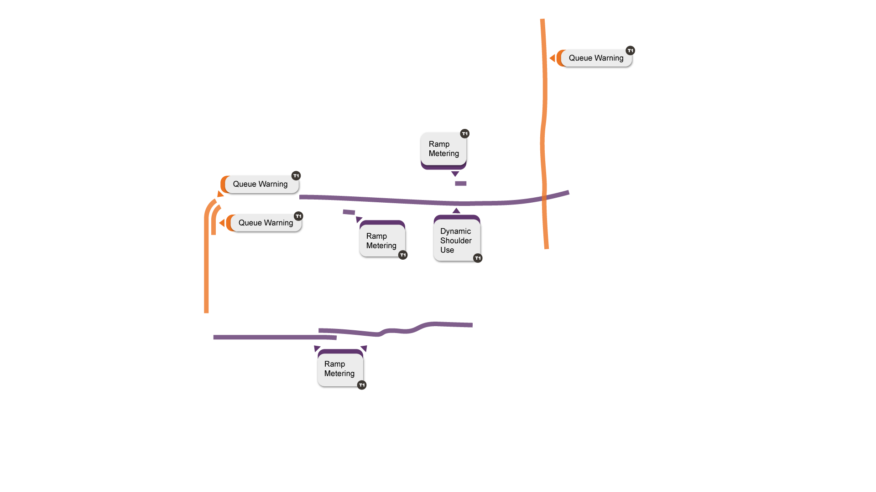
Recommended
ICM Implementation
Tier 1 Freeway
Proposed ICM projects have overlapping boundaries and are offset for readability.
Notes:
Tier 1 Freeway strategies: FY 2023-FY 2027 (estimated)
Note the bands are shown for project limits.
The stars – T1s – T2s give the general progression of projects
The colors tie back to the ICM program areas

Slide 18
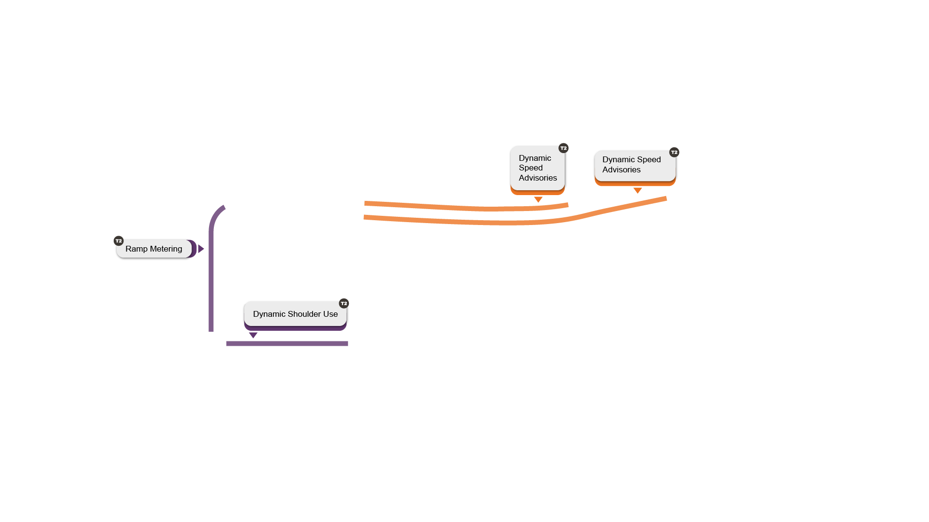
Recommended
ICM Implementation
Tier 2 Freeway
Proposed ICM projects have overlapping boundaries and are offset for readability.
Notes:
Tier 2 Freeway- FY 2028- FY 2032 (estimated)
Note the bands are shown for project limits.
The stars – T1s – T2s give the general progression of projects
The colors tie back to the ICM program areas

Slide 19
ICM Program Goals 2020-2021
Win a federal grant to expand the reach of ICM in 2021
One or more early non-freeway project programmed by DOT + locals
Positive public perception of ICM – particularly ramp metering
Notes:
The project team has continued to seek input, but to close 2020 and into 2021 we want to focus on these 3 key initiatives or goals using several committees from partner agencies
The ICM has big plans for improved safety and efficiency – to help jump start those plans an infusion of federal grant dollars will be sought to push for hard to improved traveler options, information sharing between transportation providers, and traffic management capabilities.
ICM is also focused on regional buy-in and re-focusing of transportation funding. Partners will work together to tackle project delivery with an ICM focus.
Finally, ICM will prepare the public for how ICM benefits the region – even a few strategies that are new to the area, but proven in other communities.

Slide 20
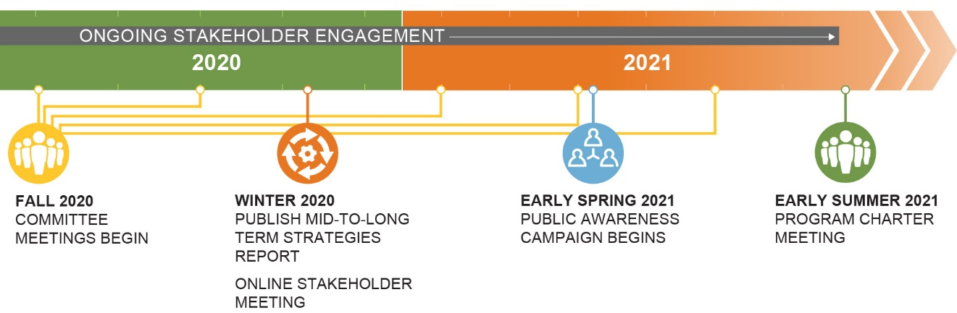
Engagement Schedule
Goals
Win a federal grant to expand the reach of ICM in 2021
One or more early non-freeway project programmed by DOT + locals
Positive public perception of ICM – particularly ramp metering
Notes:
The ICM is built on strong partnerships and engagement with stakeholders. The project team has continued to seek input, but to close 2020 and into 2021 we will focus on 3 key initiatives using several committees of partner agencies to lead the path forward
PIM – now
Public awareness campaign – spring 2021
Program charter with local agencies and partners – summer 2021

Slide 21
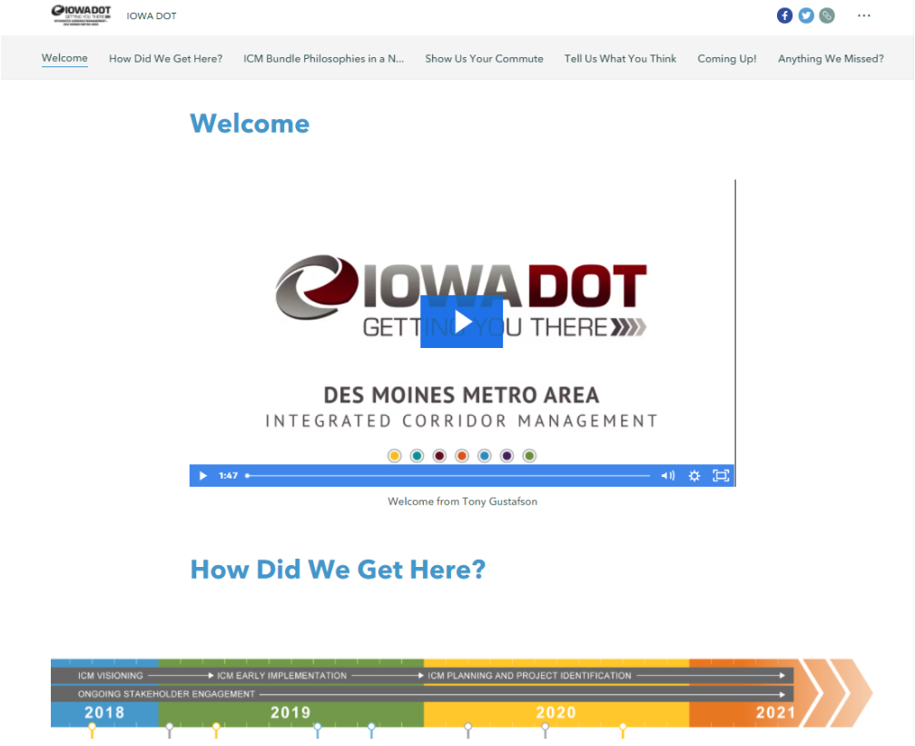
Public Information Meeting - online
https://iowadot.gov/desmoinesicm/

Slide 22



ICM Program Sustainability
Stakeholder Partnership
Maximize Existing System
Funding
21
Notes:
Wrap up slide – The future transportation system for these urban areas is going to require a sustainable program with ICM principles
DOT is going to need longstanding partnership with key stakeholder agencies to keep the program active to deal with growing transportation challenges.
The program is going to have to maximize the existing system and use technology to overcome challenges that were previously dealt with through widening and construction.
Finally, the program is going to require funding to prioritize strategic projects and funding for on-going operations and new projects that build off ICM principles; these projects are going to represent a shift in how the DOT program has been developed in the past and we need your support in adopting this new way of business.

Slide 23
Tammy Nicholson
Tamara.nicholson@iowadot.us
Questions
Iowa DOT Project Manager:
Neal Fobian neal.fobian@iowadot.us
Notes:
Questions or Comments?

