Slide 1
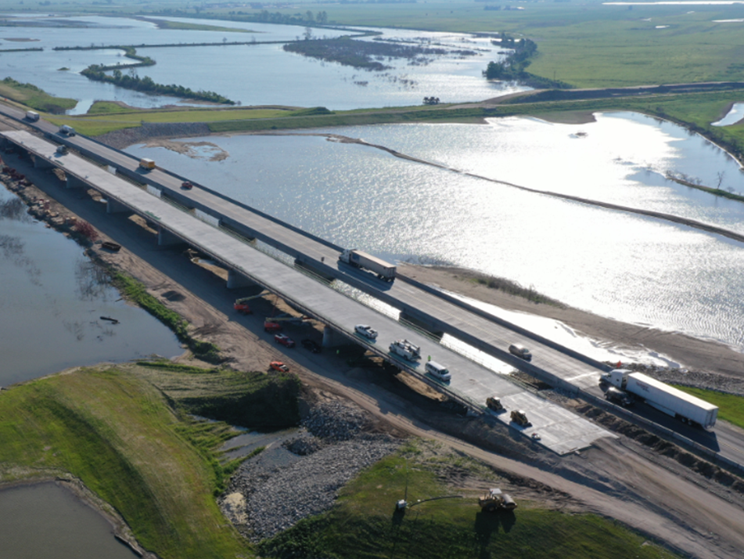
Iowa 2 Improvements Update
Status of flood related improvements on IA 2 from Missouri River to I-29
Scott Schram
District 4 Engineer

Slide 2
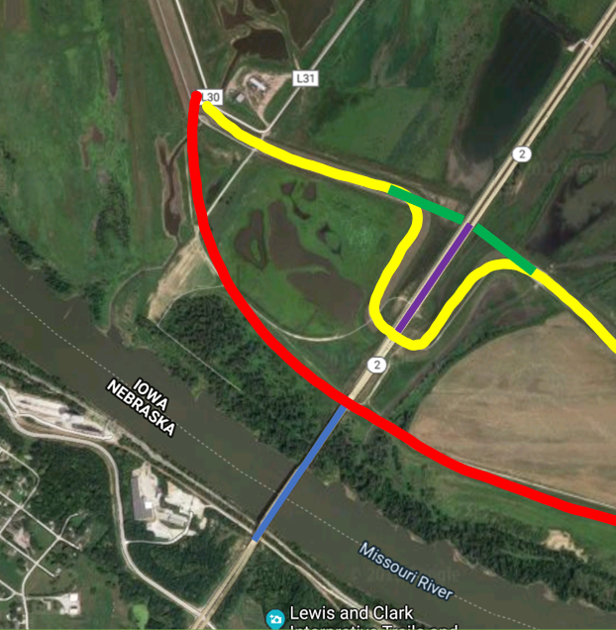
Overflow bridges – background and concept
1986
Existing river bridge (blue line) constructed and tied into original levee (red line)
2012
Levee was re-aligned (yellow line)
Levee “bump-out” needed to meet the roadway at the correct elevation
2019-2020
Constructed 1000’ long overflow bridges (purple line)
Levee realigned to remove “bump-out” (green line)
Notes:
Key Message

Slide 3
Grade Raise (Phase II)
Protective Dike
New Levee District will lead development
FY 2022 target letting
$1.5 million (DOT share)
Additional Drainage
Structure
Stand alone DOT project
Letting TBD
$2-3 million
Overflow Bridges
July 2019 letting
$34.3 million
Grade Raise (Phase I)
July 2020 Letting
$16.8 million

Slide 4
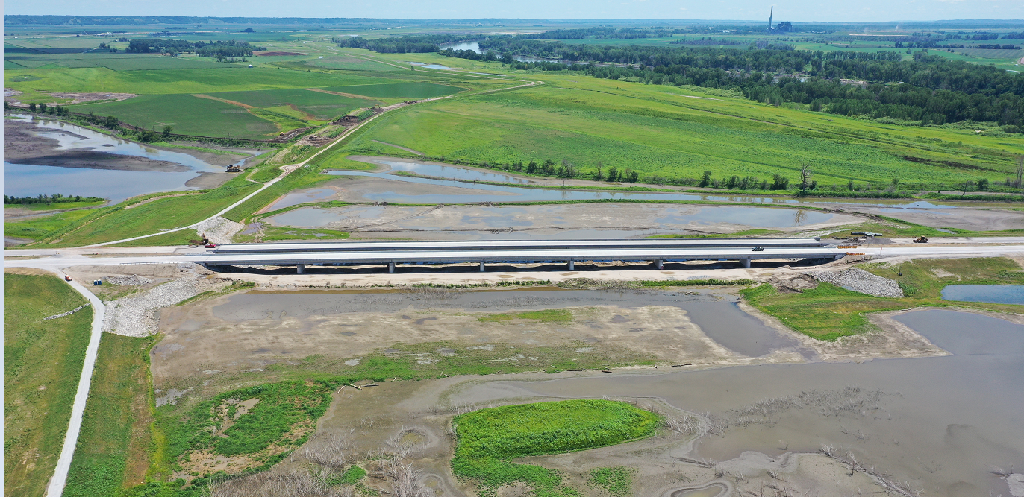
IA 2 Overflow Bridges Today
Eastbound completed December 2019
Westbound completed September 2020

Slide 5
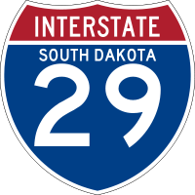
Phase I Improvements 10/30/2020 Grade Raise ~ 4’ + 2 Slab Bridges

Slide 6
Phase I Improvements (cont.) 11/2/2020 Begin Deck Pour 11/2/2020 Begin Paving 12/1/2020 Open to EB Traffic WB TBD Fall 2021

Slide 7
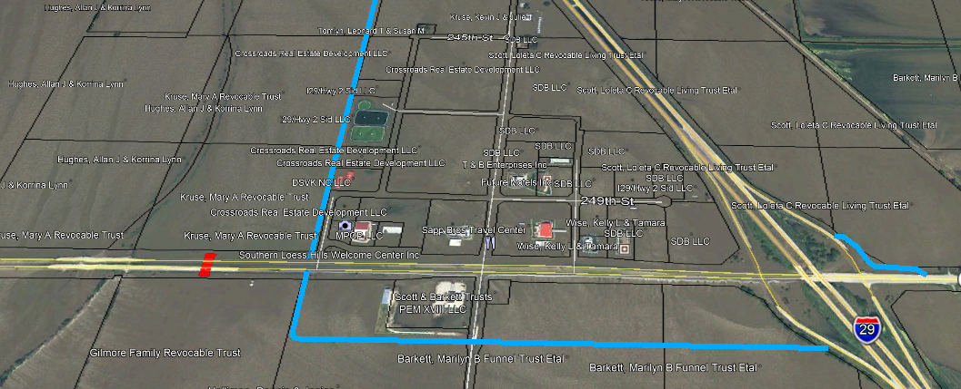
Phase II (New Levee District)
Petition filed by Landowners on 10/20/2020 to Fremont County Auditor
Next Steps per Chapter 468
County hires engineer to review and file report
Hearing is scheduled
District is established
3 landowners are elected as trustees
Levee District Hires Engineer
Local letting led by the Levee District
DOT Reimburses costs for construction (~$1.5M)

