Slide 1
Revitalize Iowa’s Sound Economy Program
Iowa Transportation Commission Workshop
November 10, 2020

Slide 2
Revitalize Iowa’s Sound Economy Program
Created in 1985
Purpose: To promote economic development through roadway improvements.
Eligible development shall have value-adding activities that feed new dollars into the economy
Available to cities and counties through an application program

Slide 3
Available Funding and Application Summary
Available Funding
Funded annually with dedicated state motor fuel and special fuel tax revenues
Application Summary for SFY2021
Total number of projects awarded: 2
Total project costs: $3,472,219
Total amount awarded: $1,736,110
 | CITY | COUNTY
Average funding generated monthly | $970,179 | $485,089
SFY 2020 current Road Use Tax Revenue (as of 9/28/2020) | $2,501,740.21 | $1,250,870.10
Current Unobligated Balance (as of 9/28/2020) | $9,926,457.38 | $1,250,870.10

Slide 4
Local Development Project Evaluation Criteria
Development Potential (35 points)
Economic impact and Cost Effectiveness (20 points)
Local Commitment and Initiative (33 points)
Transportation Need and Justification (4 points)
Local Economic Need (6 points)

Slide 5
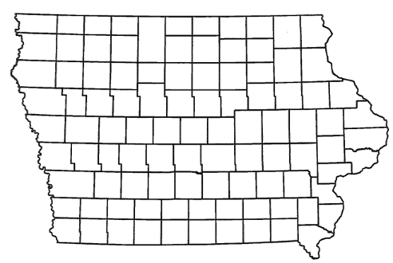
List of Local Development Applications Recommended
PROJECT NAME
SPONSOR
SCORE
TOTAL PROJECT COST
PERCENT PARTICIPATION
RECOMMENDED AMOUNT
Construction of approximately 1,700 feet of Ziegler Drive NW, turn lanes on U.S. 65, left turn lane on Ziegler Drive NW and a traffic signal at U.S. 65 and Ziegler Drive NW. | Altoona | 45 | $3,977,113 | 50% | $1,988,557
Construction of approximately 3,700 feet of Ziegler Drive. | Bondurant | 49 | $4,844,713 | 50% | $2,422,357

Slide 6
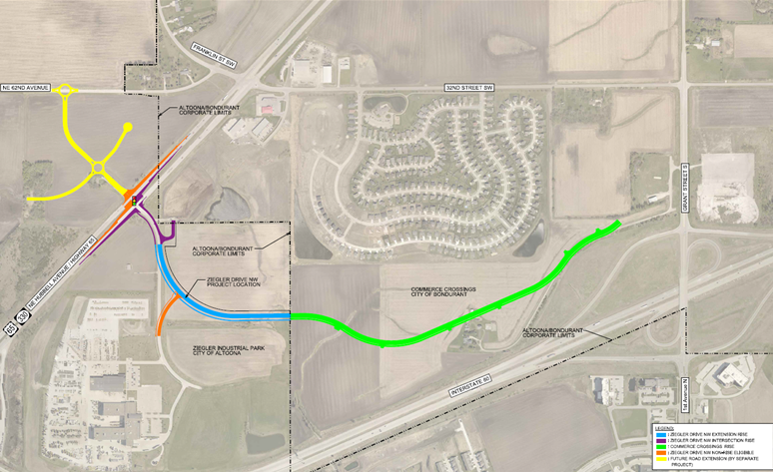
Altoona
(Local Development)
Construction of approximately 1,700 feet of Ziegler Drive NW, turn lanes on U.S. 65, left turn lane on Ziegler Drive NW and a traffic signal at U.S. 65 and Ziegler Drive NW located on the northwest side of town. This project is necessary to provide access to four lots totaling more than 34 acres for light industrial purposes.
Total Cost: $3,977,113
Requested: $1,988,557 (50%)

Slide 7
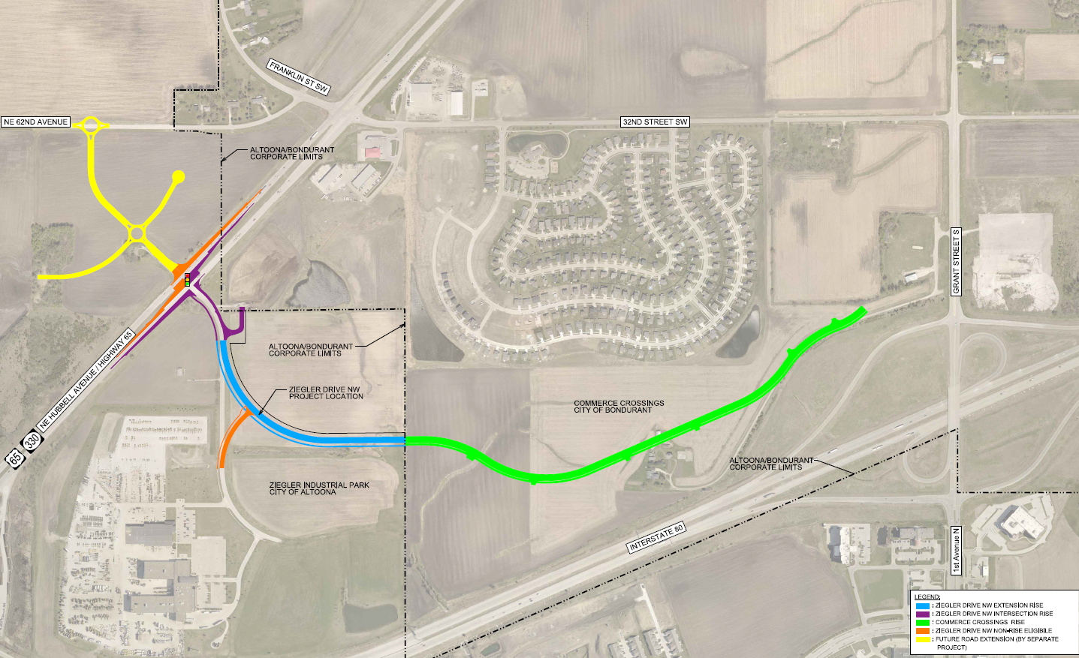
Bondurant
(Local Development)
Construction of approximately 3,700 feet of Ziegler Drive located on the southwest side of town. This project is necessary to provide access to seven lots totaling more than 70 acres for light industrial and warehouse purposes.
Total Cost: $4,844,713
Requested: $2,422,357 (50%)

Slide 8
QUESTIONS?
Craig Markley, Systems Planning Bureau
craig.markley@iowadot.us
515-239-1027

