Slide 1
Revitalize Iowa’s Sound Economy Program
Iowa Transportation Commission Business Meeting
November 10, 2020

Slide 2
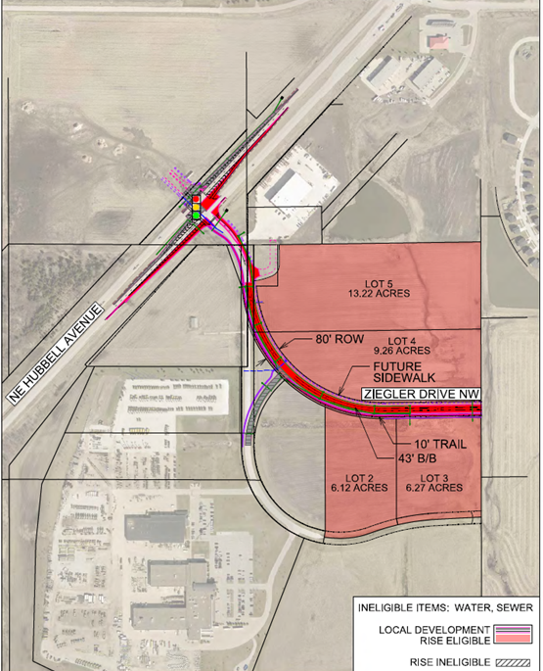
List of Local Development Applications Recommended
PROJECT NAME
SPONSOR
SCORE
TOTAL PROJECT COST
PERCENT PARTICIPATION
RECOMMENDED AMOUNT
Construction of approximately 1,700 feet of Ziegler Drive NW, turn lanes on U.S. 65, left turn lane on Ziegler Drive NW and a traffic signal at U.S. 65 and Ziegler Drive NW. | Altoona | 45 | $3,977,113 | 50% | $1,988,557

Slide 3
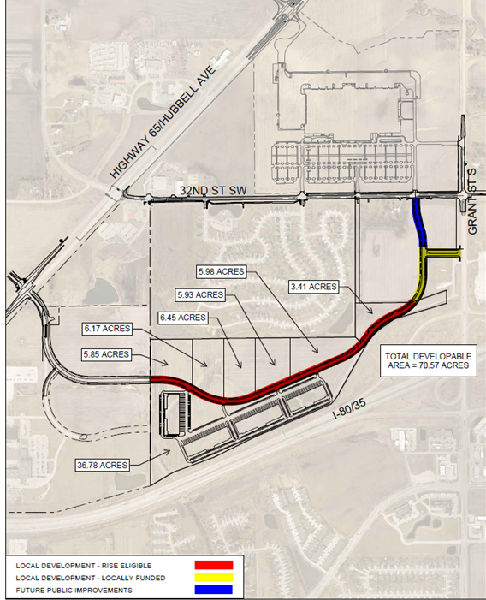
List of Local Development Applications Recommended
PROJECT NAME
SPONSOR
SCORE
TOTAL PROJECT COST
PERCENT PARTICIPATION
RECOMMENDED AMOUNT
Construction of approximately 3,700 feet of Ziegler Drive. | Bondurant | 49 | $4,844,713 | 50% | $2,422,357

