Slide 1
Revitalize Iowa’s Sound Economy Program
Iowa Transportation Commission Business Meeting
November 9, 2021

Slide 2
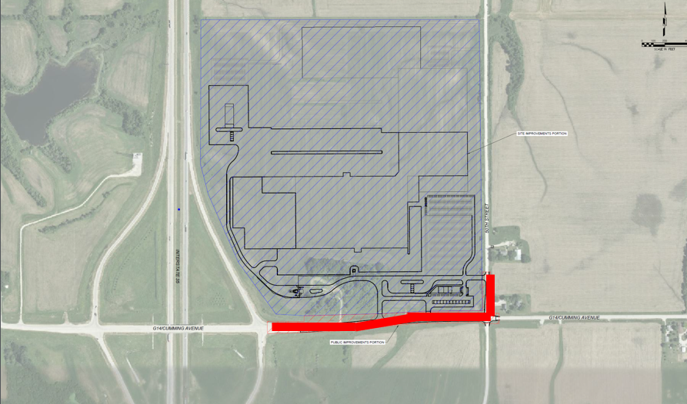
List of Immediate Opportunity Applications Recommended
PROJECT NAME
SPONSOR
JOBS
TOTAL PROJECT COST
PERCENT PARTICIPATION
RECOMMENDED AMOUNT
Widening of approximately 1,730 feet of Cumming Avenue and paving of 510 feet of 50th Street. | Cumming | 136 | $1,647,669 | 80% | $1,318,135

Slide 3
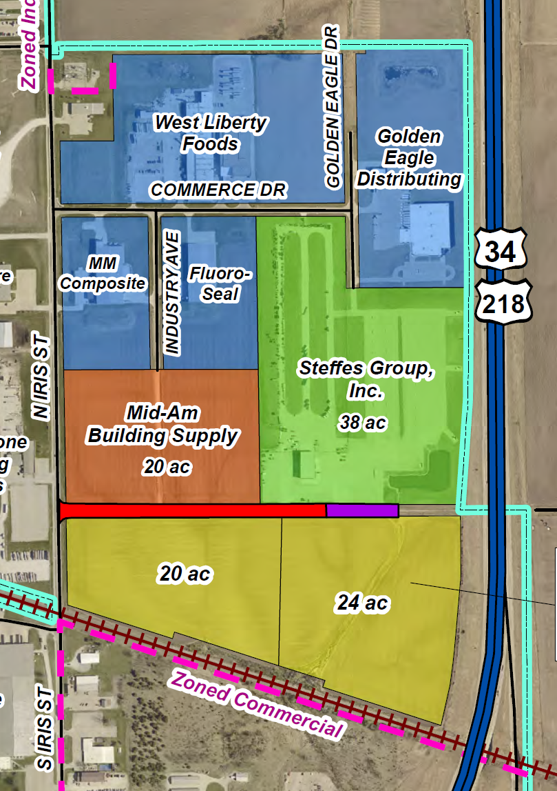
List of Local Development Applications Recommended
PROJECT NAME
SPONSOR
SCORE
TOTAL PROJECT COST
PERCENT PARTICIPATION
RECOMMENDED AMOUNT
To pave approximately 1,545 feet of Blue Grass Road. | Mt. Pleasant | 44 | $509,604 | 50% | $254,802

