Slide 1
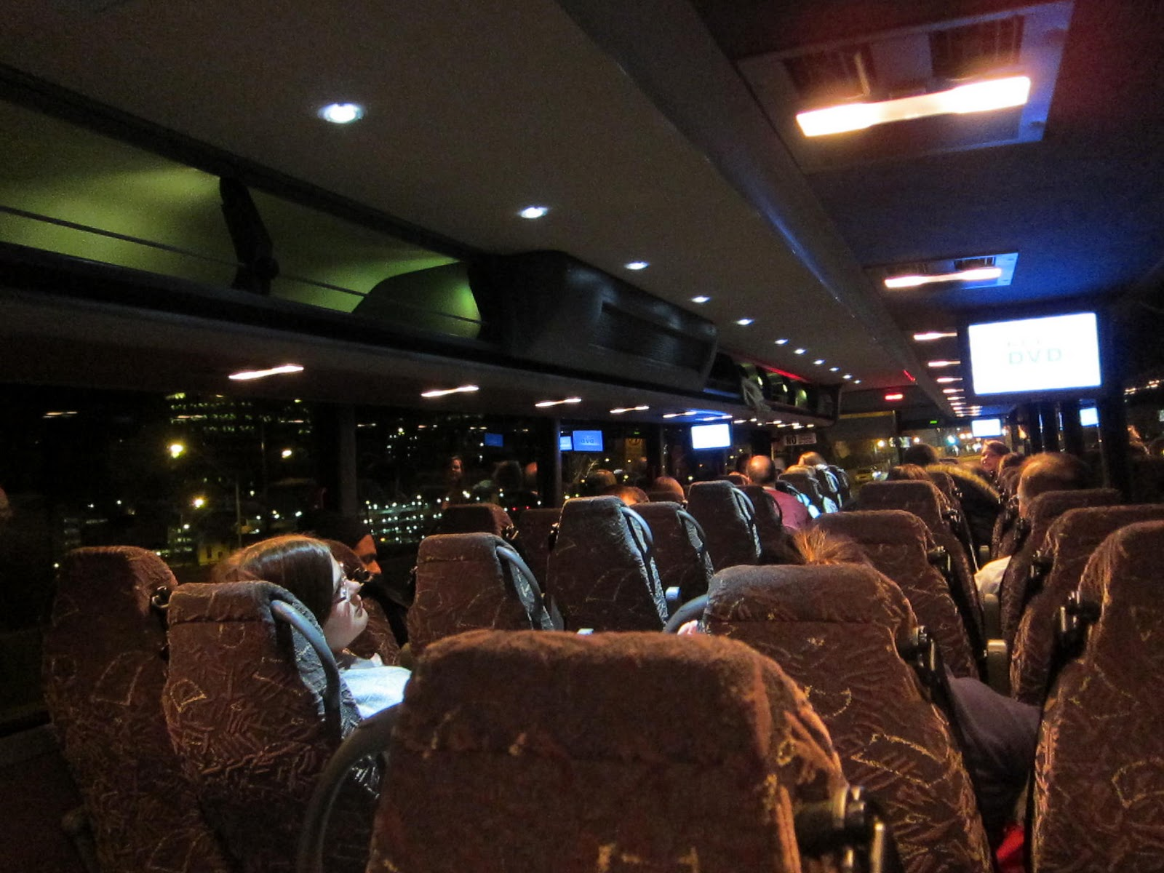

CY 22 Intercity Bus Program

Slide 2

Intercity Bus Program
CY22 Intercity Bus Program
Purpose: Support intercity bus services that includes stops at non-urbanized locations and makes meaningful connections to nationwide network
Available to private intercity bus companies, companies wishing to start bus service, public transit agencies either operating of proposing to operate bus service, and local communities wishing to support intercity connections to their community
Notes:
The intercity bus assistance program is a federally funded grant program that provides financial assistance to support intercity bus services that includes stops at non-urbanized locations and makes meaningful connections to nationwide network. Funding is available for private bus companies, public transit agencies, and local communities wishing to support intercity connections to their community to maintain the viability of intercity bus service in Iowa.

Slide 3
Funding Priorities
CY22 Intercity Bus Program
Iowa’s program has four components in priority order:
Base level support of existing services ($0.20 per revenue mile)
Start-up support for new services (three years at $0.50 per revenue mile)
Support for marketing of intercity bus services and interlined services (maximum $7,500 for existing routes per agency and $12,000 per each new route with 20% local match required)
Support for intercity bus capital improvements (over the road coaches, vertical infrastructure, vehicle renovations/improvements, ADA improvements to vehicles and facilities). Vehicles require a 15% local match while all other capital projects require 20% local match.
Notes:
The intercity bus program has four funding components under which eligible applicants may apply, in priority order:
Priority 1 is for base level support of existing services at 20 cents per revenue mile.
Second priority is Start-up support for new services at three years at 50 cents per revenue mile.
Third is support for marketing of intercity bus services and interlined services, with a maximum seventy-five hundred dollars for existing routes per agency and twelve thousand dollars per each new route established.
The fourth priority is support for intercity bus capital improvements, which includes vehicles and facilities.

Slide 4
Available Funding and Application Summary
CY22 Intercity Bus Program
Available Funding
Total Intercity Bus Funds Available: $2,149,351
15% of federal non-urbanized (FTA Section 5311) transit funding
Application Summary
Total number of projects: 10
Total number of projects funded: 9
Total project costs: $16,874,770
Total amount requested: $2,357,063
Notes:
The program is funded by utilizing 15% of federal non-urbanized FTA Section 5311 transit funding. This year, we have two million, one hundred forty-nine thousand, three hundred fifty-one dollars in available funds.
We received ten project applications, or which we are recommending nine for funding. The total project costs on all ten applications totaled sixteen million, eight hundred seventy-four thousand, seven hundred seventy dollars. The total amount of the ten requested projects was two million, three hundred fifty-seven thousand, sixty-three dollars.

Slide 5
CY22 Intercity Bus Program
List of Recommended Projects
PROJECT NAME | SPONSOR | TOTAL PROJECT COST | REQUESTED AMOUNT (% of Total Project Cost) | RECOMMENDED AMOUNT (% of Total Project Cost)
Operational Assistance | Burlington Trailways | $1,000,000 | $196,110 (19.6%) | $196,110 (19.6%)
OTR Motor Coach | Burlington Trailways | $584,627 | $496,932 (85%) | $496,932 (85%)
Bus Camera Systems | Burlington Trailways | $86,646 | $69,316 (80%) | $ 69,316 (80%)
Marketing | Burlington Trailways | $7,500 | $6,000 (80%) | $6,000 (80%)
Notes:
Burlington Trailways has requested funding for four projects. The first being the 20 cents per revenue mile, operating assistance, with a requested amount of one hundred ninety-six thousand, one hundred ten dollars. Second, the purchase of a replacement over the road motor coach for four hundred ninety-six thousand, nine hundred thirty-two dollars. Third, replacement of their bus camera systems for sixty-nine thousand three hundred sixteen dollars. Last, marketing for six thousand dollars. These four projects are all being recommended for funding at the requested amount next month.

Slide 6
CY22 Intercity Bus Program
List of Recommended Projects
continued
PROJECT NAME | SPONSOR | TOTAL PROJECT COST | REQUESTED AMOUNT (% of Total Project Cost) | RECOMMENDED AMOUNT (% of Total Project Cost)
Operational Assistance | Jefferson Lines | $3,094,558 | $154,554 (4.99%) | $154,554 (4.99%)
2 - OTR Motor Coaches | Jefferson Lines | $1,060,000 | $901,000 (85%) | $901,000 (85%)
Travel Information Center | Jefferson Lines | $22,689 | $18,151 (80%) | $18,151 (80%)
Marketing | Jefferson Lines | $9,375 | $7,500 (80%) | $7,500 (80%)
Notes:
Jefferson Lines has requested funding for four projects. The first being the 20 cents per revenue mile, operating assistance, with a requested amount of one hundred fifty-four thousand, five hundred fifty-four dollars. Second, the purchase of two replacement over the road motor coaches for nine hundred one thousand dollars. Third, for their travel information call center for eighteen thousand one hundred fifty-one dollars. Last, marketing for seven thousand five hundred dollars. These four projects are all being recommended for funding at the requested amount next month.

Slide 7
CY22 Intercity Bus Program
List of Recommended Projects
continued
PROJECT NAME | SPONSOR | TOTAL PROJECT COST | REQUESTED AMOUNT (% of Total Project Cost) | RECOMMENDED AMOUNT (% of Total Project Cost)
Marketing | Fort Dodge | $9,375 | $7,500 (80%) | $7,500 (80%)
Notes:
Fort Dodge has requested funding for marketing assistance for seven thousand five hundred dollars. We will be recommending funding next month at their requested amount.

Slide 8
CY22 Intercity Bus Program
List of Applications Not Recommended for Award
PROJECT NAME | SPONSOR | TOTAL PROJECT COST | REQUESTED AMOUNT (% of Total Project Cost) | RECOMMENDED AMOUNT (% of Total Project Cost)
Transit Facility | HIRTA | $11,000,000 | $500,000 (4.5%) | $0
Notes:
Lastly, we received a project application from Heart of Iowa Regional Transit Agency (HIRTA) for construction of a new transit facility. At this time, the project is too premature to recommend for the ICB funding program but will be willing to consider the project in the future, once some additional planning is complete.

Slide 9
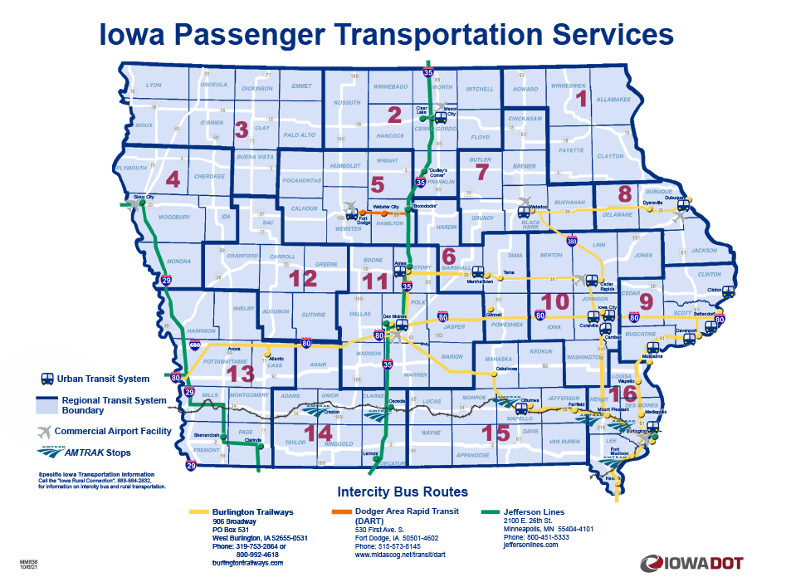
Intercity Bus Map
CY22 Intercity Bus Program
Notes:
This map provides the most recent and accurate Intercity Bus program transportation services.

Slide 10

QUESTIONS?
For more information on Iowa’s public transit and intercity bus programs, visit
www.iowadot.gov/transit
Notes:
Any questions?

