Slide 1


Bridge Asset Management
Scott Neubauer, PE
Iowa DOT Bridges and Structures Bureau
Transportation Commission Workshop
November 9, 2021

Slide 2


Presentation Overview
Preservation Activities
2. Bridge Inventory
3. Condition summary
4. Funding scenarios

Slide 3
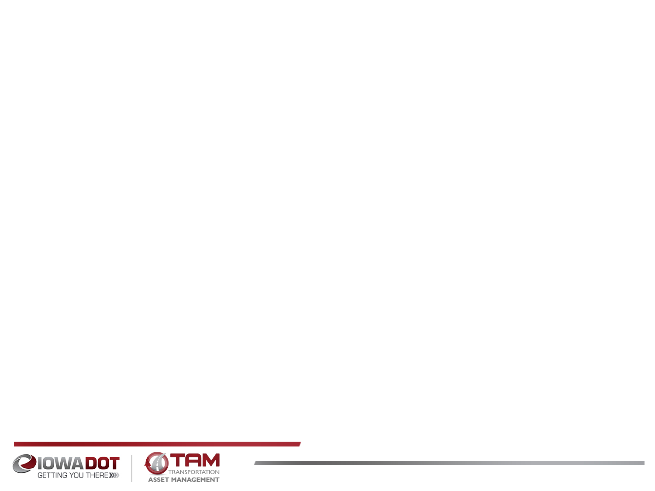
Bridge Preservation and Maintenance
What are some of the things we’re doing to preserve and maintain bridges?
Replace aging deck joints
Overlay decks with new wearing surface
Dense concrete layer
Polyester Polymer layer
Latex modified concrete layer
Epoxy polymer layer
Repair beams ends
Patch deteriorated deck areas
Install berm and bank protection
Use stainless steel reinforcing in areas with high potential for corrosion
Use High Performance Concrete (HPC) in new bridge decks
Use fewer or no deck joints
Use of Non-Destructive Evaluation (NDE) methods to assess condition
Notes:
NDE: Impact Echo, GPR, Infra red thermography, Hammer sounding, Ultrasonic Wave, Sonar, Mag particle, Dye Penetrant, Acoustic imaging, Harmonic vibration,

Slide 4
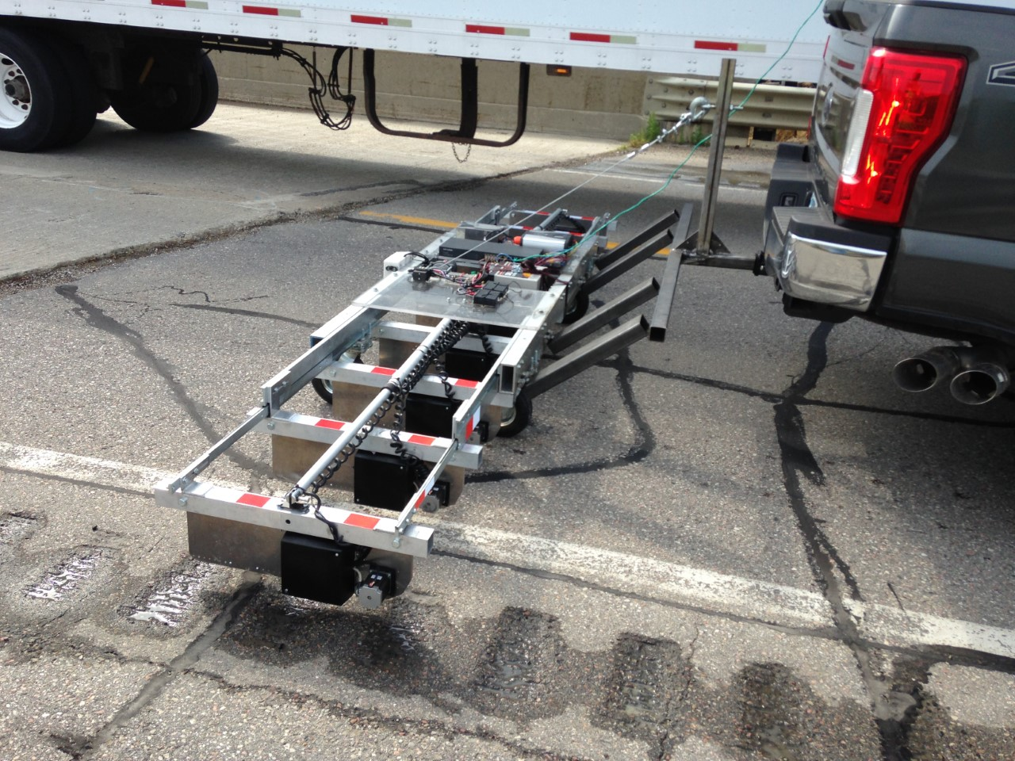

Slide 5
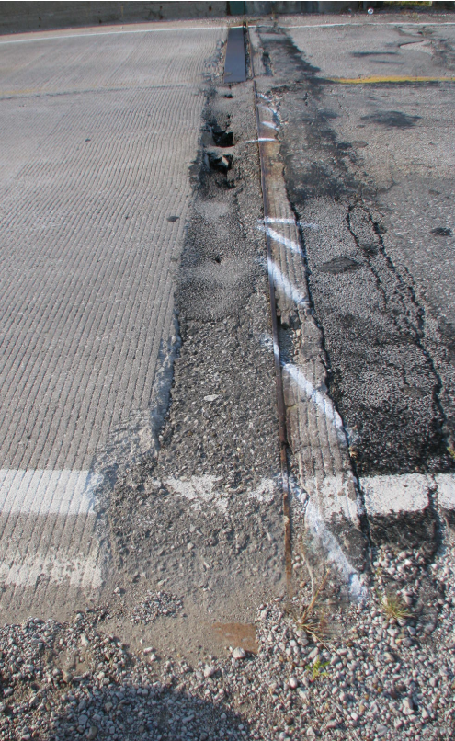
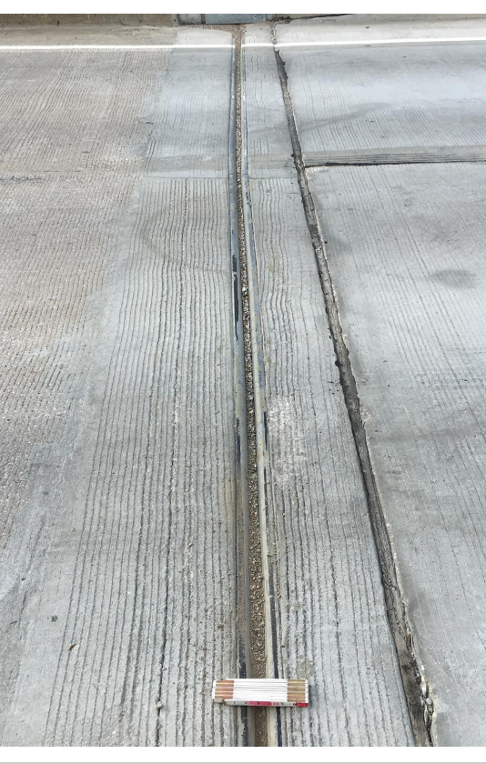
Notes:
Bridge 7834.9S092

Slide 6
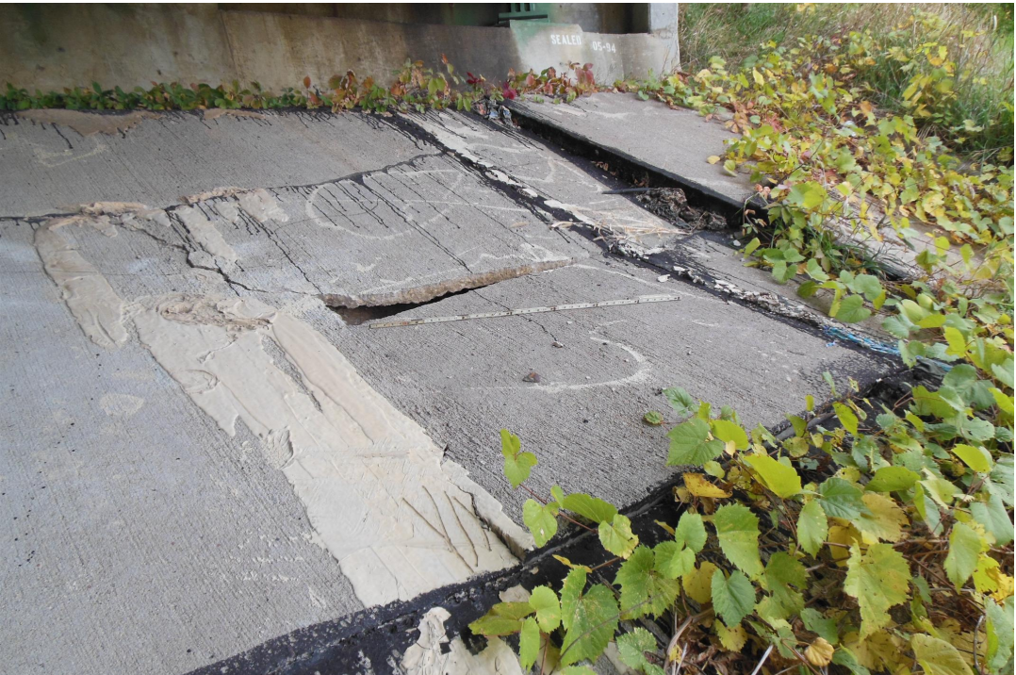
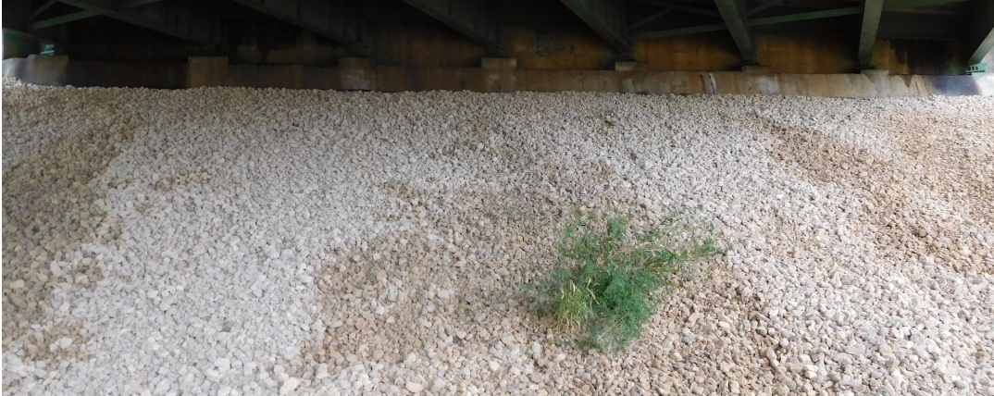
Notes:
Macadam stone – uniform crushed stone.

Slide 7
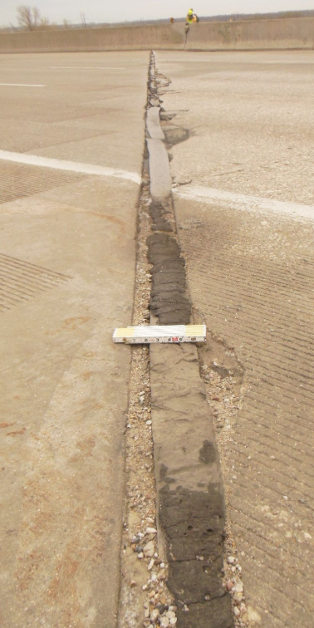
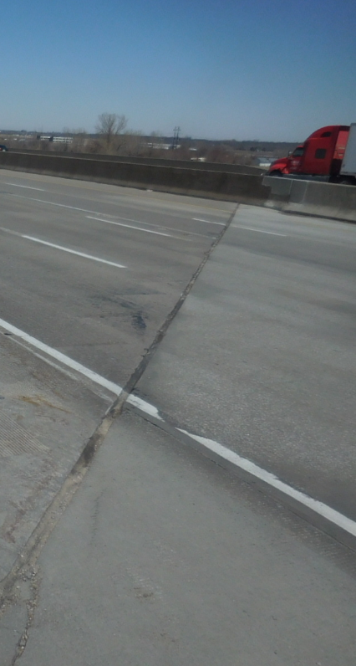
Notes:
Bridge 7788.3L035

Slide 8
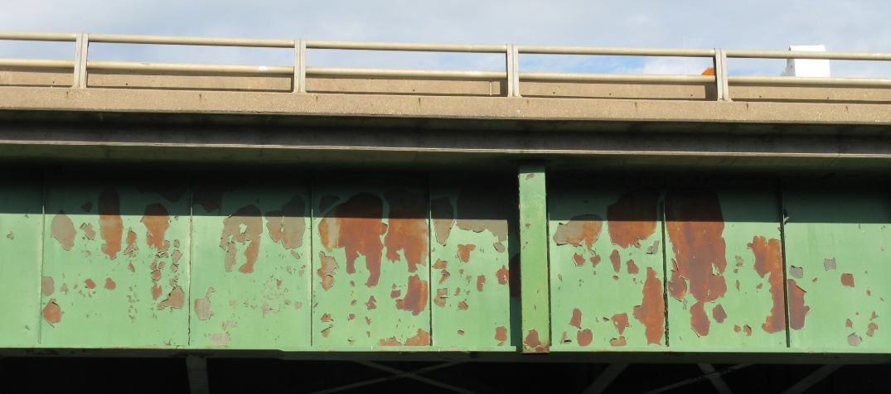
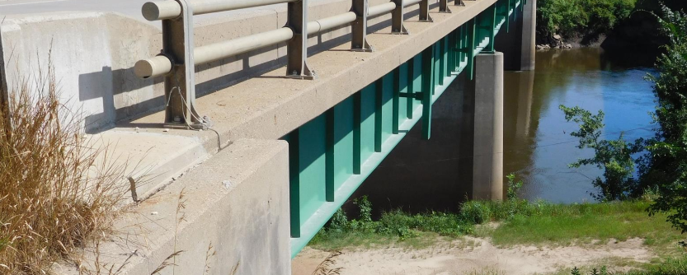
Notes:
Bridge 032220
Three coat paint system for field painting. Epoxy system or Moisture cured Urethane system. The two coat Zinc Silicate is not used in the field. Prime coat, Intermediate coat, and Finish coat.

Slide 9
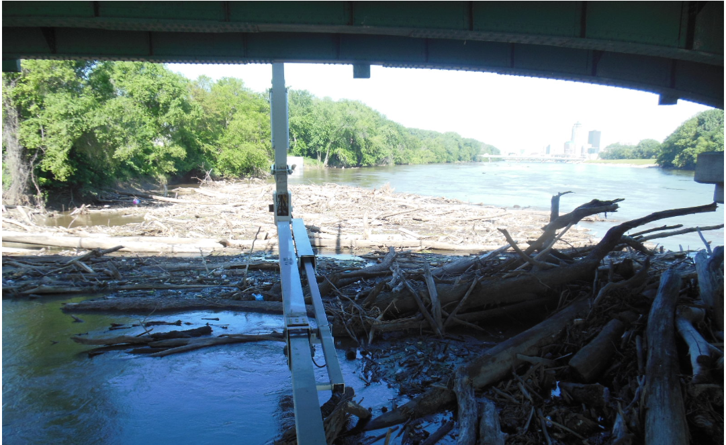
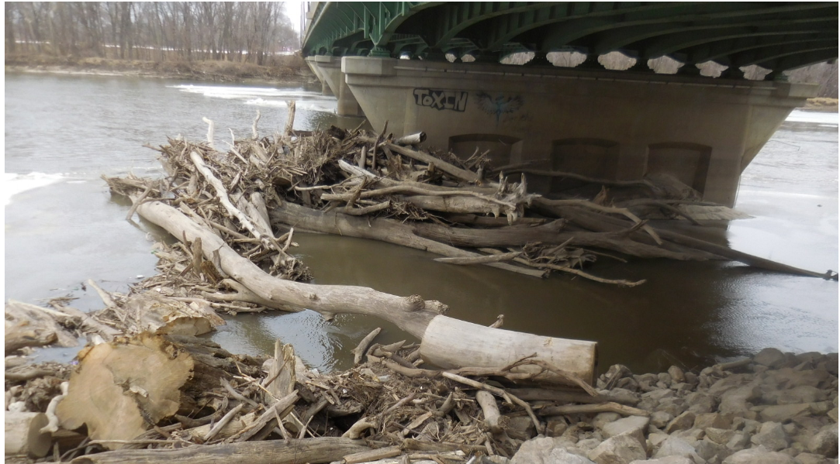
Notes:
Bridge 7784.2S069

Slide 10
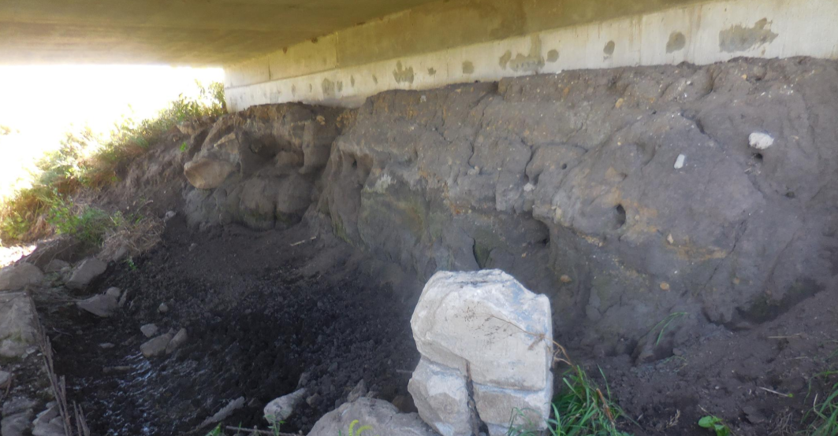
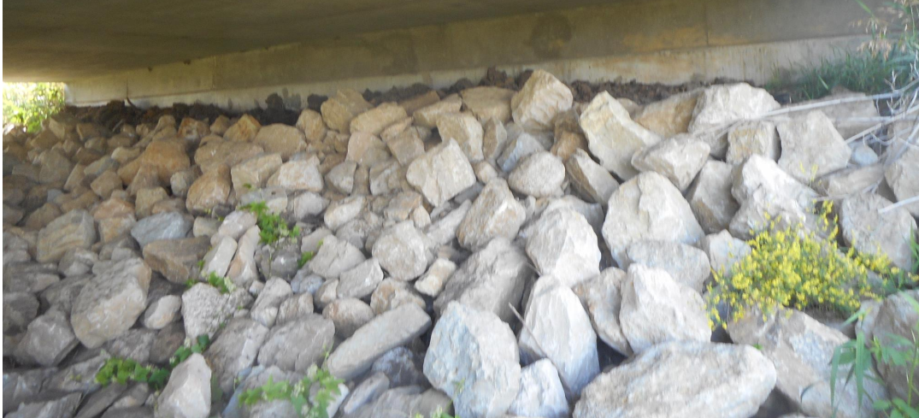
Notes:
Bridge 6669.0S218

Slide 11
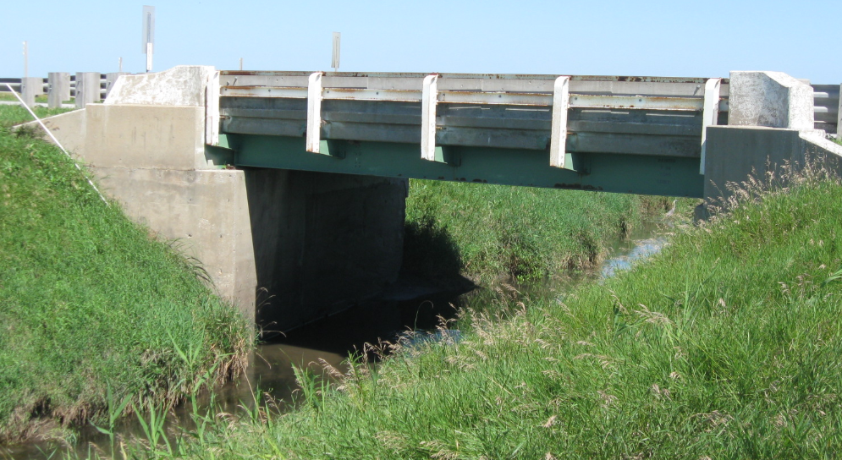
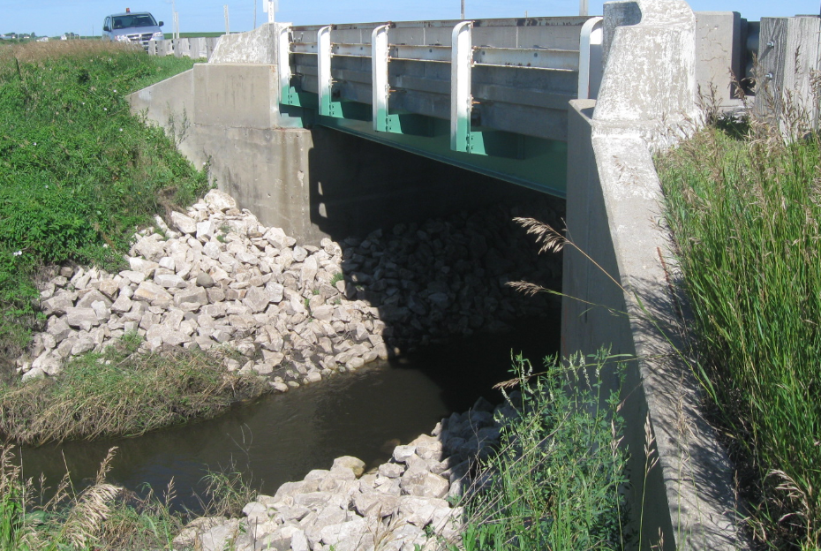
Notes:
7601.2S003

Slide 12
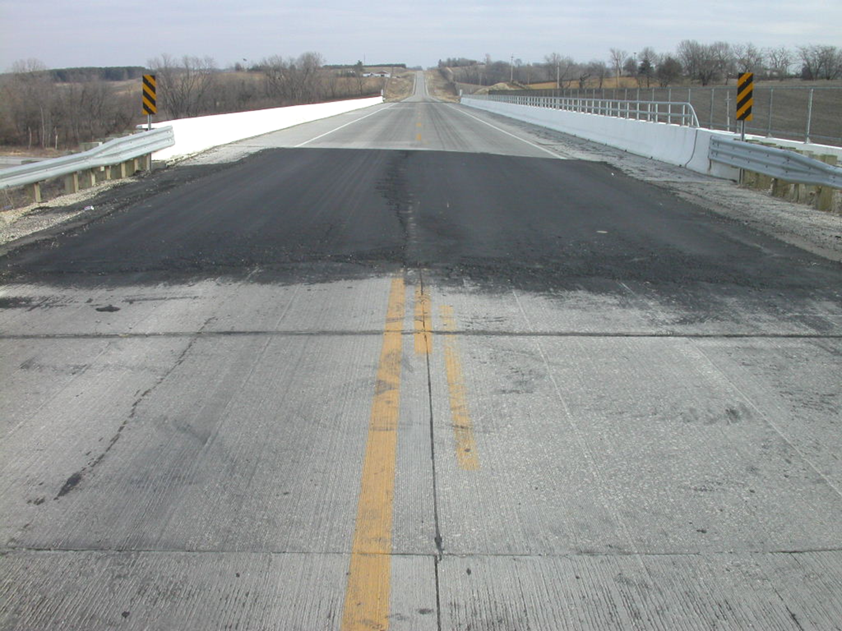
Notes:
Bridge 7767.7O035

Slide 13
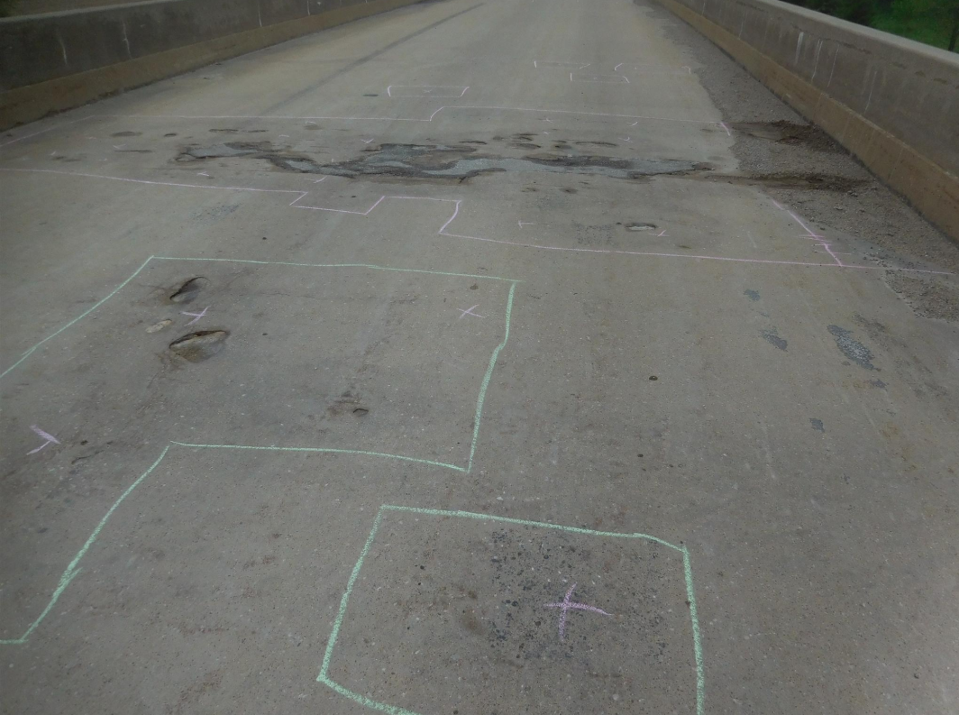
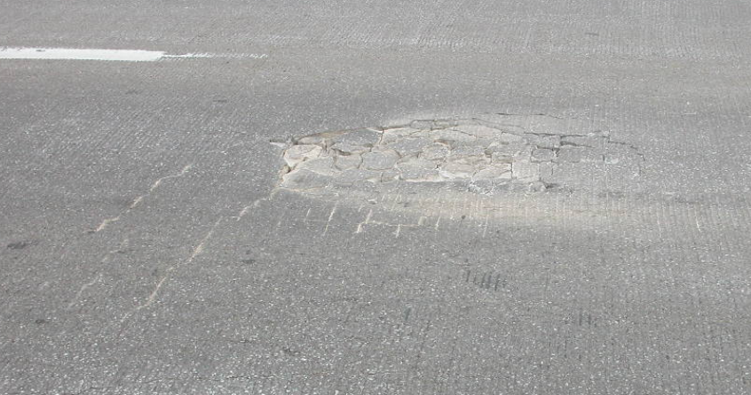
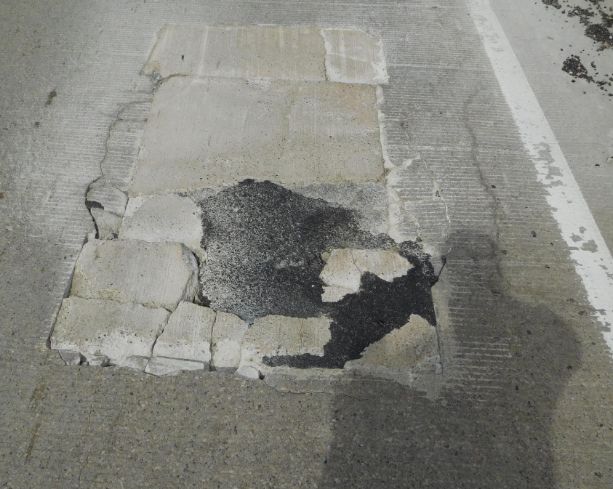
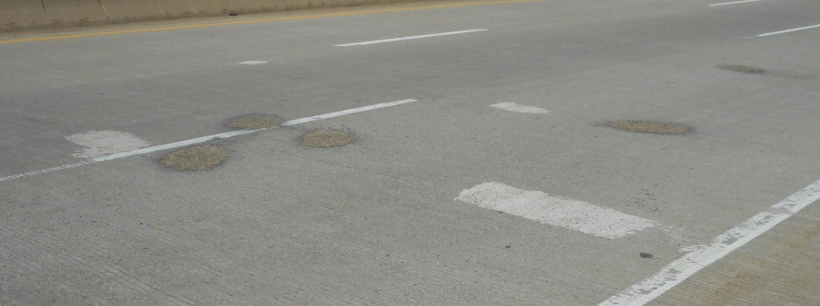
Notes:
5233.0O080
8295.9R080
3190.2S061 Peosta Channel
0625.7S030

Slide 14
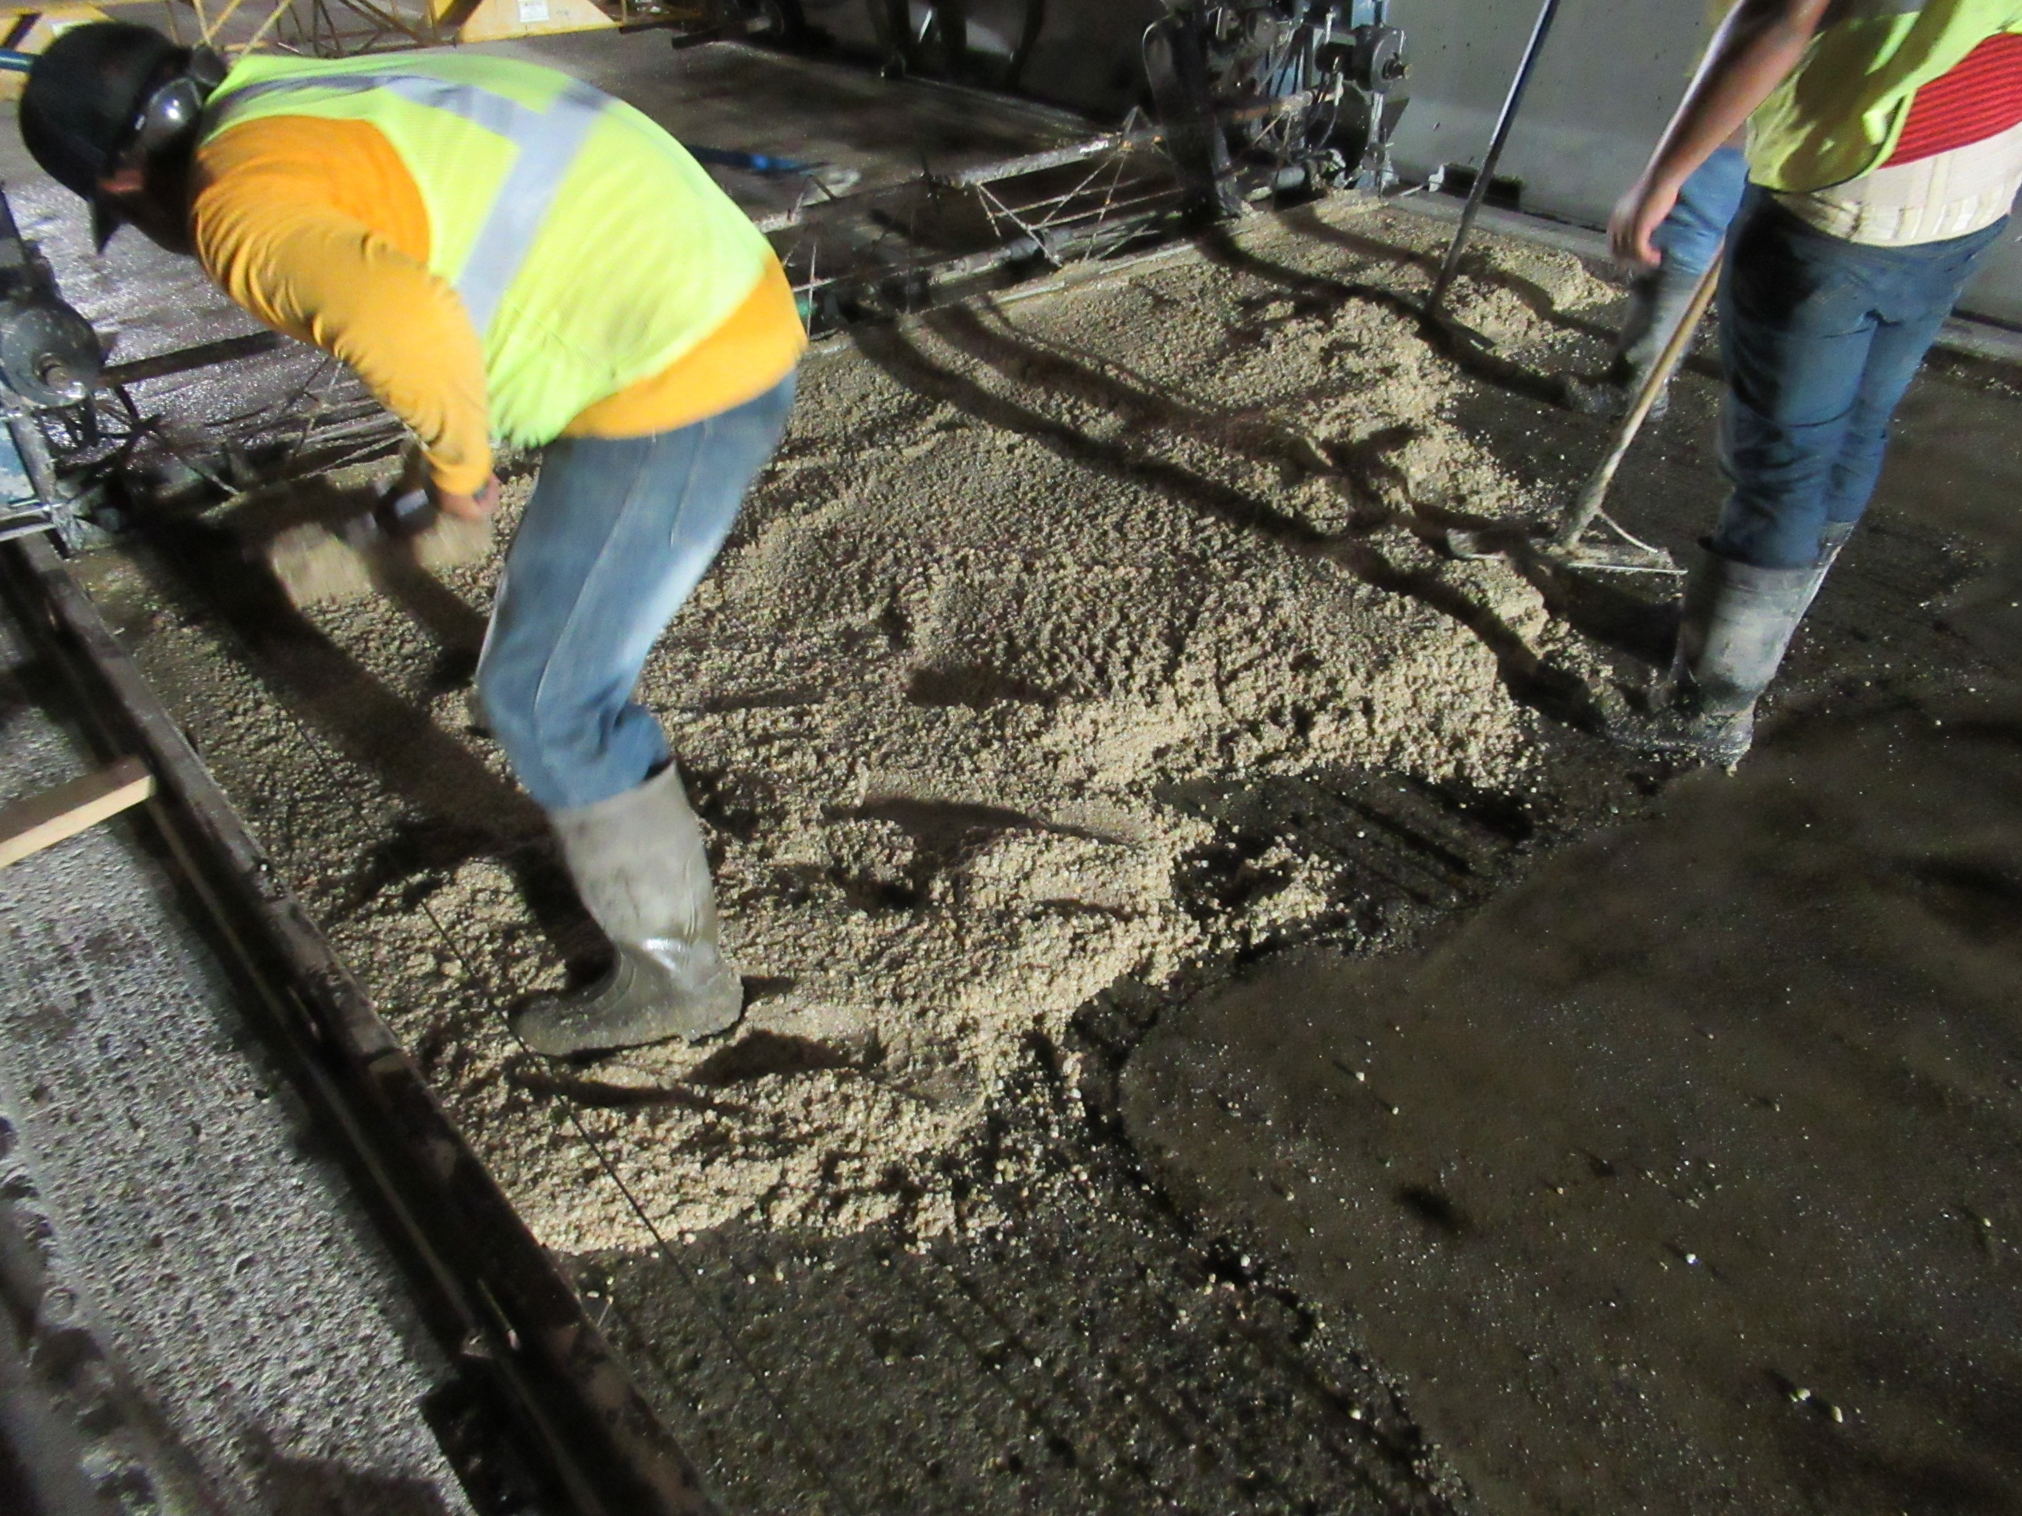
Notes:
Polyester Polymer overlay
Cedar Rapids over I-380 – 5720.8O380 8th st.

Slide 15
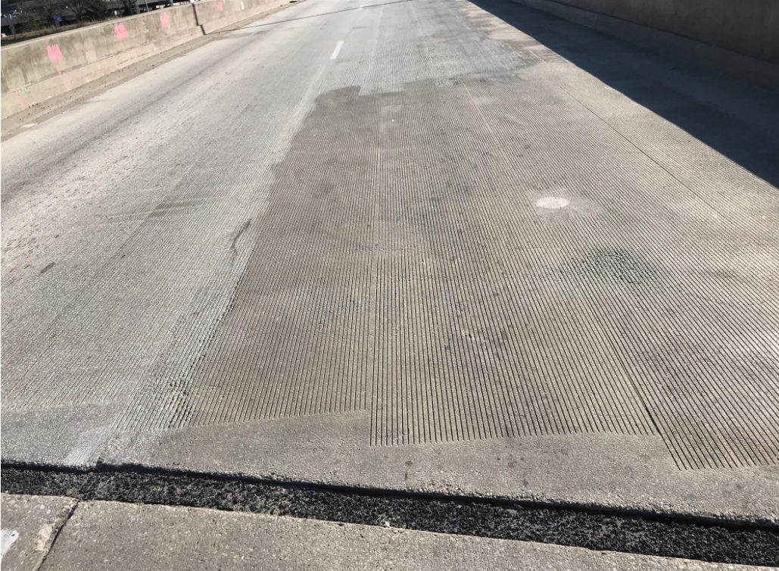
Notes:
Polyester Polymer overlay
Cedar Rapids over I-380 – 5720.8O380 8th st.

Slide 16
Bridge Inventory
The primary system includes 4,184 bridges and large culverts
Added together, the deck area of all primary system bridges is over 46 million square feet – that’s over 1.6 square miles. (over 810 football fields)
If we had to replace these bridges today, the cost would exceed $16 billion. (this would be 20 years or more of our entire program)
Average VPD 6,655. Median VPD 3,540.
Notes:
2586 bridges on the NHS. 32 total Poor. 15 Poor on NHS. 718 interstate bridges. 3466 non-interstate bridges. 4178 total bridges.
Make comment that there are 24,000 bridges statewide. Iowa’s status as number one state with the most Poor/SD bridges due to local bridges.
17.0% of bridges are on the interstate. 24.1% of the total deck area in on the interstate.
$9 billion to replace in-kind. $355/ft^2 vs $200/ft^2
The Des Moines River bridge on I-235 has the highest VPD at 94,000.

Slide 17
Bridge Inspection
Federal Highway Administration requires all bridges to be inspected every 24 months or less. (approximately 23,800 city, county and state bridges)
State bridge condition data is collected by 18 trained bridge inspectors.
It takes up to 5 years of training to be qualified to be a bridge inspector.
Inspection documentation is used to evaluate the need for replacement, rehab, or repair.
Notes:
94 FC bridges. 4184 bridges on state highways. 718 interstate (93 culverts, 25 FC), 3466 non-interstate (723 culverts, 69 FC).
Mention Scour Critical bridge inspection and how we have mitigated the scour critical bridges.

Slide 18
Bridge Project Selection Process
Bridge conditions are documented during inspections
Project recommendations are made during the inspection review process or by District personnel
Project recommendations are prioritized annually with each District
Projects are prioritized based on bridge condition, cost, development time and public need
Bridges and Structures Bureau reviews the highest priority projects and recommends projects based on available funding

Slide 20
FHWA Terms Describing Bridge Condition:
Good
Fair
Poor
Notes:
Poor is the same as SD. The SD term was misleading to people who don’t know bridges. It does not mean the bridge is near failure.

Slide 21
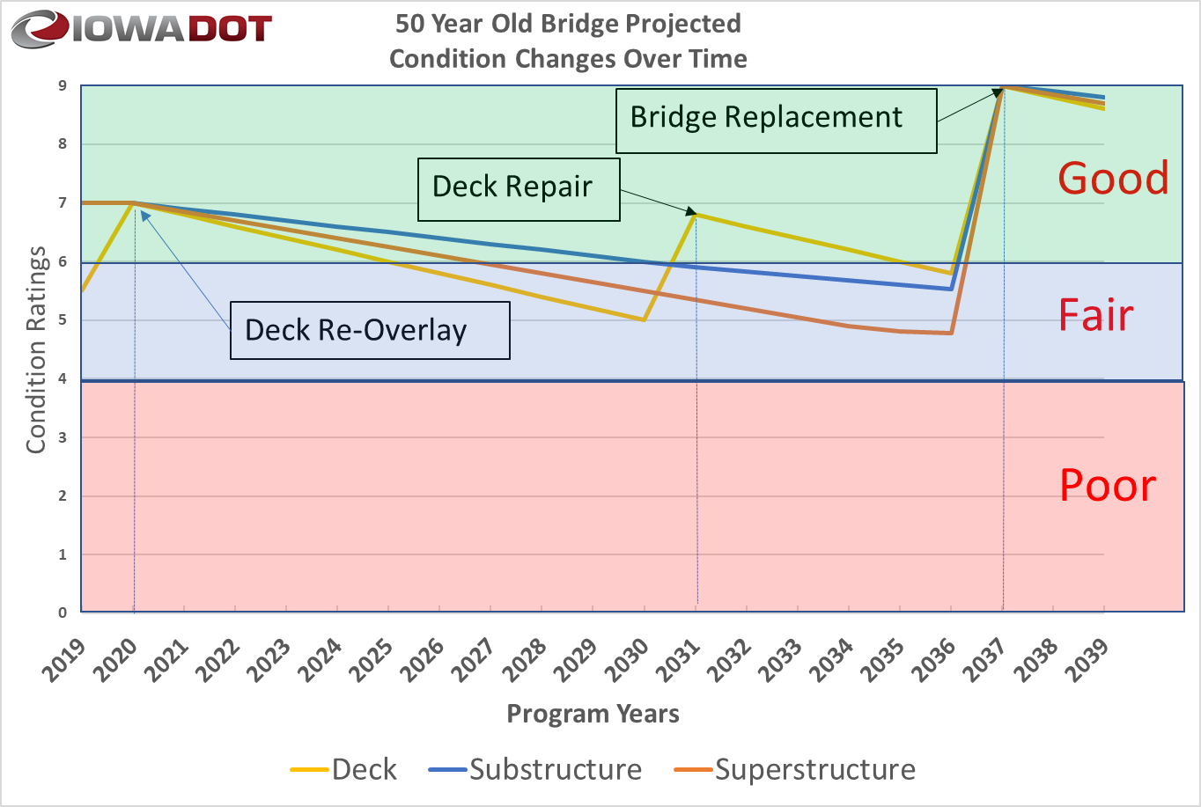
Notes:
This is a scenario recommended by our deterioration modeling system for a given bridge. Bridge 3826, IA-28 over Walnut Creek in Polk Co. Built in 1969. Second overlay in 2020. As bridges age, it is difficult to repair and maintain superstructures and Substructures.
Non-Interstate Unlimited budget CI42 Corrected.xlsx

Slide 22
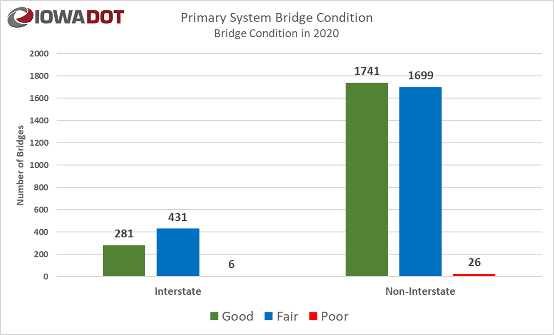
Notes:
NBI_TAPE_OUTPUT_15-03-2021_05-04-28 - Updated

Slide 23
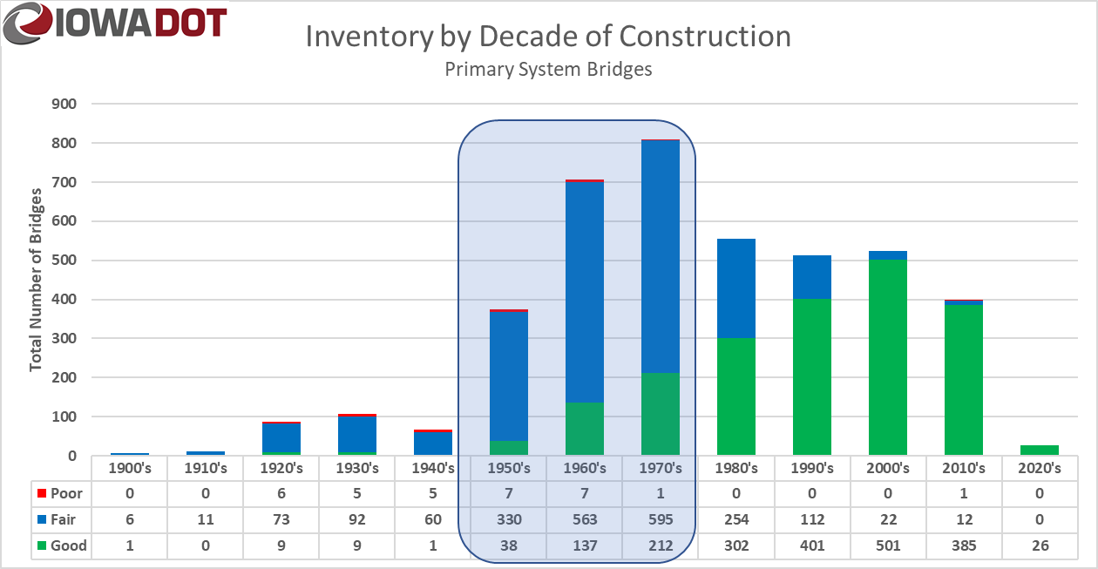
Notes:
NBI_TAPE_OUTPUT_15-03-2021_05-04-28 – Updated. Bridges in the 1950’s thru 1970’s will cost $5.6 Billion to replace.
We built 64 bridges in FY2021 (43 replacements and 21 new)
1443 bridges are over 50 years old. 34.5% of states bridges and 25.0% of state deck area.
The poor bridge in the 2010’s is the I-29 bridge that sustained damage from a fire and the bridge superstructure had to be replaced only 3 years after it was built.
The 12 fair bridges in the 2010’s are from the deck condition. 7 are on the I-29 corridor project. An issue with deck concrete quality. HPC

Slide 24
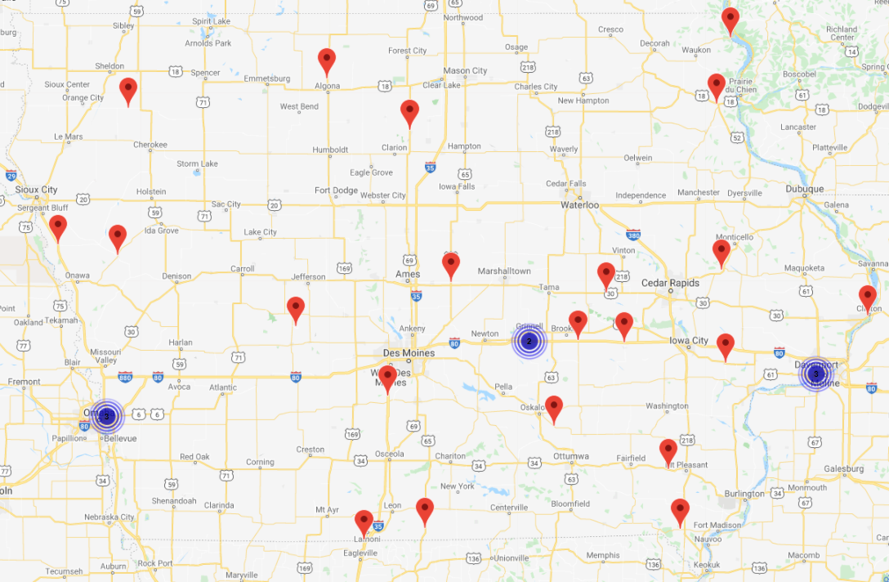
Poor Bridges on Primary Highways
Notes:
NBI_TAPE_OUTPUT_15-03-2021_05-04-28 – Updated. Only 29 Poor bridges as of 9/30/2021. 5 border bridges are Poor. 1 Underway, 2 programmed for 2022, 1 under development, 1 no work proposed.
Poor bridges statewide = 4497
3 posted poor bridges (2 border, 1 state park). There are 17 posted bridges (6 in state parks, 1 on side road, 10 on primary (3 border)).
Without the border bridges, the cost to replace the poor bridges is $50 million.

Slide 25
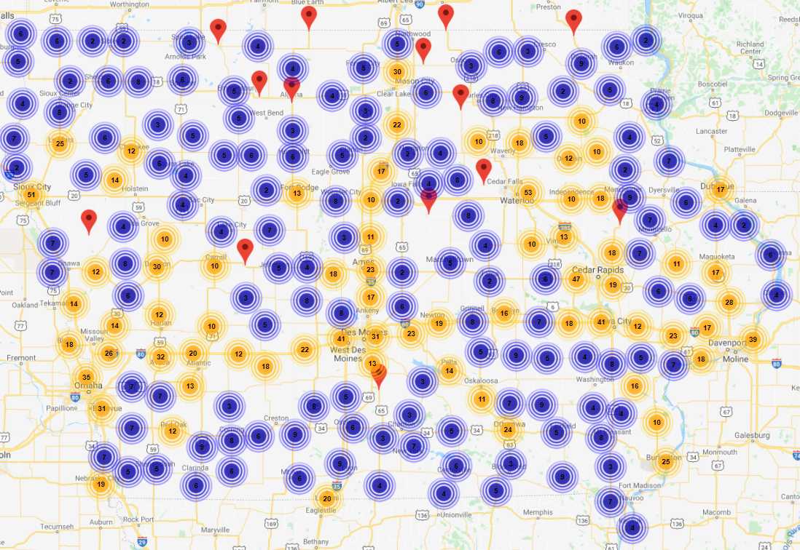
Fair Bridges on Primary Highways
Notes:
NBI_TAPE_OUTPUT_15-03-2021_05-04-28 – Updated. Only 29 Poor bridges as of 9/30/2021.
Poor bridges statewide = 4497

Slide 26
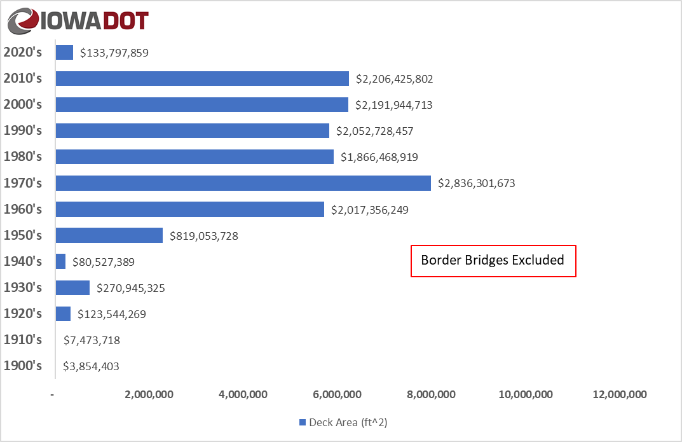
Replacement Cost and Deck Area per Decade
Notes:
NBI_TAPE_OUTPUT_15-03-2021_05-04-28 – Updated.
Total cost is $14,610,422,506

Slide 27
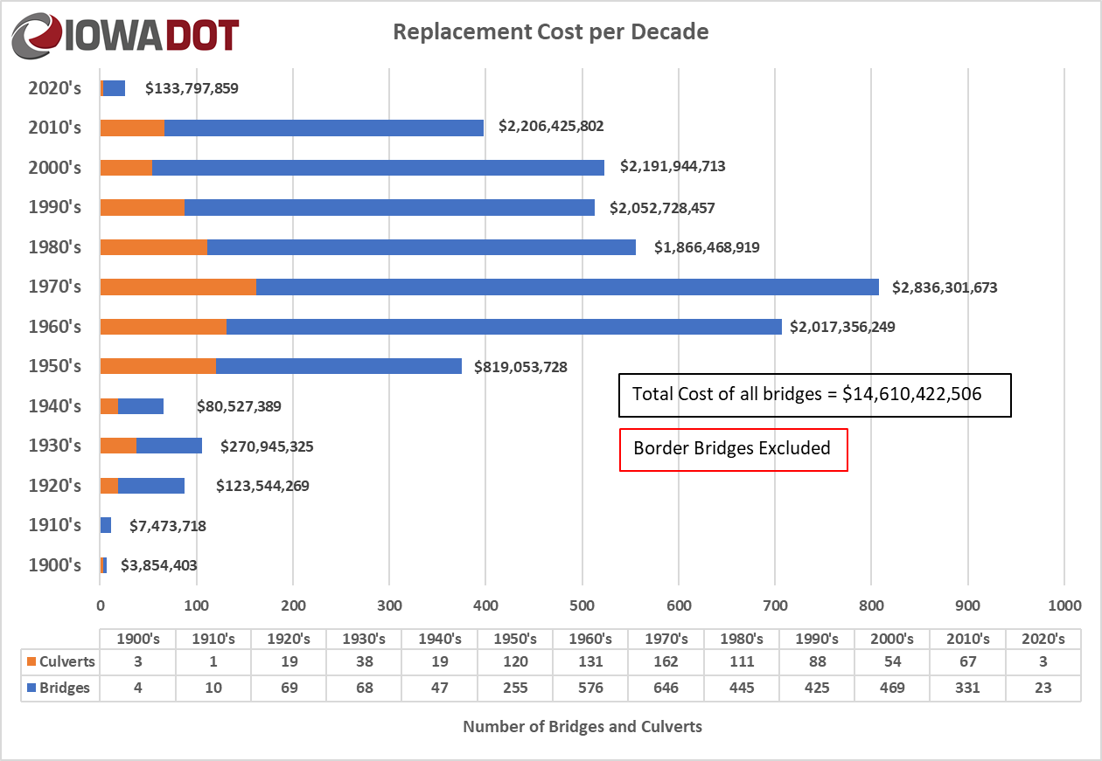
Notes:
NBI_TAPE_OUTPUT_15-03-2021_05-04-28 – Updated.
1950’s bridges only $729,053,728
1960’s bridges only $1,919,106,249
1970’s bridges only $2,714,801,673

Slide 28
Typical Bridge Costs
Replacements cost from $1.5 to $3.0 million (outliers not included)
Rehabilitations cost from $0.25 to $1.3 million
New Bridges cost from $2.3 to $3.5 million (outliers not included)
Notes:
904 Steel Girder Bridges
1853 PPCB bridges
561 Slab bridges
816 culverts
50 Other types of bridges
60 to 70% of bridges are $3 million or less (average = $1.5 million). Average of the other 30 to 40% is $6.3 million

Slide 29
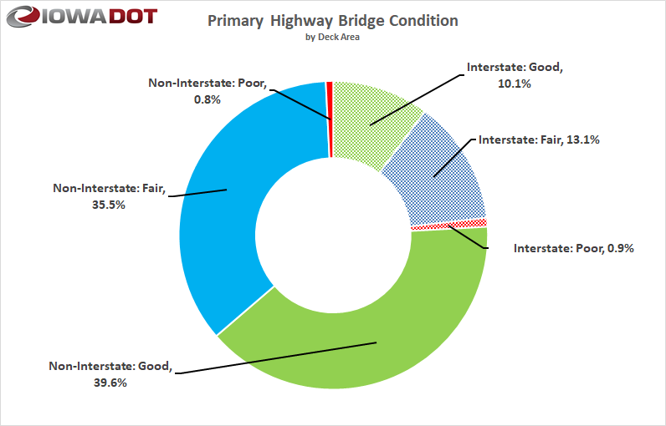
Notes:
SIIMS query 3-11-2020.xlsx
Need to discuss minimum condition on NHS required by FHWA. How do I show this without another chart?
2613 bridges on NHS (2571 state owned), 2.2% of the deck area is poor.

Slide 30
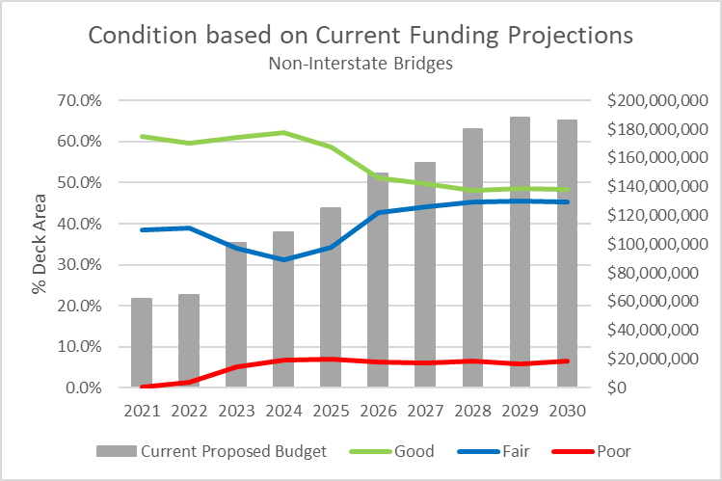
Condition Forecast
Border Bridges and culverts excluded
Notes:
OneDrive - Iowa Department of Transportation\Work\Deterioration Modeling\IDS Project\Phase VIII 2021\New Runs\Non-Interstate\Combination of 6 runs.xlsx

Slide 31
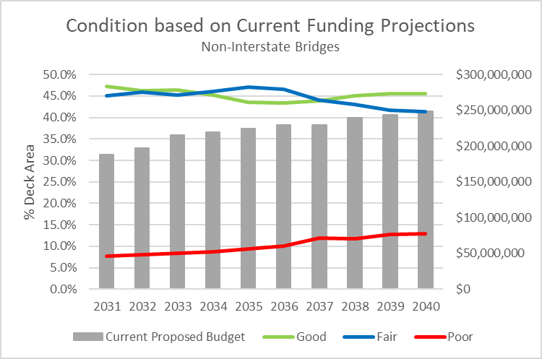
Condition Forecast
Border Bridges and culverts excluded
Notes:
OneDrive - Iowa Department of Transportation\Work\Deterioration Modeling\IDS Project\Phase VIII 2021\New Runs\Non-Interstate\Combination of 6 runs.xlsx

Slide 32
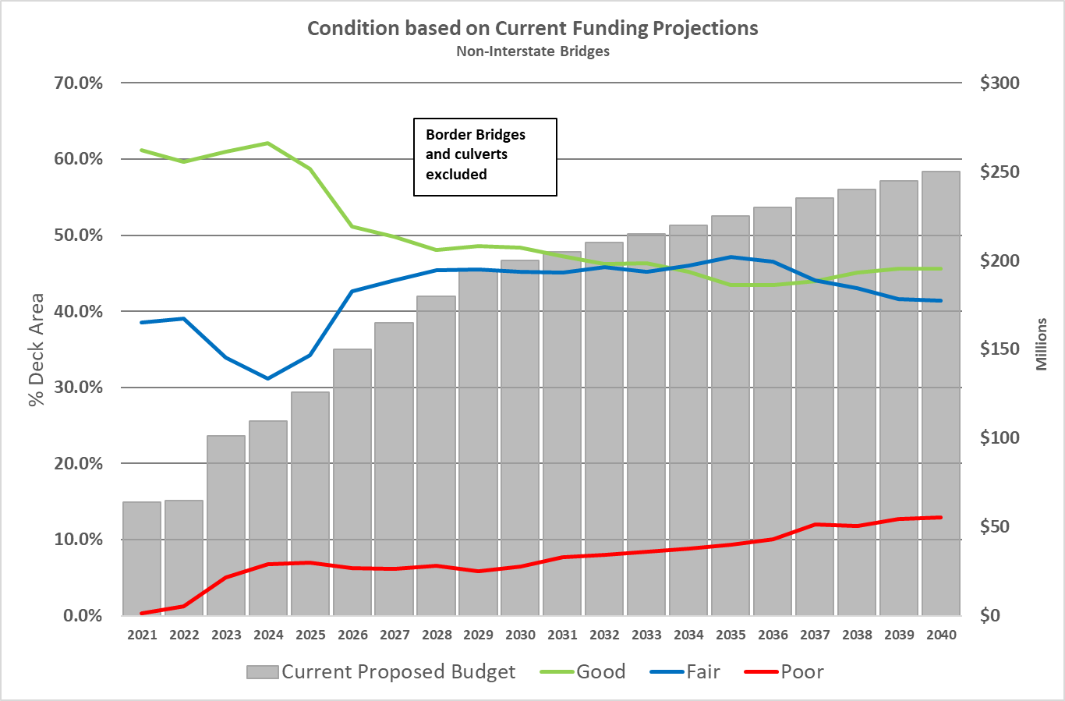
Condition Forecast
Notes:
OneDrive - Iowa Department of Transportation\Work\Deterioration Modeling\IDS Project\Phase VIII 2021\New Runs\Non-Interstate\Combination of 6 runs.xlsx
FHWA requirement to keep NHS below 10% of deck area as Poor.

Slide 33
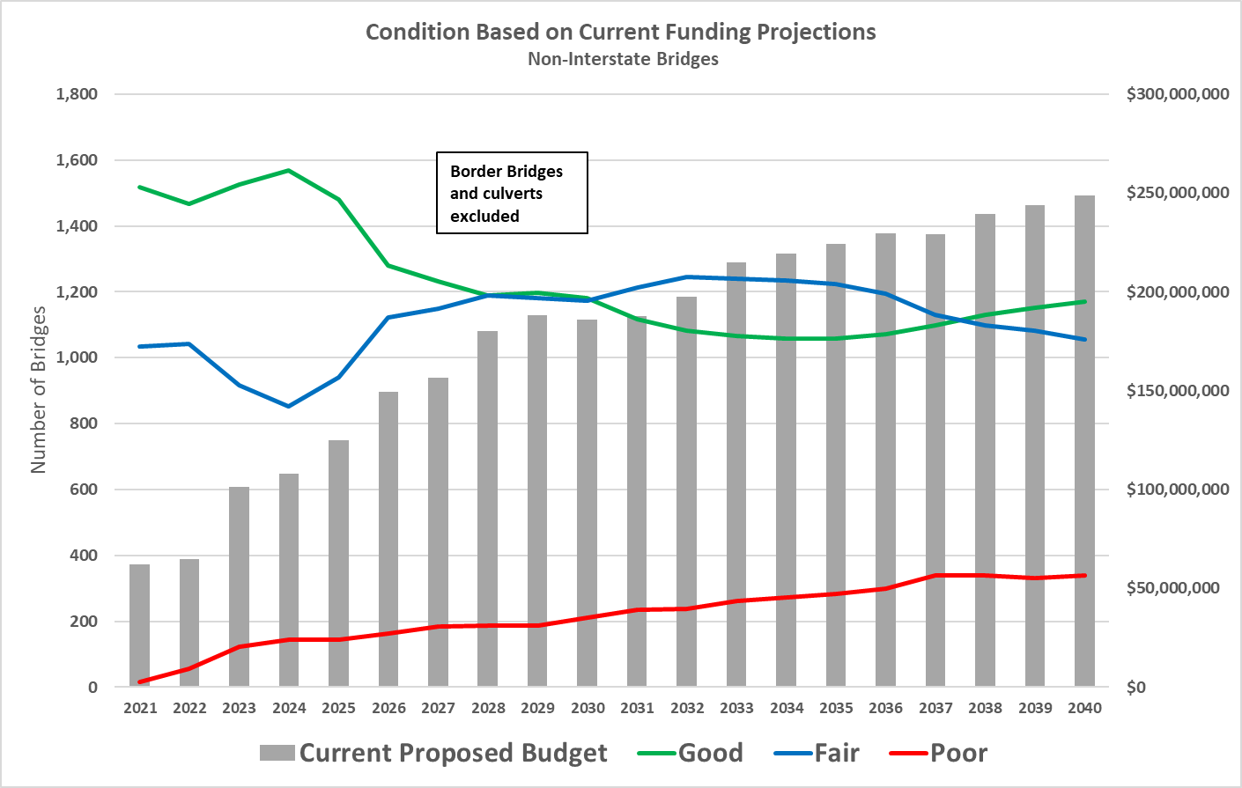
Condition Forecast
Notes:
OneDrive - Iowa Department of Transportation\Work\Deterioration Modeling\IDS Project\Phase VIII 2021\New Runs\Non-Interstate\Combination of 6 runs.xlsx

Slide 34
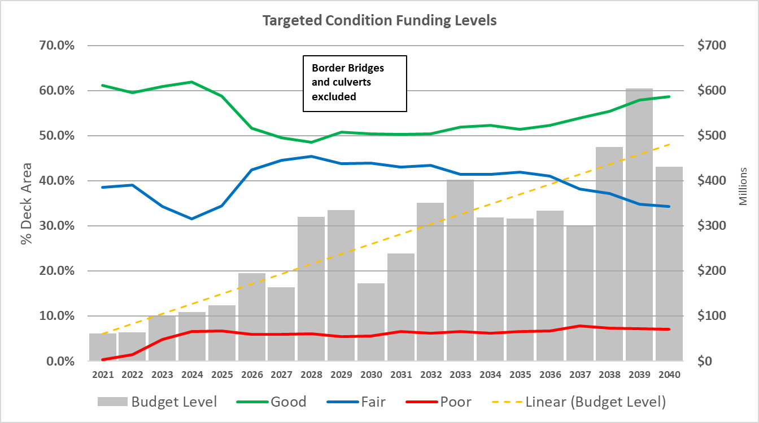
Condition Forecast
Notes:
OneDrive - Iowa Department of Transportation\Work\Deterioration Modeling\IDS Project\Phase VIII 2021\New Runs\Non-Interstate\Combination of 6 runs.xlsx

Slide 35
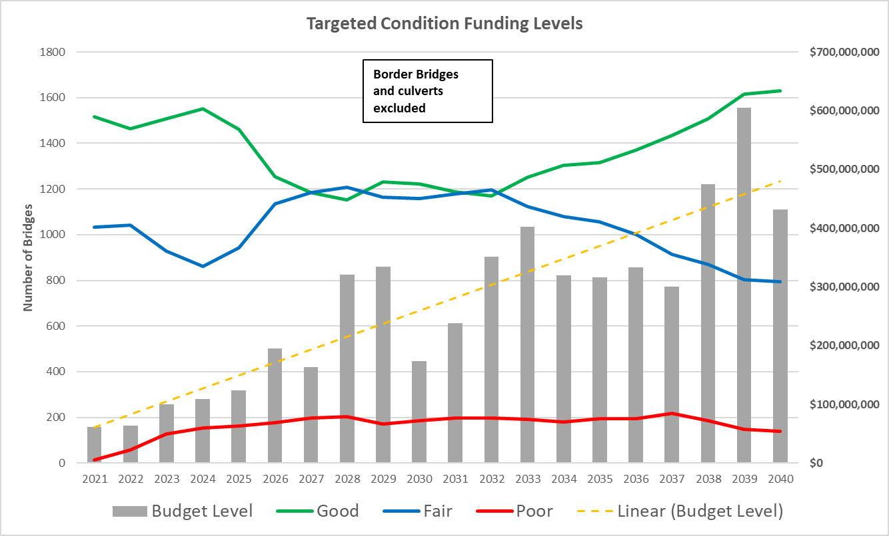
Condition Forecast
Notes:
OneDrive - Iowa Department of Transportation\Work\Deterioration Modeling\IDS Project\Phase VIII 2021\New Runs\Non-Interstate\Combination of 6 runs.xlsx

Slide 36
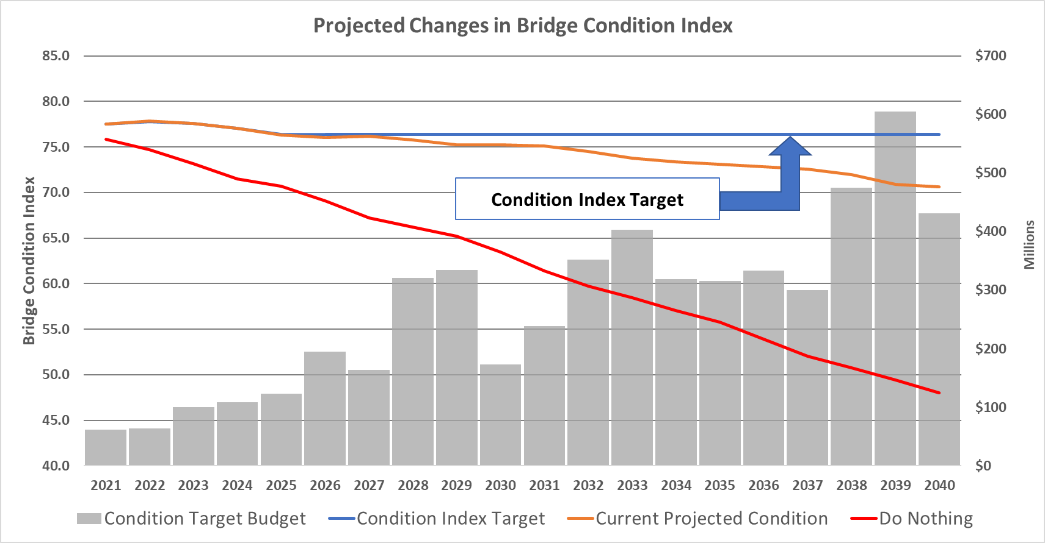
Condition Forecast
Notes:
OneDrive - Iowa Department of Transportation\Work\Deterioration Modeling\IDS Project\Phase VIII 2021\New Runs\Non-Interstate\Combination of 6 runs.xlsx

Slide 37
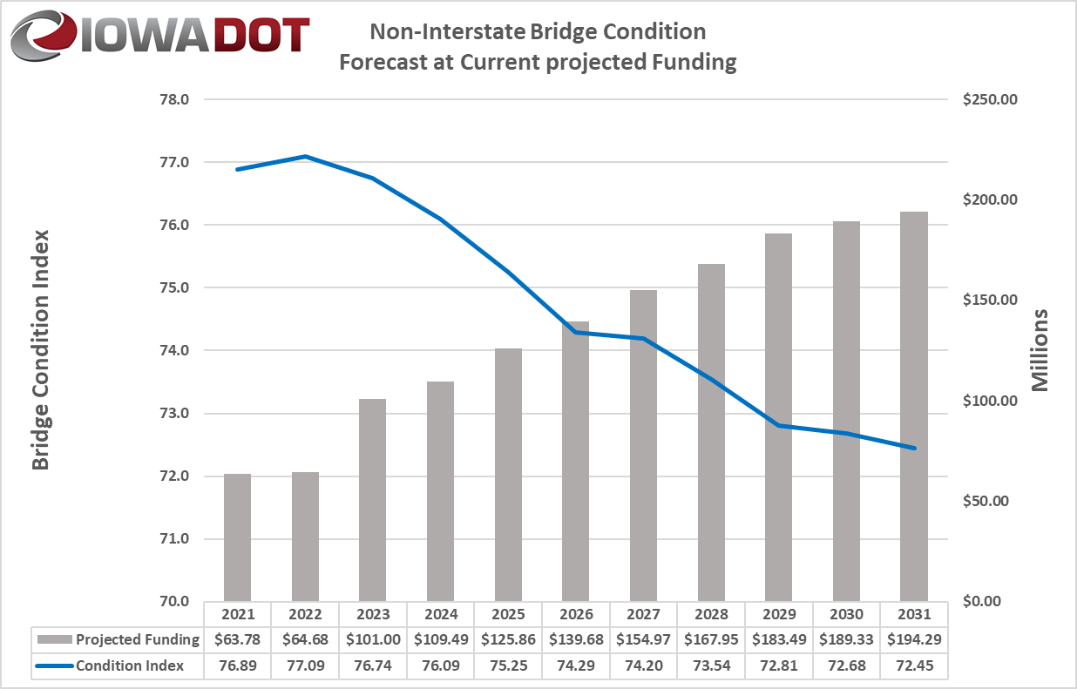
Condition Forecast

Slide 38
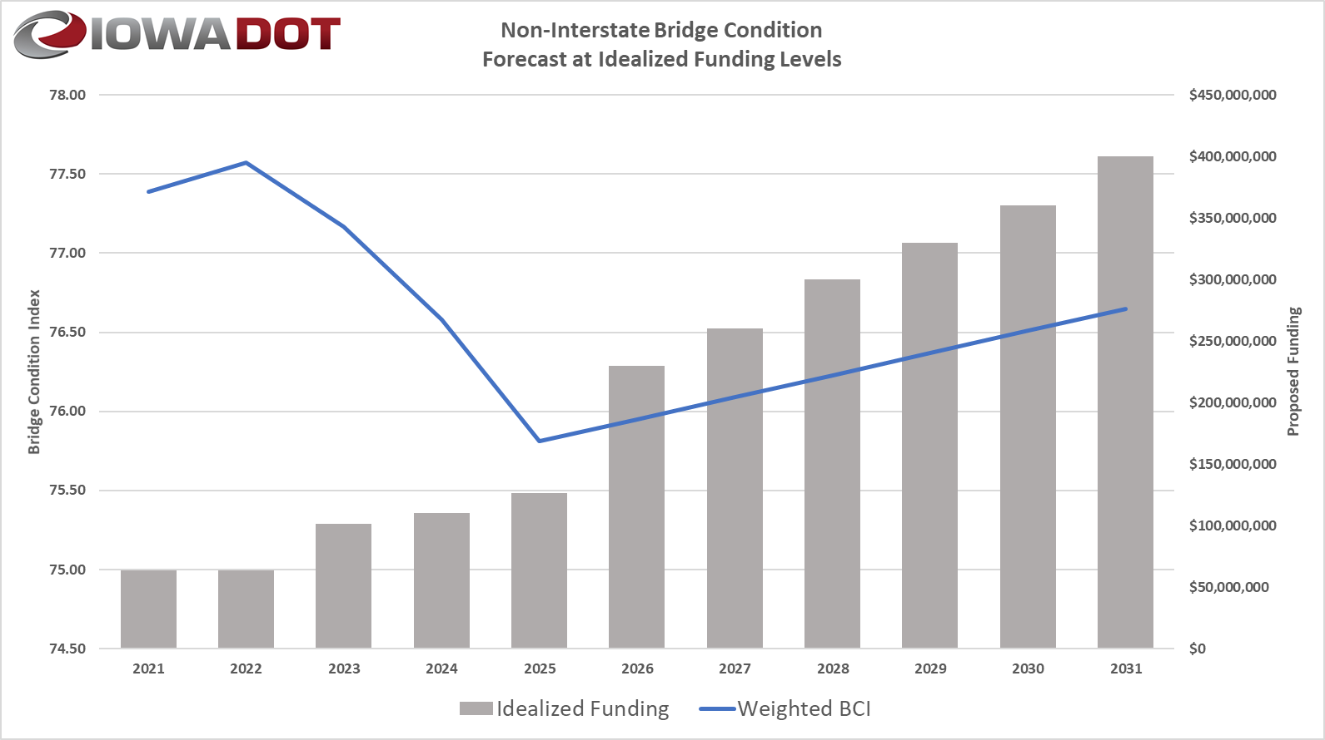
Condition Forecast
Notes:
W:\Highway\Bridge\BridgeInspection\Deterioration Modeling\IDS Project\Phase VII 2020\Non-Interstate\revised runs\2020_NonInterstate_5YR_Budget_CI42.2_Target_Gap.xlsx
Mention the age of bridge replacements and how these numbers are reasonable for the need to replace 60 or more bridges per year.

Slide 39
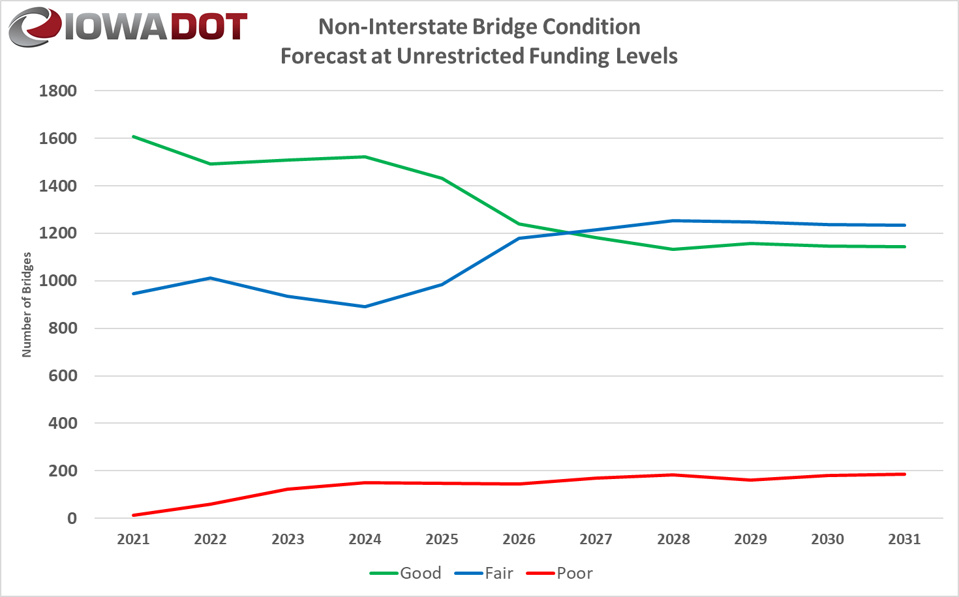
Condition Forecast
Notes:
W:\Highway\Bridge\BridgeInspection\Deterioration Modeling\IDS Project\Phase VII 2020\Non-Interstate\2020_NonInterstate_5YR_Budget_CI42.2_Target_Gap.xlsx

Slide 40



Additional Needs
There is a need to replace or rehabilitate several large bridges over the next 20 years.
I-280: Rock Island over the Mississippi River (re-deck in FY2021, $17 million)
I-129: Sioux City over the Missouri River (deck overlay in FY2021, $4.97 million)
IA-9: Lansing over the Mississippi River (replace in FY2024, $40 million)
I-80: Le Claire over the Mississippi River (replace in FY2026, $150 million)
IA-12: Sioux City Gordon Drive Viaduct (replace in FY2027, $105 million)
US-67: Davenport over the Mississippi River (replace beyond 2028, $110 million)
IA-175: Decatur over the Missouri River (replace - $60 million )
US-20: Dubuque over the Mississippi River (replace - $175 million )
US-30: Clinton over the Mississippi River (replace - $125 million )
US-63: Ottumwa Viaduct (replace - $80 million)
Note: the costs shown above represent Iowa’s estimated share.
Underway
In 5 Years
In 10 Years
In 20 Years
40
Notes:
15 bridges over Mississippi River, 12 bridges over Missouri River and 11 bridges over other waterways

Slide 41
Key Take-Aways
There is a large inventory of bridges built in the 1950’s, 1960’s and 1970’s.
Good progress has been made reducing the number of bridges classified as poor. This trend is likely to reverse due to the large number of aging bridges.
Border bridges represent large capital improvement projects that need to be planned for far in advance.
A sustained focus on stewardship is critical.

