Slide 1
COVID-19 Transportation Funding Impact
Transportation Commission Workshop
November 9, 2021

Slide 2
Update
Economic Recovery Index
Travel trends
US total rail carloads
Commercial air service passenger counts
Vehicular traffic
Infrastructure Bill Update and Overview

Slide 3
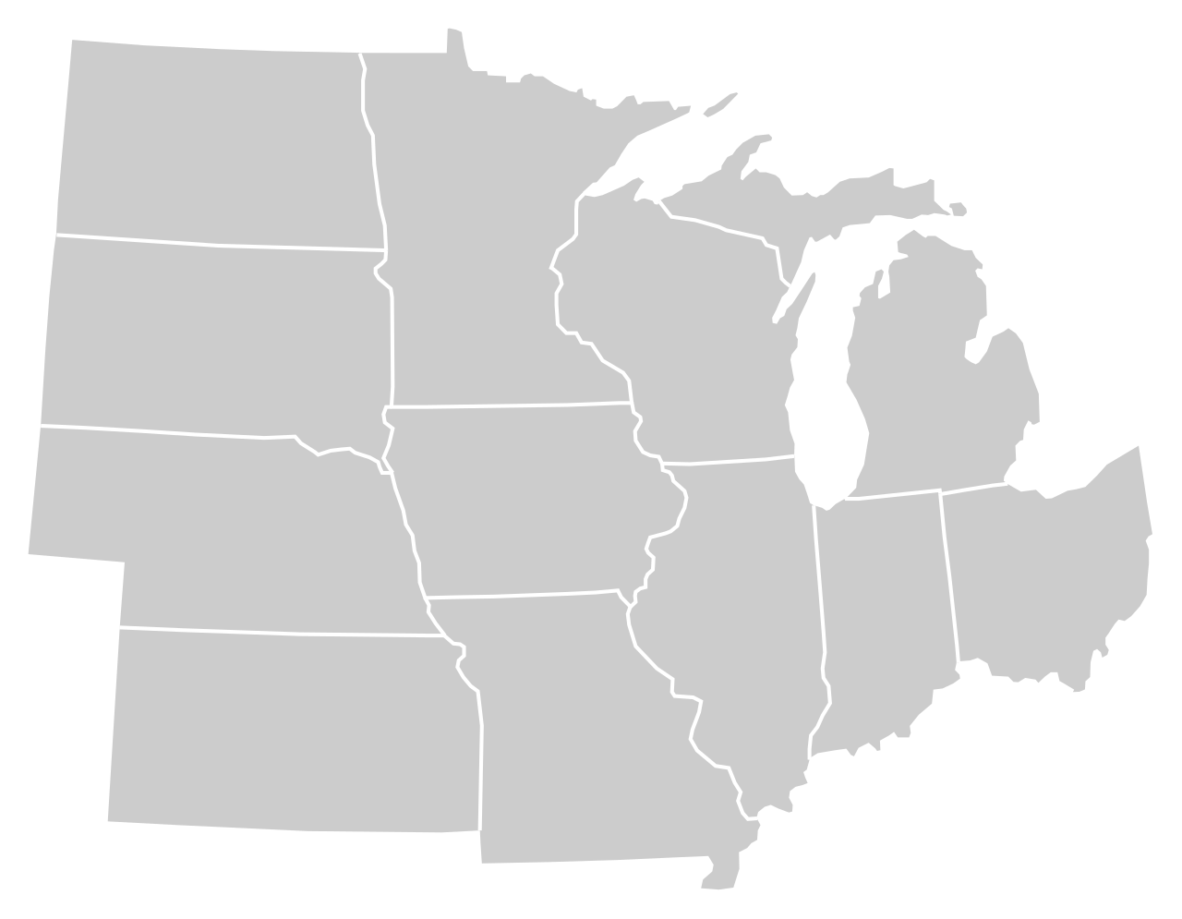
Moody’s/CNN Recovery Index - Midwest (Pre-Pandemic = 100) As of 11/5/2021
96%
95%
104%
97%
96%
99%
(97% last month)
99%
98%
89%
97%
97%
95%
Nation is at 95% (92% last month)

Slide 5
Monthly Passenger Counts at Iowa’s Eight Commercial Service Airports
(through September 2021)

Slide 6
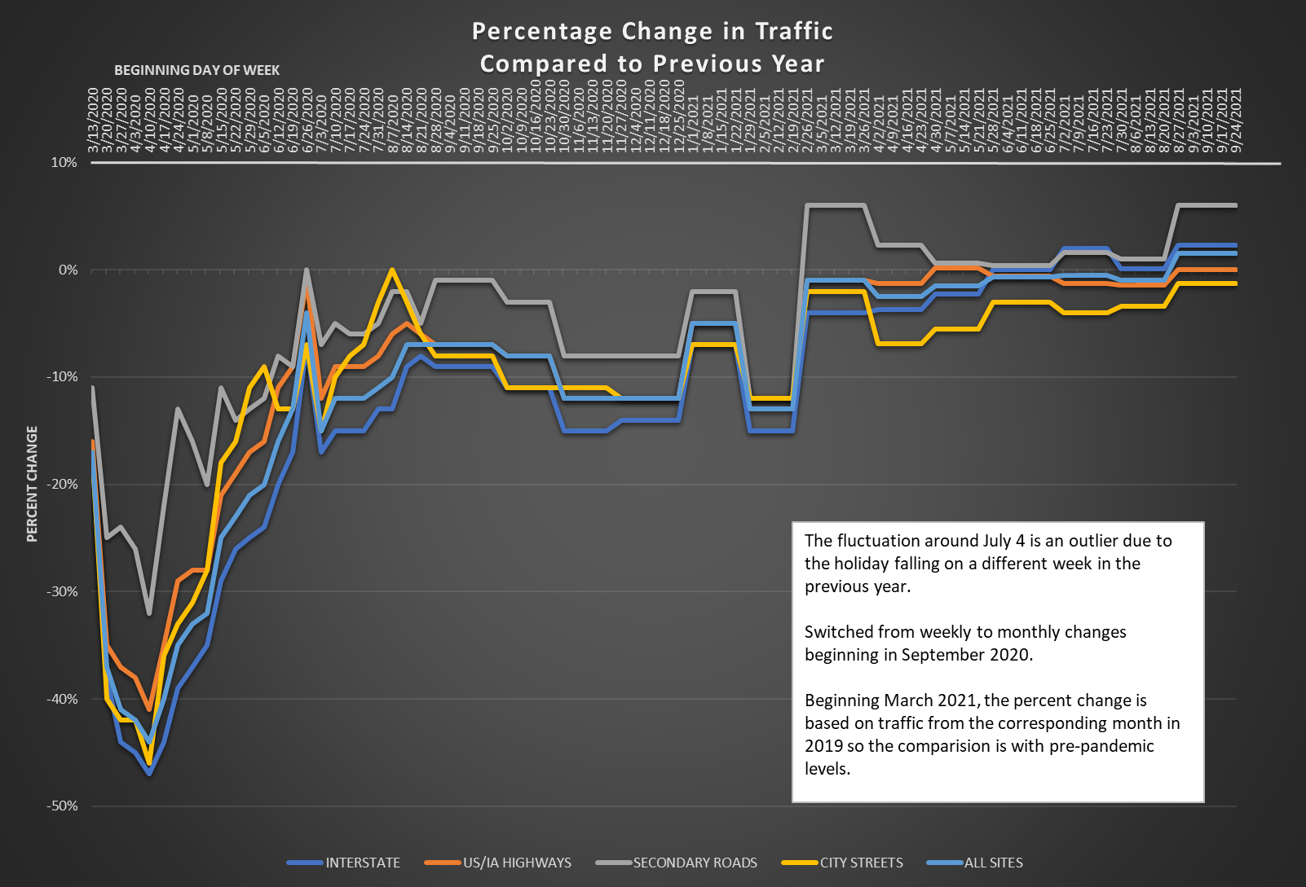

Slide 7

Infrastructure Bill Status
Infrastructure Investment and Jobs Act (IIJA)
Passed the Senate (69-30)
Passed the House on Nov. 5 (228-206)
President Biden will sign this week.
Includes reauthorization of surface transportation programs for FFY 2022 to FFY 2026.
Includes $550 billion in new funding with half going to transportation

Slide 8
Next Steps
Passage of Infrastructure Bill (FAST Act: 12/15)
Iowa DOT review and assessment (FAST Act: 12/15 to 1/16)
Iowa DOT overview to Commission (FAST Act: 2/16)
Stakeholder input
City/County/RPA/MPO Committee (FAST Act: 3/16)
All stakeholders (FAST Act: 4/16 to 6/16)
Summary of input to Commission (FAST Act: 7/16)
Recommendations to Commission (FAST Act: 8/16)
Commission action (FAST Act: 9/16)

Slide 9
Questions?

