Slide 1
Traffic Safety Improvement Program
Funding Recommendation
FY 2023

Slide 2
Background
Established in 1987 by Iowa Legislature
Iowa Code Section 312.2 and Administrative Rules 761 Chapter 164
0.5% of Road Use Tax Fund
Purpose: Implement traffic safety features in order to reduce fatalities and serious injuries
Available to all public entities responsible for public roads and streets

Slide 3
Funding Categories
Site-Specific Improvements
Construction projects to improve traffic safety and operations
Annual funding varies, generally $6-$7 million
Traffic Control Devices
For purchase of traffic control device materials
Annual funding = $500,000
Studies & Outreach
Traffic safety research, studies, and public information initiatives
Annual funding = $500,000
Listing of applications can be found at this link:
https://iowadot.gov/traffic/Traffic-and-Safety-programs/TSIP/TSIP-Program

Slide 4
Application Review/Scoring
Demonstrated relationship to traffic safety
Safety benefit
Project cost
Type of countermeasure(s) proposed
Risk factor(s) addressed
Safety engineering analysis
Multi-agency committee input
Funding subject to agreement execution

Slide 5
Application/Funding Summary
Application Summary
Applications received: 29
TSIP funds requested: $10,535,997
Available Funding
FY 2022 TSIP estimated appropriation: $7,682,155
Total funding recommended: $7,679,852
Notes:
32 site specific applications
Total requests $12,703,028
15 traffic control device applications
Total requests $1,951,290
1 study application
Total request $500,000

Slide 6
Site-Specific Improvements Funding Recommendation
PROJECT NAME | SPONSOR | SCORE | TOTAL PROJECT COST | REQUESTED AMOUNT (% of Total Project Cost) | RECOMMENDED AMOUNT (% of Total Project Cost)
V62 – edge treatments | Buchanan County | High | $2,514,521 | $362,485 (14%) | $362,485 (14%)
2nd Ave – left turn lanes | City of Des Moines | High | $16,000,000 | $500,000 (3%) | $500,000 (3%)
Boyson Rd and N 12th Ave – roundabout | City of Hiawatha | High | $530,900 | $500,000 (94%) | $500,000 (94%)
US 75 and C38 – offset right turn lane | Iowa DOT -District 3 | High | $407,000 | $407,000 (100%) | $407,000 (100%)
US 63 and Chilicothe Rd – offset right turn lane | Iowa DOT -District 5 | High | $300,000 | $270,000 (90%) | $270,000 (90%)
NE Broadway, E 38th Ave and E 46th St– roundabouts | Polk County | High | $46,800,000 | $500,000 (1%) | $500,000 (1%)
Jump to applications not recommended for funding

Slide 7
Site-Specific Improvements Funding Recommendation
PROJECT NAME | SPONSOR | SCORE | TOTAL PROJECT COST | REQUESTED AMOUNT (% of Total Project Cost) | RECOMMENDED AMOUNT (% of Total Project Cost)
Bluff Blvd, 7th Ave S, and Thorwaldsen Pl– realignment | City of Clinton | Med-High | $600,000 | $500,000 (83%) | $500,000 (83%)
Prairie View Dr and Ashworth Rd– left turn lanes | City of West Des Moines | Med-High | $379,900 | $280,000 (74%) | $280,000 (74%)
US 30 and Mill Creek Pkwy– widen pavement | Iowa DOT -District 6 | Med-High | $82,000 | $82,000 (100%) | $82,000 (100%)
E34 – edge treatments | Jones County | Med-High | $1,750,000 | $500,000 (29%) | $500,000 (29%)
Middle Rd and Forest Grove Dr– roundabout | City of Bettendorf | Med | $9,371,160 | $500,000 (5%) | $500,000 5%)
Main St – lane conversion | City of Cedar Falls | Med | $11,829,675 | $500,000 (4%) | $500,000 (4%)
Jump to applications not recommended for funding

Slide 8
Site-Specific Improvements Funding Recommendation
PROJECT NAME | SPONSOR | SCORE | TOTAL PROJECT COST | REQUESTED AMOUNT (% of Total Project Cost) | RECOMMENDED AMOUNT (% of Total Project Cost)
Mt Vernon Rd/8th Ave and 10th St SE – roundabout | City of Cedar Rapids | Med | $1,522,980 | $500,000 (33%) | $500,000 (33%)
Bowling St and Wilson Ave SW– roundabout | City of Cedar Rapids | Med | $894,000 | $500,000 (56%) | $280,000 (31%)
Albia Rd and N Quincy Ave – roundabout | City of Ottumwa | Med | $515,340 | $500,000 (97%) | $500,000 (97%)
NE Delaware Ave- lane conversion/signals | City of Ankeny | Med-Low | $10,511,260 | $500,000 (5%) | $500,000 (5%)
Jump to applications not recommended for funding

Slide 9
Traffic Control Devices Funding Recommendation
PROJECT NAME | SPONSOR | SCORE | TOTAL PROJECT COST | REQUESTED AMOUNT (% of Total Project Cost) | RECOMMENDED AMOUNT (% of Total Project Cost)
Portable Temporary Traffic Signals | Cerro Gordo/Hancock County | High | $50,520 | $38,121 (75%) | $38,121 (75%)
Portable Temporary Traffic Signals | Dubuque County | High | $55,450 | $55,450 (100%) | $55,450 (100%)
Portable Temporary Traffic Signals | Hamilton County | High | $41,795 | $41,795 (100%) | $41,795 (100%)
Sign Replacement Program for Cities and Counties | Iowa DOT – Local Systems Bureau | High | $200,000 | $200,000 (100%) | $200,000 (100%)
Portable Temporary Traffic Signals | Madison County | High | $63,000 | $63,000 (100%) | $63,000 (100%)
Flashing Yellow Arrow Conversion at 7 intersections | City of Pleasant Hill | Med-Low | $244,500 | $2000,000 (82%) | $100,000 (41%)
Jump to applications not recommended for funding

Slide 10
Studies & Outreach Funding Recommendation
PROJECT NAME
REQUESTED AMOUNT
RECOMMENDED AMOUNT
Studies Program | $500,000 | $500,000

Slide 11
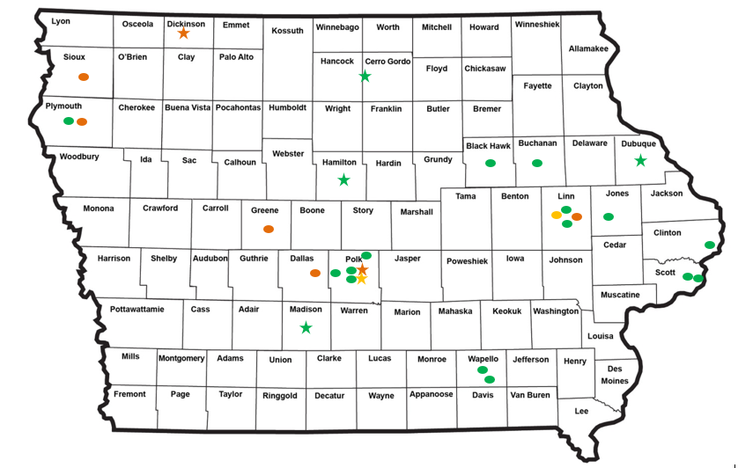
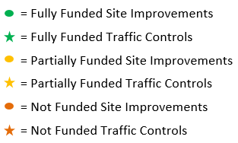
Map of Applications Received

Slide 12
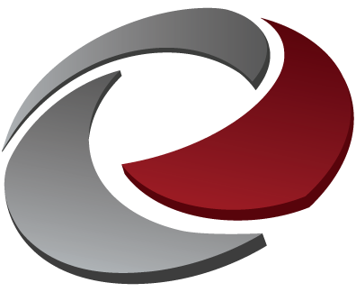
QUESTIONS?
Jan Laaser-Webb, Traffic and Safety Bureau
jan.laaser-webb@iowadot.us
515-239-1349

Slide 13
Site-Specific Improvements Applications Not Recommended for Award
REQUESTED AMOUNT
(% of Total Project Cost)
RECOMMENDED AMOUNT
(% of Total Project Cost)
PROJECT NAME
SPONSOR
SCORE
TOTAL PROJECT COST
IA 100 and E Post Rd– turn lanes/signal | City of Marion | Medium | $900,000 | $500,000 (56%) | $0
IA 17 and State St – offset right turn lanes | Iowa DOT – District 1 | Medium-Low | $792,000 | $500,000 (63%) | $0
US 30 and N Grimmell Rd– offset right turn lanes | Iowa DOT – District 1 | Medium-Low | $655,000 | $500,000 (76%) | $0
IA 10 and Jay Ave - roundabout | Iowa DOT – District 3 | Low | $1,600,000 | $500,000 (31%) | $0
Return to Recommendation Summary

Slide 14
Site-Specific Improvements Applications Not Recommended for Award
REQUESTED AMOUNT
(% of Total Project Cost)
RECOMMENDED AMOUNT
(% of Total Project Cost)
PROJECT NAME
SPONSOR
SCORE
TOTAL PROJECT COST
C30 and K64– edge treatments | Plymouth County | Low | $534,140 | $340,590 (64%) | $0
Return to Recommendation Summary

Slide 15
Traffic Control Devices Applications Not Recommended for Award
REQUESTED AMOUNT
(% of Total Project Cost)
RECOMMENDED AMOUNT
(% of Total Project Cost)
PROJECT NAME
SPONSOR
SCORE
TOTAL PROJECT COST
Signal Upgrade - Interconnect Via Fiber Optic | City of Arnolds Park/Okoboji | Not Eligible | $242,000 | $242,000 (100%) | $0
Traffic Signal Upgrade | Polk County | Not Eligible | $46,800,000 | $253,555 (1%) | $0
Return to Recommendation Summary

