Slide 1
The Mission of the Governor’s Traffic Safety Bureau is to identify traffic safety problems and, partnering with city, county, state and local agencies, develop and implement traffic safety programs to reduce death and injury on Iowa’s streets and highways.

Slide 2
Iowa Highway Safety Plans
Highway Safety Plan
GTSB
Also serves as the application for NHTSA Funding
Annual
State Strategic Highway Safety Plan
DOT
Partner Pledge by Department Heads
5 Years

Slide 3
National Highway Traffic Safety Administration Funding - NHTSA
General Traffic Enforcement
LE High Visibility Enforcement
Speed
Occupant Protection
Distracted Driving
Impaired Driving
Roadway Safety
Pedestrian
Bicycle Helmet Distribution
Media/Education

Slide 4
National Highway Traffic Safety Administration Funding- NHTSA
Impaired Driving
LE High Visibility Enforcement
Advanced Roadside Impaired Driving Enforcement (ARIDE) Training
Drug Recognition Expert Program
Iowa Law Enforcement Academy Instruction
IA Attorney General’s Traffic Safety Resource Prosecutor
24/7 Sobriety Program
Media/Education

Slide 5
National Highway Traffic Safety Administration Funding - NHTSA
Occupant Protection
LE High Visibility Enforcement
Seatbelt Survey
Child Protection Survey & Distribution
Nighttime Enforcement
Media/Education

Slide 6
National Highway Traffic Safety Administration Funding - NHTSA
Data Improvement
DOT TraCs
DOT Traffic & Safety
DOT Iowa Crash Analysis Tool (ICAT)
IA Department of Public Health – EMS Response Time
University of IA – Injury Prevention Research and National Driving Simulator

Slide 7
National Highway Traffic Safety Administration Funding - NHTSA
Motorcycles
DOT Motorcycle Rider Education
Share the Road Media & Education

Slide 8
GTSB Partners/Contracts
201 Law Enforcement Contracts
General
Impaired
Occupant Protection
23 Law Enforcement Project Contracts
Excessive Speed
Pedestrian
Nighttime Seatbelt
27 Research, Data Improvement, Traffic Safety Survey, Training Contracts
University of Iowa
Iowa State University
Iowa Law Enforcement Academy
Attorney General Prosecuting Attorney Training Coordinator
20 Media/Educational Contracts

Slide 9
Iowa Fatality Reduction Task Force

Slide 10
Fatality Reduction Task Force – Call to Action
The ultimate goal of zero fatalities with an incremental goal of 300 fatalities in 2021
The campaign focuses on 4 key messages that address the most common risk factors that drivers face on the road:
Wear a seatbelt and make sure all passengers do as well
No speeding
No distractions
No alcohol or drugs

Slide 11
Fatality Reduction Task Force – Call to Action
Objectives
Empower drivers that they can change their own behaviors and save lives
Motivate drivers to be actively engaged in the task of driving when behind the wheel

Slide 12
Why below 300?
1925 – Last time traffic fatalities in Iowa
were under 300
1970 – 912 Traffic fatalities

Slide 13
Initial Task Force Partners
Iowa Department of Public Safety
Iowa Department of Transportation
Iowa Police Chiefs Association
Iowa State Sheriffs’ and Deputies’ Association
National Highway Traffic Safety Administration
Federal Highway Administration
Federal Motor Carrier Safety Administration
Iowa State University/In-Trans
AAA of Iowa/Minnesota

Slide 14
Press Conference
June 8, 2021
Des Moines, Iowa

Slide 15
Capital Dispatch – Perry Beeman: https://iowacapitaldispatch.com/2021/06/08/pandemic-turns-iowa-into-speedway-traffic-fatalities-rise/?eType=EmailBlastContent&eId=fec649f1-84f7-4d1d-86a1-5615454f1c13
Radio Iowa: https://www.radioiowa.com/2021/06/08/state-troopers-launch-new-crackdown-on-dangerous-drivers/
KWWL – Daniel Perreault: https://kwwl.com/2021/06/06/after-deadly-may-on-the-roads-state-patrol-steps-up-education-campaign-for-safe-driving/
KCCI – Laura Terrell: https://www.kcci.com/article/iowa-to-step-up-traffic-enforcement-to-slow-road-fatalities/36666226
Iowa Torch: https://iowatorch.com/2021/06/09/task-force-challenges-iowans-to-keep-traffic-deaths-below-300/
Storm Lake Pilot Tribune: https://www.stormlakepilottribune.com/story/2889117.html
KWWL – Michele White: https://kwwl.com/2021/06/10/more-officers-education-this-week-to-make-roads-safer/
KWIT – Mary Hartnett: https://www.kwit.org/post/increased-patrols-impaired-and-distracted-drivers
KICD – MM Williams: https://kicdam.com/news/170071-isp-talks-fatality-numbers-on-iowa-roads/
KTIV – Brett Funke: https://ktiv.com/2021/06/10/sioux-city-police-department-to-participate-in-traffic-safety-initiatives/
Storm Lake Radio: https://stormlakeradio.com/news/2021/06/09/traffic-officials-working-to-slow-iowas-rising-fatality-rate
Muscatine Journal – David Hotle: https://muscatinejournal.com/muscatine/news/local/muscatine-police-to-step-up-enforcement-this-weekend/article_0185ca60-9c19-5c66-8769-2663a42b2f54.html
Explore Okoboji: https://www.exploreokoboji.com/news/news-stories/traffic-enforcement-officials-working-to-slow-iowa-s-rising-fatality-rate/
KCRG – Taylor Holt: https://www.kcrg.com/2021/06/09/iowa-state-patrol-taking-part-statewide-effort-reduce-fatalities-iowa-roadways/
iHeart Radio – Sue Danielson: https://whoradio.iheart.com/content/2021-06-08-iowa-state-patrol-traffic-deaths-up-more-speeding-impaired-driving/
KAAL: https://www.kaaltv.com/iowa-news/iowa-to-step-up-traffic-enforcement-to-slow-road-fatalities/6134876/?cat=10151
RACOON RIVER RADIO: https://www.raccoonvalleyradio.com/2021/06/12/iowa-state-patrol-working-new-initiative-to-reduce-traffic-fatalities/
CEDAR RAPIDS GAZETTE: https://www.thegazette.com/opinion/iowa-police-cant-enforce-their-way-to-zero-traffic-deaths/
BIG NEWS NETWORK.COM: https://www.bignewsnetwork.com/news/269854799/iowa-to-clamp-down-on-phones-speeding-to-reduce-traffic-deaths

Slide 16
4 Enforcement Waves Conducted in 2021
Date(s) | Focus
March 17 (St. Patrick’s Day) | Seatbelt Usage and Impaired Driving
June 9-12 (Father’s Day) | Impaired Driving
September 16 | Speed
October 2-4 | Distracted Driving

Slide 17
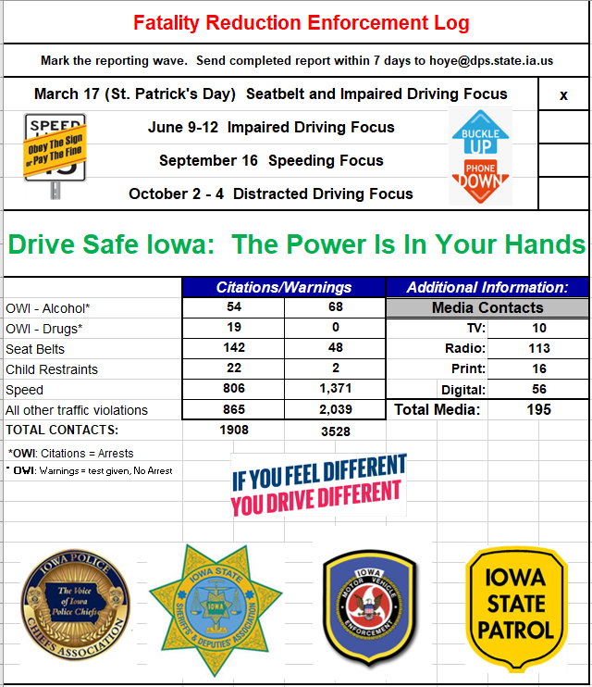

Slide 18
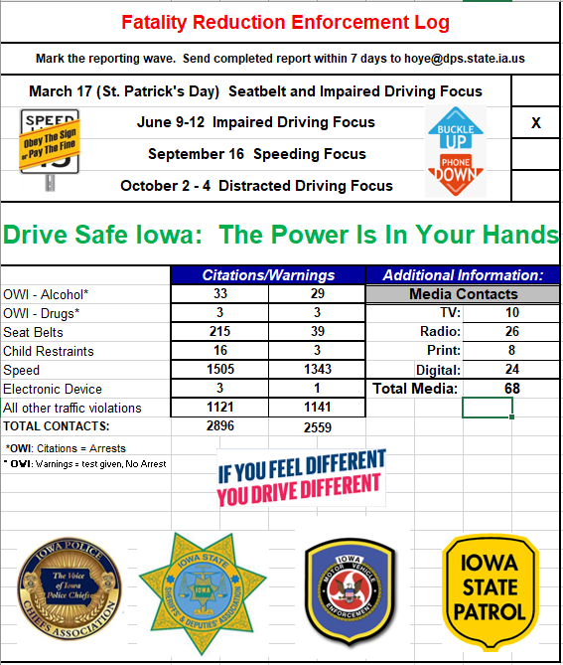

Slide 19
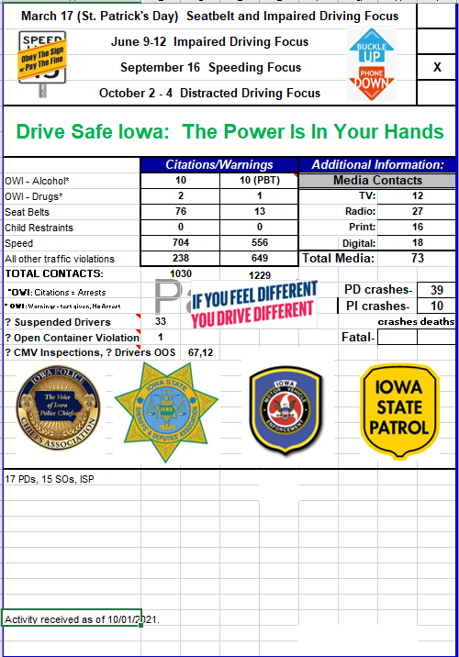

Slide 20
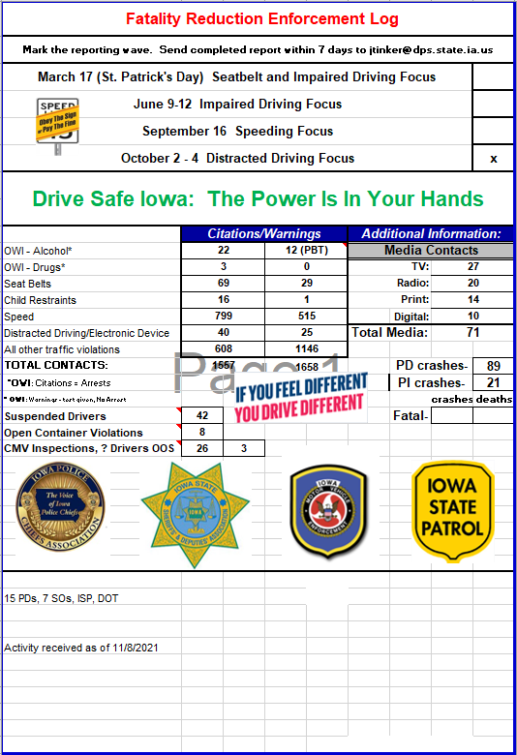

Slide 21
Social Media Content
A playbook was developed that contains shareable social media content for the Traffic Fatality Reduction Task Force campaign.
Links to downloadable graphics are provided on the pages of this playbook, each with accompanying suggested posts that can be used on individual channels.
The graphics are sized to be usable on Facebook, Instagram and Twitter. All graphics are available for download in a jpg format at https://zerofatalitiesiowa.com/taskforce.aspx

Slide 24
Planning meeting with Director Marler, Colonel Fulk in November
Continuation of the Task Force into 2022
Additional Task Force Partners & Agencies
Rural Emphasis
Challenges

