Slide 1
Revitalize Iowa’s Sound Economy Program
Iowa Transportation Commission Workshop
November 9, 2021

Slide 2
Revitalize Iowa’s Sound Economy Program
Created in 1985
Purpose: To promote economic development through roadway improvements.
Eligible development shall have value-adding activities that feed new dollars into the economy
Available to cities and counties through an application program

Slide 3
Available Funding and Application Summary
Available Funding
Funded annually with dedicated state motor fuel and special fuel tax revenues
Application Summary for SFY2022
Total number of projects awarded: 2
Total project costs: $1,527,066
Total amount awarded: $981,653
 | CITY | COUNTY
Average funding generated monthly | $905,101 | $452,550
SFY 2022 current Road Use Tax Revenue (as of 9/30/2021) | $3,047,370.62 | $1,523,685.31
Current Unobligated Balance (as of 9/30/2021) | $4,743,001.26 | $1,989,339.79

Slide 4
Immediate Opportunity Project Evaluation Criteria
Growth Potential
Average wages meet at least 100% laborshed wage
Quality of Jobs
No pattern of violations
In-state suppliers
Impact on import substitution
Few Iowa competitors
Operating expenditures spent in Iowa
Out-of-state sales
Hiring preferences to Iowa residents

Slide 5
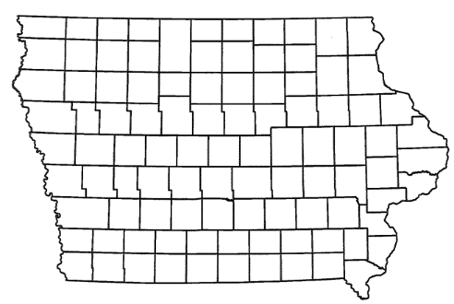
List of Immediate Opportunity Applications Recommended
PROJECT NAME
SPONSOR
JOBS
TOTAL PROJECT COST
PERCENT PARTICIPATION
RECOMMENDED AMOUNT
Widening of approximately 1,730 feet of Cumming Avenue and paving of 510 feet of 50th Street. | Cumming | 136 | $1,647,669 | 80% | $1,318,135

Slide 6
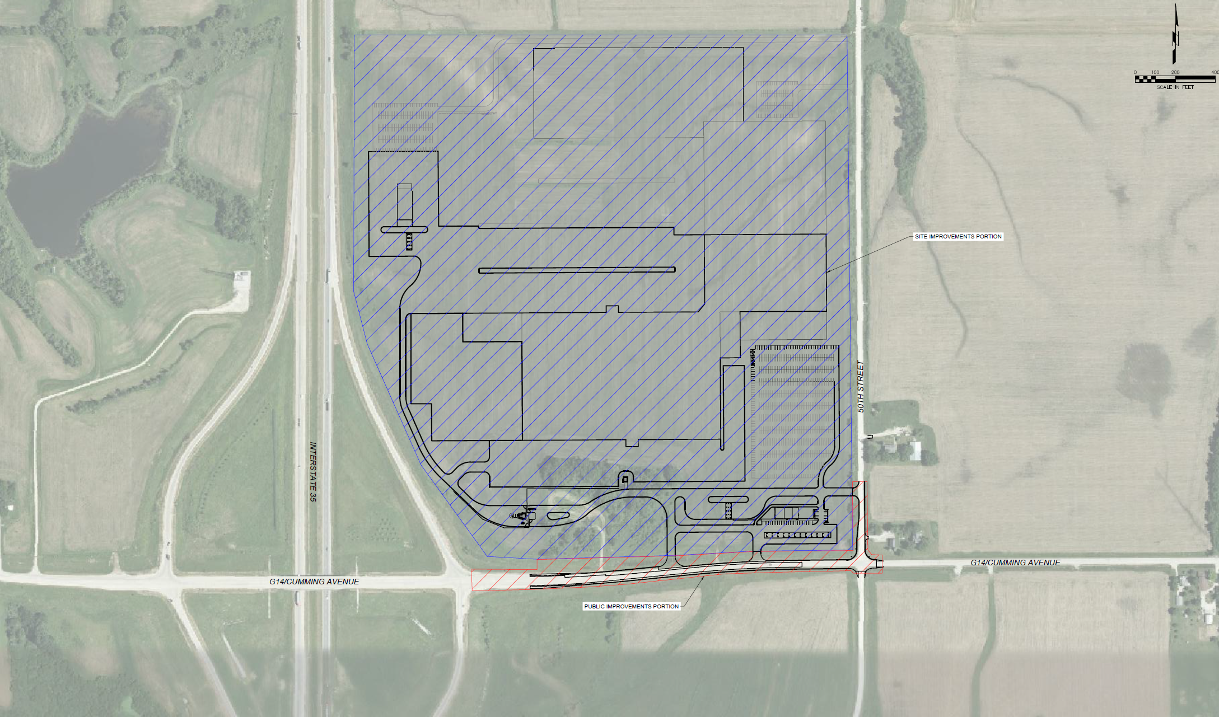
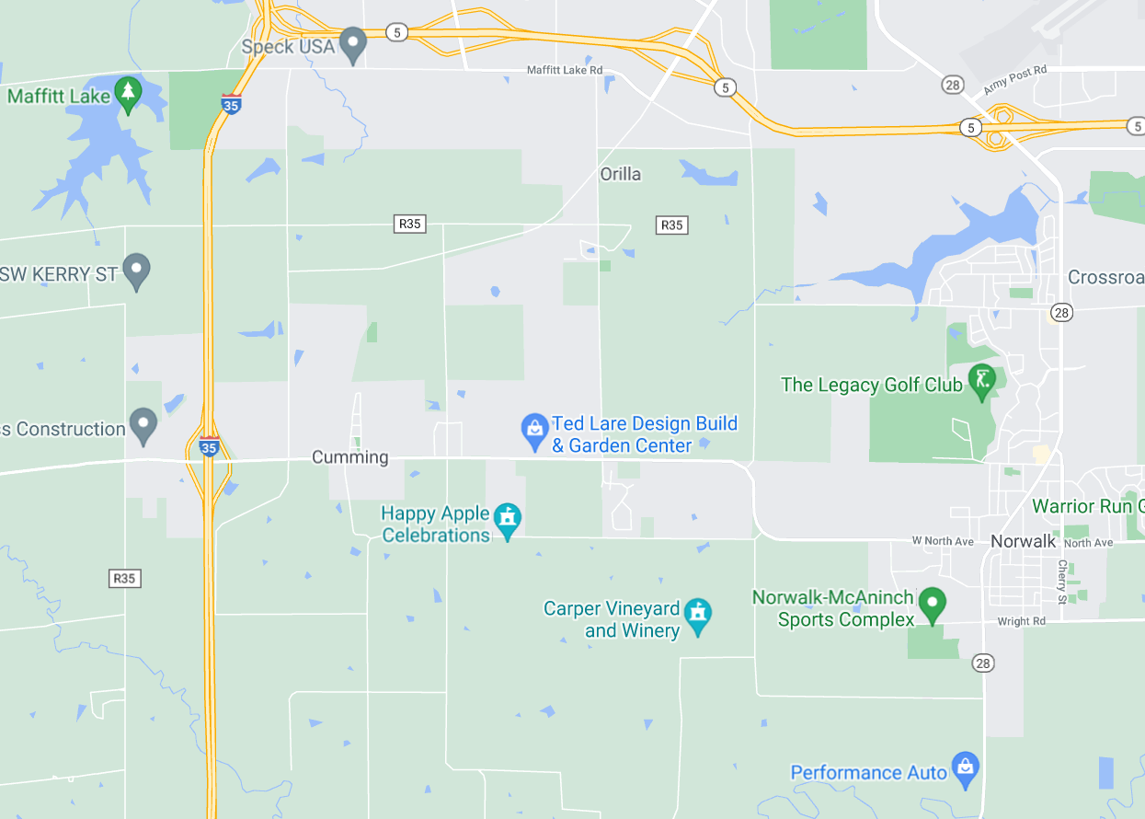
Cumming
(Immediate Opportunity)
Widening of approximately 1,730 feet of Cumming Avenue and paving of 510 feet of 50th Street located on the west side of town. This improvement is necessary to provide improved access to the proposed site of Hy-Vee Warehouse, a distribution warehouse and office.
Total Cost: $1,647,669 RISE Cost/Job Assisted: $9,692.17
Requested: $1,318,135 (80%) Capital Investment/RISE $: $102.67
Jobs Created: 136 Company Average Wages: $24.48 (101% of laborshed)

Slide 7
Local Development Project Evaluation Criteria
Development Potential (35 points)
Economic impact and Cost Effectiveness (20 points)
Local Commitment and Initiative (33 points)
Transportation Need and Justification (4 points)
Local Economic Need (6 points)

Slide 8
List of Local Development Applications Recommended
PROJECT NAME
SPONSOR
SCORE
TOTAL PROJECT COST
PERCENT PARTICIPATION
RECOMMENDED AMOUNT
To pave approximately 1,545 feet of Blue Grass Road. | Mt. Pleasant | 44 | $509,604 | 50% | $254,802

Slide 9
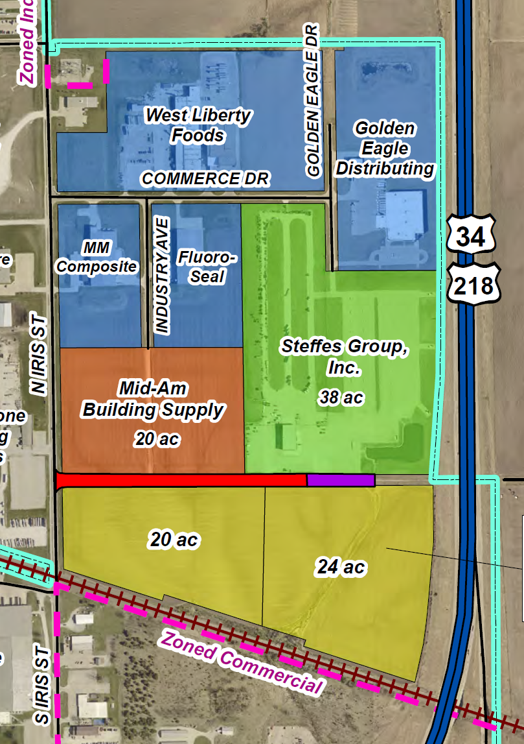
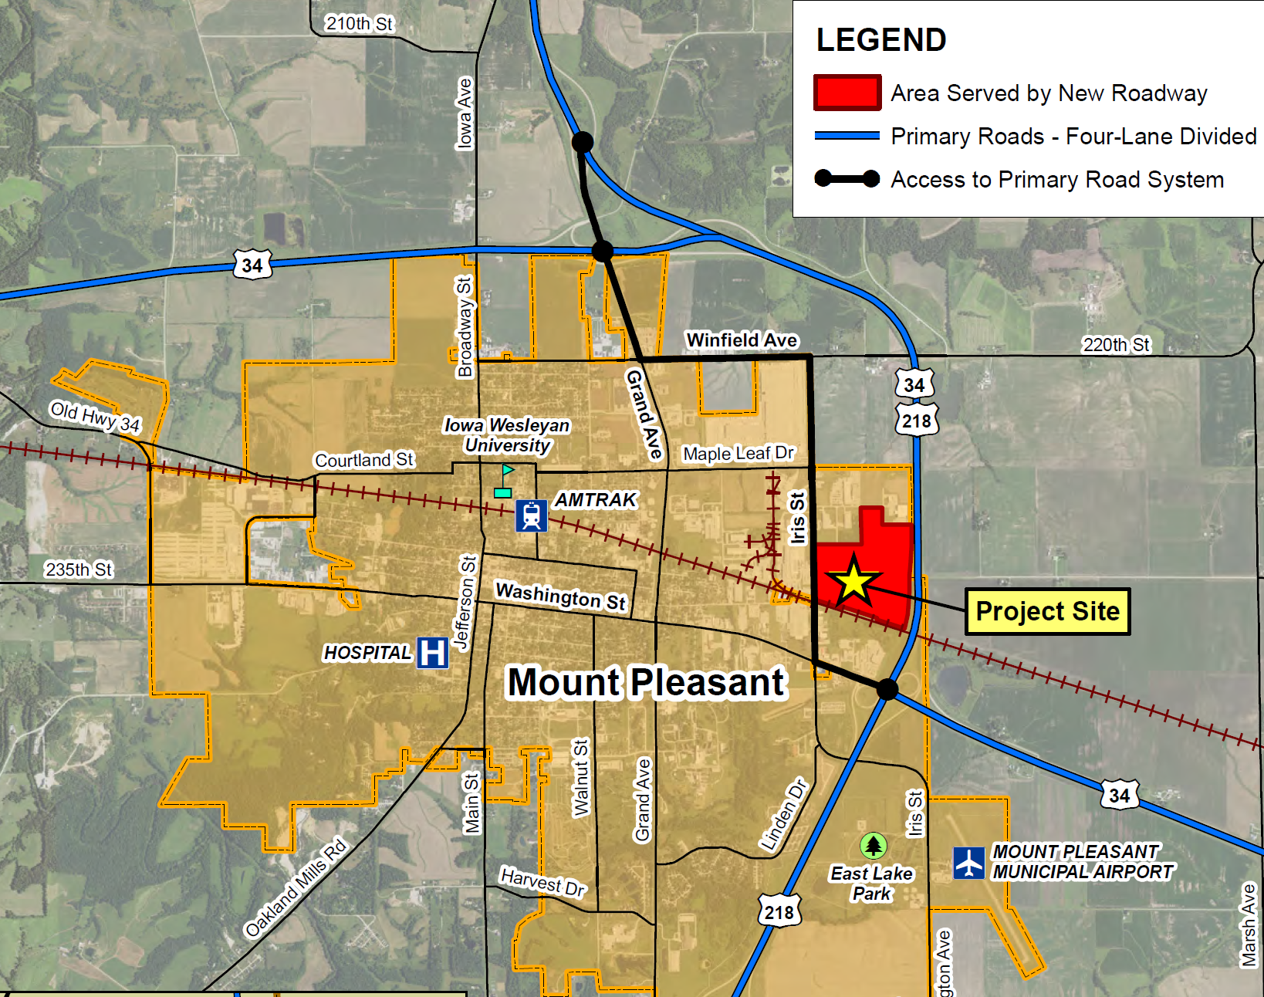
Mt. Pleasant
(Local Development)
Paving of approximately 1,545 feet of Blue Grass Road located on the northeast side of town. This project is necessary to provide access to two lots totaling more than 44 acres for industrial purposes.
Total Cost: $509,604
Requested: $254,802 (50%)

Slide 10
QUESTIONS?
Craig Markley, Systems Planning Bureau
craig.markley@iowadot.us
515-239-1027

