Slide 1
Traffic Safety Improvement Program
Funding Recommendation
FY 2024

Slide 2
Background
Established in 1987 by Iowa Legislature
Iowa Code Section 312.2 and Administrative Rules 761 Chapter 164
0.5% of Road Use Tax Fund
Purpose: Implement traffic safety features in order to reduce fatalities and serious injuries
Available to all public entities responsible for public roads and streets

Slide 3
Funding Categories
Site-Specific Improvements
Construction projects to improve traffic safety and operations
Annual funding varies, generally $6-$7 million
Traffic Control Devices
For purchase of traffic control device materials
Annual funding = $500,000
Studies & Outreach
Traffic safety research, studies, and public information initiatives
Annual funding = $500,000
Listing of applications can be found at this link:
https://iowadot.gov/traffic/Traffic-and-Safety-programs/TSIP/TSIP-Program

Slide 4
Application Review/Scoring
Demonstrated relationship to traffic safety
Safety benefit
Project cost
Type of countermeasure(s) proposed
Risk factor(s) addressed
Safety engineering analysis
Multi-agency committee input
Funding subject to agreement execution

Slide 5
Application/Funding Summary
Application Summary
Applications received: 33
TSIP funds requested: $10,535,997
Available Funding
FY 2024 TSIP estimated appropriation: $8,062,723
Total funding recommended: $7,901,027
Notes:
32 site specific applications
Total requests $12,703,028
15 traffic control device applications
Total requests $1,951,290
1 study application
Total request $500,000

Slide 6
Site-Specific Improvements Funding Recommendation
PROJECT NAME | SPONSOR | SCORE | TOTAL PROJECT COST | REQUESTED AMOUNT (% of Total Project Cost) | RECOMMENDED AMOUNT (% of Total Project Cost)
J46 – edge treatments | Appanoose County | High | $2,806,120 | $500,000 (18%) | $500,000 (18%)
B20 – edge treatments | Cerro Gordo County | High | $237,659 | $225,693 (95%) | $225,693 (95%)
E University Ave – lane conversion | City of Des Moines | High | $900,000 | $500,000 (56%) | $500,000 (56%)
Hammond Ave and Shaulis Rd– roundabout | City of Waterloo | High | $1,350,000 | $500,000 (37%) | $500,000 (37%)
US 63 – lane conversion | Iowa DOT -District 1 | High | $1,324,568 | $500,000 (38%) | $500,000 (38%)
US 20 and S27 interchange– interchange lighting | Iowa DOT -District 1 | High | $115,000 | $115,000 (100%) | $115,000 (100%)

Slide 7
Site-Specific Improvements Funding Recommendation
PROJECT NAME | SPONSOR | SCORE | TOTAL PROJECT COST | REQUESTED AMOUNT (% of Total Project Cost) | RECOMMENDED AMOUNT (% of Total Project Cost)
Apple Rd – edge treatments | Fayette County | High | $1,026,433 | $402,958 (39%) | $402,958 (39%)
G76– edge treatments | Marion County | High | $537,545 | $500,000 (93%) | $500,000 (93%)
T15 – edge treatments | Marion County | High | $365,439 | $365,439 (100%) | $365,439 (100%)
G36 – edge treatments | Washington County | High | $789,254 | $500,000 (63%) | $500,000 (63%)
Johnson Ave NW and 18 St NW– roundabout | City of Cedar Rapids | Med | $965,366 | $500,000 (52%) | $500,000 52%)
S 19 St and Manufacturing Dr – roundabout | City of Clinton | Med | $1,305,555 | $500,000 (38%) | $500,000 (38%)

Slide 8
Site-Specific Improvements Funding Recommendation
PROJECT NAME | SPONSOR | SCORE | TOTAL PROJECT COST | REQUESTED AMOUNT (% of Total Project Cost) | RECOMMENDED AMOUNT (% of Total Project Cost)
SE 36 St and Army Post Rd – roundabout | City of Des Moines | Med | $2,200,000 | $500,000 (23%) | $500,000 (23%)
IA 100 and East Post Rd – left turn lanes | City of Marion | Med | $985,000 | $500,000 (51%) | $500,000 (51%)
V66 – lane widening/edge treatments | Iowa County | Med | $2,900,461 | $440,446 (15%) | $440,446 (15%)
C30 and K64 – edge treatments/reconstruction | Plymouth County | Med | $640,250 | $500,000 (78%) | $500,000 (78%)

Slide 9
Traffic Control Devices Funding Recommendation
PROJECT NAME | SPONSOR | SCORE | TOTAL PROJECT COST | REQUESTED AMOUNT (% of Total Project Cost) | RECOMMENDED AMOUNT (% of Total Project Cost)
Flashing Beacons and Intersection Warning Signs | City of Clear Lake | Med | $26,190 | $26,190 (100%) | $15,090 (57%)
RRFB Ped Crossing | City of Garnavillo | Med | $106,800 | $90,800 (85%) | $30,000 (30%)
Speed Feedback Signs | City of Moravia | Med | $10,419 | $9,000 (86%) | $9,689 (93%)
Pedestrian Signals and Battery Backup | City of Newton | Med | $102,420 | $102,420 (100%) | $102,420 (100%)
Speed Feedback Signs | City of Sutherland | Med | $6,180 | $6,180 (100%) | $5,990 (97%)
Flashing Beacons | City of Vincent | Med | $4,350 | $4,350 (100%) | $4,350 (100%)

Slide 10
Traffic Control Devices Funding Recommendation
PROJECT NAME | SPONSOR | SCORE | TOTAL PROJECT COST | REQUESTED AMOUNT (% of Total Project Cost) | RECOMMENDED AMOUNT (% of Total Project Cost)
Speed Feedback Signs | Iowa DOT – District 1 | Med | $5,000 | $5,000 (100%) | $5,000 (100%)
Blinking LED Wrong Way Signs | Iowa DOT - TAS | Med | $100,000 | $50,000 (50%) | $50,000 (50%)
Portable Temporary Traffic Signals | Pottawattamie County | Med | $51,300 | $51,300 (100%) | $51,300 (100%)
Flashing Beacon and Radar Detection | Poweshiek County | Med | $6,000 | $6,000 (100%) | $2,900 (48%)
Flashing Beacon and Radar Detection | Tama County | Med | $9,000 | $9,000 (100%) | $2,900 (32%)
Portable Temporary Traffic Signals | Webster County | Med | $62,700 | $62,700 (100%) | $62,700 (100%)

Slide 11
Traffic Control Devices Funding Recommendation
PROJECT NAME | SPONSOR | SCORE | TOTAL PROJECT COST | REQUESTED AMOUNT (% of Total Project Cost) | RECOMMENDED AMOUNT (% of Total Project Cost)
Reflective Strips | Webster County | Med | $9,152 | $9,152 (100%) | $9,152 (100%)

Slide 12
Studies & Outreach Funding Recommendation
PROJECT NAME
REQUESTED AMOUNT
RECOMMENDED AMOUNT
Studies Program | $500,000 | $500,000

Slide 13
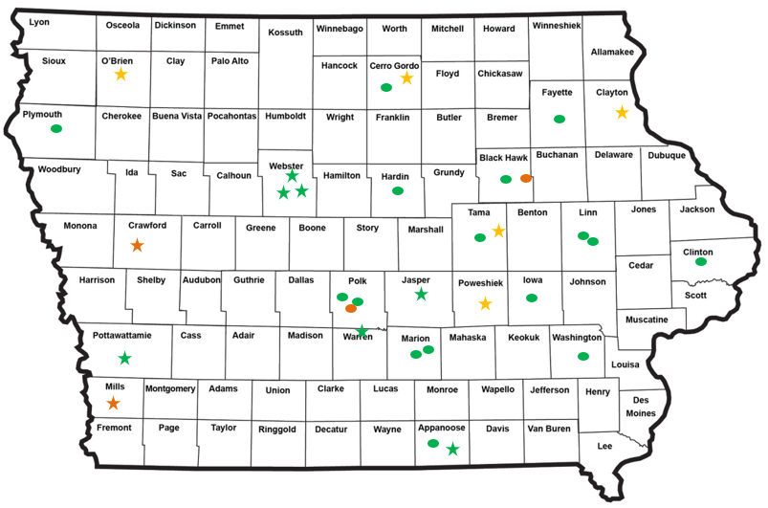
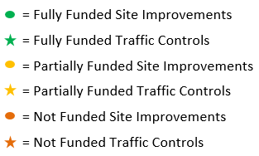
Map of Applications Received

Slide 14
QUESTIONS?
Jan Laaser-Webb, Traffic and Safety Bureau
jan.laaser-webb@iowadot.us
515-239-1349

Slide 15
Site-Specific Improvements Applications Not Recommended for Award
REQUESTED AMOUNT
(% of Total Project Cost)
RECOMMENDED AMOUNT
(% of Total Project Cost)
PROJECT NAME
SPONSOR
SCORE
TOTAL PROJECT COST
8 St SE and 8 Ave SE – roundabout | City of Altoona | Med-low | $3,380,723 | $316,040 (9%) | $0 (0%)
US 63 and Sycamore St – signals | City of Waterloo | Low | $251,000 | $251,000 (100%) | $0 (0%)
Return to Recommendation Summary

Slide 16
Traffic Control Devices Applications Not Recommended for Award
REQUESTED AMOUNT
(% of Total Project Cost)
RECOMMENDED AMOUNT
(% of Total Project Cost)
PROJECT NAME
SPONSOR
SCORE
TOTAL PROJECT COST
Ped Signals and Advanced Video/Radar Detection | City of Denison | Low | $359,000 | $250,000 (70%) | $0 (0%)
Install Traffic Signal, Flashing Yellow Arrow Conversion, and Battery Backups | Mills County | Low | $30,820 | $30,820 (100%) | $0 (0%)
Return to Recommendation Summary

