Slide 1
LIFTS Program Funding Recommendation
2022 Funding Cycle – November 8, 2022

Slide 2
Linking Iowa’s Freight Transportation System Program
Fixing America’s Surface Transportation (FAST) Act signed into law in 2015.
Expands the eligibility of multimodal freight projects for federal transportation funding through the establishment of the National Highway Freight Program (NHFP)
The Bipartisan Infrastructure Law (BIL-2021) allows up to 30% of a state’s NHFP to be used on freight intermodal or freight rail projects.
Transportation Commission chose to award up to 10% of Iowa’s NHFP through the administration of the LIFTS competitive funding program.
Current funding round has up to $1.7 million available.
Notes:
This current round of funding we bring to you today utilizes Federal funding which comes from Iowa’s 10% National Highway Freight Program apportionment set fourth in the FAST ACT, and included in the Bipartisan Infrastructure Law signed in 2021. The LIFTS program is a competitive, application-based grant program and its purpose is to provide grant funding for multi-modal freight projects that have economic and public benefit by enhancing the shipment of freight within the state, but are typically ineligible for traditional state or federal highway funding.
For this 2022 round we have approximately $1.7 million dollars to award.

Slide 3
LIFTS Purpose:
The purpose of the LIFTS program is to provide grants for projects that help meet the changing demands of Iowa’s multimodal freight system. The funding program is designed to:
Enhance economic development by improving the multimodal freight transportation system.
Provide flexible funding for the changing demands of the freight transportation system.
Enhance the ability to provide competitive transportation options for shipment of products and moving goods.
Provide incentives to alternate modes for economic development opportunities.
Notes:
The program will provide funding for freight projects that have economic and public benefit by enhancing the shipment of freight but are typically ineligible for state or federal highway funding.

Slide 4
LIFTS Project Requirements:
All FHWA federal aid funding requirements apply, including:
Federal Requirements, Standards and Guidelines
Environmental reviews
Compliance with FHWA Buy America
Letting through the Iowa DOT
Match Requirements:
Public applicants or public/private partnership applicants are eligible for up to 80% project cost reimbursement
Private applicants are eligible for up to 50% project cost reimbursement
Horizontal infrastructure for construction of surface transportation facilities is eligible. Vertical infrastructure, such as buildings, is not eligible.
Notes:
The federal funding comes from FHWA, so federal aid project requirements for FHWA funded projects apply to LIFTS projects. These include: adherence to federal standards, environmental reviews, compliance with FHWA’s Buy America and letting through the Iowa Dot.
The match for LIFTS projects varies according to the project sponsor.
Public or public/private partnerships -eligible for up to 80% project cost reimbursement
Private applicants are eligible for up to 50% project cost reimbursement
In order to better meet the FHWA Buy America requirements, Iowa DOT is limiting LIFTS projects to horizontal infrastructure.

Slide 5
Project Evaluation Criteria
Freight mobility Benefits (25%)
Economic Benefits (25%)
Public Benefits (20%)
Project Readiness (20%)
Innovation/Process Improvement (10%)
Notes:
An application is required in order to submit for LIFTS funding. Once applications are received, an evaluation team is identified and we review each application and evaluate them based on these five categories that are weighted as shown.
Freight Mobility Benefits (25%): applicant must document how the proposed project will increase freight mobility
Economic Benefits (25%): applicant must document how the proposed project will impact the local, regional, and or national economy, provide a cost savings to shippers.
Public Benefits (20%): Applicant must document how the proposed project will benefit other transportation users, provide environmental benefits, and enhance the quality of life or improve safety.
Project Readiness (20%): The applicant must realistically document how prepared the project is to begin – higher weight because of timelines to utilize federal funding
Innovation/Process Improvement (10%): The project must document any innovative/new technologies being used, how novel the construction/project management process.
Application incorporates questions for each category to help with the evaluation.

Slide 6
Available Funding and Application Summary
Available Funding
2022 $1.7 million
Application Summary
Total number of projects: 5
Total project costs: $17,009,573
Total amount requested: $8,504,787
Notes:
For this year’s round we received 5 applications to evaluate. Total project cost for this project is $xxxx million, and the total amount requested is roughly $xxxxxmillion. Today we are recommending this project for a full grant award.

Slide 7
Applications Received and Recommended for Award
REQUESTED AMOUNT
(% of Total Project Cost)
RECOMMENDED AMOUNT
(% of Total Project Cost)
PROJECT NAME
SPONSOR
TOTAL PROJECT COST
ISRY Tie Rehabilitation Project (Appanoose County) | Iowa Southern Railway Company (ISRY) | $661,869 | $330,935 (50 %) | $330,935 (50%)
Notes:
We are recommending that one project be awarded funding.
The applicant is Iowa Southern Railway Company, located in Centerville, Iowa. ISRY began leasing this rail line from Appanoose County Community Railroad in 2016. With the increase in business over the last several years, there has been more wear and tear on the track and in order to continue the level of service and continue to grow the customer base it is imperative that ties are replaced in several areas that are at a higher risk of derailments that in turn cause service disruptions and create a safety issue. The scope of work for this project involves tie replacement and anchoring of up to 5,000 new cross ties (8'x6"x9"x7"), 10,000 new rail anchors and 20,000 new track spikes between Mile Post 9 to Mile Post 19 that spans between Centerville, IA and Moravia, IA. Within the 10-mile area there are approximately five (5) separate locations where the ties would be installed.
Staff recommends a full grant in the amount of $330,935.
(if asked, project was scored at 55/100)

Slide 8
Applications Received and Not Recommended for Award
REQUESTED AMOUNT
(% of Total Project Cost)
RECOMMENDED AMOUNT
(% of Total Project Cost)
PROJECT NAME
SPONSOR
TOTAL PROJECT COST
Hancock Grain Expansion (Pottawattamie County) | The Scoular Company | $8,300,000 | $4,150,000 (50 %) | 0 (0%)
Central Iowa’s Railport & Logistics Park - Phase 2 (Polk County) | Ten D / Merchants Distribution Service | $3,400,000 | $1,700,000 (50 %) | 0 (0%)
North Fleet, William E Dock & South Fleet (Jackson County) | Lawson Marine Services | $4,544,304 | $2,272,152 (50 %) | 0 (0%)
Rail Spur Improvement in Stuart (Adair County) | Wausau Supply Company | $103,400 | $51,700 (50 %) | 0 (0%)
Notes:
Four other project applications were received and not recommended for funding.
Each project was thoroughly reviewed and discussed with the project sponsor. Although there are potential freight transportation benefits to each project, each is not recommended for LIFTS for due to anticipated difficulties in completing project development utilizing the restrictive FHWA funding. Noted issues include; inclusion of vertical infrastructure which would be difficult to comply with FHWA Buy America, federalizing the entire development thus encumbering current and future development, and the relative size of project related to the cost to comply with federal funding development requirements.

Slide 9
Map of Applications Received
Application received and award recommended
Application received and not recommended for funding
Notes:
Just a slide showing where within the state we received applications from this year.

Slide 10
QUESTIONS?
Tammy Nicholson, Modal Transportation Bureau
Tamara.nicholson@iowadot.us
515-239-1052

Slide 11
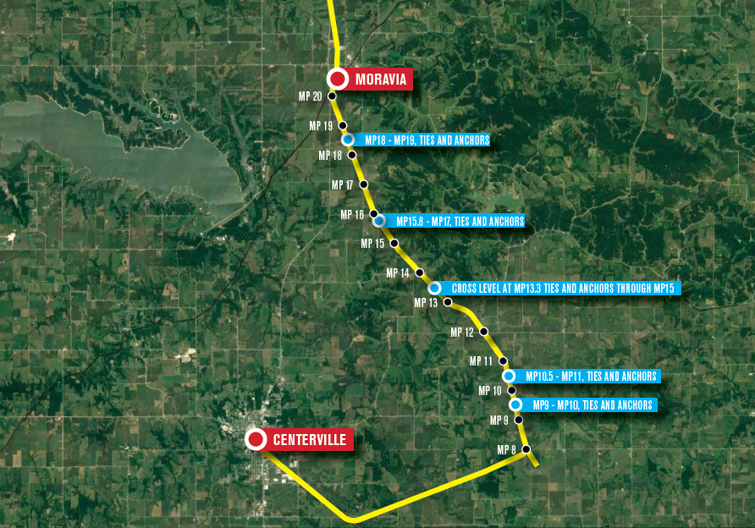
ISRY Tie Rehabilitation Project (Appanoose County): Iowa Southern Railway Company (ISRY)
ISRY began leasing this rail line from Appanoose County Community Railroad in 2016. With the increase in business over the last several years, there has been more wear and tear on the track and in order to continue the level of service and continue to grow the customer base it is imperative that ties are replaced in several areas that are at a higher risk of derailments that in turn cause service disruptions and create a safety issue. The scope of work for this project involves tie replacement and anchoring of up to 5,000 new cross ties (8'x6"x9"x7"), 10,000 new rail anchors and 20,000 new track spikes between Mile Post 9 to Mile Post 19 that spans between Centerville, IA and Moravia, IA. Within the 10-mile area there are approximately five (5) separate locations where the ties would be installed.
Total Cost: $661,869
Requested: $330,935
(50%)

Slide 12
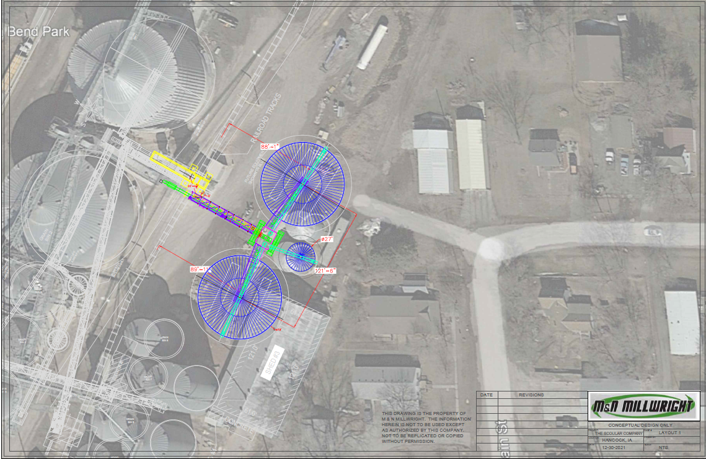
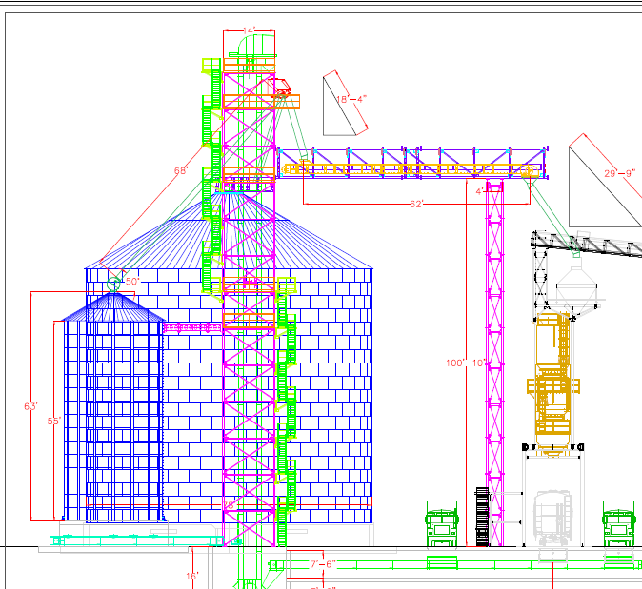
Hancock Grain Expansion (Pottawattamie County): The Scoular Company
Project is to increase grain storage and grain unloading/loadout capacity at the Hancock, Ia train loading
facility. The project includes the construction of two steel bins of 300,000 bushels capacity each, one 25,000-bushel bin, a 25,000 BPH receiving/loadout leg on the east side of the railroad tracks and two truck receiving pits. The project includes the construction of a steel building around our main grain receiving and loadout area. Lastly, the project includes hard surfacing of many of our roads.
Total Cost: $8,300,000
Requested: $4,150,000
(50%)

Slide 13
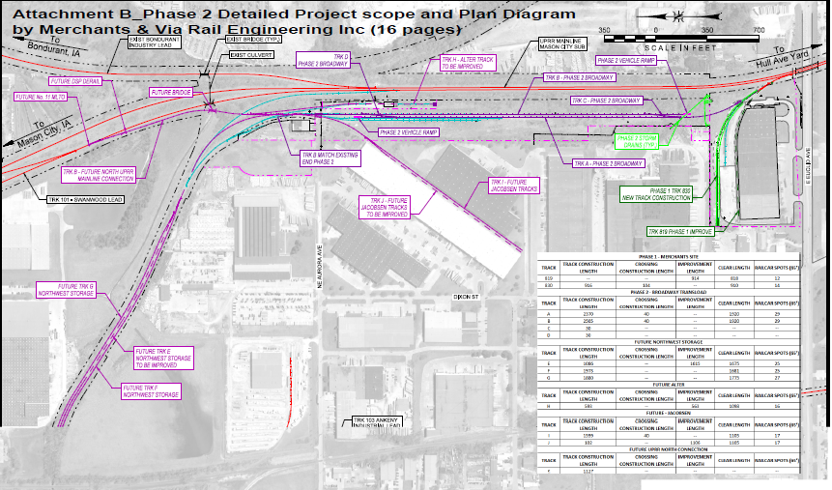
Central Iowa’s Railport & Logistics Park - Phase 2 (Polk County): Ten D / Merchants Distribution Service
This railport site is directly connected to UP Railroad in Central Iowa. Phase 2 would add 5,015 foot of new rail, plus make more accessible 8500 ft of other track (current and future), plus add market-needed yard, services, and storage options. This Project would also add additional trans-loading service capacities and capabilities. The site design also makes it easier, more flexible, safer, and faster for the RR to serve this location by adding siding-tracks and a south connection to the mainline (enabling the site to be served from the North and South).
Total Cost: $3,400,000
Requested: $1,700,000
(50%)

Slide 14
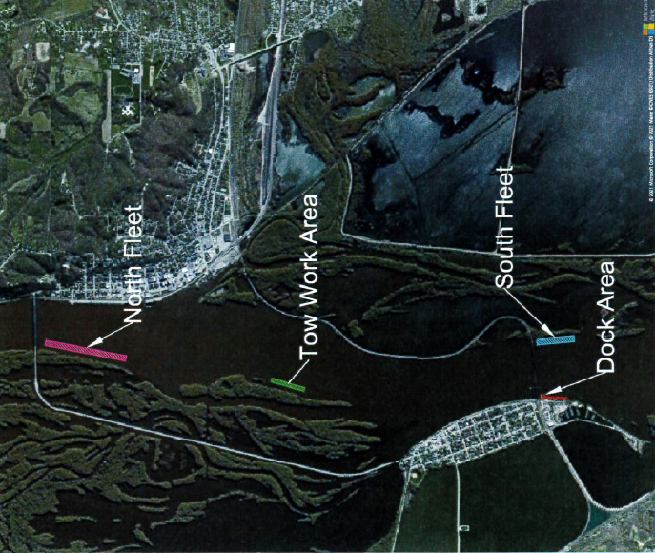
North Fleet, William E Dock & South Fleet (Jackson County): Lawson Marine Services
The project would provide a place for towboats to tie up between Lock 12 & 13 for work do be done on barges, during emergencies and weather issues when needed. The project would build the North Fleet allowing towboats to tie up for tow work, the William E Dock to allow for tugboat (Savanna-Sabula bridge) assists and barge work, and the South Fleet for fleeting barges for repair, cleaning and waiting for tows.
Total Cost: $4,544,304
Requested: $2,272,152
(50%)

Slide 15
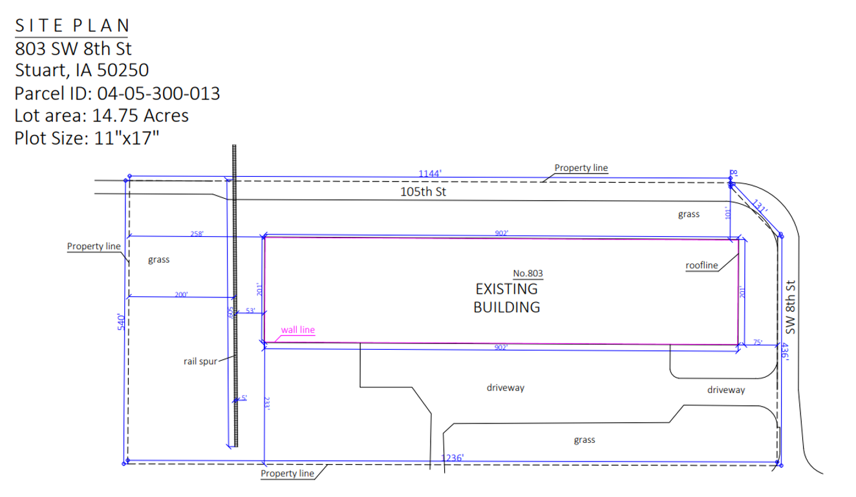
Rail Spur Improvement in Stuart (Adair County): Wausau Supply Company
The project would improve the grounds around the existing rail spur to facilitate a more safe and efficient work environment. This improved work area directly correlates to greater use of rail to reduce the amount of on-highway truckload mode usage.
Total Cost: $103,400
Requested: $51,700
(50%)

