Slide 1
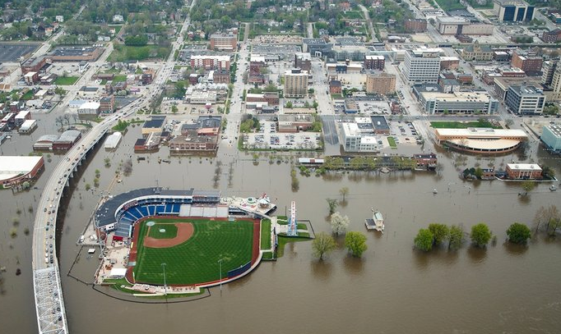
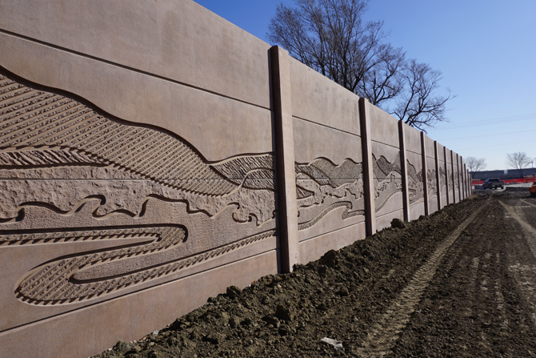
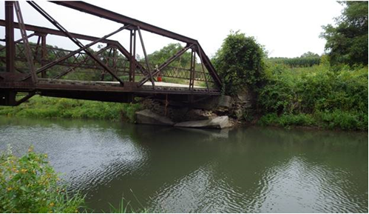
Five-Year Program – Resiliency
November 8th, 2022

Slide 2
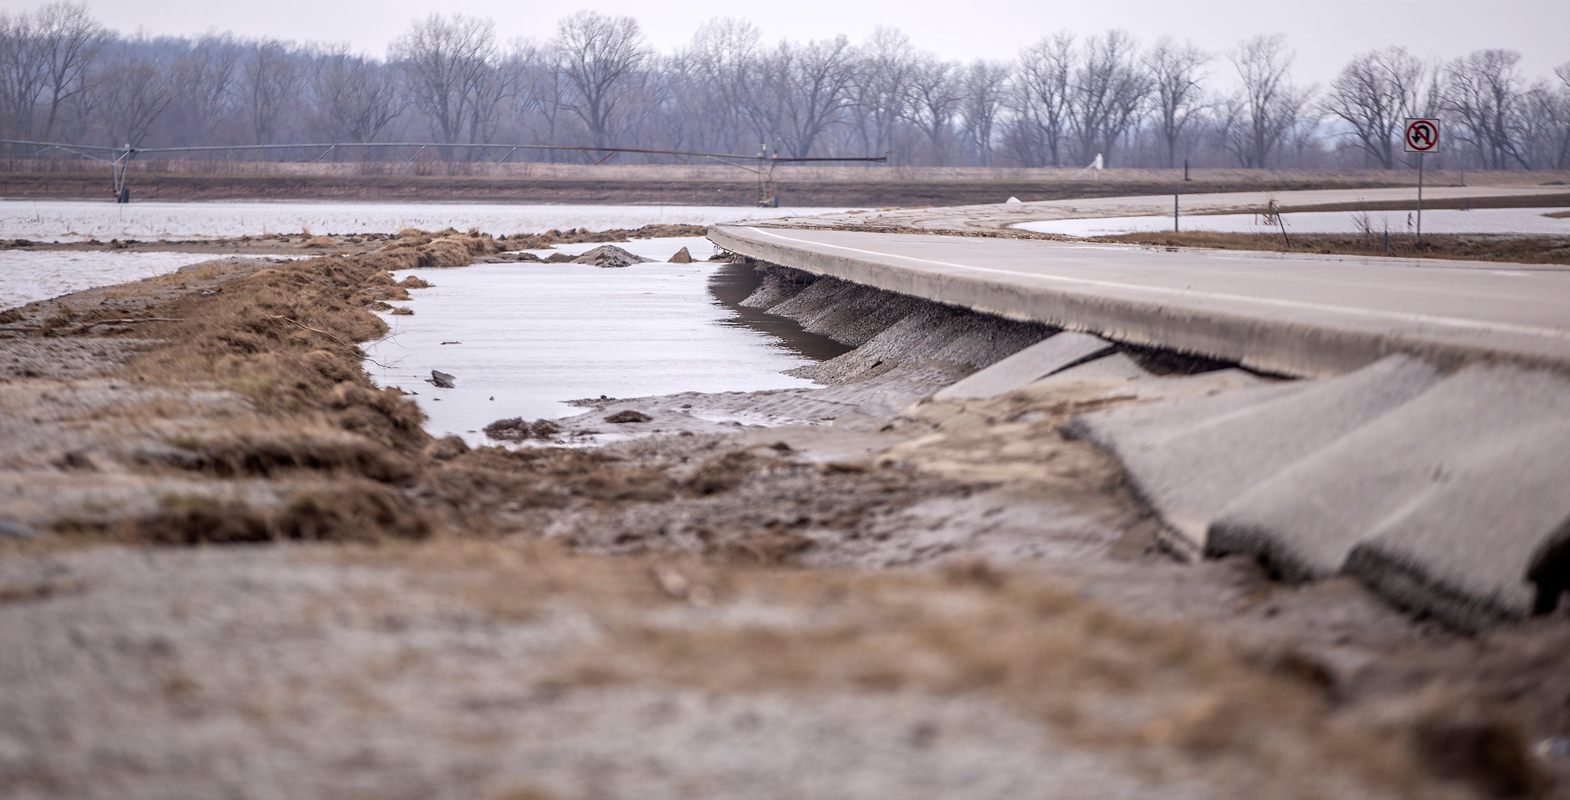
Defining
Resiliency
“The ability to anticipate, prepare for, and adapt to changing conditions and withstand, respond to, and quickly recover from disruptions.”
-Iowa DOT Resiliency Working Group (RWG)
Notes:
In defining resiliency, the Resiliency Working Group has adopted a similar definition as what other states and FHWA has and it reads as “Resiliency is the ability to anticipate, prepare for, and adapt to changing conditions and withstand, respond to, and quickly recover from disruptions.

Slide 3
Notes:
Here is a visual depiction of resiliency. Here we see that as a disruption occurs to a system or asset over time the performance of that system changes and moves through different phases. Every system or asset has a baseline level of performance with respect to any disruption. When a disruption occurs the system or asset will absorb some of the impact from the disruption but ultimately degradation of the performance of that system occurs. Following that period, there is usually a response to the disruption and then typically a period of recovery and adaptation. As you can see in some cases there’s potentially multiple trajectories where a system might in one case be improved to adapt to future disruptions and minimize the impacts or it is simply replaced as is and returned to its original level of performance and when similar disruptions occur degradation of the same magnitude will likely occur.

Slide 4
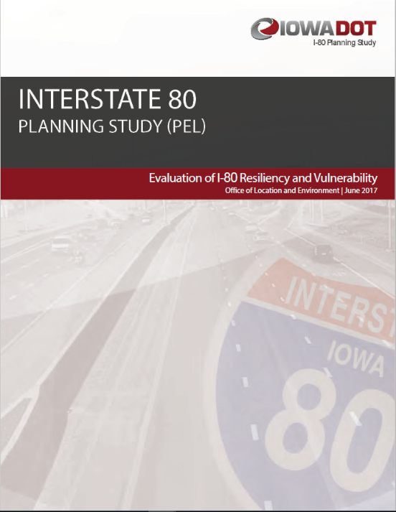
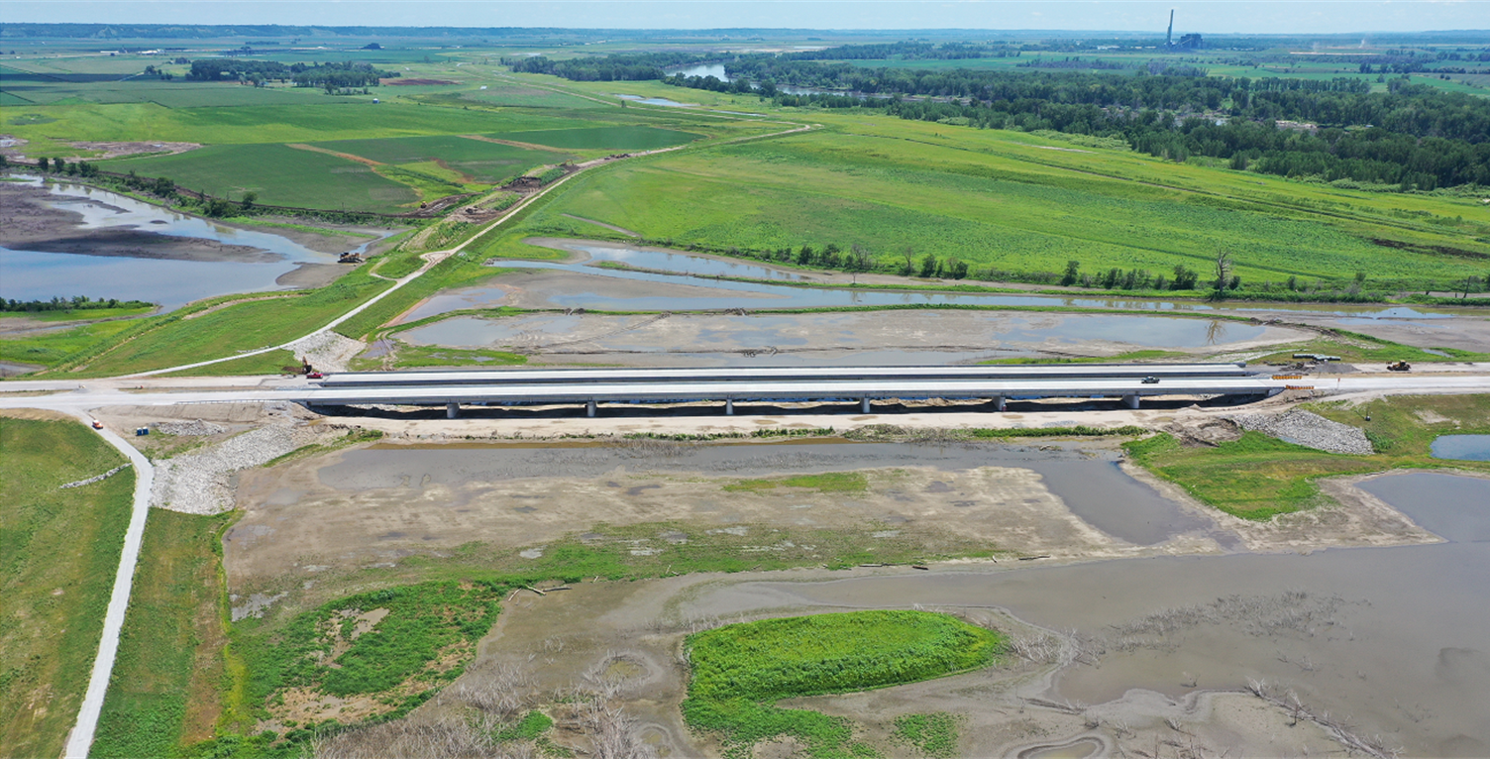
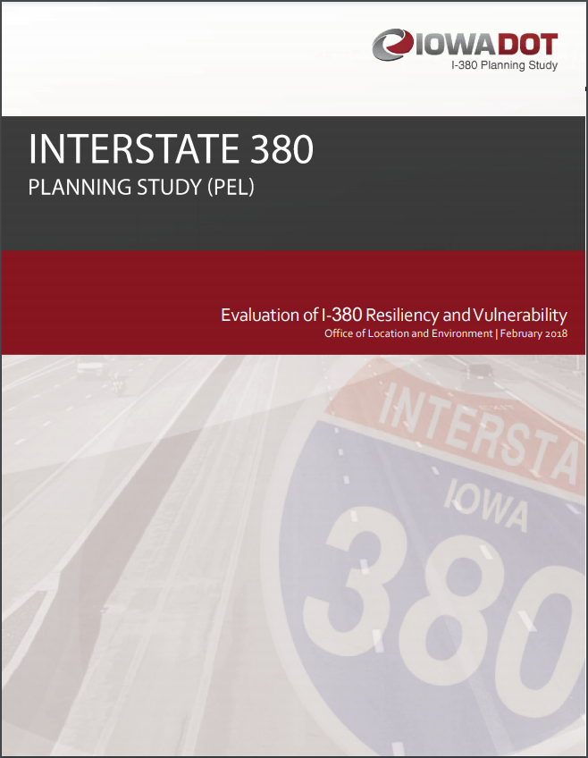
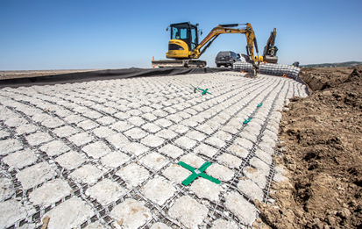
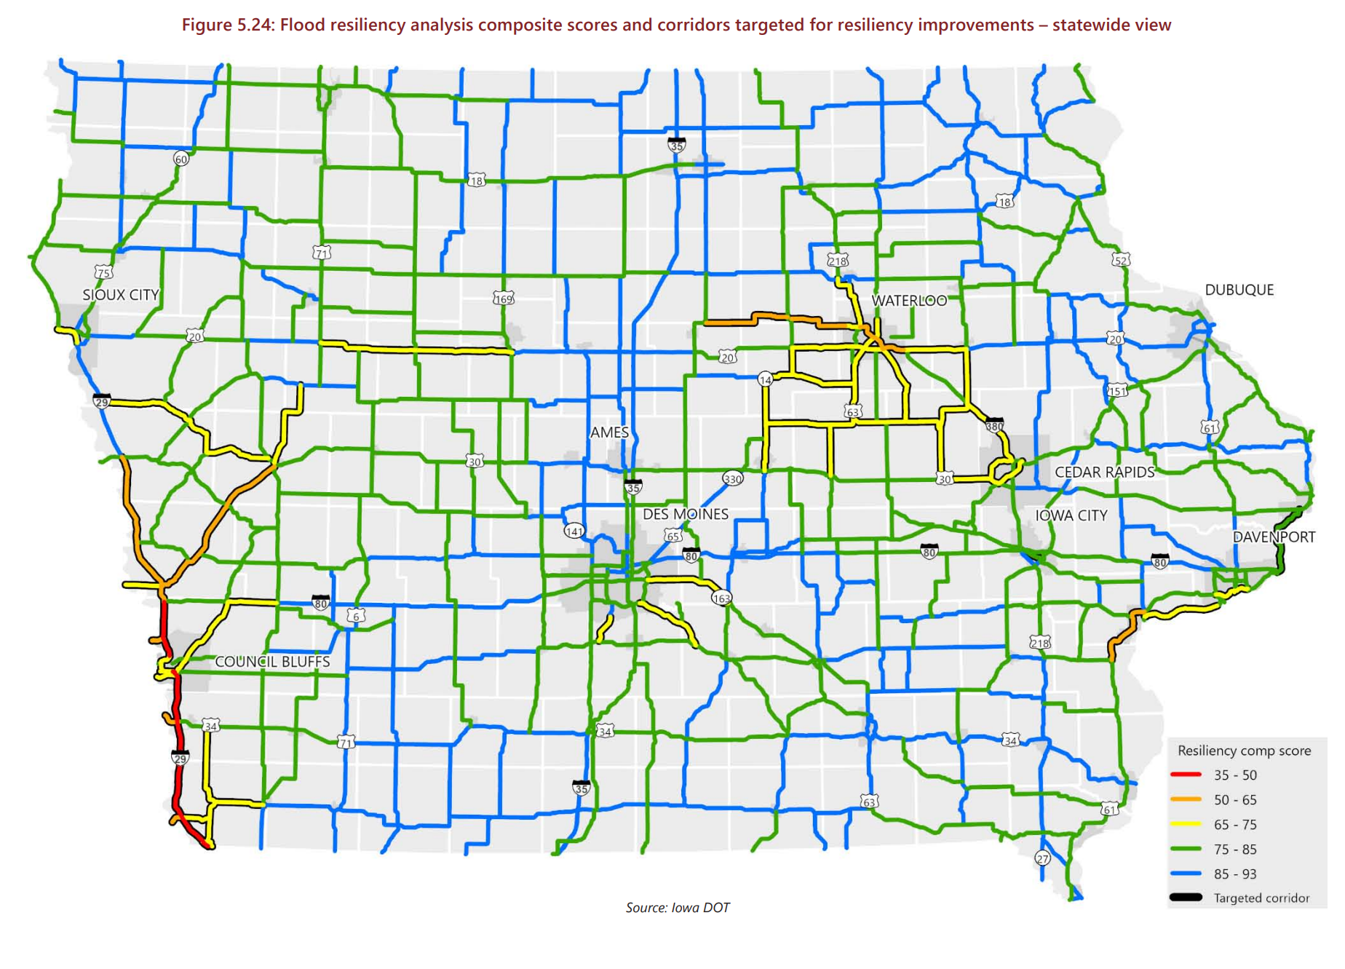
Recent Iowa DOT efforts
Notes:
Integrating resiliency into our projects and operations isn’t necessarily new for our department. We have been making resiliency type improvements to our system over the year’s but we just might not have called it a resiliency improvements. In the most recent years that has changed. For example, two of our more recent PEL studies included memorandums on Resiliency and vulnerability for Interstates 80 and 380. In terms of constructions projects some recent examples include the raising of the Iowa 2 bridge in Western Iowa and the Flexamat placed on I 680. We’ve also started to consider resilience in some of our recent planning and analysis as you can see in the middle you can see a screen shot of a statewide flood resiliency analysis that was developed for the most recent update of the state’s Long-Range Transportation Plan. The resiliency working group is also considering how the state will implement the PROTECT program that was established with the passage of IIJA. With that program there is a voluntary planning requirement that the RWG will start working on soon.

Slide 5
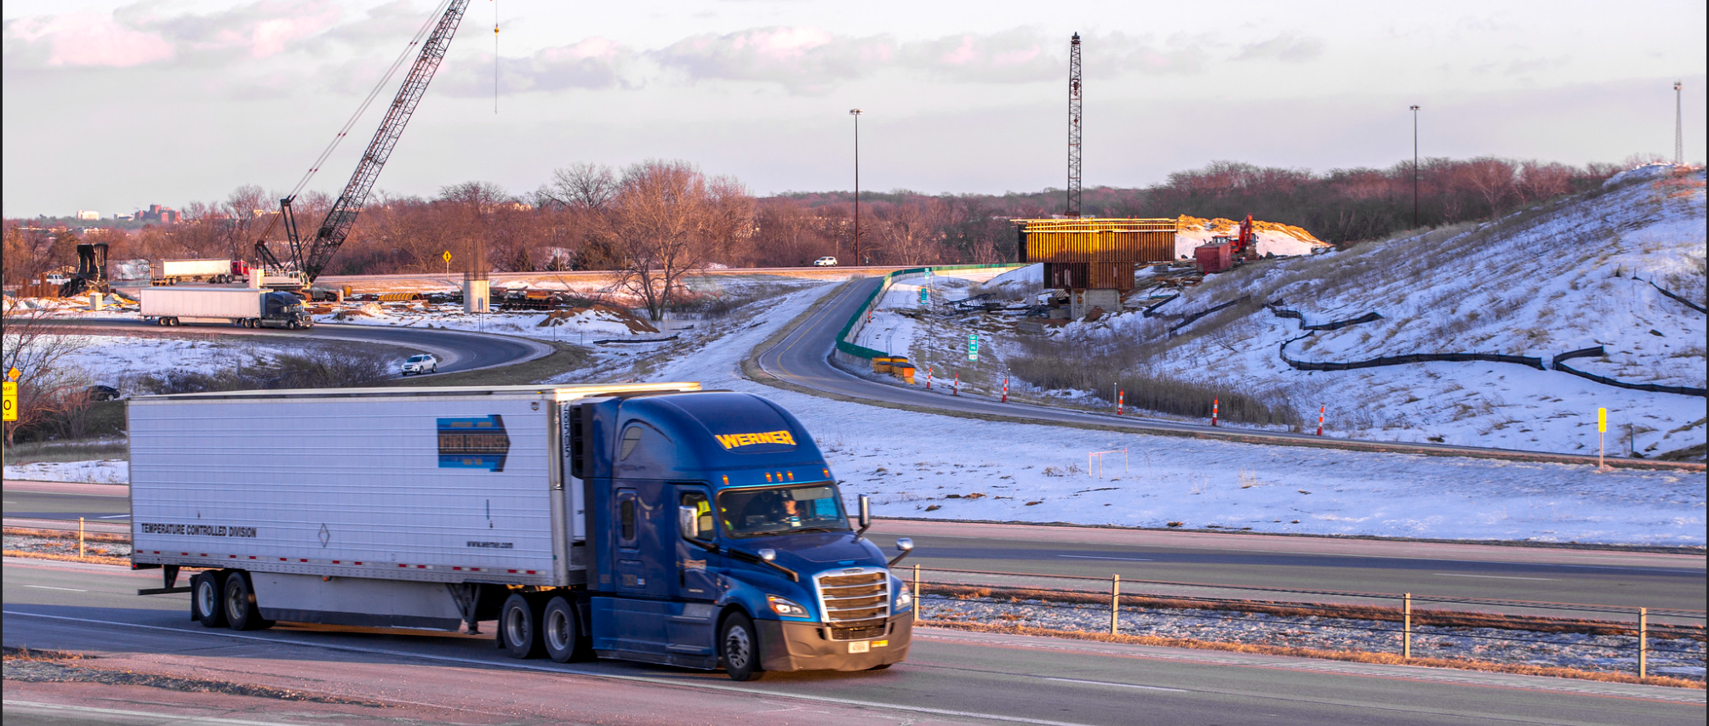
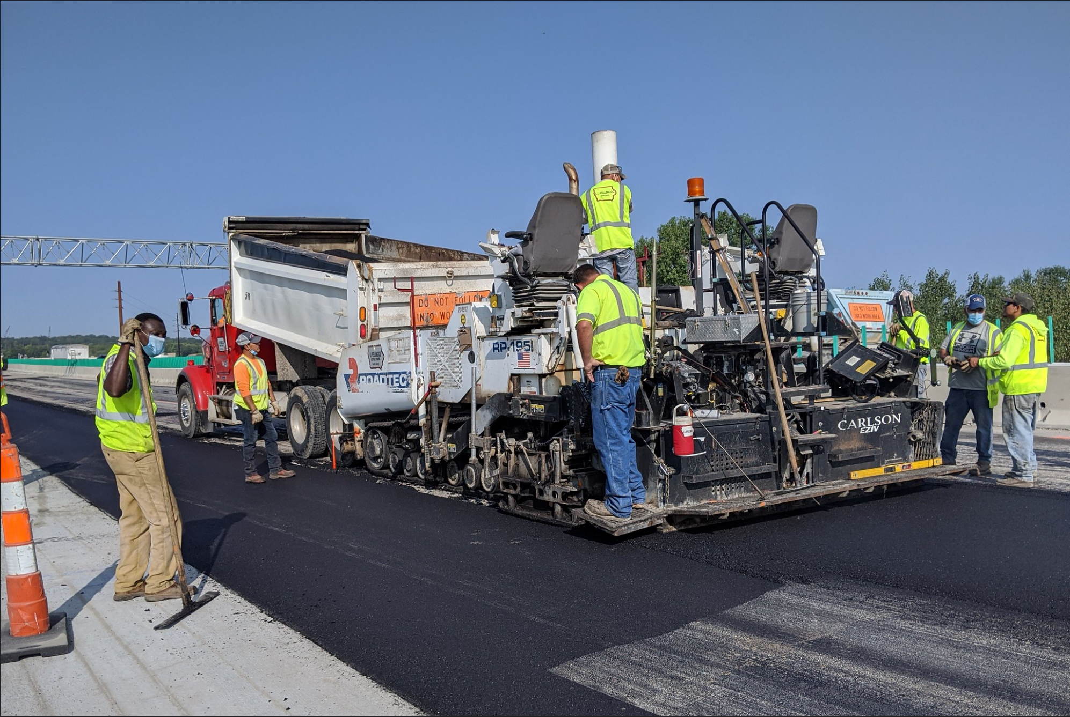
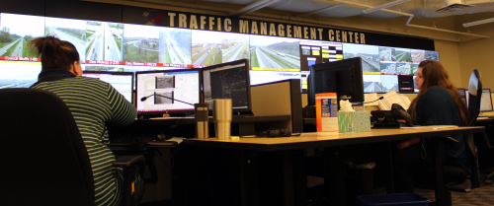
Beyond traditional resilience efforts
Operations & Freight
Workforce
Cybersecurity
Response and Enforcement
Notes:
The examples I have provide so far focus on some of the traditional transportation efforts you might see. But there has certainly been an increased focus on other aspects of resiliency in transportation. The Resiliency Working Group is exploring how to incorporate….
Operations and Freight
Ensuring that our system is available and operating to expected standards to allow freight and commerce to flow.
Workforce
It shouldn’t be to terribly surprising after a global pandemic that there has been a focus on the resiliency of the workforce in the transportation industry. For us that might mean how we work in unexpected circumstances to ensure our customer needs are being met or the future transition of a good chunk of our staff to retirement and how do we transfer that crucial knowledge to new employees.
Cybersecurity
Increasingly public agencies have faced pressure to bolster their cybersecurity protection and ensure that networks and servers remain online and are not compromised by hackers or ransomware. This is especially true as we move to a more online and digital services.
Response and enforcement
Finally, as an agency we have a duty to respond to traffic incidents on our roadway and enforce the rules of the road. When disruptions occur how can we respond and what resources can we leverage (such as our officers on the road and the TMC) to ensure the traveling public is safe and moving.

Slide 6
Iowa in Motion 2050
State long-range transportation plan (SLRTP)
Adopted by the Commission May 10, 2022
Key enhancements
Clearly defined system objectives
Expanded consideration and analysis of safety
Accessibility and equity considerations
Rightsizing policy guidance
Focus on infrastructure resiliency
Clarified role in project development
Notes:
State long-range transportation plan
Adopted May 2022
Federally required per Title 23 of United States Code
Also required per Iowa Code chapter 307A; formally adopted by the Iowa Transportation Commission
Updated every five years
Key enhancements include two areas of increasing emphasis: rightsizing policy guidance and a focus on infrastructure resiliency.
Early stakeholder exercises were conducted to determine the top transportation planning priorities to consider during SLRTP development.
Three asset management themes were in the top ten issues, including rightsizing by focusing on TSMO strategies and metrics like travel time reliability rather than expanding capacity.
Resiliency, specifically increasing system resiliency and proactively planning for extreme weather events, was the second highest rated issue.
The Iowa DOT has established working groups for both resiliency and sustainability. Both groups have begun meeting regularly, established charters, and are beginning work that will help more fully integrate these themes into Iowa DOT’s work.

Slide 7
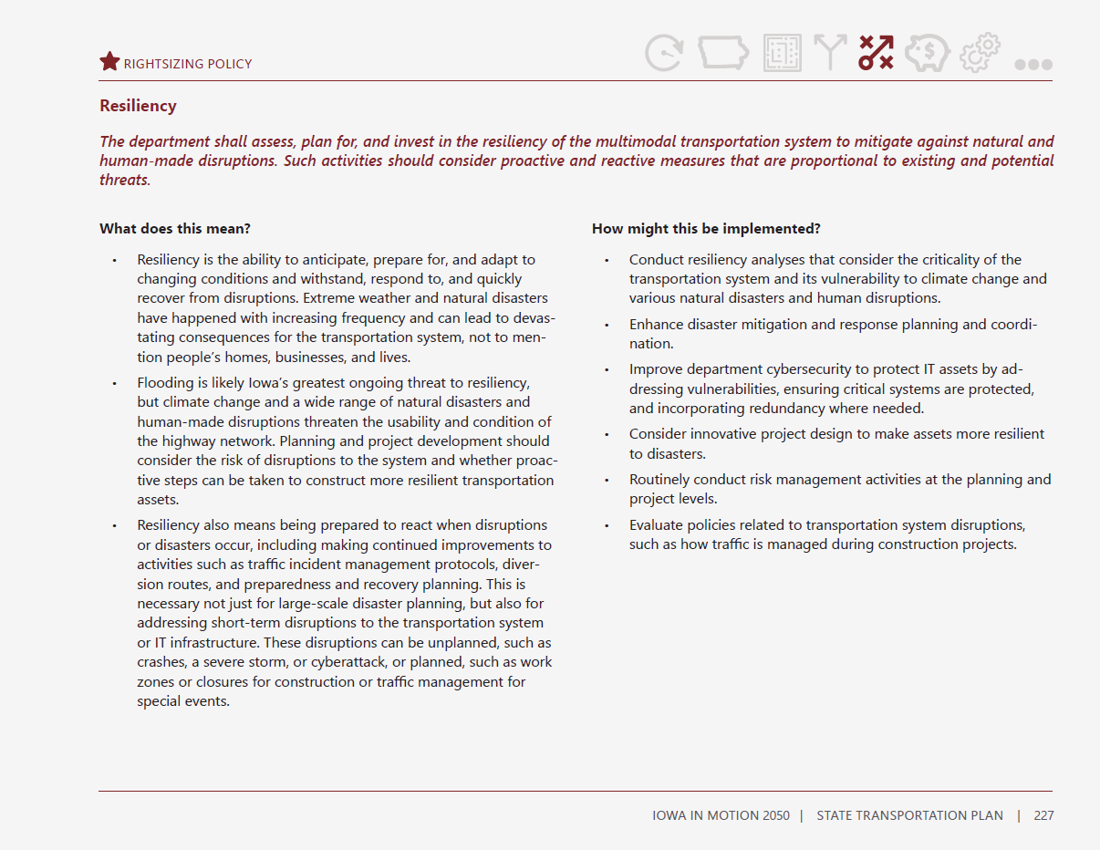
Resiliency policy statement
The department shall assess, plan for, and invest in the resiliency of the multimodal transportation system to mitigate against natural and human-made disruptions. Such activities should consider proactive and reactive measures that are proportional to existing and potential threats.
SLRTP discusses:
What this means
How it might be implemented
Notes:
One of the policy statements relates specifically to resiliency. The statement reads:
The department shall assess, plan for, and invest in the resiliency of the multimodal transportation system to mitigate against natural and human-made disruptions. Such activities should consider proactive and reactive measures that are proportional to existing and potential threats.
The SLRTP provides context for what this means and possible ways to implement it.
One of the ways identified to implement it is to conduct resiliency analyses that consider the criticality of the transportation system and its vulnerability to climate change and various natural disasters and human disruptions.
We have conducted this type of analysis for flood resiliency and included its output in the SLRTP.
Transition to Sturtz.

Slide 8
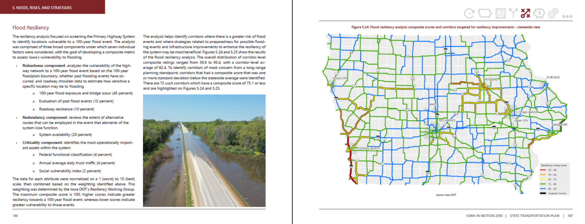
Translating analysis to the SLRTP
Notes:
This example spread from the SLRTP shows how each layer of analysis is represented in the plan – a one-page high-level summary of the methodology is provided, along with a statewide map of the output. Urban inset maps are also included.

Slide 9
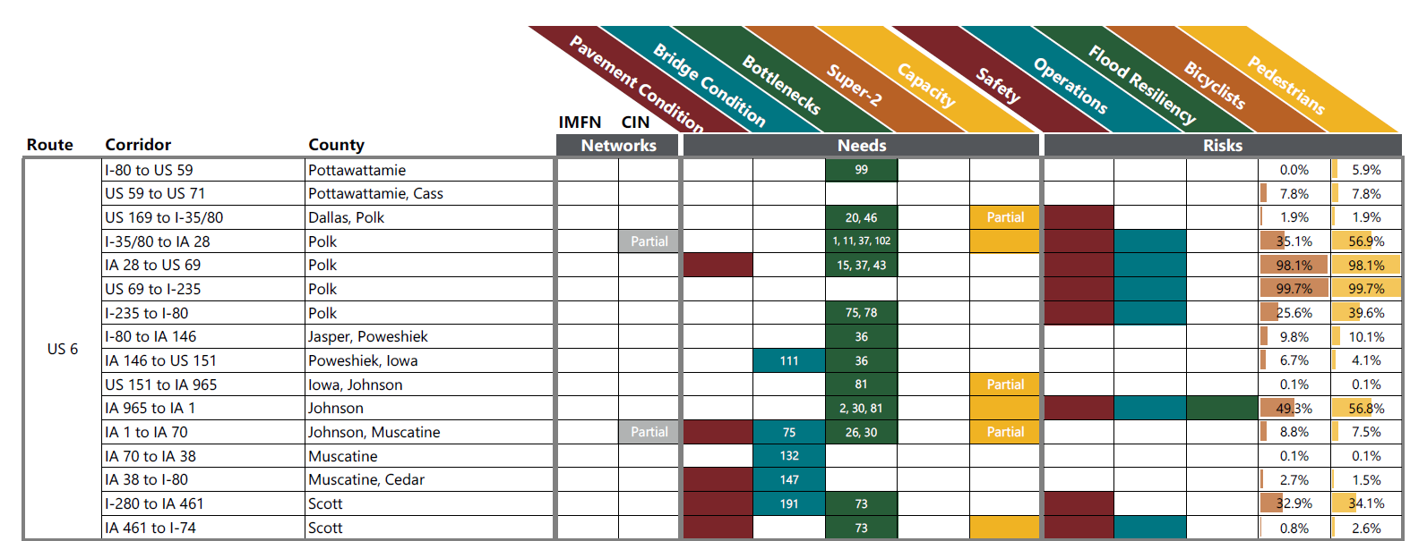
Highway needs and risks
Ten-layer analysis across 464 corridors covering entire Primary Highway System
Targeted locations based on each need/risk analysis; combined in a matrix of all corridors
Needs
Pavement Condition
Bridge Condition
Risks
Safety
Operations
Bottlenecks
Mobility and Safety (Super-2)
Capacity
Flood Resiliency
Pedestrians
Bicyclists
Notes:
Flood resiliency is only one of the layers of analysis conducted for the highway system and included in the SLRTP.
There are a total of nine layers of analysis for needs and risks.
Needs are based on measured or estimated data and represent a possible gap.
Risks are based on there being the potential for greater risk relative to that area of analysis, and thus greater potential benefit for improvements to address that risk.
In order to be able to summarize results in a meaningful way, the analyses are conducted at, or rolled up to, the corridor level. Corridors are generally homogenous sections of highways with corridor breaks occurring at locations like major intersections, incorporated boundaries, and places where the roadway characteristics change significantly, such as a two to four lane transition.
After each layer of analysis is discussed, they are combined into a matrix that shows all 464 highway corridors in the state. This provides a quick view of how many needs and risks have been identified for any highway corridor in the state.

Slide 10
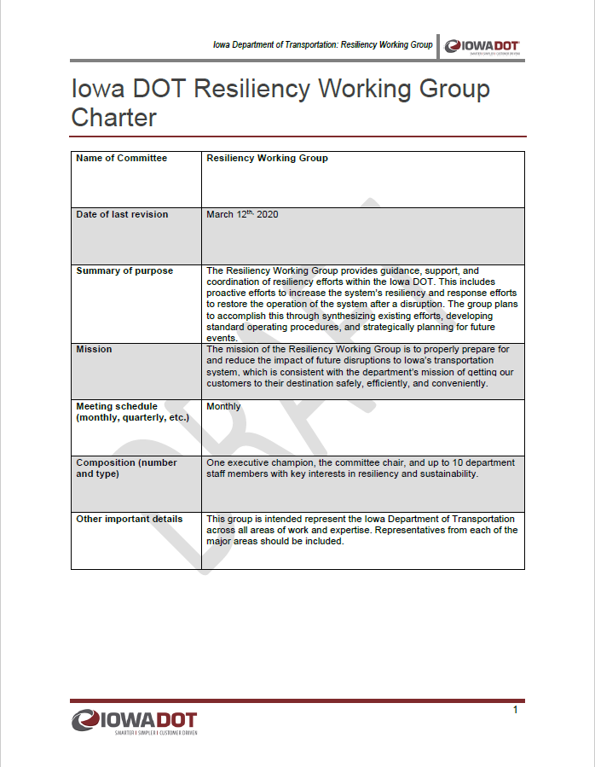
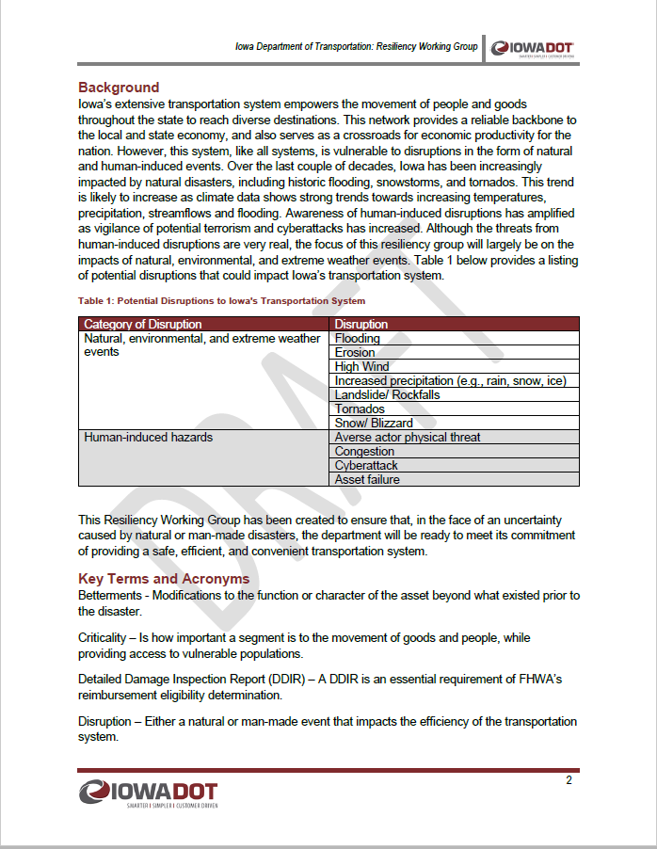
Resiliency Working Group (RWG)
Background
Over the last couple of decades, Iowa has been increasingly impacted by natural disasters, including historic flooding, snowstorms, and tornados. This trend is likely to increase as climate data shows strong trends towards increasing temperatures, precipitation, streamflows and flooding. Similarly, awareness of possible human-induced disruptions such as cyberattacks and terrorism have also been amplified.
Purpose
The Resiliency Working Group provides guidance, support, and coordination of resiliency efforts within the Iowa DOT. This includes proactive efforts to increase the system resiliency and response efforts to restore the operation of the system after a disruption.
Replace with screenshots of Resiliency Group Charter
Mission
The mission of the Resiliency Working Group is to properly prepare for and reduce the impact of future disruptions to Iowa’s transportation system, which is consistent with the department’s mission of getting our customers to their destination safely, efficiently, and conveniently.
Performance Measures
Robustness, Redundancy, Resourcefulness, and Rapidity
Notes:
In 2019 an internal Resiliency Working Group was stood up at the Iowa DOT in response significant flooding in southwest Iowa along the Missouri River. The initial focus of this group was to coordinate the response and repairs associated with this event. Since the flooding in 2019 the group has consistently met and the focus has transitioned from reactive response to proactive planning. The group has started focusing on what resiliency means for the department throughout the project development process and how the department can better prepare for future events.

Slide 11
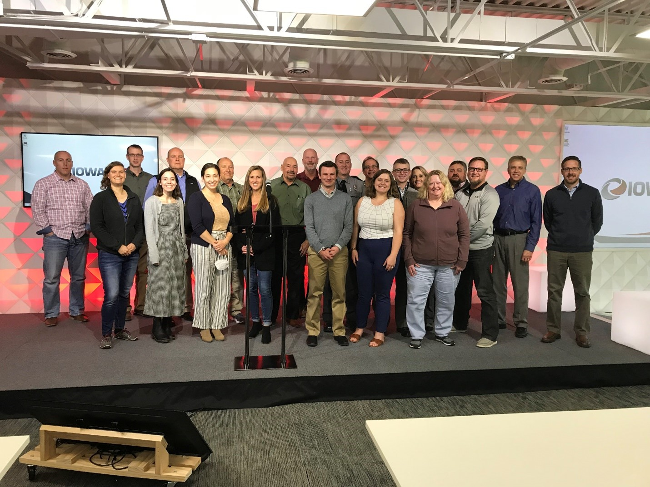
Resiliency and Sustainability Working Group’s Visioning Workshop Nov 2021
11
Strategies Identified
“employ a programmatic method for implementing resiliency into the 5-year program”

Slide 12
Framework for Screening & Prioritization
Impetus for creating this framework: Visioning Workshop strategy and new Promoting Resilient Operations for Transformative, Cost-saving Transportation (PROTECT) formula program
2 Screening Phases:
Project location is in an area that has been or is likely to be impacted by natural disruptive events.
Project is eligible for PROTECT funding.
Prioritization Phase:
Projects are evaluated based on their relative criticality to the system.
Potential tie breaks are resolved by evaluating remaining service life of the impacted pavements.
Recommendation Phase:
Candidate projects would be reviewed by the RWG with a recommendation to Executive Leadership.
Selected resilience projects would then be added to the candidates list for future programming consideration by the Commission.

Slide 13
PROTECT
Program

Slide 14
Promoting Resilient Operations for Transformative, Cost-saving Transportation (PROTECT) Program
Purpose
Iowa’s share of Apportioned Federal Formula Funding is approximately $18.4 million for FFY 2023
Funds apportioned to the state may be used for natural infrastructure or the construction or modification of storm surge, flood protection, or aquatic ecosystem restoration elements that are functionally connected to a transportation improvement.
Guidance released on 7/29/2022
Discretionary Competitive Funding
Planning Grants
Resilience Improvement Grants
Community Resilience and Evacuation Route Grants
At-Risk Coastal Infrastructure

Slide 15
PROTECT Program
Resilience Improvement Plan
Voluntary planning component
Development of a resilience Improvement plan may reduce the non-federal cost share of a project by up to 10 percent.
Plan contents:
Systemic approach
Risk based assessments
Strategy development
Investment plan
Iowa DOT staff has initiated efforts to develop this voluntary plan.

Slide 16
THANK YOU FOR YOUR TIME AND ATTENTION
Samuel Sturtz
Transportation Planner
Systems Planning Bureau

