Slide 1
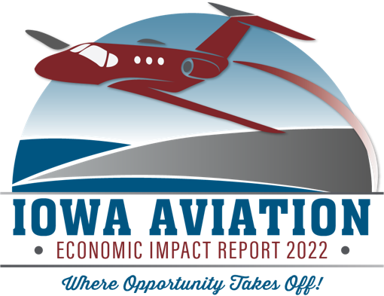
Iowa Aviation
Economic Impact Report
2022

Slide 2
THE BIG ANSWER
$6.4B
41,000
$124M

Slide 3
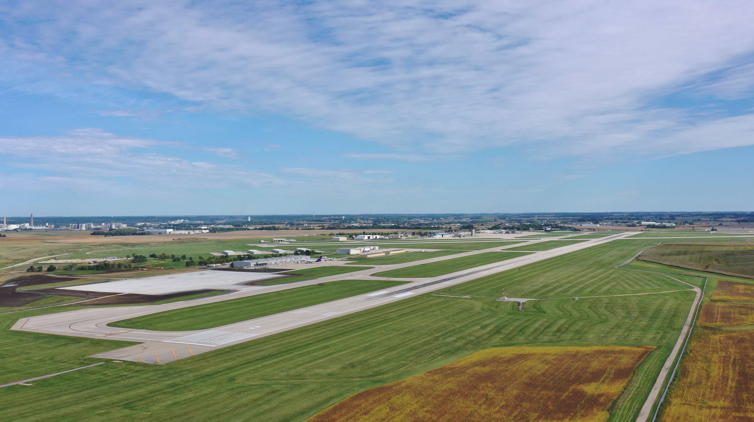
PRESENTATION OUTLINE
USES AND BENEFITS
ECONOMIC IMPACTS

Slide 4
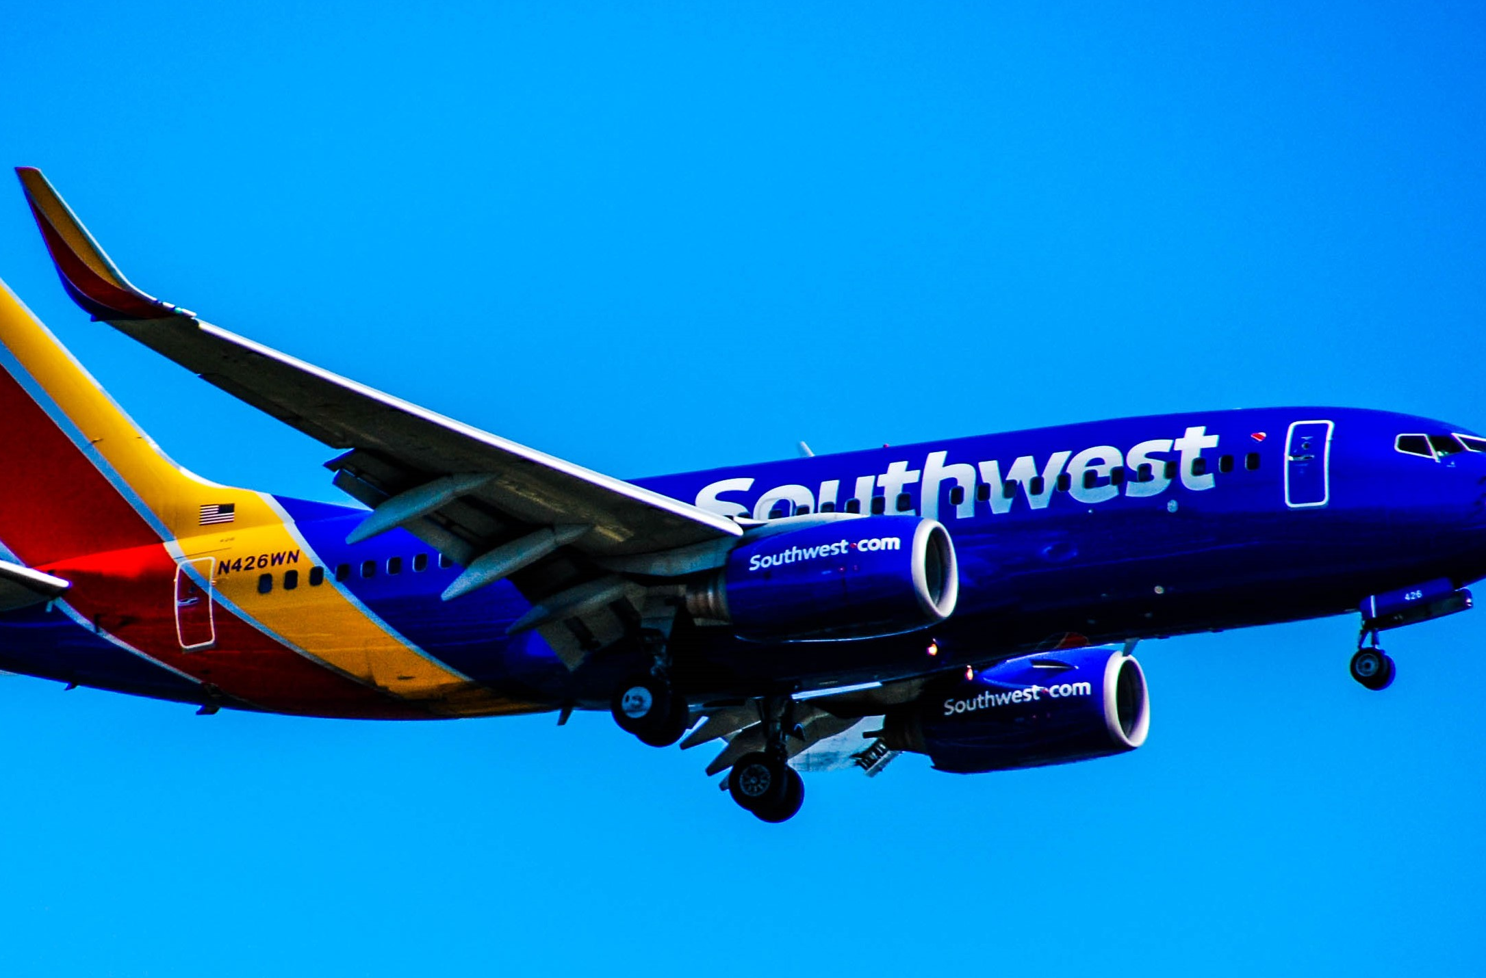
WHAT ARE SOME AVIATION ACTIVITIES THAT GENERATE ECONOMIC IMPACT?

Slide 5
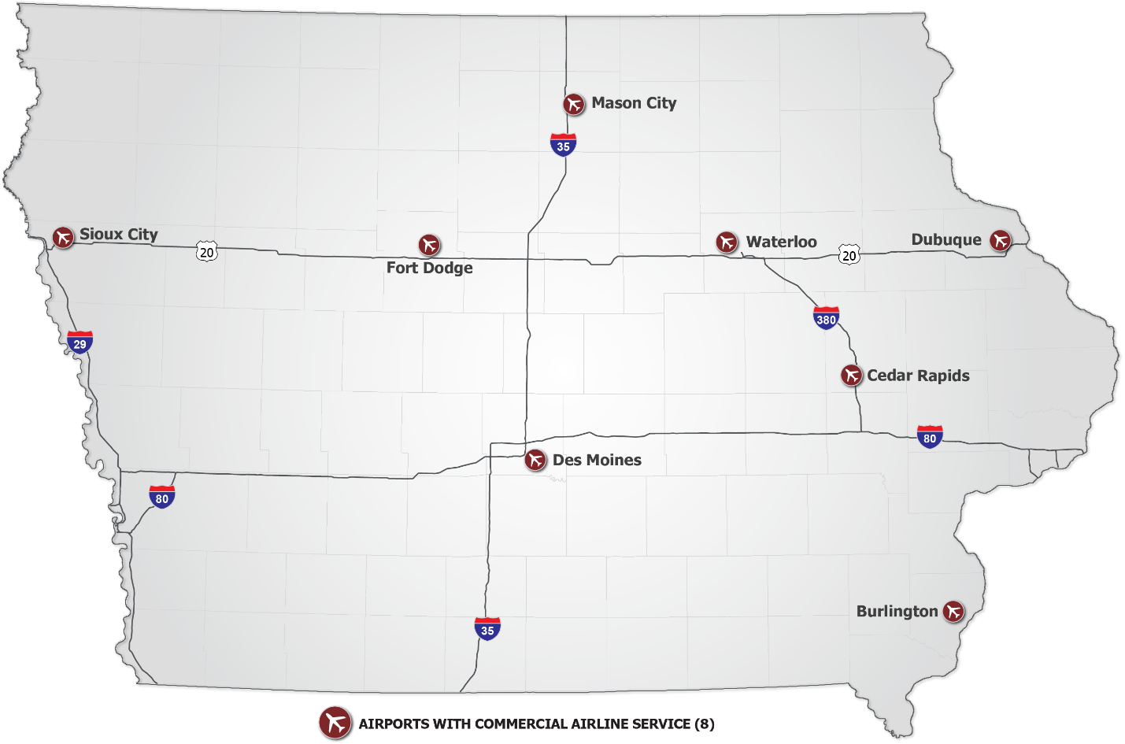
AIRLINE SERVICE
Serving over 4 million passengers with service to 25+ nonstop markets
8
COMMERCIAL AIRPORTS

Slide 6
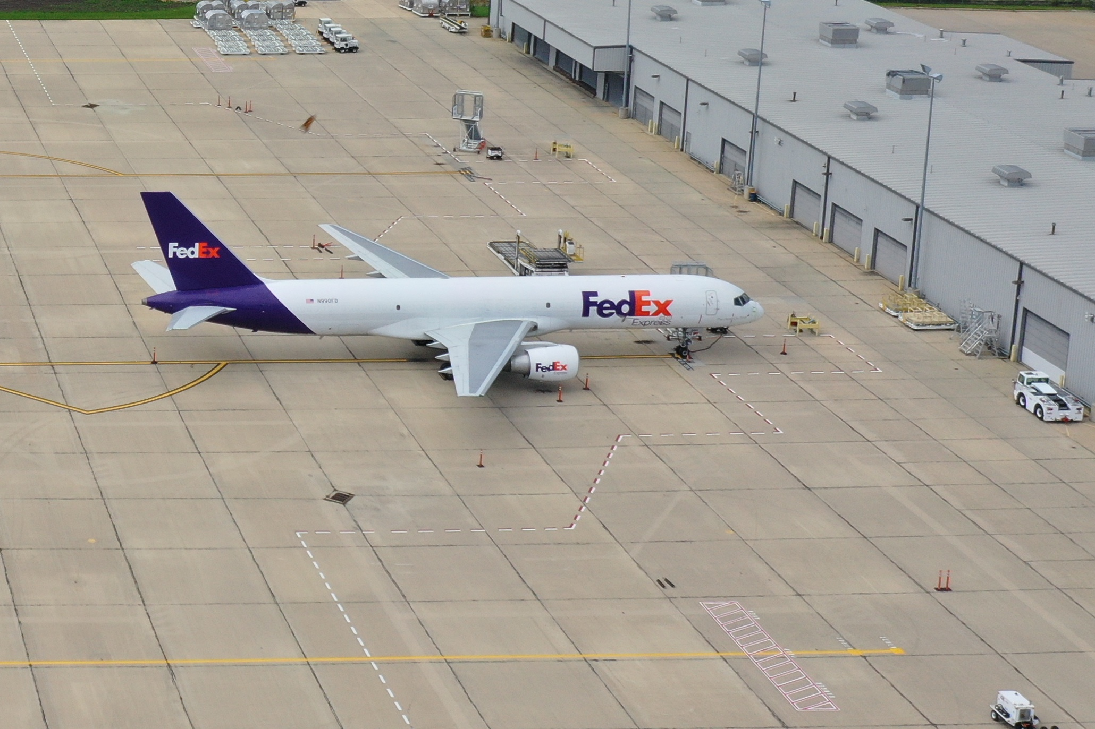
AIR CARGO
Scheduled service provided by large integrators and 20+ on-demand carriers
TOTAL ANNUAL TONS – EnPLANED and DEPLANED
DSM
90K+
CID
TONS of Cargo moved by air

Slide 7
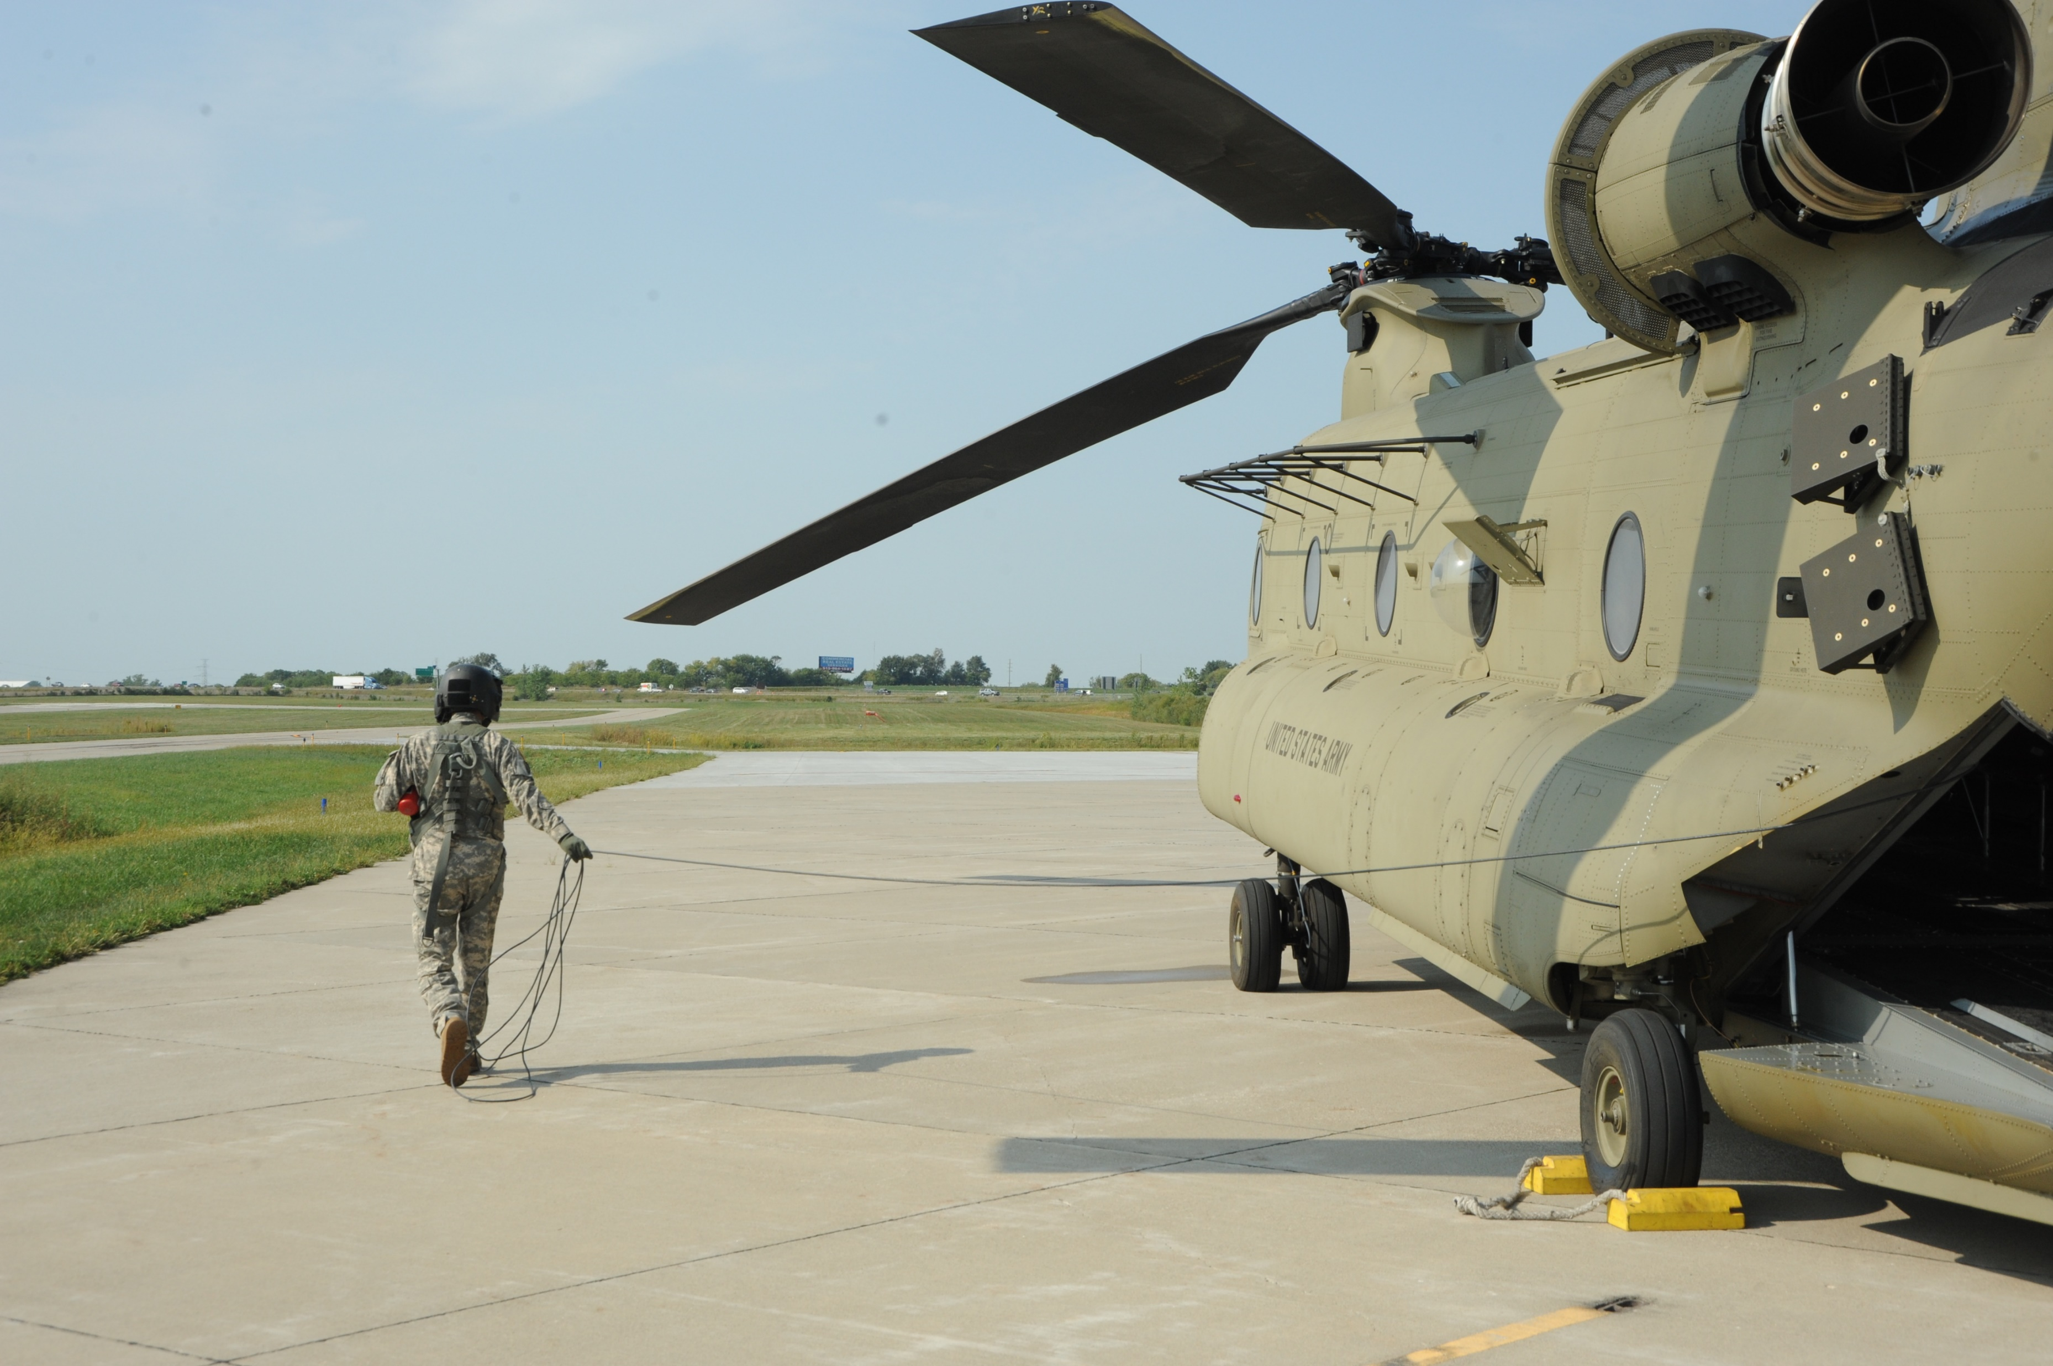
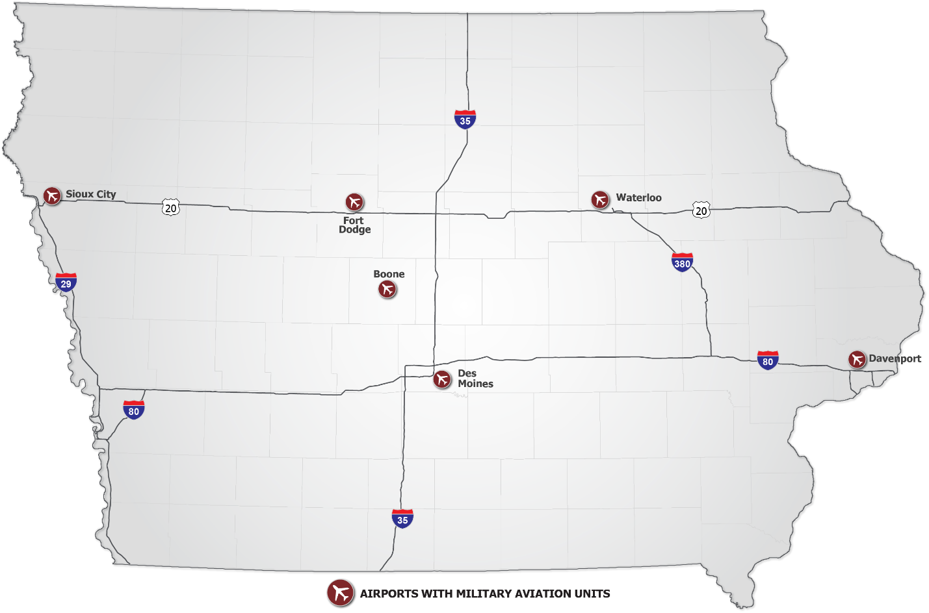
MILITARY
Air National Guard Units and Army Aviation Support Facilities
6
Airports with military Units

Slide 8
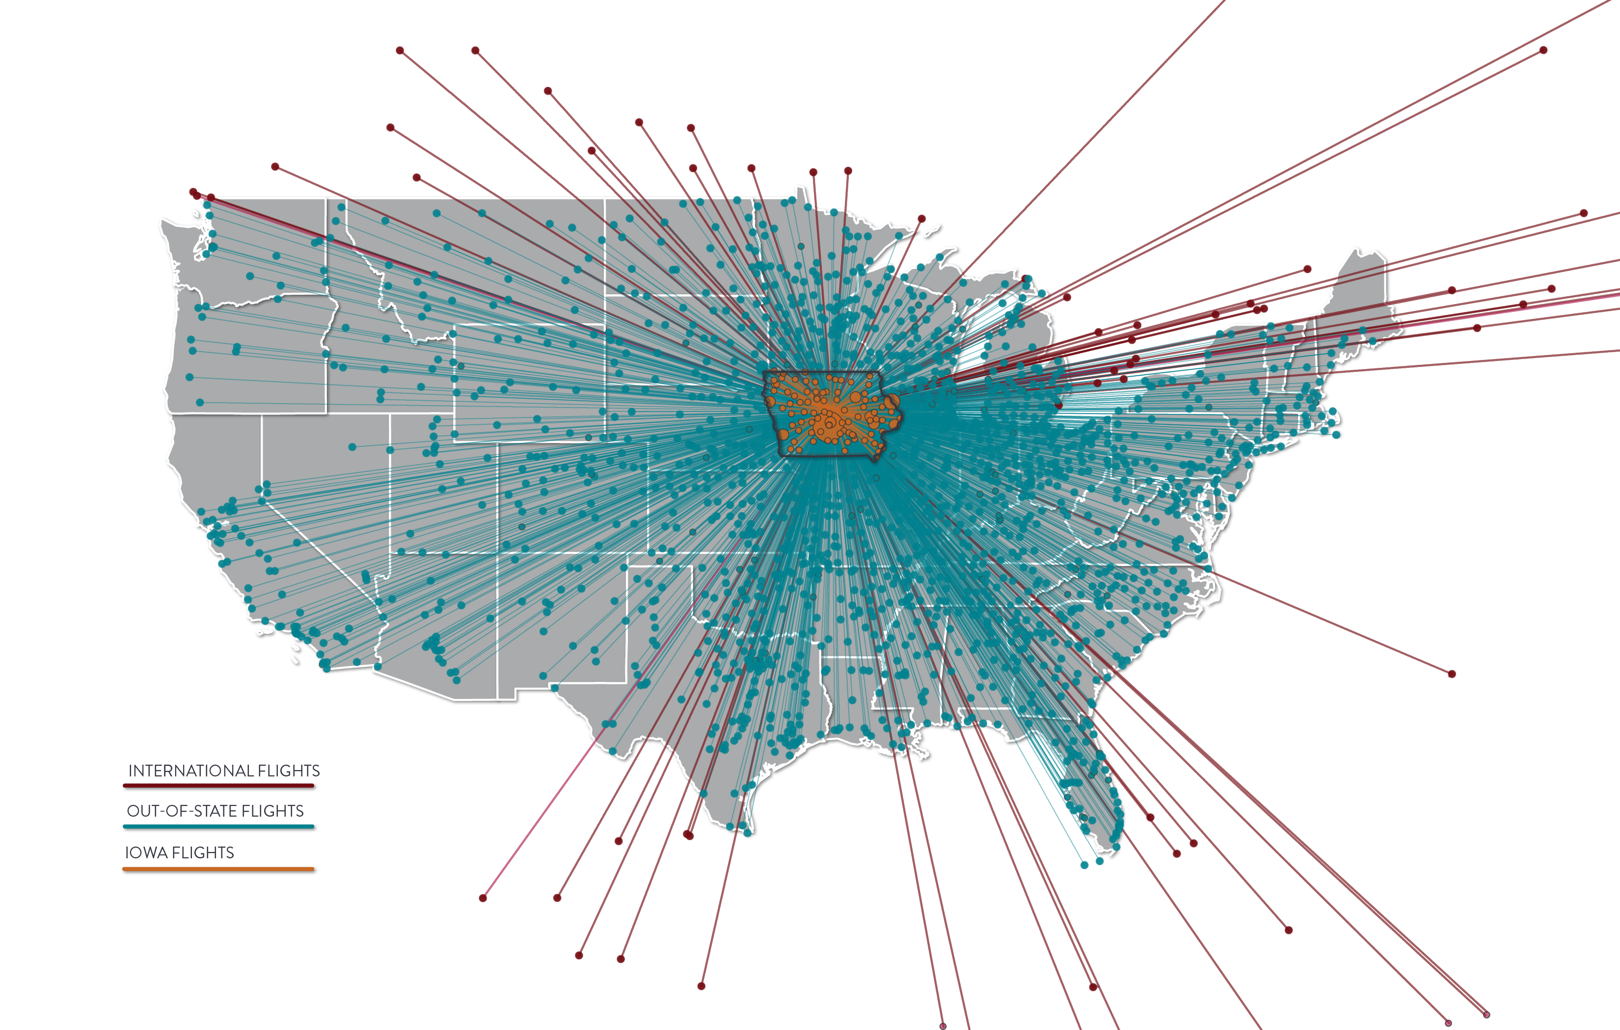
Business Use
From 2019 to 2020, Iowa saw flights to and from 49 states and 27 countries
1,400+
Unique Businesses using Iowa airports

Slide 9
AVIATION’S IMPORTANCE TO IOWA BUSINESS
166,000
IOWA EMPLOYEES USE COMMERCIAL AIR SERVICE
$10B
In ANNUAL Payroll
$25B
In ANNUAL Economic activity

Slide 10
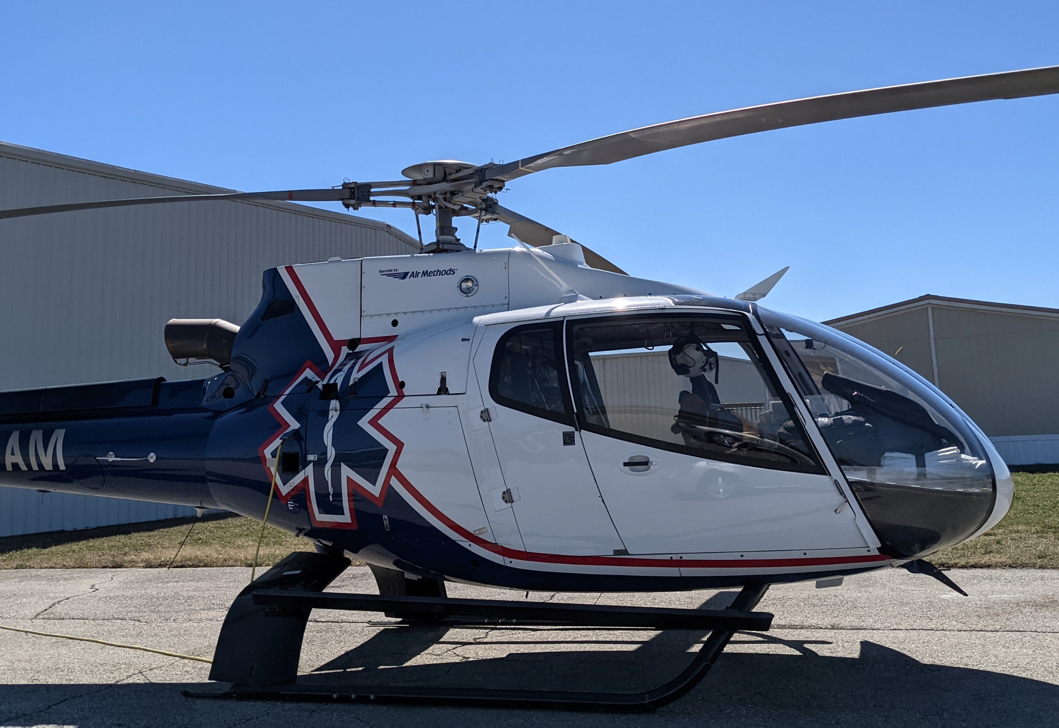
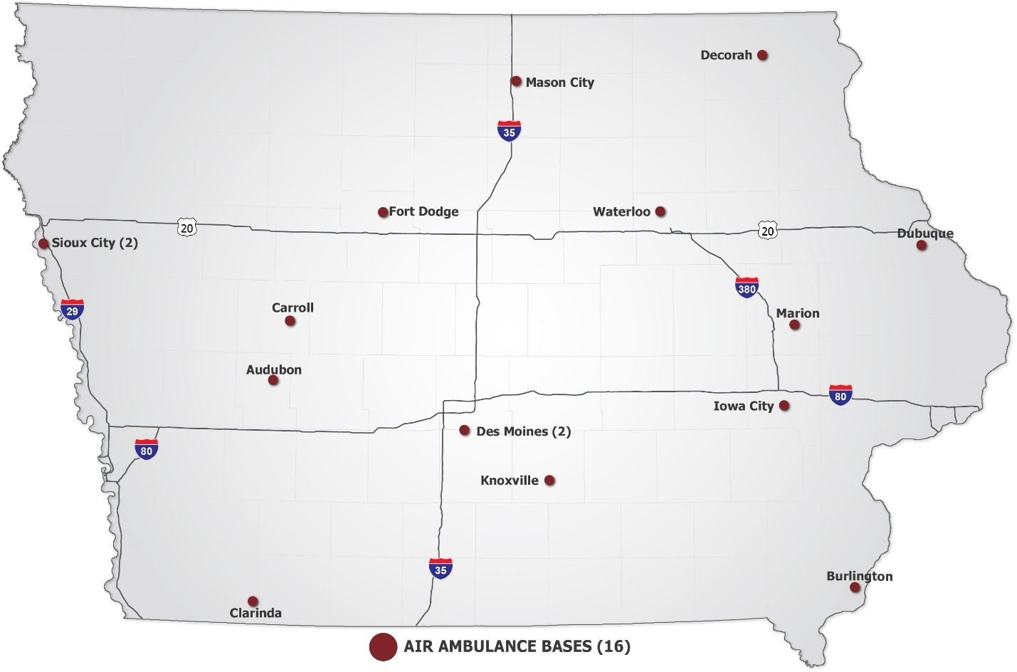
Air Medical
Includes emergency services, ground care, and patient transport
23
$449M
Ambulance aircraft
TOTAL IMPACT

Slide 11
AERIAL APPLICATORS
Impacts are generated across Iowa
Fixed wing, helicopter, UAS
In-state and out-of-state applicators
$373M
5M
105
400+
YIELD BENEFIT
Acres Sprayed
Airports serving aerial applicators
Registered AG Aircraft

Slide 12
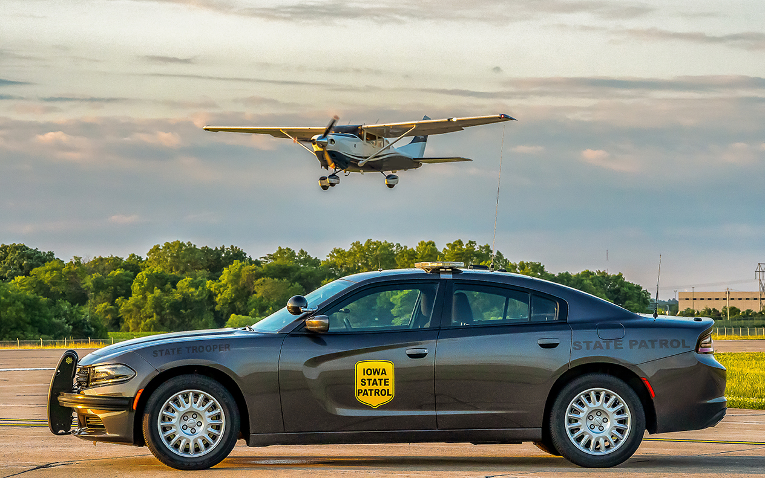
PUBLIC SAFETY
Iowa State Patrol relies on aircraft and drones
Traffic control
Emergency response
Search and rescue
Disaster assessment
SINCE 1956
AIRCRAFT HAVE BEEN USED TO ENHANCE PUBLIC SAFETY

Slide 13
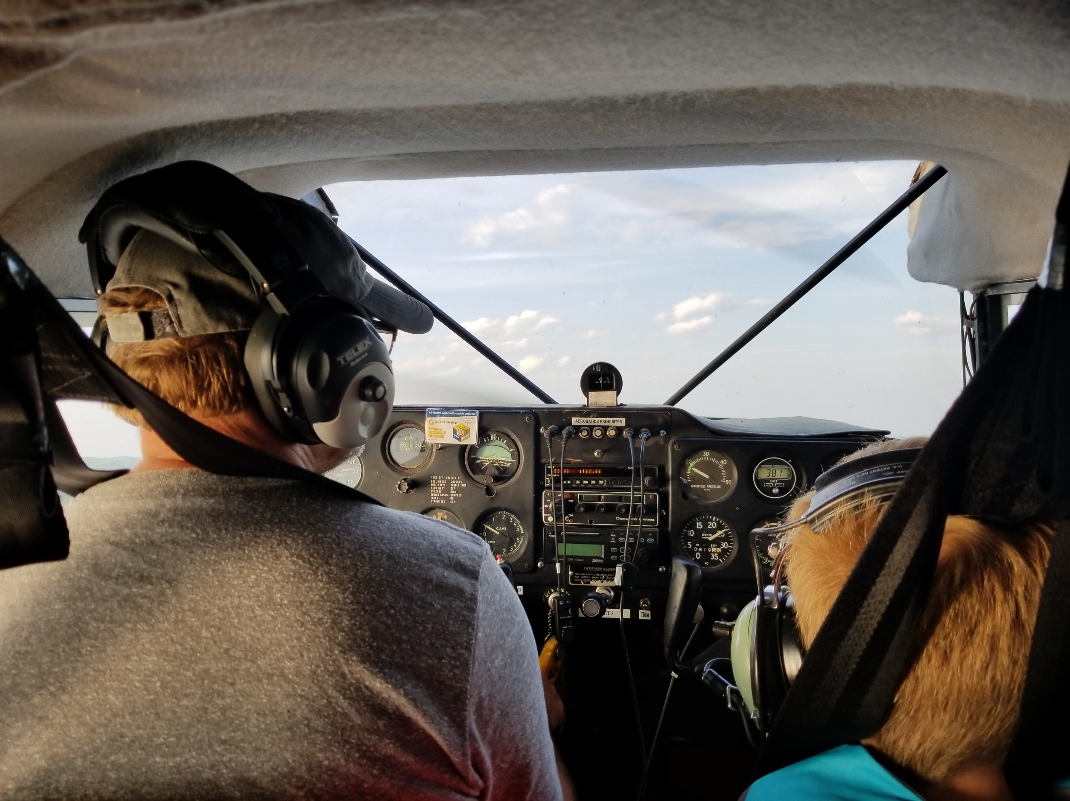
GRASSROOTS AVIATION
Museums, charity flights, and fly-in events are hosted around Iowa

Slide 14
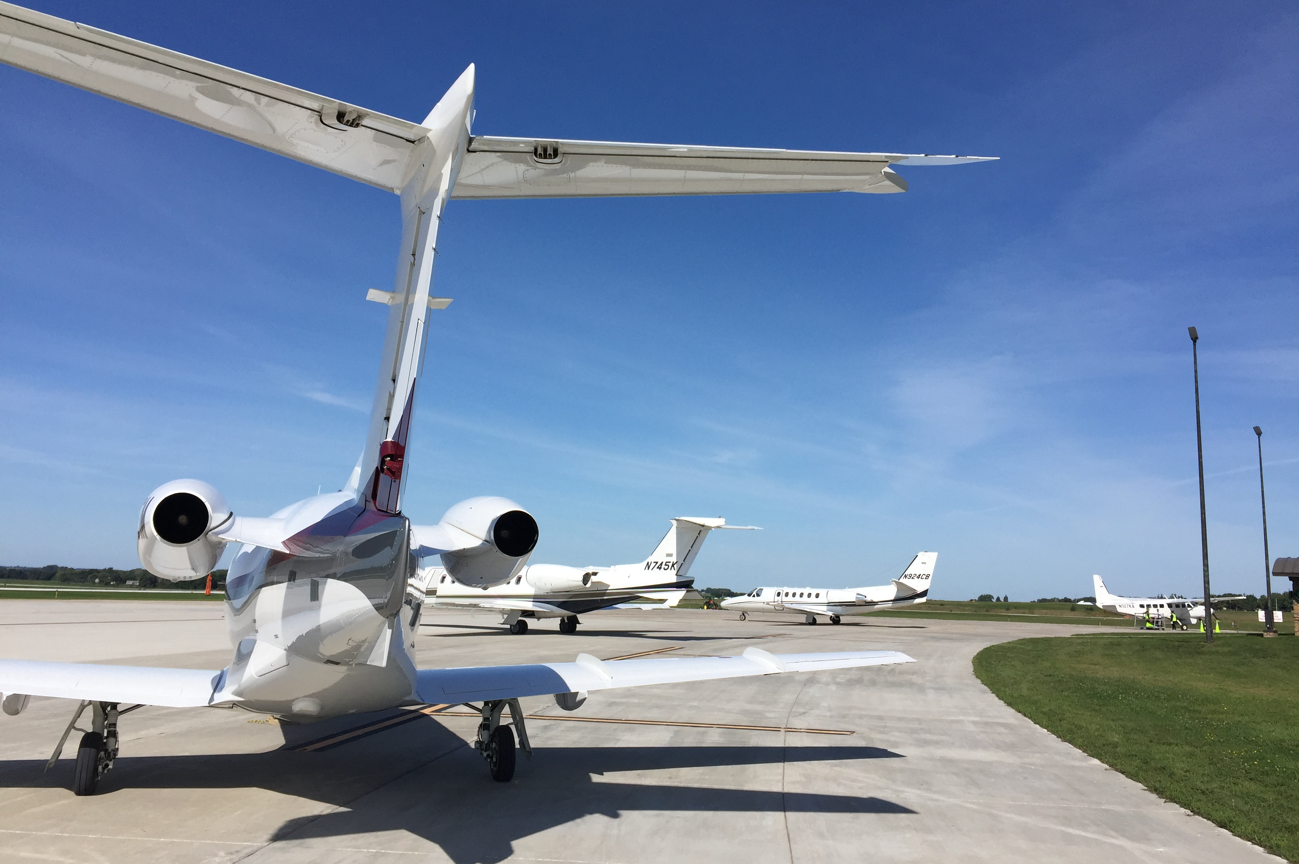
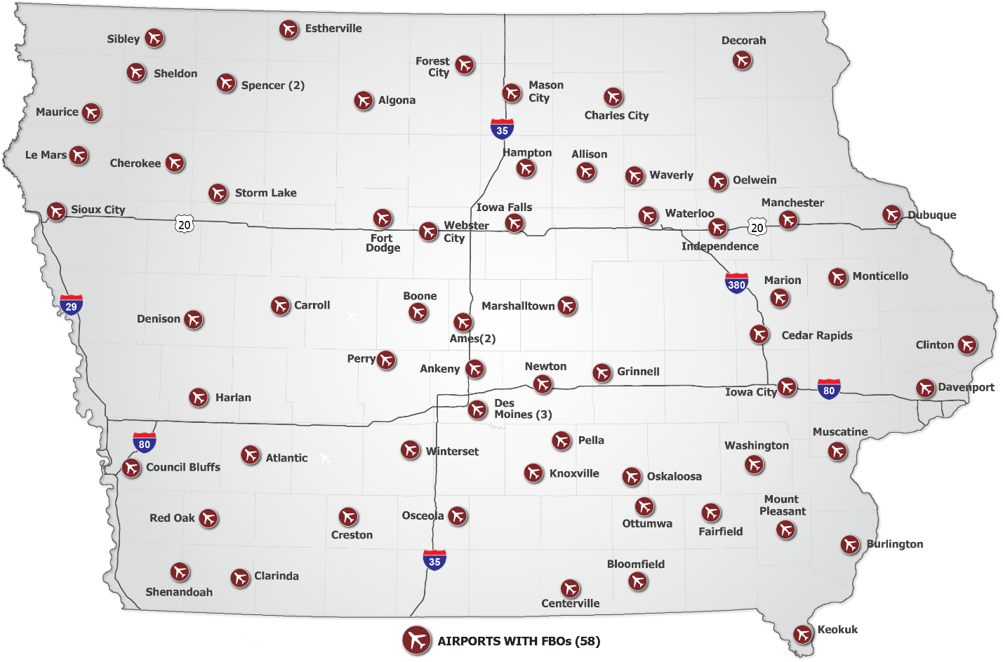
Fixed Base Operators
Focal point of many airports that offers important services for pilots and aircraft.
62
58
at
FBOs
Airports

Slide 15
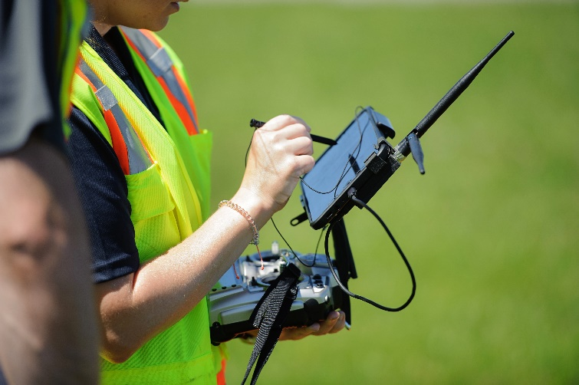
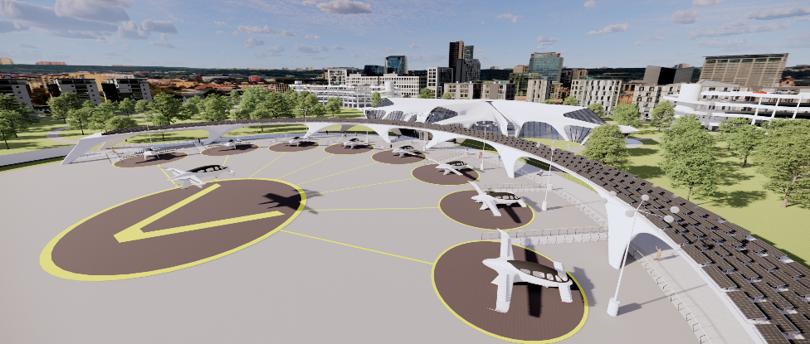
UAS & AAM
3K+
Cutting-edge technology developed and in use by Iowa businesses
Remote Pilots

Slide 16
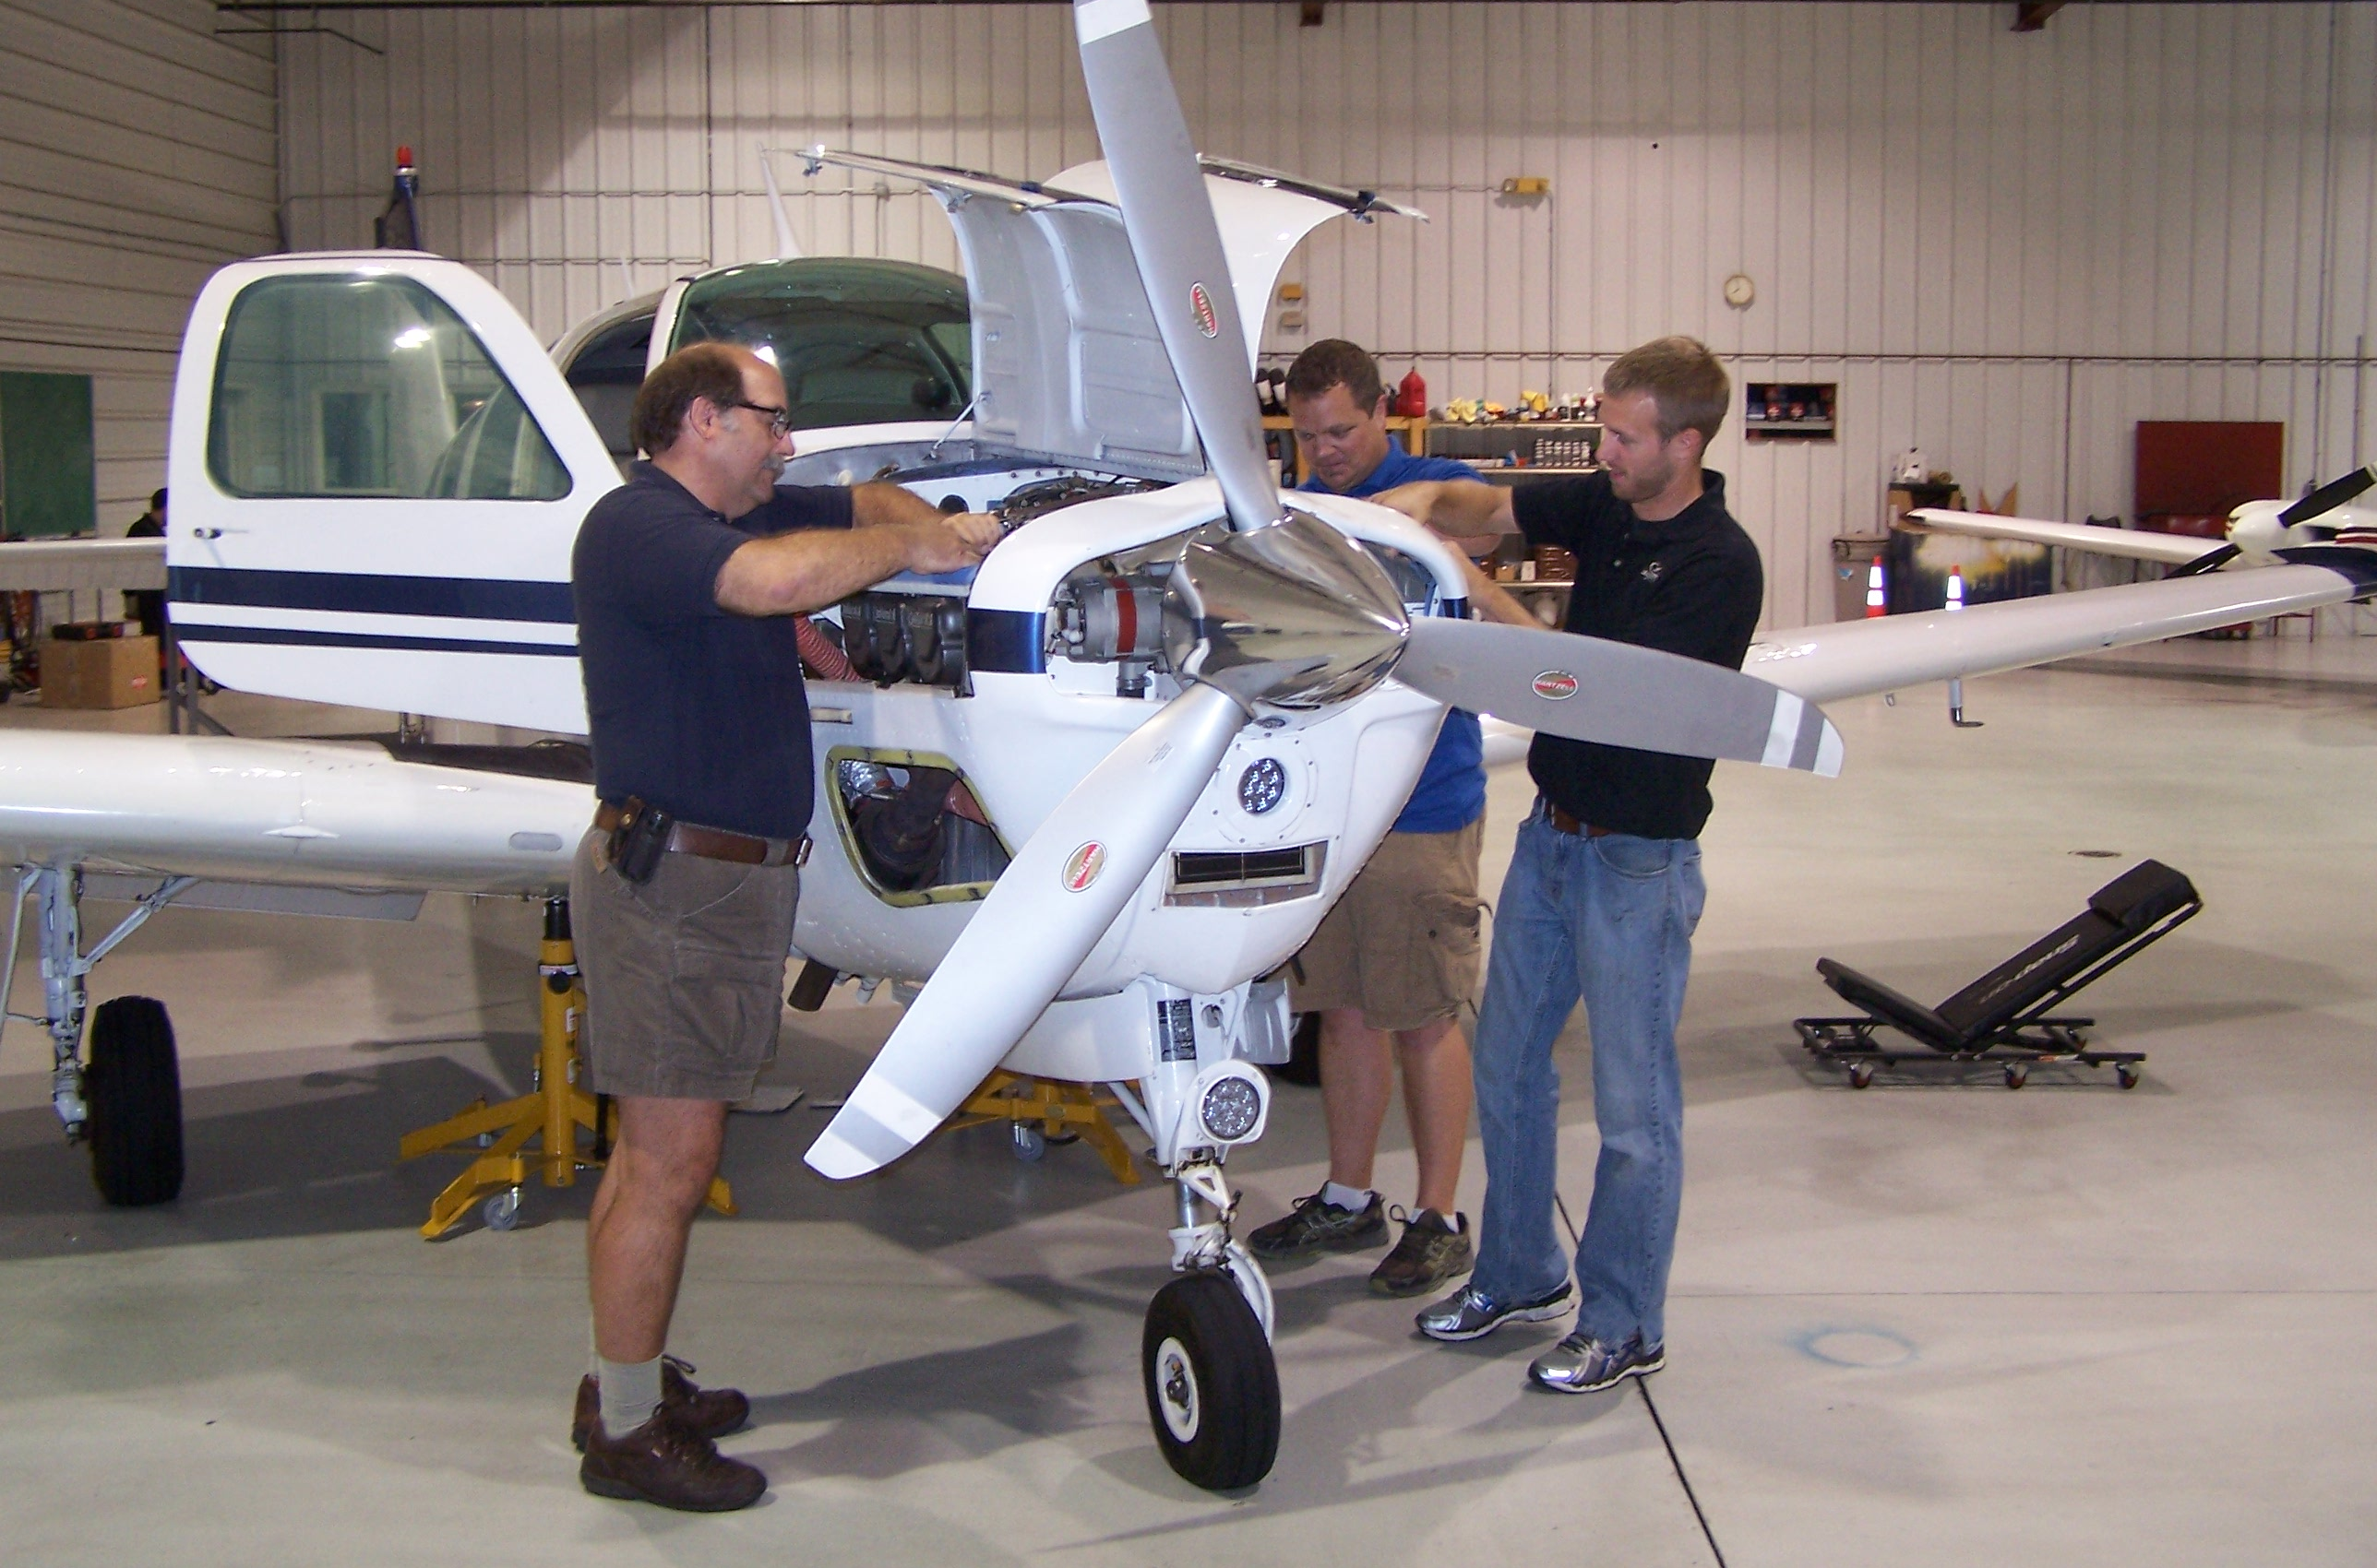
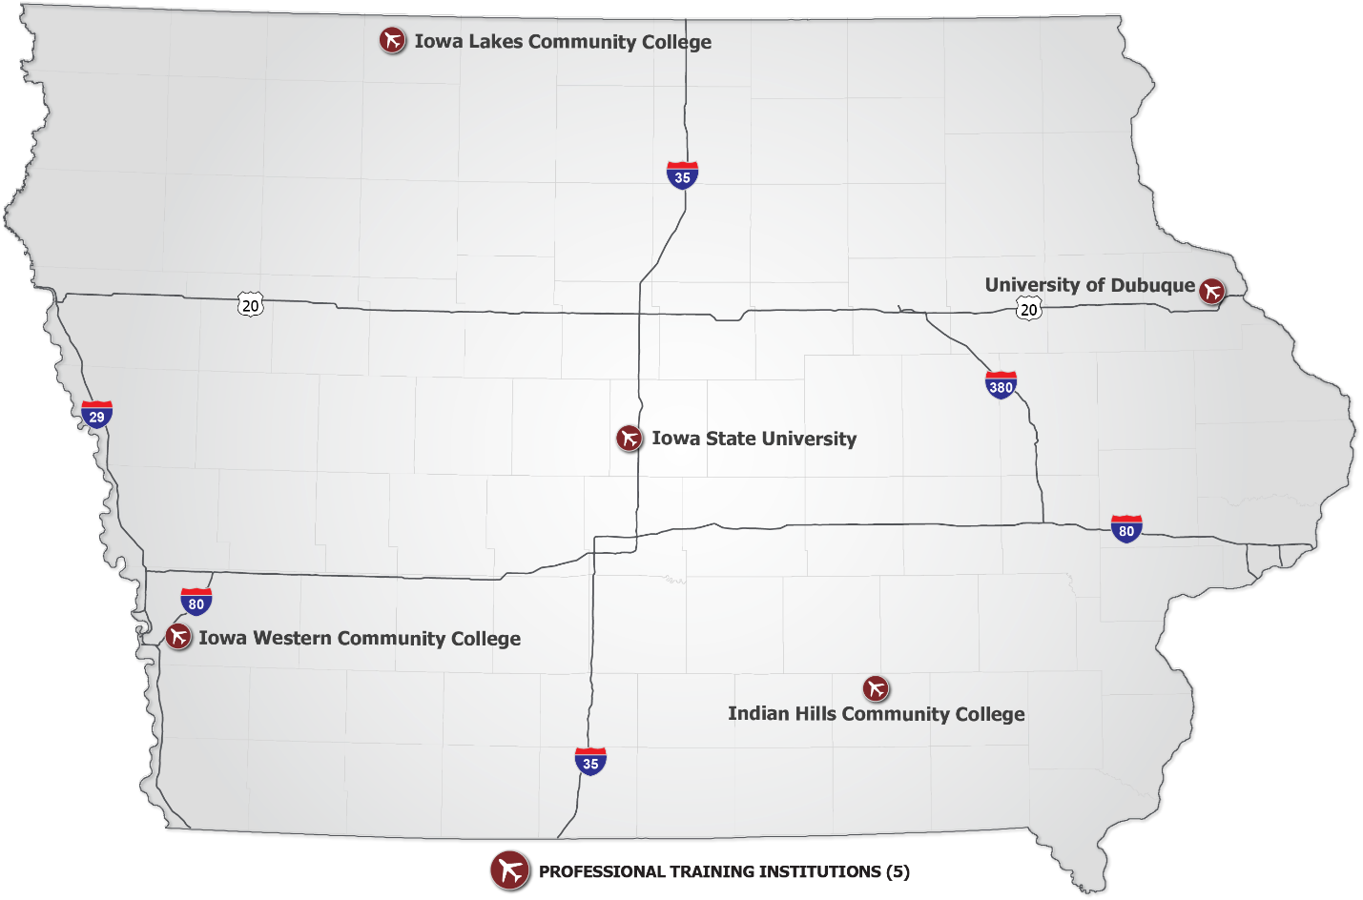
AVIATION EDUCATION
4-year and 2-year programs for future pilots and mechanics
5
POST-Secondary education programs

Slide 17
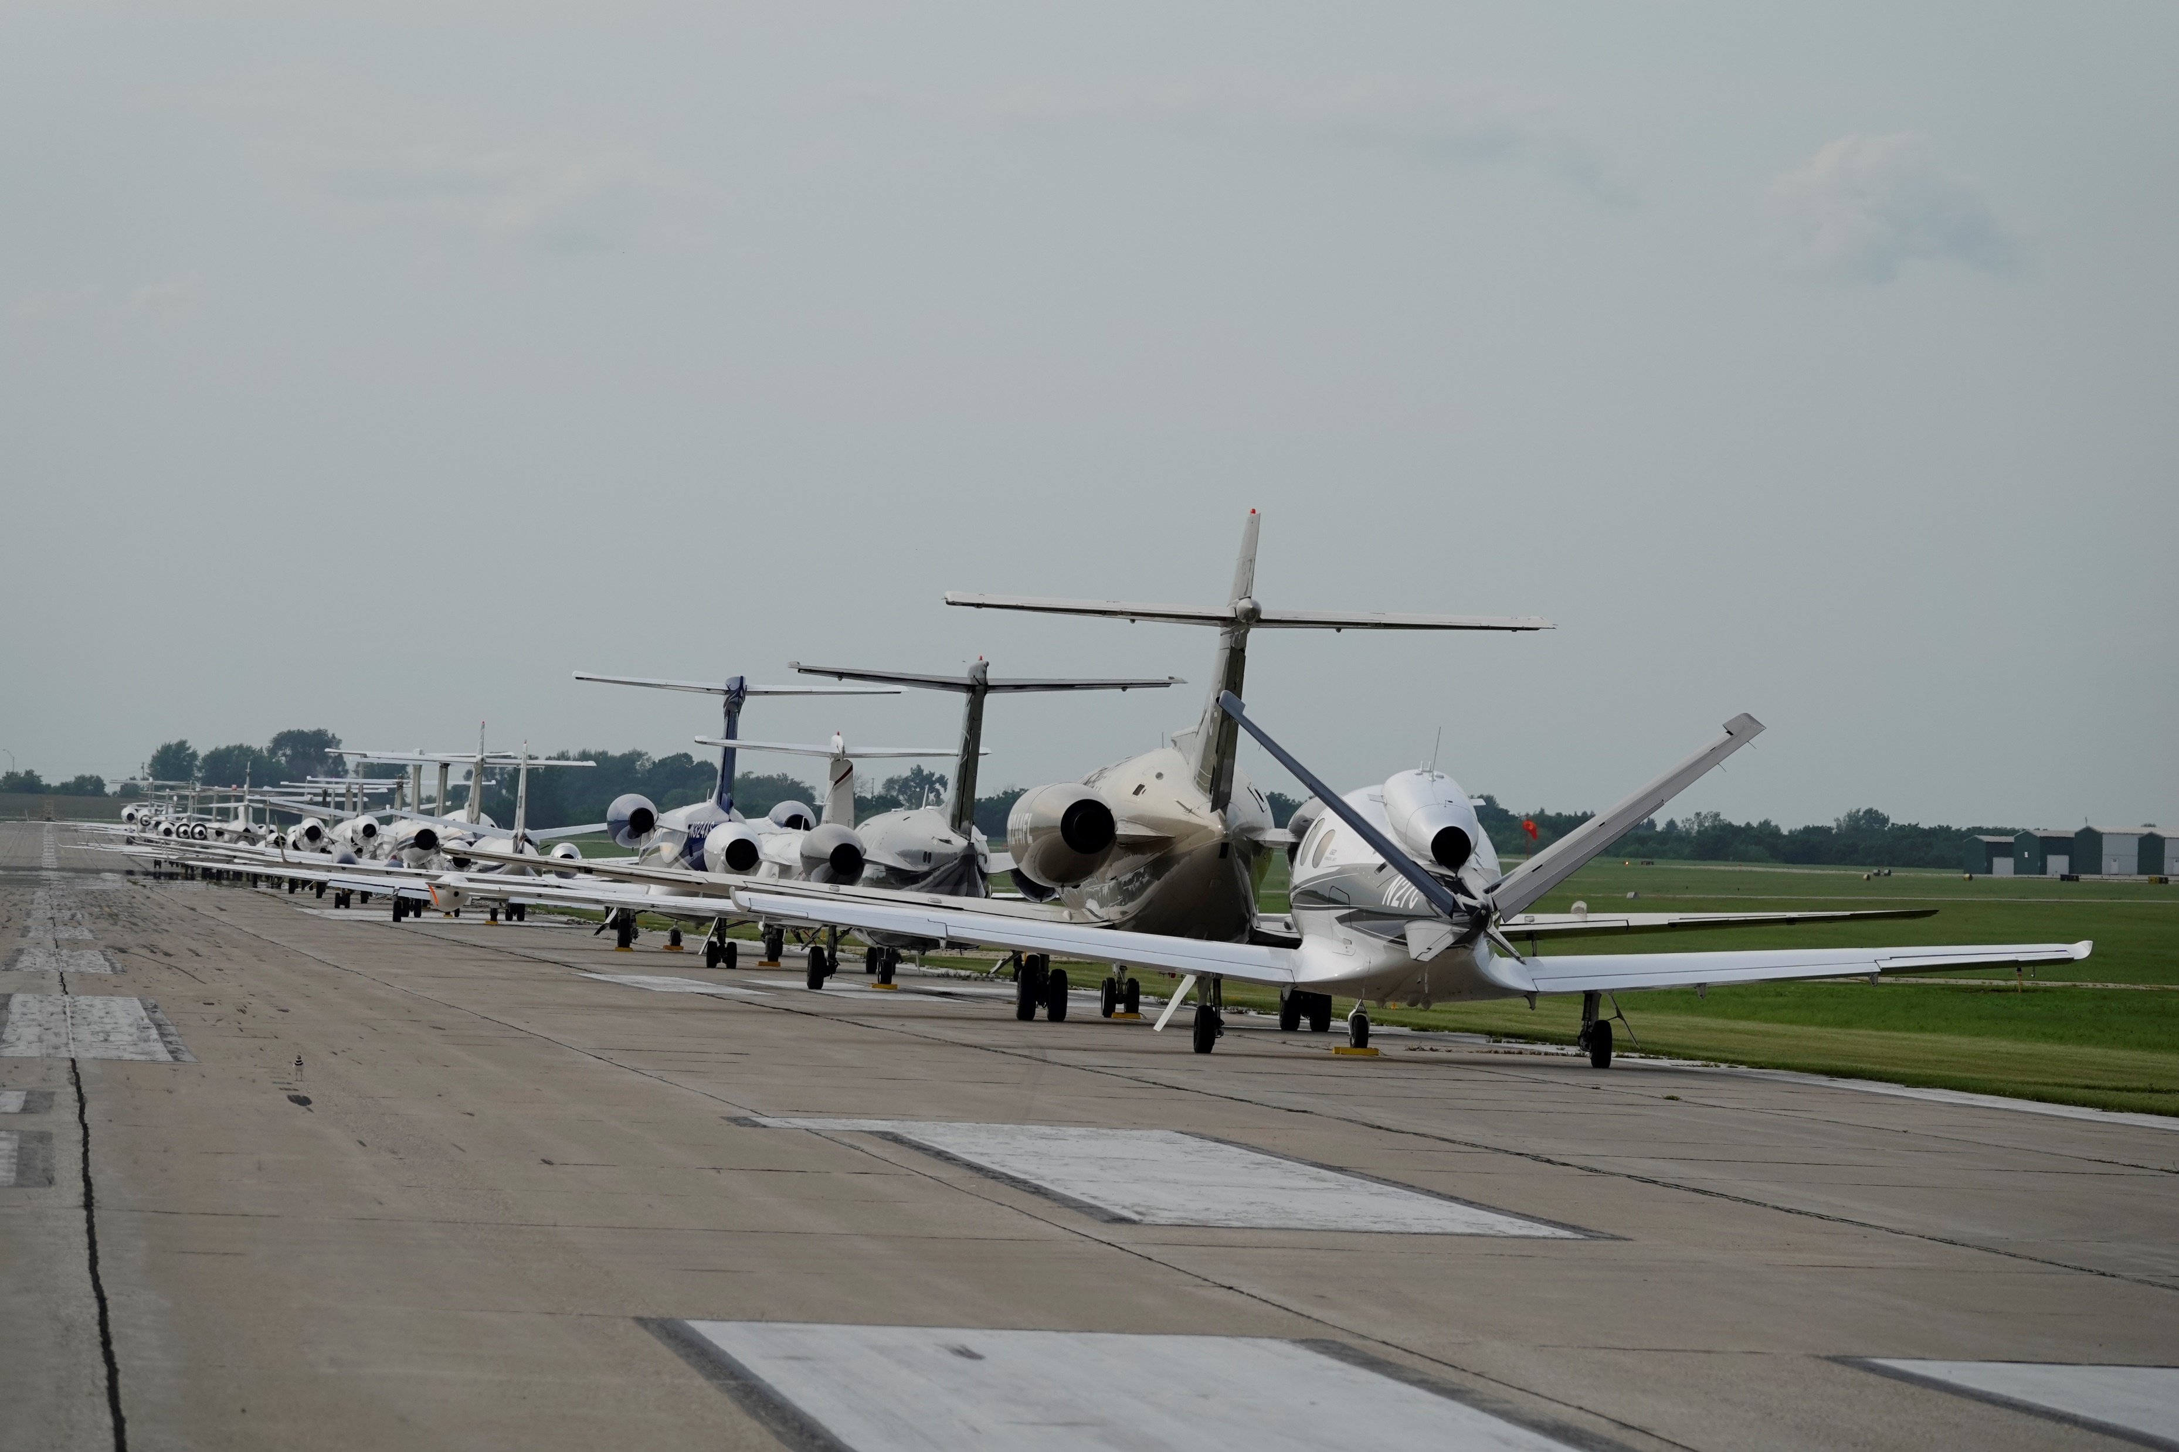
THE ECONOMIC IMPACTS OF AVIATION IN IOWA

Slide 18
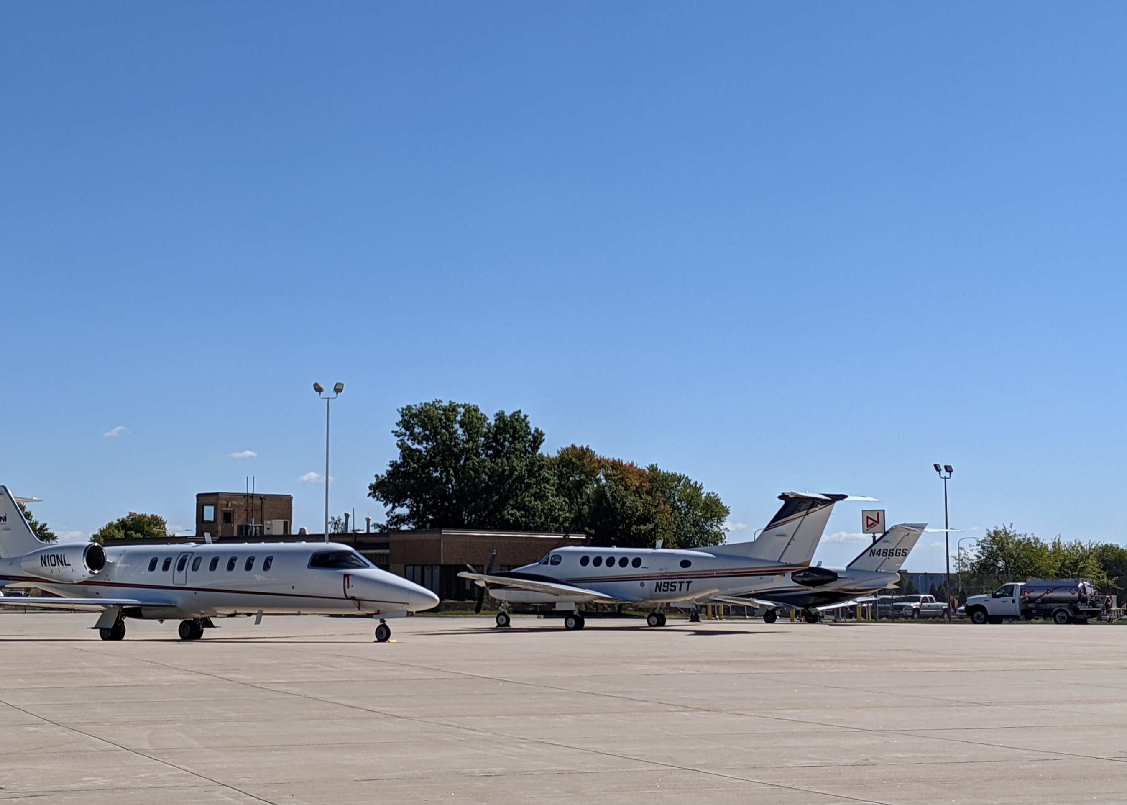
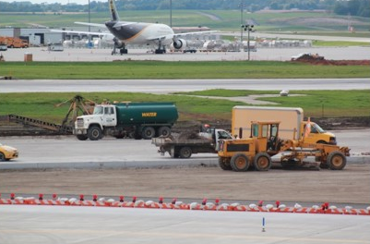
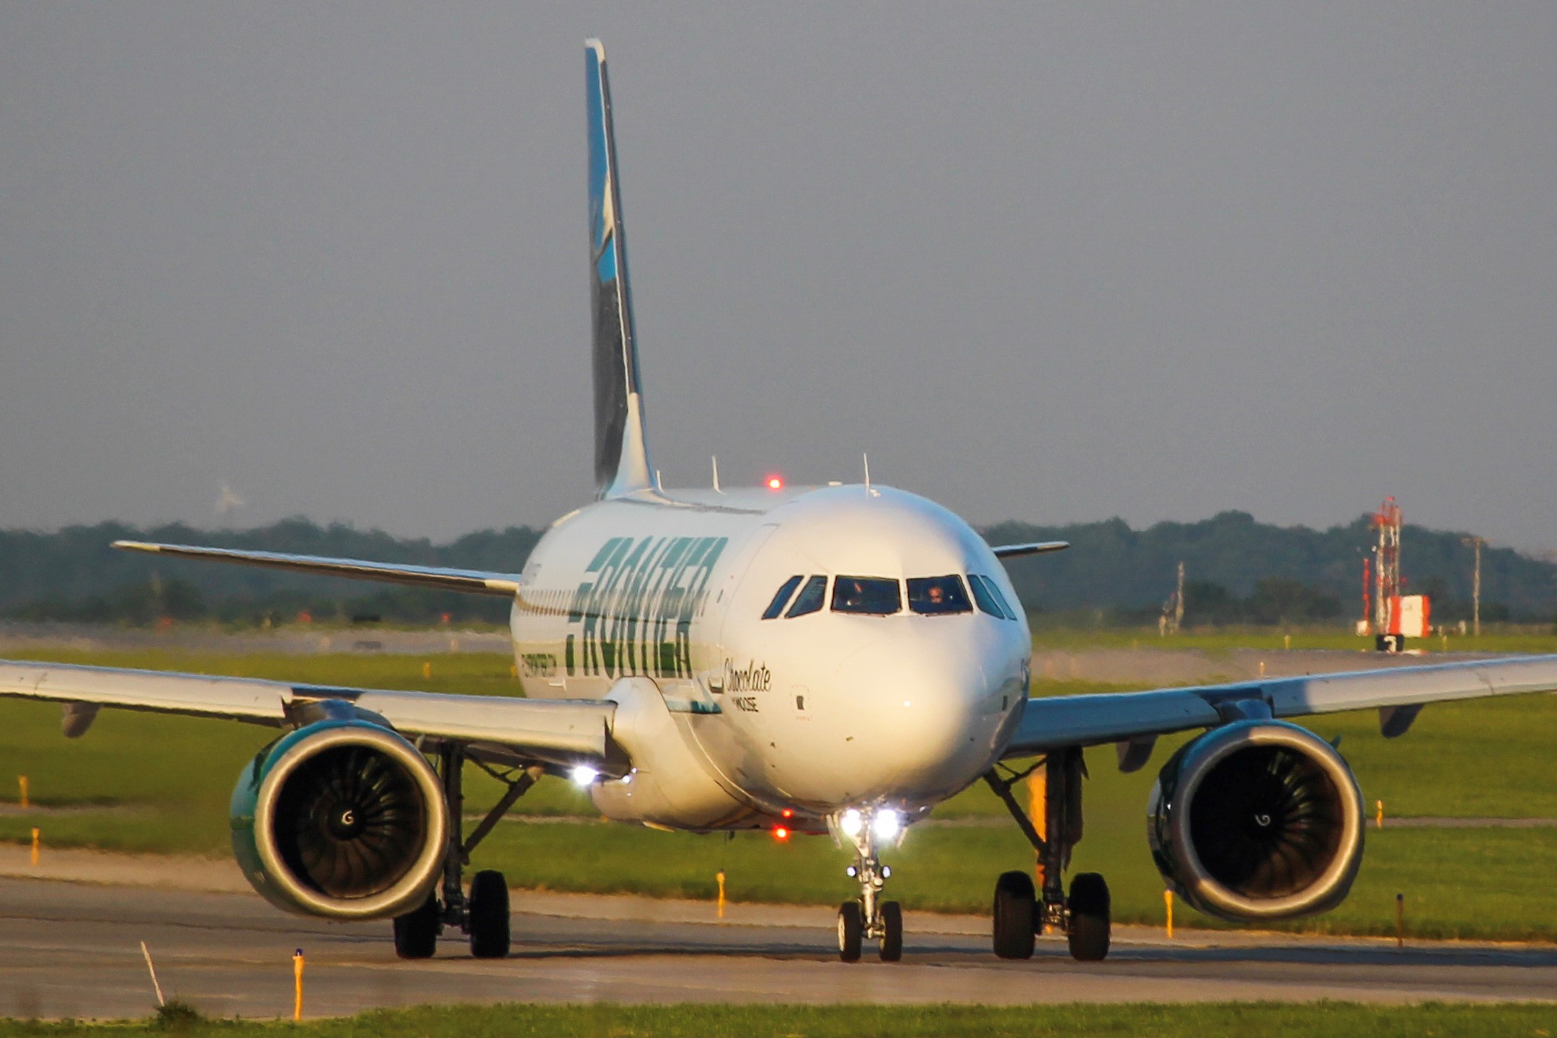
Iowa Airports
Support on-airport activity, construction investment, and visitor spending
On-Airport Activity
$1.8B
TOTAL ECONOMIC ACTIVITY
Construction investment
17,000
Total JOB IMPACTS
VISITOR SPENDING
250+
On-airport BUSINESSES

Slide 19
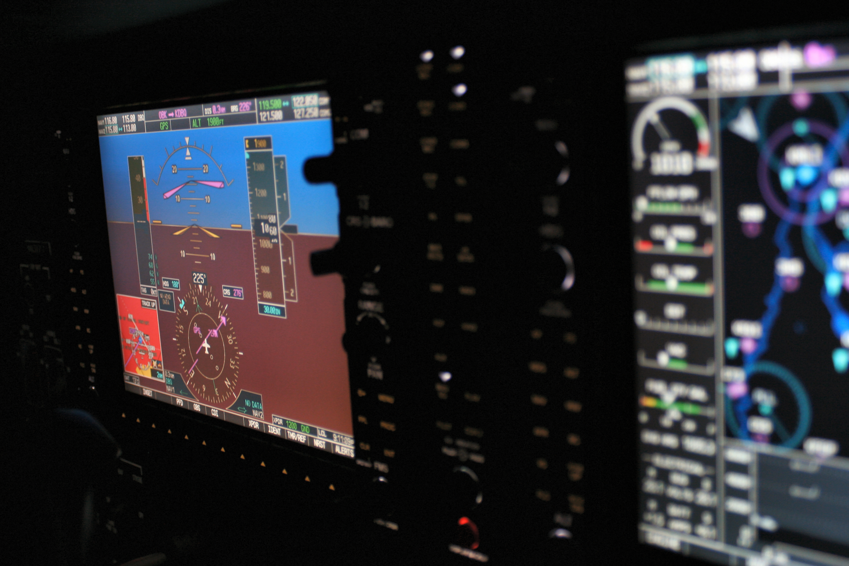
Aerospace
Located in Communities Around the State, Typically Off Airport Property
$4.6B
TOTAL ECONOMIC ACTIVITY
24,000
Total JOB IMPACTS
25+
AEROSPACE BUSINESSES

Slide 20
Aviation-Related Tax Revenues
Generated from income and purchases tied to the aviation industry in Iowa
State income tax
Sales tax
Use tax
Aviation fuel taxes
Aircraft registration fees
$124M
TOTAL TAX IMPACTS

Slide 21
$6.4B
41,000
$124M
FOR MORE INFORMATION VISIT: iowadot.gov/aviation

