Slide 1
Transportation Trends Update
Transportation Commission Workshop
November 14, 2023

Slide 2
Overview
US total rail carloads
Commercial air service passenger counts
Vehicular traffic
Mississippi River and Panama Canal

Slide 4
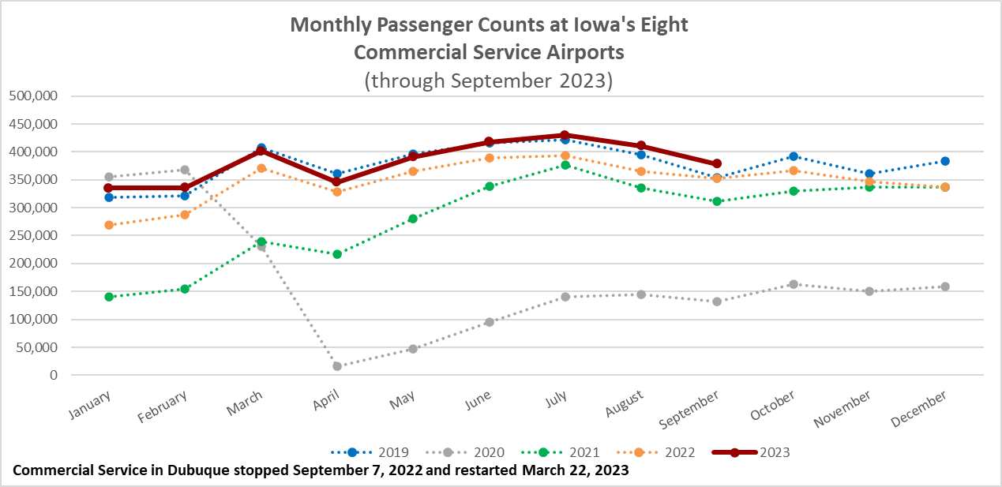

Slide 5
Monthly State Vehicle Miles of Travel
(through September 2023)

Slide 6
Mississippi River
Water levels have been falling since June and expected to continue to drop.
Result is barges are not fully loaded with grain causing reduced barge supply.
Impacts partially mitigated by lower demand for shipping by barge
Panama Canal
Drought has reduced the amount of freshwater available to use for the lock system
Maximum ships per day will be restricted to 18 in February – normal is 36 to 38.
Forty percent of all US container traffic travels through the Panama Canal
“The passage of one ship is estimated to consume as much water as half a million Panamanians use in one day.” New York Times, Nov. 1, 2023

Slide 7
Questions?

