Slide 1
Revitalize Iowa’s Sound Economy Program
Iowa Transportation Commission Business Meeting
November 14, 2023

Slide 2
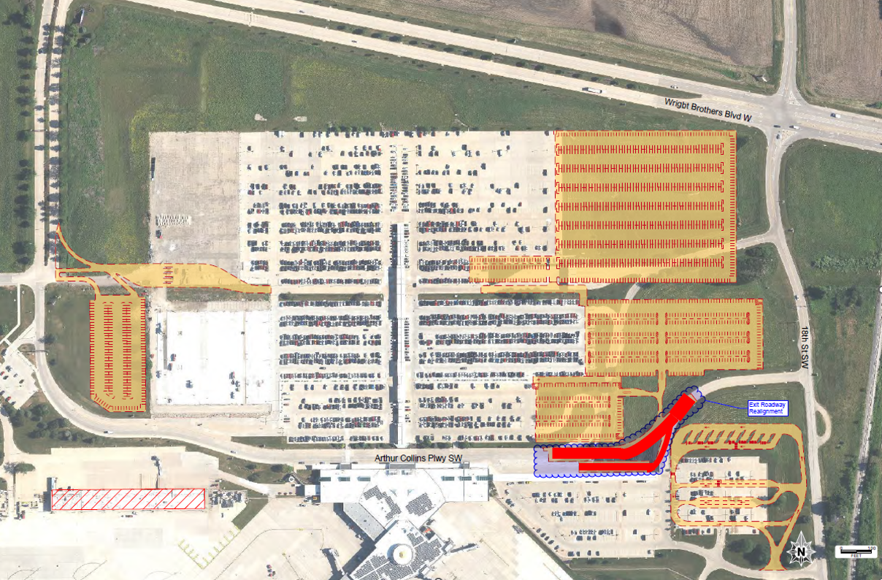
List of Local Development Applications Recommended
PROJECT NAME
SPONSOR
SCORE
TOTAL PROJECT COST
PERCENT PARTICIPATION
RECOMMENDED AMOUNT
Realignment of approximately 534 feet of Arthur Collins Parkway SW | Cedar Rapids | 61 | $1,099,786 | 50% | $549,893

