Slide 1
Revitalize Iowa’s Sound Economy Program
Iowa Transportation Commission Workshop
November 14, 2023

Slide 2
Revitalize Iowa’s Sound Economy Program
Created in 1985
Purpose: To promote economic development through roadway improvements.
Eligible development shall have value-adding activities that feed new dollars into the economy
Available to cities and counties through an application program

Slide 3
Monthly Program Financial Report
Funded annually with dedicated state motor fuel and special fuel tax revenues
 | City RISE Fund | County RISE Fund
FY2024 Projected Total RISE Road Use Tax Fund (RUTF) Revenue ¹ | $11,759,666 | $5,879,833
Actual RISE Revenue Received as of 9/30/2023 ² (% of FY2024 Projected Revenue) | $3,195,181 (27.2%) | $1,494,421 (25.4%)
FY2024 RISE Funds Awarded as of 9/30/23 (% of Projected Total RUTF committed) | $2,205,356 (18.8%) | $0 (0%)
Fund Balance as of 9/30/23 | $53,447,377 | $17,631,341
Outstanding Commitments as of 9/30/23³ | ($43,719,225) | ($19,174,279)
Uncommitted Balance as of 9/30/23 | $9,728,152 | ($1,542,938)
¹ Calculation based on FY2023 average monthly RISE RUTF revenue of $979,972 to the city RISE fund and $489,986 to the county RISE fund. As of 9/30/2023, FY2024 is 25.0% complete.
² Actual RISE revenue includes RUTF revenue, loan repayments, and project settlements. These revenue sources are variable and are not included in projections.
³ Award of $402,057 to Story City in October 2023 is not reflected in the outstanding commitments as of 9/30/2023.

Slide 4
Local Development Project Evaluation Criteria
Development Potential (35 points)
Economic Impact and Cost Effectiveness (20 points)
Local Commitment and Initiative (33 points)
Transportation Need and Justification (4 points)
Local Economic Need (6 points)

Slide 5
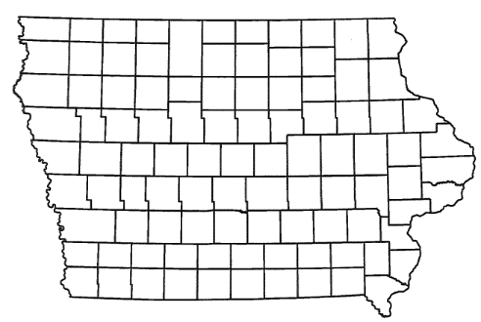
List of Local Development Applications Recommended
PROJECT NAME
SPONSOR
SCORE
TOTAL PROJECT COST
PERCENT PARTICIPATION
RECOMMENDED AMOUNT
Realignment of approximately 534 feet of Arthur Collins Parkway SW | Cedar Rapids | 61 | $1,099,786 | 50% | $549,893

Slide 6
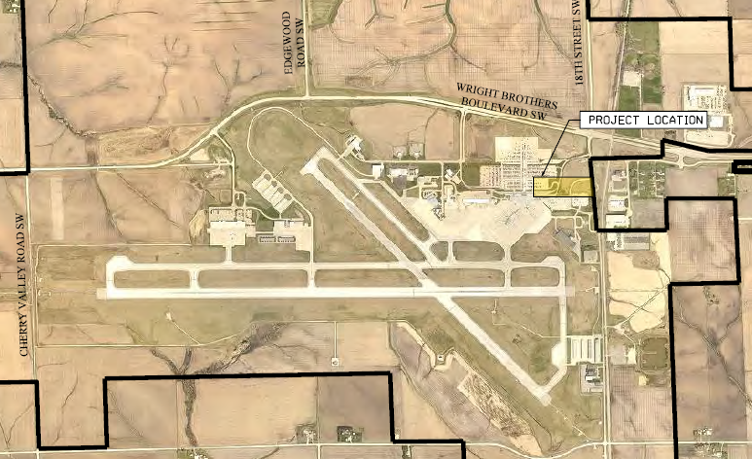
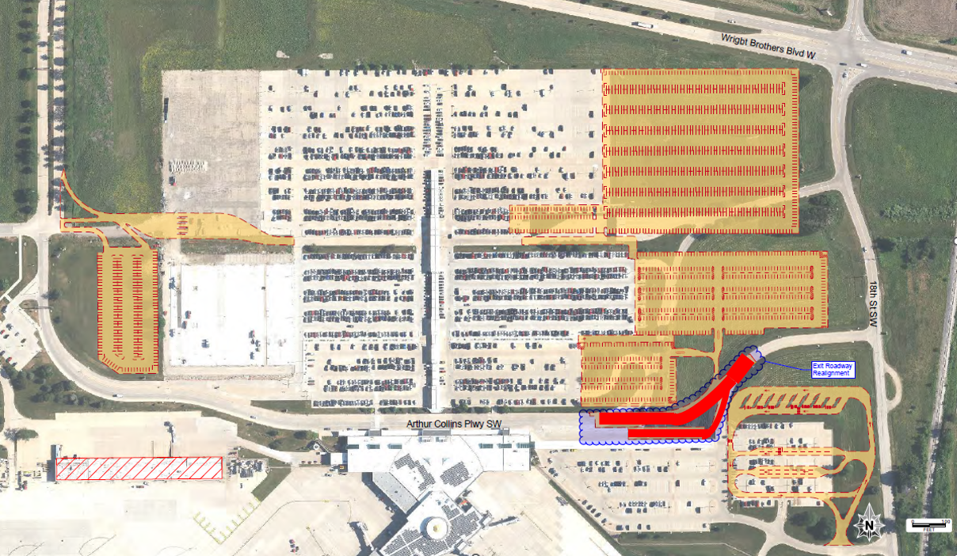
CEDAR RAPIDS
Local Development - Airport
Realignment of approximately 534 feet of Arthur Collins Parkway SW located on the southwest side of town. This project is necessary to provide improved access to the commercial passenger terminal at the Eastern Iowa Airport.
Total Cost: $1,099,786
Requested: $549,893 (50%)

Slide 7
QUESTIONS?
Debra Arp, Systems Planning Bureau
Debra.Arp@iowadot.us
515-239-1681

