Slide 1
Traffic Safety Improvement Program
Funding Recommendation
FY 2025

Slide 2
Background
Established in 1987 by Iowa Legislature
Iowa Code Section 312.2 and Administrative Rules 761 Chapter 164
0.5% of Road Use Tax Fund
Purpose: Implement traffic safety features in order to reduce fatalities and serious injuries
Available to all public entities responsible for public roads and streets

Slide 3
Funding Categories
Site-Specific Improvements
Construction projects to improve traffic safety and operations
Annual funding varies, generally $6-$7 million
Traffic Control Devices
For purchase of traffic control device materials
Annual funding = $500,000
Studies & Outreach
Traffic safety research, studies, and public information initiatives
Annual funding = $500,000
Listing of applications can be found at this link:
https://iowadot.gov/traffic/Traffic-and-Safety-programs/TSIP/TSIP-Program

Slide 4
Application Review/Scoring
Demonstrated relationship to traffic safety
Safety benefit
Project cost
Type of countermeasure(s) proposed
Risk factor(s) addressed
Safety engineering analysis
Multi-agency committee input
Funding subject to agreement execution

Slide 5
Application/Funding Summary
Application Summary
Applications received: 49
TSIP funds requested: $13,480,694
Available Funding
FY 2025 TSIP estimated appropriation: $8,146,187
Total funding recommended: $8,143,382
Notes:
32 site specific applications
Total requests $12,703,028
15 traffic control device applications
Total requests $1,951,290
1 study application
Total request $500,000

Slide 6
Site-Specific Improvements Funding Recommendation
PROJECT NAME | SPONSOR | SCORE | TOTAL PROJECT COST | REQUESTED AMOUNT (% of Total Project Cost) | RECOMMENDED AMOUNT (% of Total Project Cost)
W35 – edge treatments | Buchanan County | High | $4,285,097 | $500,000 (12%) | $500,000 (12%)
US 69 – turn lanes/raised median | City of Ankeny | High | $8,751,000 | $500,000 (6%) | $500,000 (6%)
1st Ave W and I-380 SB Ramp – turn lanes/reconstruction | City of Cedar Rapids | High | $1,104,000 | $495,000 (45%) | $440,000 (40%)
53rd St and Utica Ridge Rd – turn lanes | City of Davenport | High | $973,279 | $500,000 (51%) | $500,000 (51%)
6th Ave and Day St – retroreflective backplates/add signal heads/remove through lane/adjust clearance intervals | City of Des Moines | High | $2,700,000 | $500,000 (19%) | $500,000 (19%)
D14 and P56 – roundabout | Webster County | High | $1,206,700 | $500,000 (41%) | $500,000 (41%)

Slide 7
Site-Specific Improvements Funding Recommendation
PROJECT NAME | SPONSOR | SCORE | TOTAL PROJECT COST | REQUESTED AMOUNT (% of Total Project Cost) | RECOMMENDED AMOUNT (% of Total Project Cost)
S70 – edge treatments | Appanoose County | Med-High | $653,102 | $500,000 (77%) | $500,000 (77%)
C17 – edge treatments | Clayton County | Med-High | $726,579 | $500,000 (69%) | $500,000 (69%)
Ellis Rd – guardrail | City of Cedar Rapids | Med | $630,087 | $500,000 (79%) | $450,000 (71%)
41st St and Beaver Ave – realignment | City of Des Moines | Med | $775,000 | $500,000 (65%) | $450,000 (58%)
W Fulliam Ave and N Houser St – roundabout | City of Muscatine | Med | $314,956 | $314,956 (100%) | $314,956 (100%)
Countywide – destination lighting | Jackson County | Med | $326,700 | $326,700 (100%) | $148,500 (45%)

Slide 8
Site-Specific Improvements Funding Recommendation
PROJECT NAME | SPONSOR | SCORE | TOTAL PROJECT COST | REQUESTED AMOUNT (% of Total Project Cost) | RECOMMENDED AMOUNT (% of Total Project Cost)
X64 – widen lanes/edge treatments | Jones County | Med | $3,750,000 | $500,000 (13%) | $500,000 (13%)
Statewide – vulnerable road user countermeasures | Traffic and Safety Bureau | Med | $250,000 | $250,000 (100%) | $250,000 (100%)
W38 – lane widening/edge treatments | Washington County | Med | $2,932,331 | $500,000 (17%) | $500,000 (17%)
Viking Rd and Prairie Pkwy - roundabout | City of Cedar Falls | Med-low | $3,023,000 | $500,000 (17%) | $290,000 (10%)
S Main St and Summitt St – reconstruction | City of Maquoketa | Med-low | $531,950 | $500,000 (94%) | $290,000 (55%)

Slide 9
Traffic Control Devices Funding Recommendation
PROJECT NAME | SPONSOR | SCORE | TOTAL PROJECT COST | REQUESTED AMOUNT (% of Total Project Cost) | RECOMMENDED AMOUNT (% of Total Project Cost)
RRFB Ped Crossing | City of West Des Moines | High | $80,000 | $60,000 (75%) | $60,000 (75%)
Speed Feedback Signs | City of Waucoma | Med-high | $12,500 | $12,500 (100%) | $12,500 (100%)
Portable Temporary Traffic Signals | Clay County | Med-high | $68,750 | $68,750 (100%) | $60,000 (87%)
Flashing Beacons | Humboldt County | Med-high | $19,323 | $19,323 (100%) | $10,000 (52%)
Sign Replacement Program | Local Systems Bureau | Med-high | $200,000 | $200,000 (100%) | $100,000 (50%)
Portable Temporary Traffic Signals | Mills County | Med-high | $62,200 | $62,200 (100%) | $60,000 (96%)

Slide 10
Traffic Control Devices Funding Recommendation
PROJECT NAME | SPONSOR | SCORE | TOTAL PROJECT COST | REQUESTED AMOUNT (% of Total Project Cost) | RECOMMENDED AMOUNT (% of Total Project Cost)
Portable Temporary Traffic Signals | Appanoose County | Med | $62,195 | $62,195 (100%) | $60,000 (96%)
Speed Feedback Signs | City of Dysart | Med | $26,845 | $26,845 (100%) | $8,000 (30%)
Programmable Signal Heads | City of West Des Moines | Med | $90,000 | $90,000 (100%) | $45,000 (50%)
Flashing Beacons | Hancock County | Med | $25,141 | $25,141 (100%) | $6,000 (24%)
Portable Temporary Traffic Signals | Jefferson County | Med | $59,000 | $59,000 (100%) | $60,000 (102%)
Upgrade Signs | City of Dike | Med-low | $7,926 | $7,926 (100%) | $7,926 (100%)

Slide 11
Traffic Control Devices Funding Recommendation
PROJECT NAME | SPONSOR | SCORE | TOTAL PROJECT COST | REQUESTED AMOUNT (% of Total Project Cost) | RECOMMENDED AMOUNT (% of Total Project Cost)
Activated Warning Light System | Pottawattamie County | Med-low | $120,579 | $106,237 (88%) | $13,000 (11%)
Flashing Beacons | Van Buren County | Med-low | $40,084 | $40,084 (100%) | $7,500 (19%)

Slide 12
Studies & Outreach Funding Recommendation
PROJECT NAME
REQUESTED AMOUNT
RECOMMENDED AMOUNT
Studies Program | $500,000 | $500,000

Slide 13
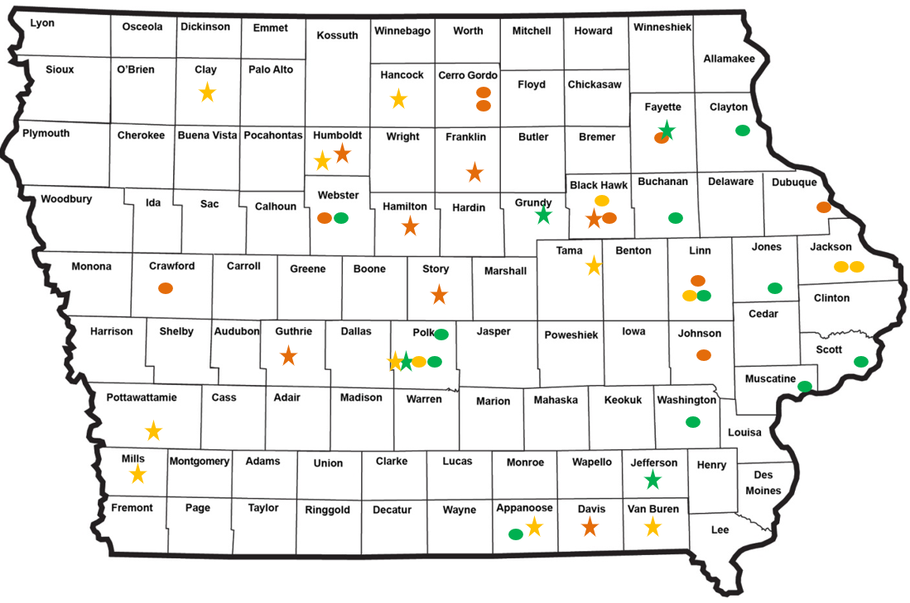
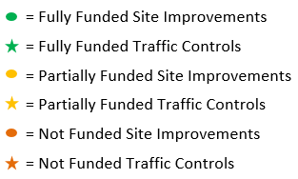
Map of Applications Received

Slide 14
QUESTIONS?
Jan Laaser-Webb, Traffic and Safety Bureau
jan.laaser-webb@iowadot.us
515-239-1349

Slide 15
Site-Specific Improvements Applications Not Recommended for Award
REQUESTED AMOUNT
(% of Total Project Cost)
RECOMMENDED AMOUNT
(% of Total Project Cost)
PROJECT NAME
SPONSOR
SCORE
TOTAL PROJECT COST
S62 - realignment | Cerro Gordo County | Med-low | $536,049 | $500,000 (93%) | $0 (0%)
NW Arterial and JFK Rd – right turn lane | City of Dubuque | Med-low | $389,642 | $311,714 (80%) | $0 (0%)
IA 56 and W51 - realignment | District 2/Fayette County | Med-low | $961,676 | $500,000 (52%) | $0 (0%)
IA 141 – edge treatments | District 3 | Med-low | $2,350,000 | $500,000 (21%) | $0 (0%)
210th St and IA 1 – turn lanes | Johnson County | Med-low | $615,390 | $500,000 (81%) | $0 (0%)
Return to Recommendation Summary

Slide 16
Site-Specific Improvements Applications Not Recommended for Award
REQUESTED AMOUNT
(% of Total Project Cost)
RECOMMENDED AMOUNT
(% of Total Project Cost)
PROJECT NAME
SPONSOR
SCORE
TOTAL PROJECT COST
D14 and P59 - roundabout | Webster County | Med-low | $1,140,700 | $500,000 (44%) | $0 (0%)
S56 – edge treatments | Cerro Gordo County | Low | $1,023,502 | $500,000 (49%) | $0 (0%)
Boyson Rd – lane conversion | City of Hiawatha | Low | $1,744,596 | $350,000 (20%) | $0 (0%)
US 63 NB and Sycamore St – new signal | City of Waterloo | Low | $262,500 | $262,500 (100%) | $0 (0%)
Return to Recommendation Summary

Slide 17
Traffic Control Devices Applications Not Recommended for Award
REQUESTED AMOUNT
(% of Total Project Cost)
RECOMMENDED AMOUNT
(% of Total Project Cost)
PROJECT NAME
SPONSOR
SCORE
TOTAL PROJECT COST
Flashing Beacons | City of Popejoy | Low | $1,475 | $1,475 (100%) | $0 (0%)
Bike Lane Relocation | City of Waterloo | Low | $47,429 | $47,429 (100%) | $0 (0%)
Portable Temporary Traffic Signals | Davis County | Low | $63,500 | $63,500 (100%) | $0 (0%)
Blinker Signs | Guthrie County | Low | $41,356 | $41,356 (100%) | $0 (0%)
Return to Recommendation Summary
Notes:
Popejoy – Chose not to fund because location did not make sense for a flashing beacon
Waterloo – The proposed project was not really a safety project
Davis – Will be sharing with Appanoose who is being recommended funding
Guthrie – There are other improvements that could be made first and the benefits of this type of sign have not been extensively studied

Slide 18
Traffic Control Devices Applications Not Recommended for Award
REQUESTED AMOUNT
(% of Total Project Cost)
RECOMMENDED AMOUNT
(% of Total Project Cost)
PROJECT NAME
SPONSOR
SCORE
TOTAL PROJECT COST
Portable Changeable Message Signs | Hamilton County | Low | $40,150 | $40,150 (100%) | $0 (0%)
Portable Temporary Traffic Signals | Humboldt County | Low | $55,400 | $55,400 (100%) | $0 (0%)
Portable Temporary Traffic Signals | Story County | Low | $61,100 | $61,100 (100%) | $0 (0%)
Return to Recommendation Summary
Notes:
Hamilton – This did not rate high enough to be funded
Humboldt – Surrounding counties all have PTTS
Story – Surrounding counties have PTTS and Story can always apply next year, it is a competitive year

