Slide 1
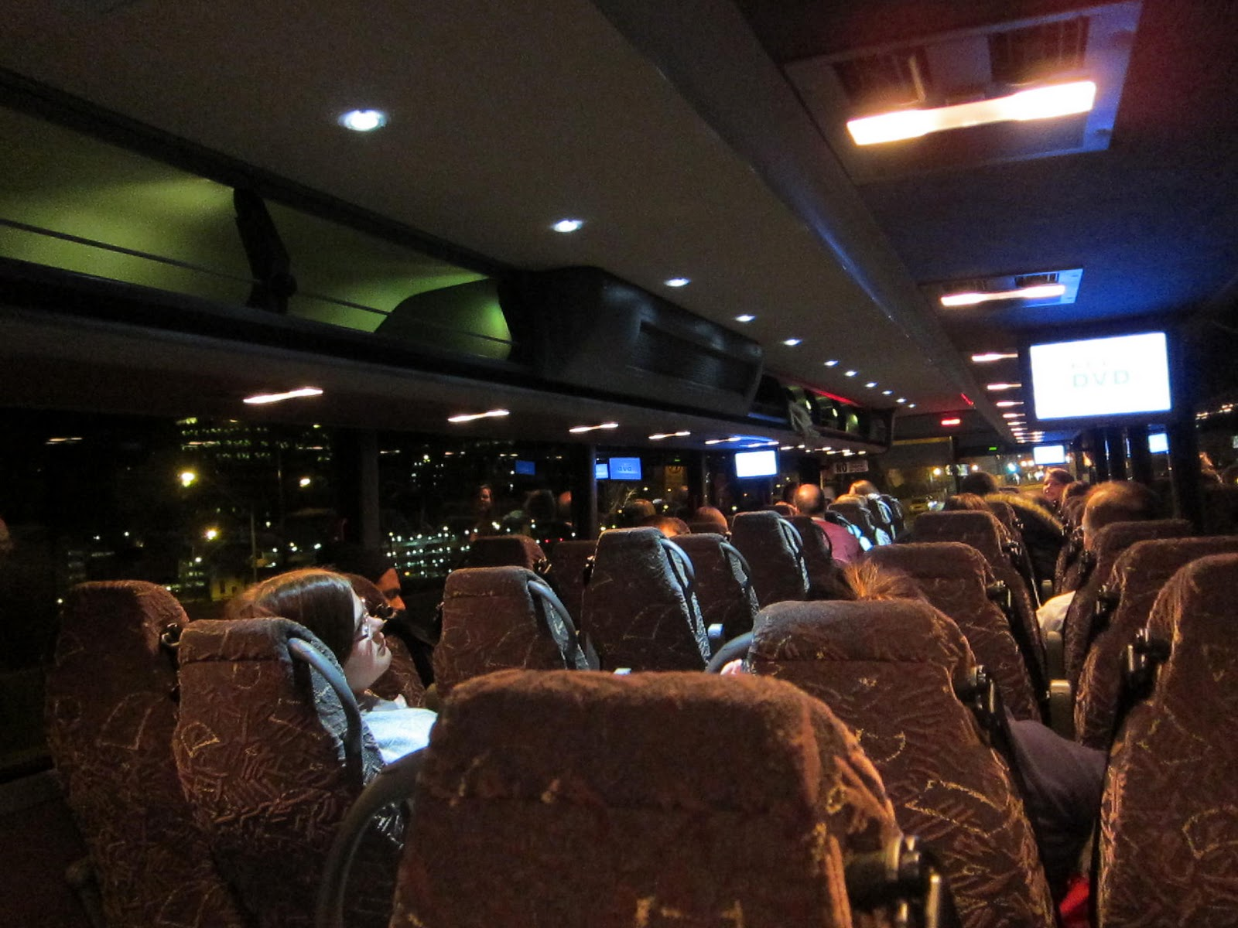
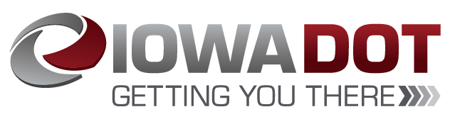
CY 24 Intercity Bus Program
Transportation Commission Workshop
November 14, 2023

Slide 2

Intercity Bus Program
CY24 Intercity Bus Program
Purpose: Support intercity bus services that includes stops at non-urbanized locations and makes meaningful connections to nationwide network
Available to private intercity bus companies, companies wishing to start bus service, public transit agencies either operating of proposing to operate bus service, and local communities wishing to support intercity connections to their community
Slide 2
Notes:
The intercity bus assistance program is a federally funded grant program that provides financial assistance to support intercity bus services that includes stops at non-urbanized locations and makes meaningful connections to the nationwide network. Funding is available for private bus companies, public transit agencies, and local communities wishing to support intercity connections to their community to maintain the viability of intercity bus service in Iowa.

Slide 3
Funding Priorities
CY24 Intercity Bus Program
Iowa’s program has four components in priority order:
Base level support of existing services ($0.20 per revenue mile)
Start-up support for new services (three years at $0.50 per revenue mile)
Support for marketing of intercity bus services and interlined services (maximum $7,500 for existing routes per agency and $12,000 per each new route with 20% local match required)
Support for intercity bus capital improvements (over the road coaches, vertical infrastructure, vehicle renovations/improvements, ADA improvements to vehicles and facilities). Vehicles require a 15% local match while all other capital projects require 20% local match.
Slide 3
Notes:
The intercity bus program has four funding components under which eligible applicants may apply, in priority order:
Priority 1 is for base level support of existing services at 20 cents per revenue mile.
Second priority is Start-up support for new services at three years at 50 cents per revenue mile.
Third is support for marketing of intercity bus services and interlined services, with a maximum seventy-five hundred dollars for existing routes per agency and twelve thousand dollars per each new route established.
The fourth priority is support for intercity bus capital improvements, which includes vehicles and facilities.

Slide 4
Available Funding and Application Summary
CY24 Intercity Bus Program
Available Funding
Total Intercity Bus Funds Available: $2,694,172
15% of federal non-urbanized (FTA Section 5311) transit funding
Application Summary
Total number of projects: 3
Total number of projects recommended: 3
Total project costs: $2,624,275
Total amount requested: $2,230,165
Remaining Balance : $464,007
Slide 4
Notes:
The program is funded by utilizing 15% of federal non-urbanized FTA Section 5311 transit funding. This year, we have two million, six hundred ninety-four thousand, one hundred seventy-two dollars in available funds.
We received three project applications that we are recommending for funding. The total project costs on the three applications totaled $2,624,275. The total amount of funding requested on these three projects is $2,230,165.
This leaves us with a remaining balance of $464,007 for future projects that will be available in the next round of funding.

Slide 5
CY24 Intercity Bus Program
List of Recommended Projects
PROJECT NAME | SPONSOR | TOTAL PROJECT COST | REQUESTED AMOUNT (% of Total Project Cost) | RECOMMENDED AMOUNT (% of Total Project Cost)
1 – Over the Road Motor Coach | Burlington Trailways | $799,900 | $679,915 (85%) | $679,915 (85%)
Slide 5
Notes:
Burlington Trailways has requested funding for one project. This would be for the purchase of one replacement over the road motor coach at a total project cost of $799,900. This is eligible for 85% project funding and the requested amount is $679,915. This project is being recommended for funding at the requested amount next month.

Slide 6
CY24 Intercity Bus Program
List of Recommended Projects,
continued
PROJECT NAME | SPONSOR | TOTAL PROJECT COST | REQUESTED AMOUNT (% of Total Project Cost) | RECOMMENDED AMOUNT (% of Total Project Cost)
3 – Over the Road Motor Coaches | Jefferson Lines | $1,815,000 | $1,542,750 (85%) | $1,542,750 (85%)
Slide 6
Notes:
Jefferson Lines has requested funding for one project. This would be for the purchase of three replacement over the road motor coaches at a total project cost of $1,815,000. This is eligible for 85% project funding and the requested amount is $1,542,750. This project is being recommended for funding at the requested amount next month.

Slide 7
CY24 Intercity Bus Program
List of Recommended Projects,
continued
PROJECT NAME | SPONSOR | TOTAL PROJECT COST | REQUESTED AMOUNT (% of Total Project Cost) | RECOMMENDED AMOUNT (% of Total Project Cost)
Marketing | Fort Dodge | $9,375 | $7,500 (80%) | $7,500 (80%)
Slide 7
Notes:
Fort Dodge has requested funding for marketing assistance for seven thousand five hundred dollars, which is an 80% eligible expense. We will be recommending funding next month at their requested amount.

Slide 8
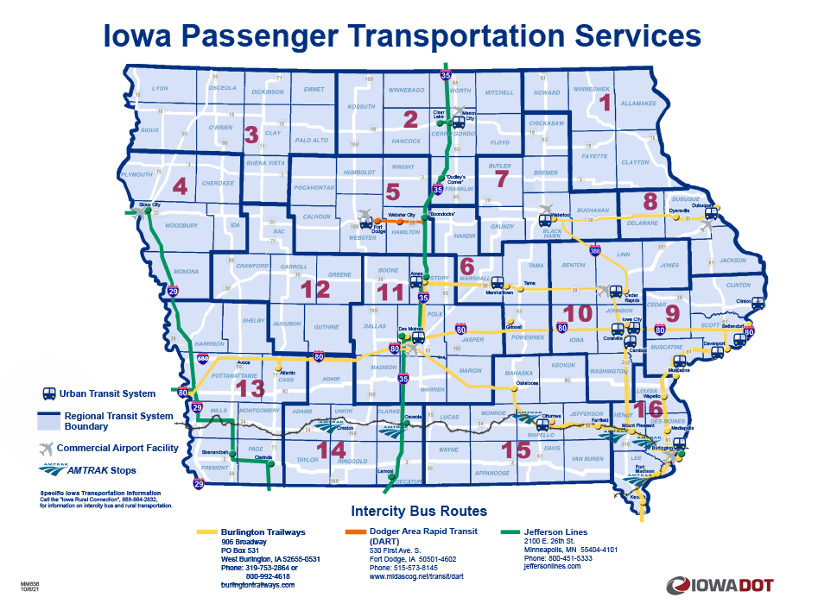
Intercity Bus Map
CY24 Intercity Bus Program
Slide 8
Notes:
This map provides the most recent and accurate Intercity Bus program transportation services.

Slide 9
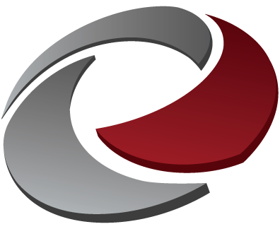
QUESTIONS?
For more information on Iowa’s public transit and intercity bus programs, visit
www.iowadot.gov/transit
Or contact the ICB Program Administrator
Matt Oetker
515-239-1765
matthew.oetker@iowadot.us
Slide 9
Notes:
Any questions?

