Slide 1



Transportation Trends Update
November 12, 2024
3/2/2023

Slide 2
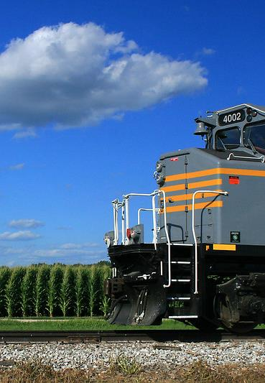

Agenda
US total rail carloads
Commercial air service passenger counts
Vehicular traffic
Water transportation

Slide 4
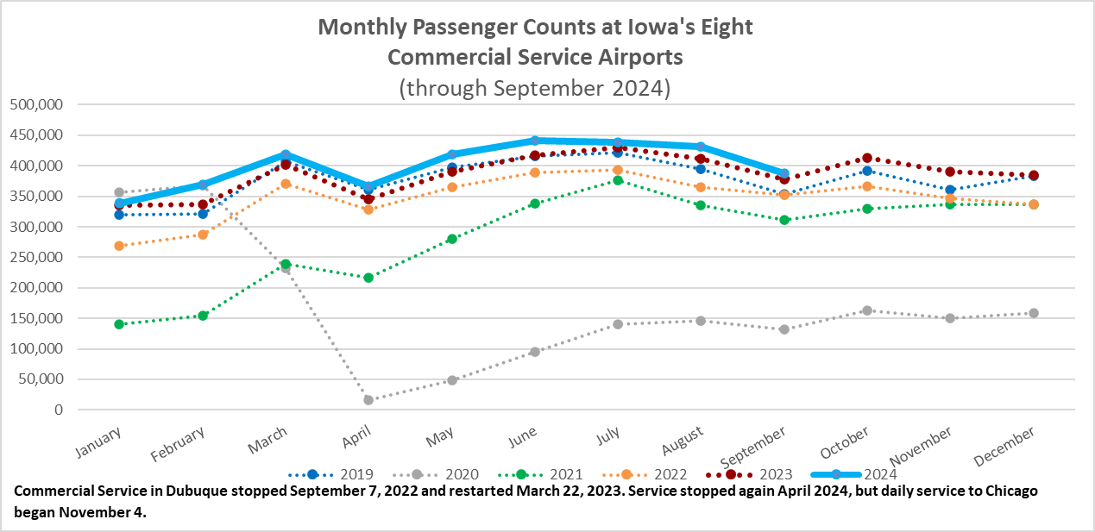

Slide 5
Monthly State Vehicle Miles of Travel
(through September 2024)

Slide 6
Water Transportation
Mississippi River
Drought has again caused low water levels on the Mississippi River
Restrictions on draft and tow sizes are in place.
“Every foot of reduced water depth or draft is the equivalent of loading 7,000 fewer bushels of soybeans on an individual barge” – Mike Steenhoek with the Soy Transportation Coalition
Barge freight rates are increasing

Slide 7
Questions?

