Slide 1
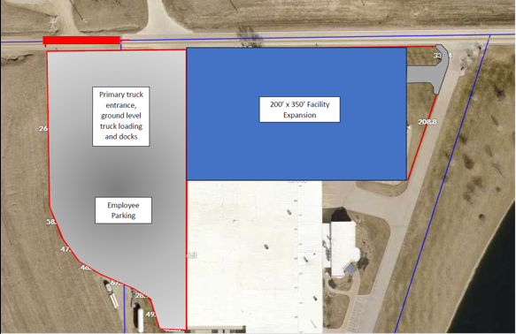
Local Development Recommendation
PROJECT NAME | SPONSOR | SCORE | TOTAL PROJECT COST | PERCENT PARTICIPATION | RECOMMENDED AMOUNT
Paving of approximately 150 feet of South 128th Avenue East located southwest of Lynnville | Jasper County | 66 | $570,423 | 50% | $285,212
1
1

