Slide 1
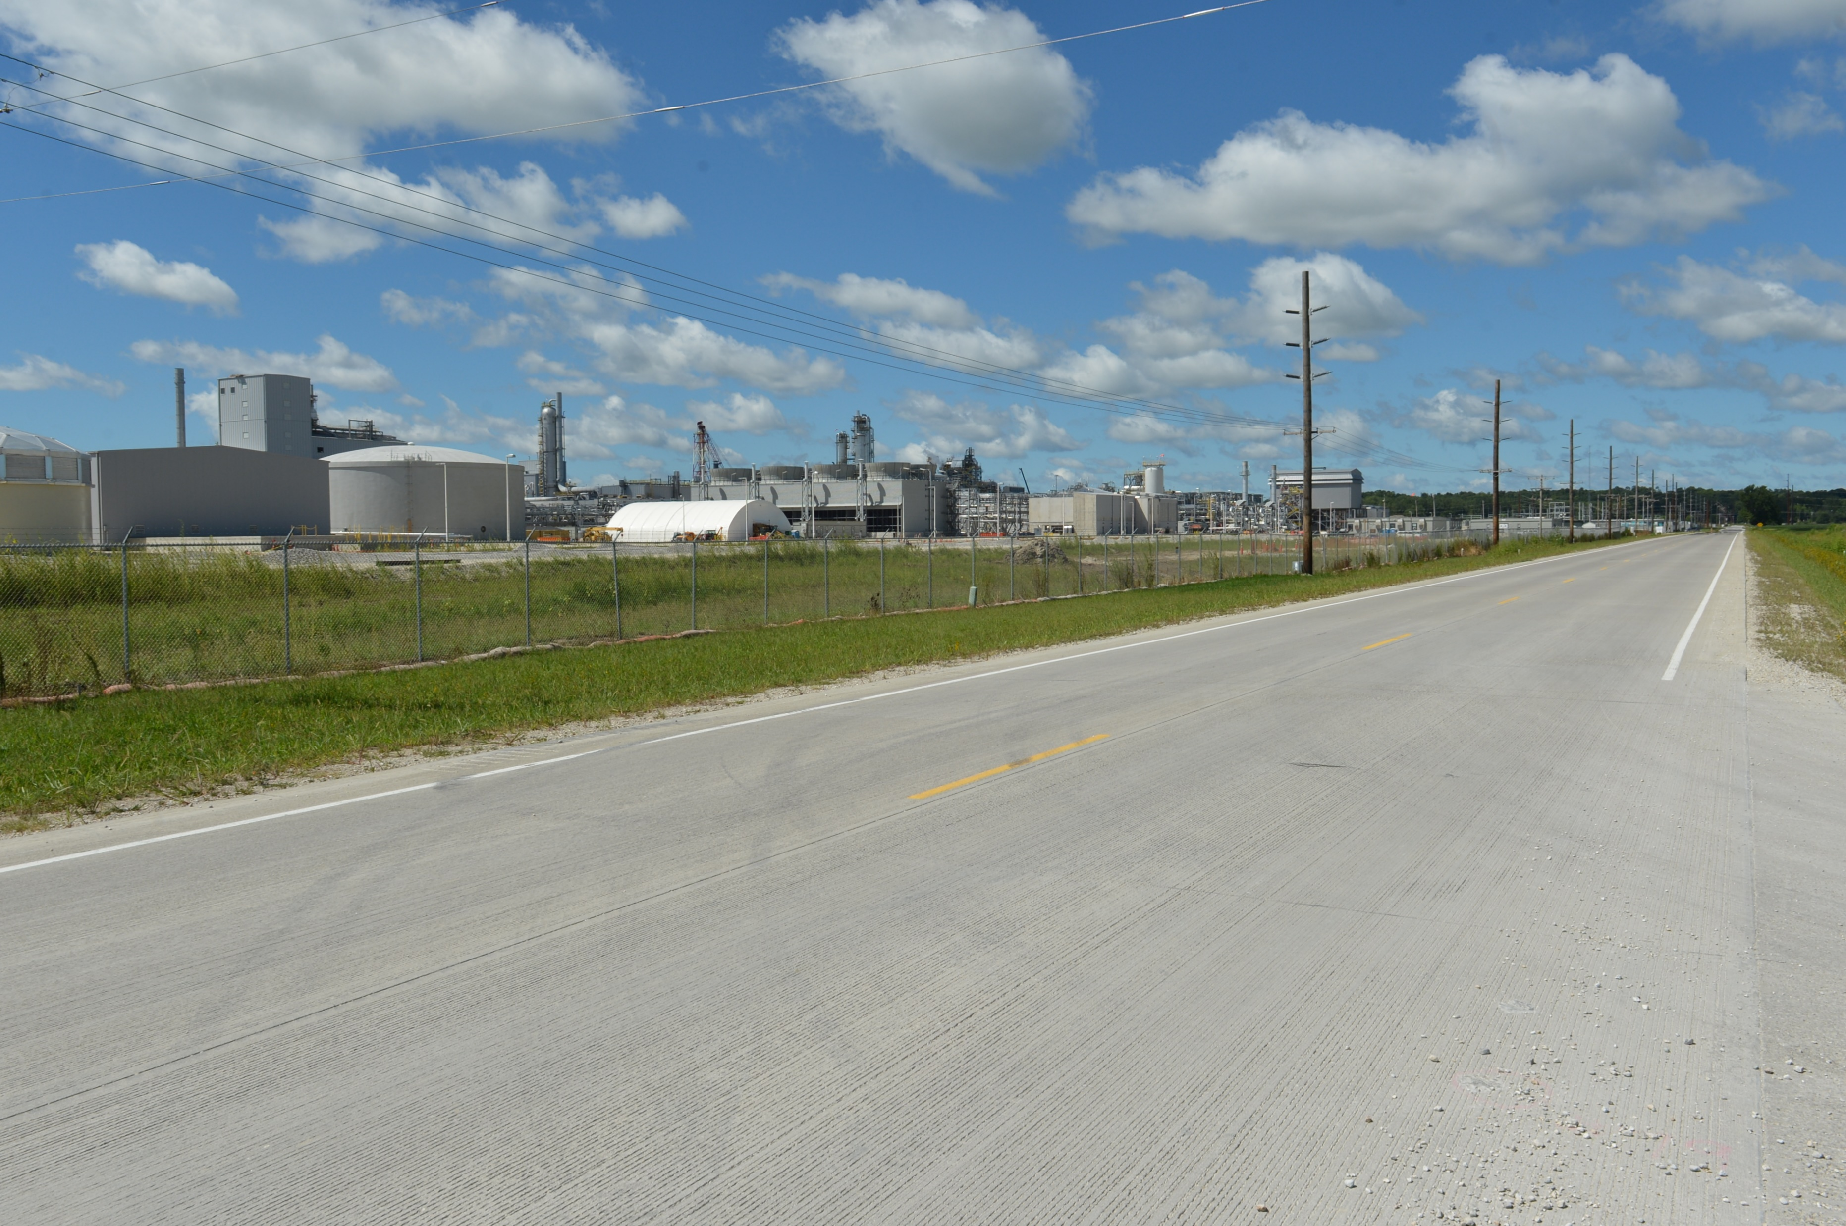
Revitalize Iowa’s Sound Economy Program
Funding Recommendation
Debra Arp
Local Systems Bureau, Grant Team Leader
11/12/2024

Slide 2
Revitalize Iowa’s Sound Economy Program
Created in 1985
Purpose: To promote economic development through roadway improvements
Eligible development shall have value-adding activities that feed new dollars into the economy
Available to cities and counties through an application program
2
2

Slide 3
Monthly Program Financial Report
Funded annually with dedicated state motor fuel and special fuel tax revenues
 | City RISE Fund | County RISE Fund
FY2025 Projected Total RISE Road Use Tax Fund (RUTF) Revenue ¹ | $11,611,933 | $5,805,967
Actual RISE Revenue Received as of 9/30/2024 ² (% of FY2025 Projected Revenue) | $3,081,811 (26.5%) | $1,512,874 (26.1%)
FY2025 RISE Funds Awarded as of 9/30/2024 (% of Projected Total RUTF committed) | $695,775 (6.0%) | $0 (0%)
Fund Balance as of 9/30/2024 | $54,204,847 | $18,673,394
Outstanding Commitments as of 9/30/2024³ | ($38,286,204) | ($17,160,520)
Uncommitted Balance as of 9/30/2024 | $15,918,643 | $1,512,874
¹ Calculation based on FY2024 average monthly RISE RUTF revenue of $967,661 to the city RISE fund and $483,831 to the county RISE fund. As of 9/30/2024, FY2025 is 25.0% complete.
² Actual RISE revenue includes RUTF revenue, loan repayments, and project settlements. These revenue sources are variable and are not included in projections.
³ Award of $1,482,758 to Rock Valley, $942,294 to Sioux Center and $5,775,530 to Boone in October 2024 (Total $8,200,582) is not reflected in the outstanding commitments of 9/30/2024.
3
3

Slide 4
Local Development Project Evaluation Criteria
Criteria | Points
Development Potential | 35
Economic Impact and Cost Effectiveness | 20
Local Commitment and Initiative | 33
Transportation Need and Justification | 4
Local Economic Need | 6
4
4

Slide 5
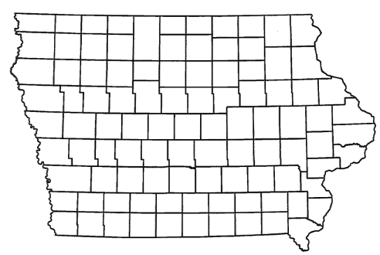
Local Development Recommendations
PROJECT NAME | SPONSOR | SCORE | TOTAL PROJECT COST | PERCENT PARTICIPATION | RECOMMENDED AMOUNT
Paving of approximately 150 feet of South 128th Avenue East located southwest of Lynnville | Jasper County | 66 | $570,423 | 50% | $285,212
5
5

Slide 6
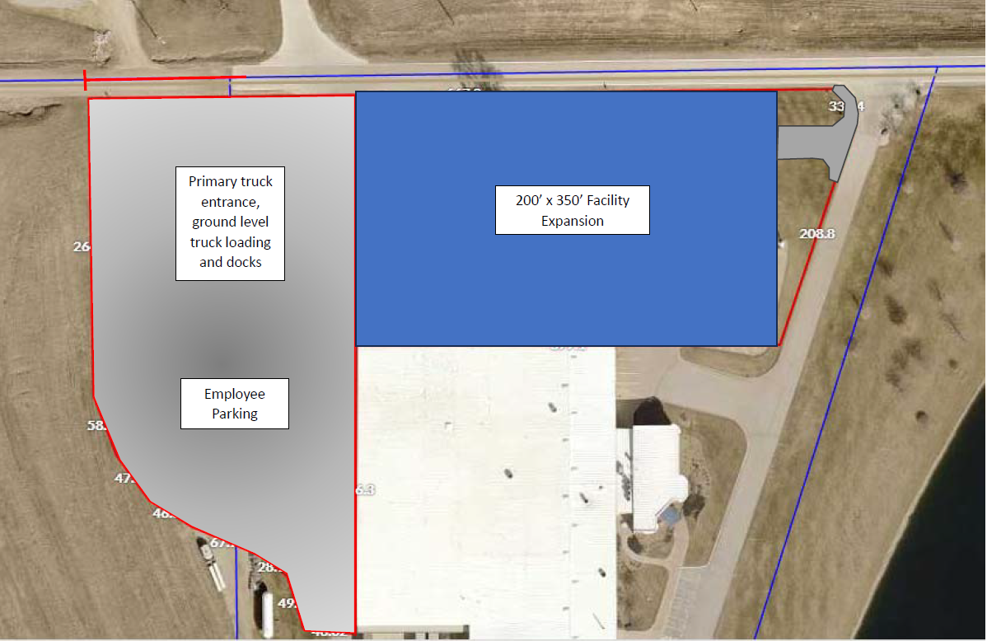
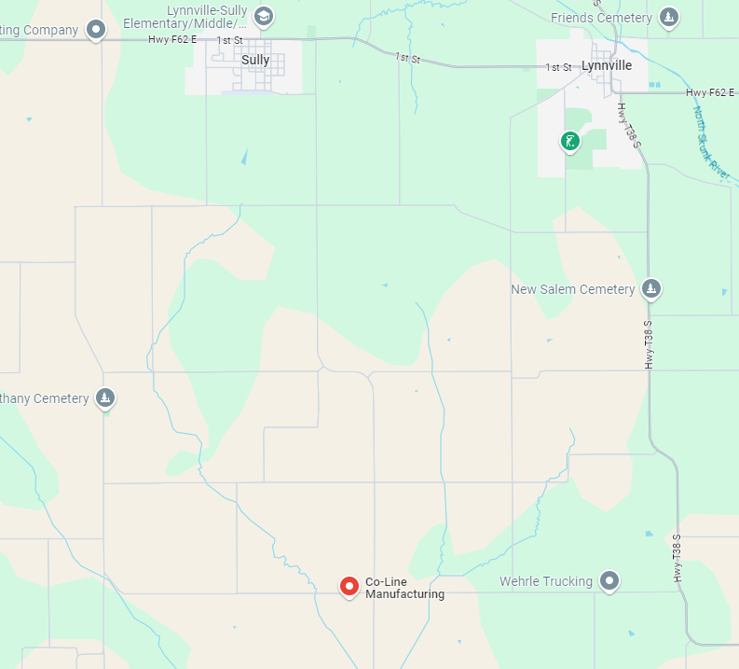
Jasper County
Local Development
Paving of approximately 150 feet of South 128th Avenue East located southwest of Lynnville on the Jasper-Mahaska county line. This project is necessary to provide improved access totaling over four acres for industrial purposes.
Total Cost: $570,423
Requested: $285,212 (50%)
6

Slide 7
Questions?
jennifer.kolacia@iowadot.us
515-239-1738

