Slide 1
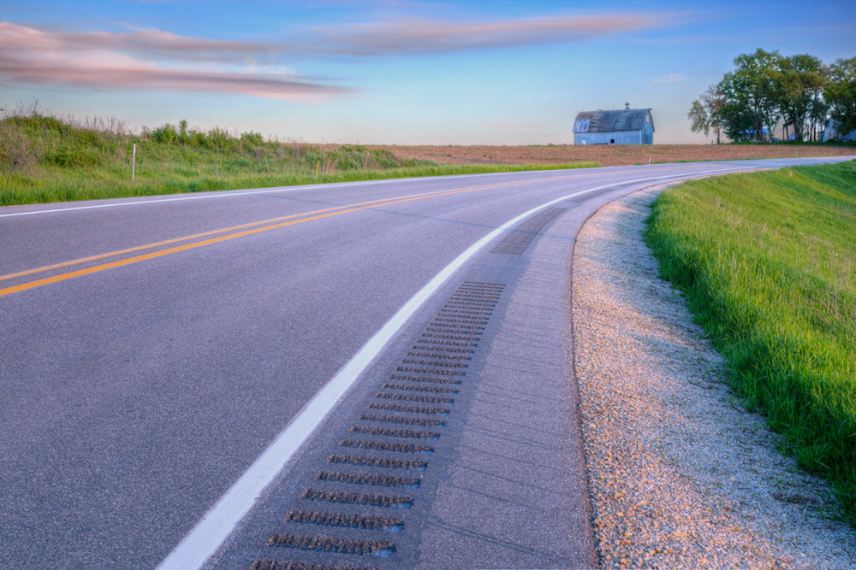

Traffic Safety Improvement Program
Funding Recommendation FY 2026
Jan Laaser-Webb
State Safety Engineer
11/12/2024
Notes:
Thank you for the time today to share the FY 2025 funding recommendations for the Traffic Safety Improvement Program. We often refer to the program as TSIP.

Slide 2
Background
Purpose: Implement traffic safety features in order to reduce fatalities and serious injuries
Available to all public entities responsible for public roads and streets
Iowa Code Section 312.2 ; Administrative Rule 761 Chapter 164
2
2
Notes:
The program’s purpose is funding projects specifically intended to reduce fatalities and major injuries on Iowa’s roadways.

Slide 3
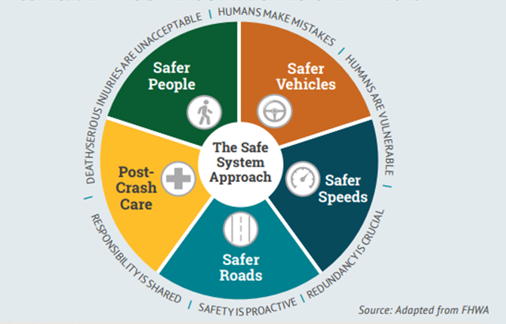

Slide 4
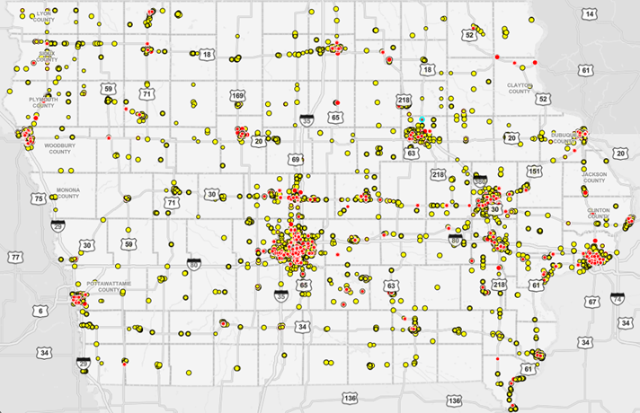
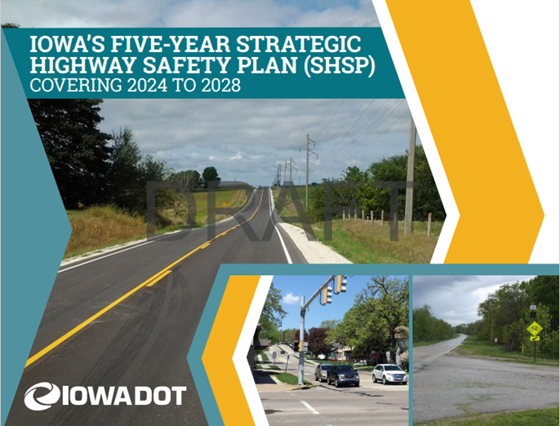
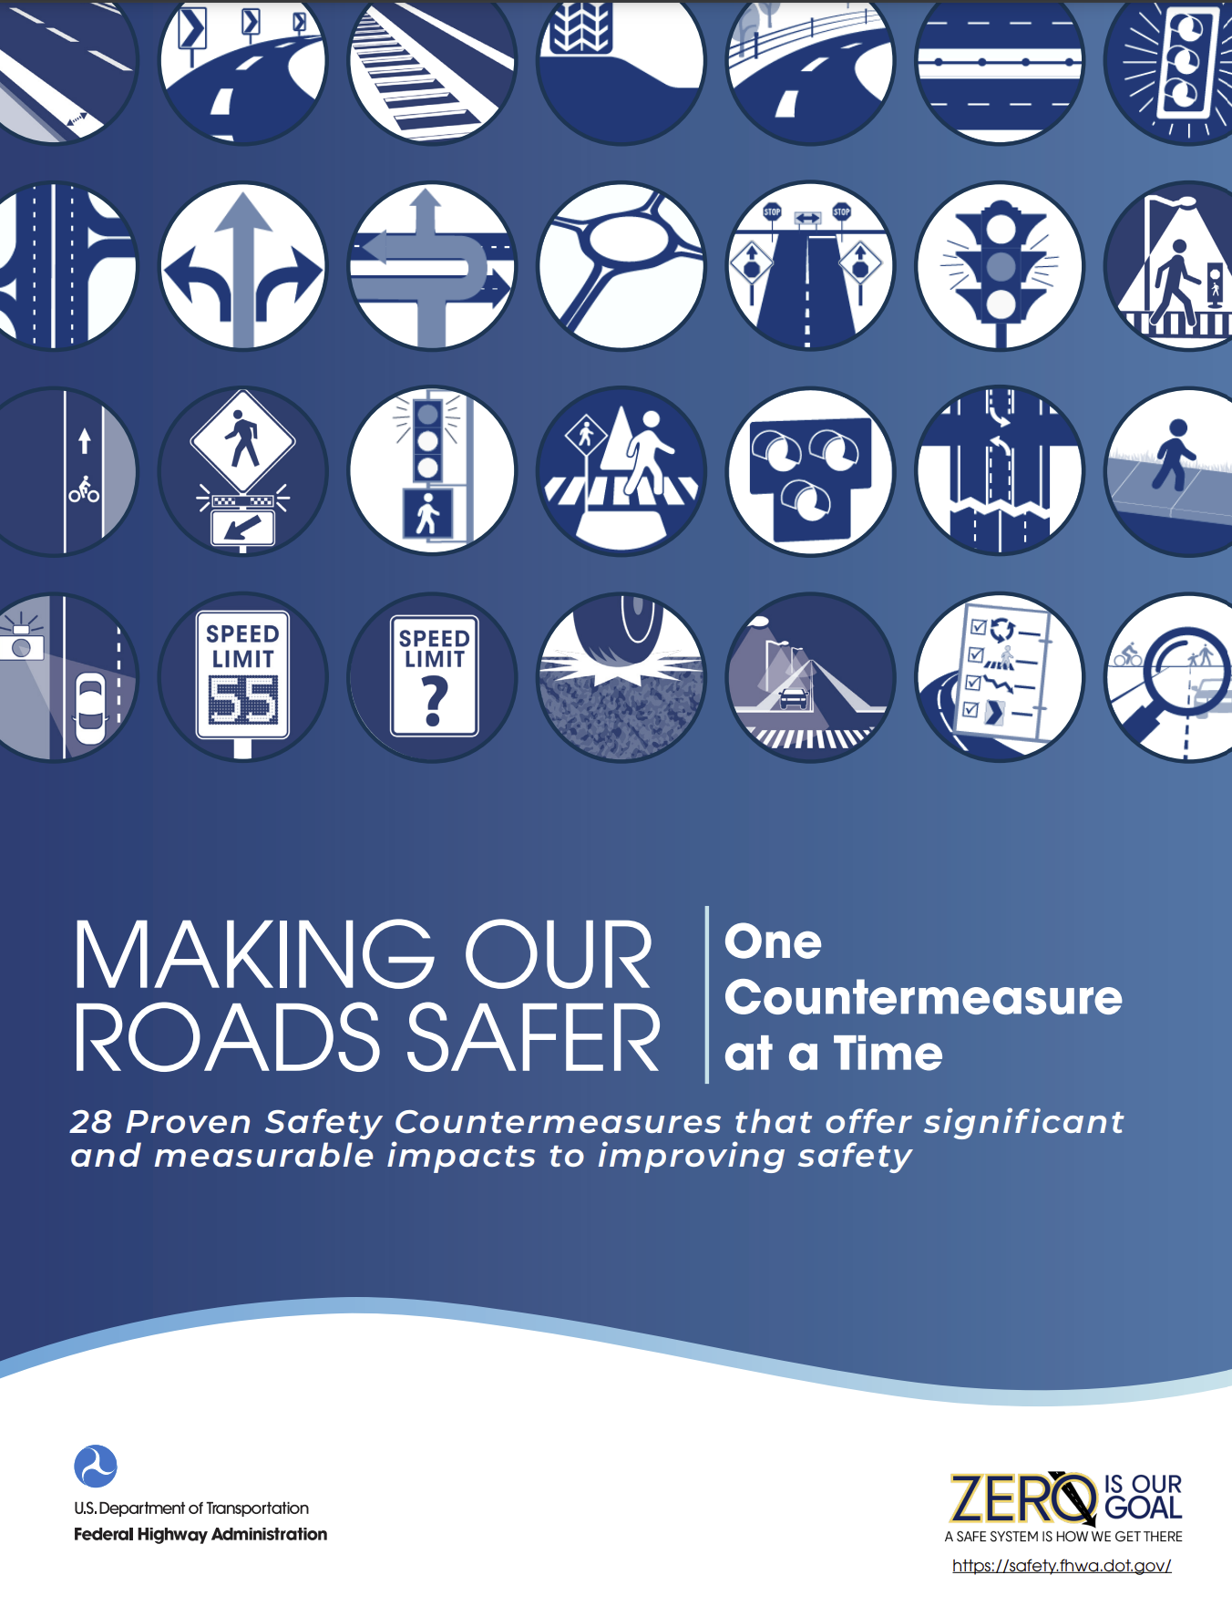
Resources
Notes:
Using the Safe System Approach, we work to develop plans

Slide 5
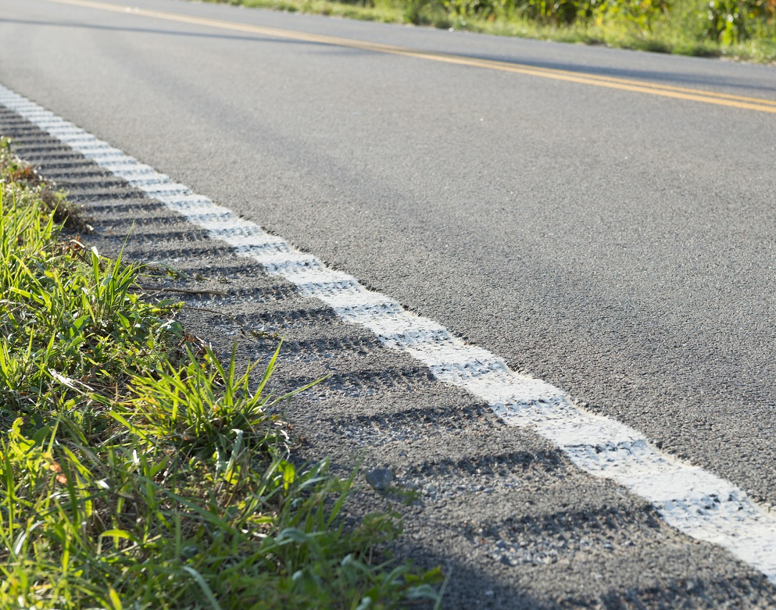
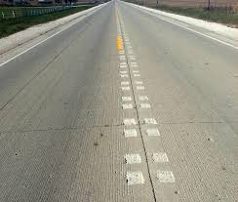
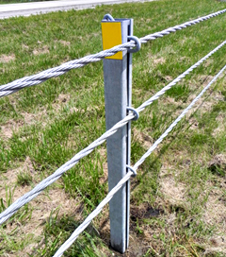
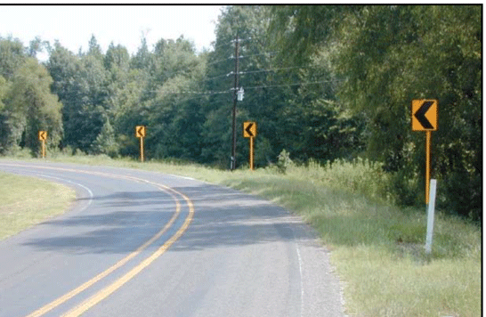
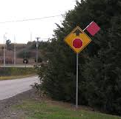
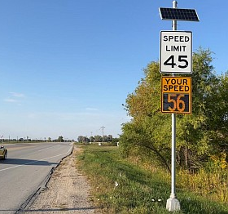
Notes:
Countermeasure examples

Slide 6
Funding Categories
Site-Specific Improvements
  Construction projects to improve traffic safety
  Annual funding varies, generally $6-$7 million
Traffic Control Devices
  Traffic control device materials
  Annual funding = $500,000
Studies & Outreach
  Traffic safety research and public information initiatives
  Annual funding = $500,000
Listing of applications can be found at this link:
https://iowadot.gov/traffic/Traffic-and-Safety-programs/TSIP/TSIP-Program
6
6
Notes:
There are 3 funding categories. Site specific are generally construction projects aimed at tweaking segments or intersections for safer travel, traffic control devices are generally signing or pavement marking for improved communication with the traveling public, and studies or outreach efforts are intended to prove or improve the effectiveness of all of the above.

Slide 7
Application Review/Scoring
Demonstrated relationship to traffic safety
Site’s potential for crash reduction
Type of countermeasure(s) proposed
Risk factor(s) addressed
Safety engineering analysis
Multi-agency committee input
Funding subject to agreement execution
Safety benefit expected vs. Project cost expected
Supported by transportation plan or engineering study
7
7
Notes:
When scoring applications, we look at the site’s potential for crash reduction (or PCR), anticipated safety benefit, the ratio of that benefit to the project cost, whether the countermeasure is proven or experimental, and whether or not the chosen countermeasure fits the type of crashes or risks experienced.
We’re fortunate to have a robust multi-agency committee made up of representatives from several bureaus within the DOT as well as county and city engineers.
As a sidenote, all funding is subject to finalizing an agreement

Slide 8
Available Funding and Application Summary
Available Funding: | Column 2
Annual estimated appropriation | $8,600,000
Total reversions | $0
Application Summary:
Applications received | 57
Total funds requested | $15,833,504
Total funding recommended | $8,621,060
8
8
Notes:
The FY2026 estimated appropriation is $8.6M. We received 57 applications this year totaling over $15.8M in requests.

Slide 9
Site-specific Improvement
Recommended for Funding
PROJECT NAME | SPONSOR | SCORE | TOTAL PROJECT COST | REQUESTED AMOUNT (% of Total Project Cost) | RECOMMENDED AMOUNT (% of Total Project Cost)
IA 57 & Union Rd – roundabout | City of Cedar Falls | High | $1,796,900 | $500,000 (28%) | $500,000 (28%)
Kimberly Rd & 36th St – install directional median | City of Davenport | High | $150,000 | $150,000 (100%) | $150,000 (100%)
N 15th St – lane conversion | City of Fort Dodge | High | $5,981,000 | $500,000 (8%) | $500,000 (8%)
Dace/Leech Ave – lane conversion | City of Sioux City | High | $91,804 | $91,804 (100%) | $91,804 (100%)
US 30 & Durham Ave – reduced conflict intersection | State Center | High | $2,000,000 | $500,000 (25%) | $500,000 (25%)
9
9

Slide 10
Site-specific Improvement
Recommended for Funding
PROJECT NAME | SPONSOR | SCORE | TOTAL PROJECT COST | REQUESTED AMOUNT (% of Total Project Cost) | RECOMMENDED AMOUNT (% of Total Project Cost)
H43 – shoulders, center and edge rumbles, safety edge, friction | Jefferson County | High | $4,856,325 | $500,000 (10%) | $500,000 (10%)
Ellis Rd & Covington Rd – roundabout | Linn County & City of Cedar Rapids | High | $1,655,027 | $500,000 (30%) | $500,000 (30%)
US 69 & 13th St – left turn lanes, protected left turn phasing | City of Ames | Med Hi | $2,785,000 | $500,000 (18%) | $500,000 (18%)
W 1st St – lane conversion | City of Ankeny | Med Hi | $9,464,000 | $500,000 (5%) | $500,000 (5%)
Heartland & Commerce – roundabout | City of Coralville | Med Hi | $1,258,000 | $500,000 (40%) | $500,000 (40%)
10
10

Slide 11
Site-specific Improvement
Recommended for Funding
PROJECT NAME | SPONSOR | SCORE | TOTAL PROJECT COST | REQUESTED AMOUNT (% of Total Project Cost) | RECOMMENDED AMOUNT (% of Total Project Cost)
19th St – lane conversion, shared use path, install backplates | City of Des Moines | Med Hi | $2,100,000 | $500,000 (24%) | $500,000 (24%)
W55 – shoulders, safety edge, center & edge rumbles, 6” markings | Henry County | Med Hi | $3,129,179 | $500,000 (16%) | $500,000 (16%)
3 curves – paved shoulders, 6” markings, shoulder rumbles | Humboldt County | Med Hi | $345,654 | $345,654 (100%) | $345,654 (100%)
110th St – paved shoulders, center & edge rumbles, 6” markings | Jefferson County | Med Hi | $2,604,323 | $222,986 (9%) | $222,986 (9%)
P53 – lane widening, paved shoulders, 6” markings, safety edge | Madison & Dallas Counties | Med Hi | $432,300 | $432,300 (100%) | $432,300 (100%)
11
11

Slide 12
Site-specific Improvement
Recommended for Funding
PROJECT NAME | SPONSOR | SCORE | TOTAL PROJECT COST | REQUESTED AMOUNT (% of Total Project Cost) | RECOMMENDED AMOUNT (% of Total Project Cost)
13 intersections – destination lighting | Marion County | Med Hi | $231,000 | $231,000 (100%) | $80,000 (35%)
W45 – paved shoulders, center & edge rumbles, safety edge, 6” markings | Buchanan County | Med | $3,612,000 | $500,000 (14%) | $400,000 (11%)
US 65 & Grant – left turn lanes and realignment | City of Bondurant | Med | $3,682,970 | $500,000 (14%) | $400,000 (11%)
Elmore Ave & 46th St – traffic signal | City of Davenport | Med | $300,000 | $300,000 (100%) | $200,000 (67%)
W51 – paved shoulders, shoulder rumbles, safety edge, 6” markings | Fayette County | Med Hi | $4,323,090 | $500,000 (12%) | $300,000 (7%)
12
12

Slide 13
Traffic Control Device
Recommended for Funding
PROJECT NAME | SPONSOR | SCORE | TOTAL PROJECT COST | REQUESTED AMOUNT (% of Total Project Cost) | RECOMMENDED AMOUNT (% of Total Project Cost)
Each of 4 major approaches to Unionville – speed feedback signs | Appanoose County | Med Hi | $15,000 | $14,184 (95%) | $14,184 (95%)
Each of 3 major approaches to Andrew – speed feedback signs | City of Andrew | Med Hi | $15,000 | $15,000 (100%) | $5,000 (33%)
Each of 3 major approaches to Delmar – speed feedback signs | City of Delmar | Med Hi | $15,000 | $15,000 (100%) | $5,000 (33%)
Each of 3 major approaches to Elgin – speed feedback signs | City of Elgin | Med Hi | $9,731 | $9,731 (100%) | $9,731 (100%)
Portable temporary traffic signals | Jackson, Cedar, & Jones Counties | Med Hi | $60,300 | $60,300 (100%) | $50,000 (83%)
13
13

Slide 14
Traffic Control Device
Recommended for Funding
PROJECT NAME | SPONSOR | SCORE | TOTAL PROJECT COST | REQUESTED AMOUNT (% of Total Project Cost) | RECOMMENDED AMOUNT (% of Total Project Cost)
Portable temporary traffic signals | Lee County | Med Hi | $65,000 | $65,000 (100%) | $50,000 (77%)
Portable temporary traffic signals | Story & Boone Counties | Med Hi | $60,000 | $60,000 (100%) | $50,000 (83%)
4 intersections – upgrade signal lenses & add retroreflective backplates | City of Sioux City | Med | $31,581 | $31,581 (100%) | $31,581 (100%)
F12 & Z36 – solar flashing beacons | Clinton County | Med | $8,260 | $8,260 (100%) | $8,260 (100%)
27 locations – flashing yellow arrow & add retroreflective backplates | City of Des Moines | Med | $350,000 | $294,600 (84%) | $147,300 (42%)
14
14

Slide 15
Traffic Control Device
Recommended for Funding
PROJECT NAME | SPONSOR | SCORE | TOTAL PROJECT COST | REQUESTED AMOUNT (% of Total Project Cost) | RECOMMENDED AMOUNT (% of Total Project Cost)
J20 & S Hoover St – speed feedback signs | Henry County | Med | $31,092 | $10,962 (35%) | $9,000 (29%)
Sign Replacement Program | Local Systems Bureau | Med | $200,000 | $200,000 (100%) | $100,000 (50%)
3 intersections – solar flashing beacons | Marion County | Med | $10,000 | $10,000 (100%) | $10,000 (100%)
East St & Fulton St – solar flashing beacons | City of Grand Mound | Med | $8,260 | $8,260 (100%) | $8,260 (100%)
15
15

Slide 16
Studies and Outreach
Recommended for Funding
PROJECT NAME | SPONSOR | SCORE | TOTAL PROJECT COST | REQUESTED AMOUNT (% of Total Project Cost) | RECOMMENDED AMOUNT (% of Total Project Cost)
Safety Studies Program | Traffic & Safety Bureau | High | $500,000 | $500,000 (100%) | $500,000 (100%)
16
16

Slide 17
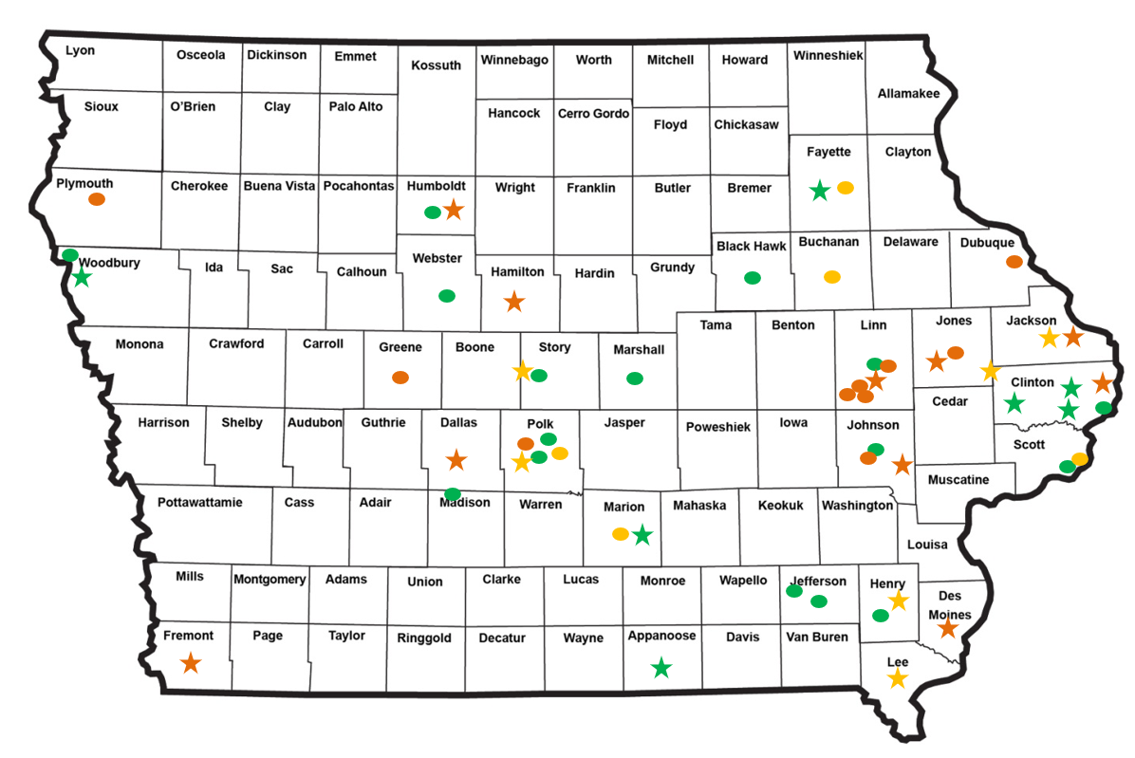
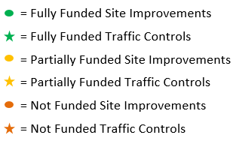
Map of Applications Received
17

Slide 18



Questions?
Jan.Laaser-webb@iowadot.us
515-239-1349

Slide 19
Site-specific Improvement
Not Recommended for Funding
PROJECT NAME | SPONSOR | SCORE | TOTAL PROJECT COST | REQUESTED AMOUNT (% of Total Project Cost) | RECOMMENDED AMOUNT (% of Total Project Cost)
W45 – paved shoulders, center & edge rumbles, safety edge, 6” markings | Buchanan County | Med | $3,612,000 | $500,000 (14%) | $0 (0%)
US 65 & Grant – left turn lanes and realignment | City of Bondurant | Med | $3,682,970 | $500,000 (14%) | $0 (0%)
1st Ave – install pedestrian beacon & fence median | City of Cedar Rapids | Med | $841,180 | $500,000 (59%) | $0 (0%)
Blairs Ferry & Dry Creek – directional median | City of Cedar Rapids | Med | $508,336 | $404,501 (80%) | $0 (0%)
Elmore Ave & 46th St – traffic signal | City of Davenport | Med | $300,000 | $300,000 (100%) | $0 (0%)
19
19

Slide 20
Site-specific Improvement
Not Recommended for Funding
PROJECT NAME | SPONSOR | SCORE | TOTAL PROJECT COST | REQUESTED AMOUNT (% of Total Project Cost) | RECOMMENDED AMOUNT (% of Total Project Cost)
Boyson Rd & Boyson Ct – roundabout | City of Hiawatha | Med | $1,270,143 | $500,000 (39%) | $0 (0%)
Center Ave & Jacoby Dr – roundabout | City of Epworth | Med Lo | $1,352,528 | $500,000 (37%) | $0 (0%)
IA 100 & IA 13 – reconfiguration | City of Marion | Med Lo | $617,250 | $500,000 (81%) | $0 (0%)
I 35 & US 6 interchange – convert to diverging diamond | City of Urbandale | Med Lo | $15,234,030 | $500,000 (3%) | $0 (0%)
IA 1 & 210th St – left & right turn lanes | Johnson County | Med Lo | $730,099 | $500,000 (68%) | $0 (0%)
20
20

Slide 21
Site-specific Improvement
Not Recommended for Funding
PROJECT NAME | SPONSOR | SCORE | TOTAL PROJECT COST | REQUESTED AMOUNT (% of Total Project Cost) | RECOMMENDED AMOUNT (% of Total Project Cost)
E28 – realign and flatten slopes | Jones County | Med | $5,750,000 | $500,000 (9%) | $0 (0%)
K42 – widen shoulders and flatten slopes | Plymouth County | Med | $1,151,300 | $500,000 (14%) | $0 (0%)
16th & Mill Creek – left turn lanes | City of Clinton | Med Hi | $449,090 | $399,099 (89%) | $0 (0%)
IA 4 – lane conversion | District 1 | Med Hi | $1,050,000 | $500,000 (48%) | $0 (0%)
21
21

Slide 22
Traffic Control Device
Not Recommended for Funding
PROJECT NAME | SPONSOR | SCORE | TOTAL PROJECT COST | REQUESTED AMOUNT (% of Total Project Cost) | RECOMMENDED AMOUNT (% of Total Project Cost)
Portable temporary traffic signals | Fremont County | Med | $56,900 | $56,900 (100%) | $0 (0%)
8 intersections – solar flashing beacons | Humboldt County | Med | $24,716 | $24,716 (100%) | $0 (0%)
Military St & Marion St – LED blinking stop sign & speed feedback signs | City of Martelle | Med | $4,466 | $4,466 (100%) | $0 (0%)
17 intersections – add retroreflective backplates | City of Marion | Med | $119,000 | $119,000 (100%) | $0 (0%)
Portable changeable message signs | Hamilton County | Med Lo | $39,300 | $39,300 (100%) | $0 (0%)
22
22

Slide 23
Traffic Control Device
Not Recommended for Funding
PROJECT NAME | SPONSOR | SCORE | TOTAL PROJECT COST | REQUESTED AMOUNT (% of Total Project Cost) | RECOMMENDED AMOUNT (% of Total Project Cost)
Willis Ave & 8th St – traffic signal upgrades | City of Perry | Med Lo | $59,285 | $59,285 (100%) | $0 (0%)
IA 1 & ACT Circle – install traffic signal | City of Iowa City | Low | $832,000 | $500,000 (60%) | $0 (0%)
Beaverdale Rd & Mt Pleasant St – traffic signal upgrades | City of West Burlington | Low | $71,603 | $58,766 (82%) | $0 (0%)
State St & S 8th St – rectangular flashing beacon | City of Bellevue | N/A | $20,000 | $15,000 (75%) | $0 (0%)
Work zone sign package program | Traffic & Safety Bureau | N/A | $70,000 | $70,000 (100%) | $0 (0%)
23
23

Slide 24
Traffic Control Device
Not Recommended for Funding
PROJECT NAME | SPONSOR | SCORE | TOTAL PROJECT COST | REQUESTED AMOUNT (% of Total Project Cost) | RECOMMENDED AMOUNT (% of Total Project Cost)
Each of 2 approaches to Charlotte – speed feedback signs | City of Charlotte | N/A | $10,000 | $10,000 (100%) | $0 (0%)
24
24

