Slide 1
CY25 Intercity Bus Program
Transportation Commission Workshop
November 12, 2024
3/2/2023
2025

Slide 2
Intercity Bus vs. Public Transit
There are three main types of public transit services: fixed route , ADA complimentary paratransit, and demand response.
Fixed Route – services are provided by our 19 urban transit agencies. This type of transit is delivered with set routes, stops, and time points. No advanced reservations are necessary.
ADA Complimentary Paratransit – services are provided by our 19 urban transit agencies. At a minimum, this type of transit is set 3/4–mile around a fixed route. Passengers must meet ADA requirements and reservations are required. Pick-up and drop-off are at desired locations.
Demand Response – services are provided by the 16 regional transit agencies. Reservations are required with pick-up and drop-off at desired locations.

Slide 3
Intercity Bus vs. Public Transit
Intercity Bus services are provided by 5 carriers in Iowa. This type of transportation is delivered with set routes, stops, and time points, including the ability to transfer passengers between providers. Advanced reservations/ ticketing are necessary.
Integrates connections between non-urbanized (rural) locations and urban areas.
Links intermodal facilities that provide the travelling public access to the network of local and regional transit systems, other intercity providers, airports, and passenger rail services.
Supports the connection between non-urbanized areas and the larger regional and national transportation systems.

Slide 4
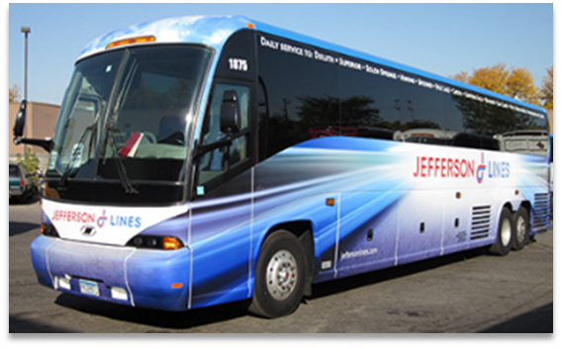
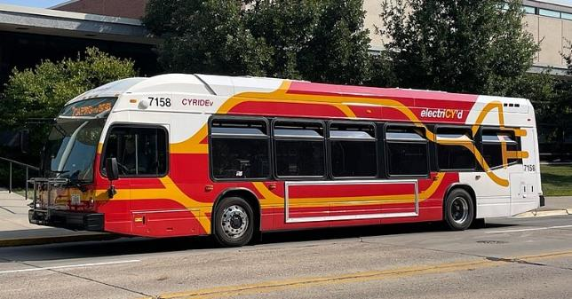
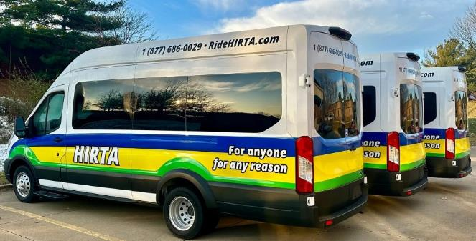
Intercity Bus vs. Public Transit
Jefferson Lines
CyRide
HIRTA

Slide 5
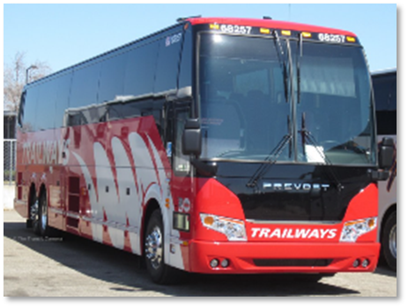
Intercity Bus Program
Purpose: Support intercity bus services that include stops at non-urbanized locations and makes meaningful connections to nationwide network
Available to private intercity bus companies, companies wishing to start bus service, public transit agencies either operating of proposing to operate bus service, and local communities wishing to support intercity connections to their community
Each state must spend no less than 15-percent of its annual apportionment of FTA Formula Grants for Rural Areas money for the development and support of intercity bus transportation, unless it can certify, after consultation with intercity bus service providers, that the intercity bus needs of the state are being adequately met.

Slide 6
Intercity Bus Map

Slide 7
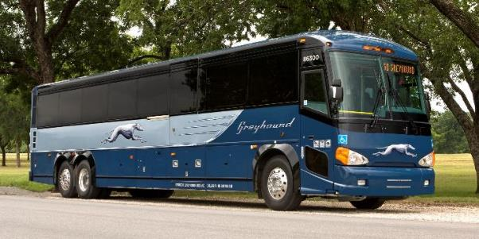
Funding Priorities
Iowa’s program has four components
- In priority order:
Base level support of existing service
$0.20 per revenue mile
Start-up support for new services
Three years at $0.50 per revenue mile
Support for marketing of intercity bus services and interlined services
Maximum $7,500 for existing routes per agency and $12,000 per each new route with 20% local match required
Support for intercity bus capital improvements
Over the road coaches, vertical infrastructure, vehicle renovations/ improvements, ADA improvements to vehicles and facilities. Vehicles require a 15% local match while all other capital projects require 20% local match.

Slide 8
Available Funding and Application Summary - CY25
Available Funding
Total Intercity Bus Funds Available: $3,513,223
15% of federal non-urbanized (FTA Section 5311) transit funding
FY24 5311(f) Funding: $2,627,951
FY23 5311(f) Funding – Unobligated: $885,272
Application Summary
Total number of projects: 9
Total number of projects recommended: 8
Total project costs: $6,938,779
Total amount requested: $3,142,016
Total amount recommended: $2,185,829
Remaining Balance : $1,327,394

Slide 9
List of Recommended Projects - CY25
Burlington Trailways
BURLINGTON TRAILWAYS | TOTAL PROJECT COST | REQUESTED AMOUNT | RECOMMENDED AMOUNT
Purchase Two Over-The-Road Motorcoaches | $1,673,463 | $1,422,443 | $1,422,443
Existing Service Support | $750,973 | $750,973 | $0
Total | $2,424,436 | $2,173,416 | $1,422,443

Slide 10
List of Recommended Projects - CY25
Greyhound Lines
GREYHOUND LINES | TOTAL PROJECT COST | REQUESTED AMOUNT | RECOMMENDED AMOUNT
Start-Up Service Support | $854,100 | $65,700 | $65,700
Total | $854,100 | $65,700 | $65,700

Slide 11
List of Recommended Projects - CY25
Jefferson Lines
JEFFERSON LINES | TOTAL PROJECT COST | REQUESTED AMOUNT | RECOMMENDED AMOUNT
Purchase One Over-The-Road Motorcoach | $722,684 | $614,281 | $614,281
Existing and Start-Up Service Support | $2,817,474 | $192,551 | $48,138
Marketing | $9,375 | $7,500 | $7,500
Mason City Travel Information Center - Rent | $23,100 | $18,480 | $4,620
Des Moines Depot - Rent | $78,235 | $62,588 | $15,647
Total | $3,650,868 | $895,400 | $690,186

Slide 12
List of Recommended Projects - CY25
City of Fort Dodge
CITY OF FORT DODGE | TOTAL PROJECT COST | REQUESTED AMOUNT | RECOMMENDED AMOUNT
Marketing | $9,375 | $7,500 | $7,500
Total | $9,375 | $7,500 | $7,500

Slide 13
Summary of Recommended Funding - CY25
 | TOTAL PROJECT COST | REQUESTED AMOUNT | RECOMMENDED AMOUNT
Burlington Trailways | $2,424,436 | $2,173,416 | $1,422,443
Greyhound Lines | $854,100 | $65,700 | $65,700
Jefferson Lines | $3,650,868 | $895,400 | $690,186
City of Fort Dodge | $9,375 | $7,500 | $7,500
Total | $6,938,779 | $3,142,016 | $2,185,829

Slide 14
Questions?
Jefferson Lines
For more information on Iowa’s public transit and intercity bus programs, visit
www.iowadot.gov/transit
Or contact the ICB Program Administrator
Matt Oetker
515-239-1765
matthew.oetker@iowadot.us

