Slide 1
Project Prioritization/Scoping Tool
Updates and Planned Enhancements
Charlie Purcell
Deputy Director, Transportation Development Division
Nov 12, 2024

Slide 2
Agenda
Background
Why and how the application was developed
Evolution of practice
How our use of the prioritization tool has changed
Project Scoring
Proposed improvements for project scoring
Recommendations
Our proposed path forward

Slide 3
User Note: Click the image icon to add your image
DELETE THIS BOX WHEN FINISHED
Background
Why and how the application was developed
Notes:
This application was conceived in 2015, in response to an overflow of larger capacity improvement projects and not enough resources to complete them all.
The Commission and the Department wanted a way to utilize our many datasets to help make more transparent and data-informed decisions on which projects to move forward.
Key features of application include:
Automated processing of a current condition score for all planned or programmed projects
Calculated scores based on DOT-managed business data
Live impact analysis of many GIS layers
Interactive mapping
Benefits of the application include:
Provide a better way to identify projects for development
Help the Department’s decision making be more data driven
Create a more transparent and repeatable project selection process
Help us better coordinate projects
Provide better communication and evaluation of potential program additions

Slide 4
Making Data Informed Decisions
Safety (18%)
Pavement (16%)
Bridge (15%)
Traffic (15%)
Mobility (14%)
Freight (12%)
System Importance (10%)
(Road Class)
Notes:
The application was built with a set of seven criteria in mind to help evaluate projects. In 201,8 the commission workshopped the criteria to determine the best comparative weights for each. These percentages were incorporated in the final cumulative/overall score for project evaluations. The overall scores were used as a screening tool to guide which projects to include in the upcoming program additions.
Safety (18%)
Weighted average crash rate from intersection to intersection giving more criticality to fatal and injury crashes.
Roadway Class (10%)
Score projects based on their location on important Iowa networks like the Commercial and Industrial Network, etc.
Freight (12%)
Score projects based on their criticality to the statewide freight network.
Pavement (16%)
Evaluating the overall condition of the pavement, while also considering its smoothness and rideability.
Bridge (15%)
Evaluating the bridge condition index, which includes age, load capacity, traffic count, and a few other factors.
Traffic (15%)
A measure of the volume of traffic that each road is carrying in comparison to what it can carry.
Mobility (14%)
Based on actual hours of delay when available, or when not available, the relationship between numbers of access points and traffic volumes.

Slide 5
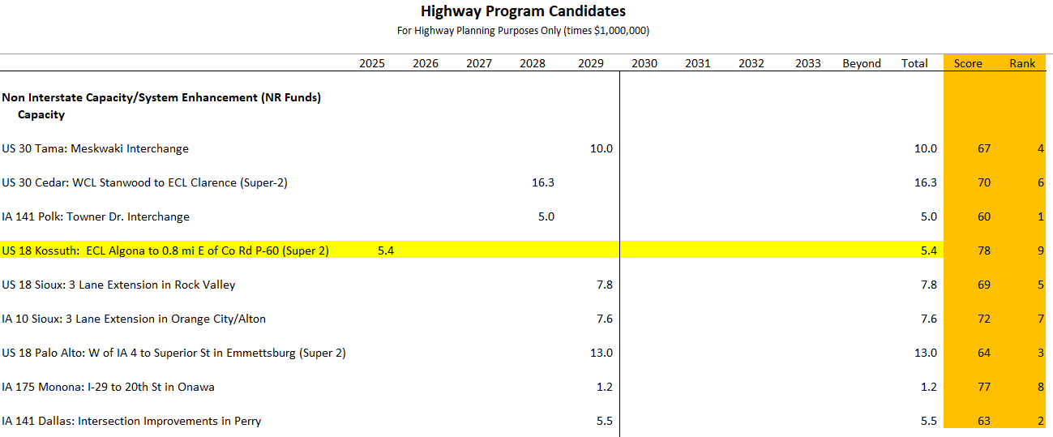
Scores don’t tell the whole story
Notes:
Provide reminder of how project scores are used in our current program development process and show up on the highway candidates list.
Explain why the scores don’t always match our recommendations because of limitations in the way project scoring works (US 18 Kossuth project highlighted is an example)

Slide 6
Evolution of Practice
How our use of the prioritization tool has changed
Notes:
Since its inception in 2015 (rollout in 2018), the intent of the Project Prioritization and Scoping application was to bring many different data sources together in a meaningful way to allow the Department to take a holistic approach at prioritizing projects.
Due to the change in workflows for identifying projects for programming, the use of the scoping tool has evolved over time.

Slide 7
Business Cases
Developed to help plan, program, and develop projects more efficiently.
Required to start certain types of projects or new studies.
Outlines why the project or study is needed and includes supporting data, including prioritization scores
Identifies potential solutions, and costs.
Used to identify projects that are brought to the Commission for consideration for programming
This Photo by Unknown Author is licensed under CC BY-SA
Notes:
One example of the way our processes have evolved is the development of a business case process.
In 2022, this process was developed to help the Department plan, program, develop and construct projects more efficiently.
To initiate certain types of projects or new studies, a Business Case must be submitted and approved.
The business case outlines why the project or study is needed along with supporting data, potential solutions, and costs.
After a business case is approved, a project may be considered for programming and development.
Only a small number of projects will require a business case; however, these are usually the high $ projects.
Project prioritization scores are part of the supporting documentation for a business case.
Approved business cases are presented to the Commission as part of the annual review of the Highway candidate projects list.
***
The overall goals of the Business Case process are to:
Provide Department staff better direction on what projects they should focus on developing
Minimize work on projects with low probability of getting programmed
Reduce the number of projects visible to the public that have a low probability of construction in the near term.
Business cases must be approved for any unprogrammed project proposed with the following funding:
Major Interstate Capacity/System Enhancement (MI) projects
Non-Interstate Capacity/Systems Enhancement (NR) projects
Interstate Stewardship (4R) projects that go beyond minimum scope required
Non-Interstate Bridge Modernization (BR) projects that go beyond minimum scope
Any study or project where the eventual construction funding is unknown, MI or NR

Slide 8
Project Scoring
Recommended improvements

Slide 9
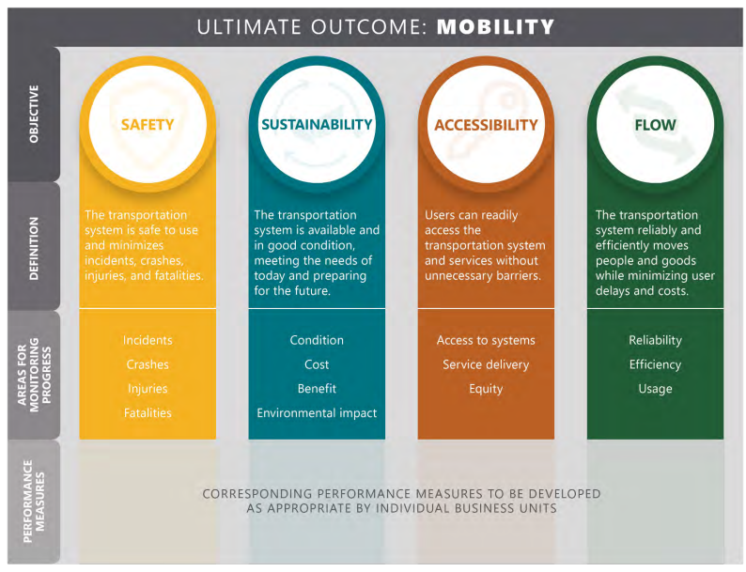
Outcome-based and Aligned
Notes:
Outcome-based: Focuses on outcomes and benefits achieved by projects relative to their costs, rather than on the magnitude of the problem being addressed. It is not enough to invest in a high-crash or high-volume location unless a project improves safety or access.
Aligned: Use the 4 key objectives identified in our long-range transportation plan to drive project prioritization and selection.
Examples of scoring categories:
Safety. Objective: limit fatalities and serious injuries. Recommended criteria: Reduction in fatal or serious crashes using crash modification factors or modeling tools.
Cost. Objective: maximize return on investment. Recommended criteria: Total benefit per dollar spent.
Future workshop will be held with commission to determine the weightings/scoring/objectives – Crash reduction/all crashes/fatals tec.

Slide 10
Summary of recommendations
Better align scoring with the long-range transportation plan objectives
Update scoring to be more based on outcomes vs existing conditions
Review proposed scoring methods and weighting with Commission at a future meeting
Notes:
Anticipated effort to develop business case repository and modify present condition scores are not expected to be significant. Developing outcome-based scores will take more effort but we will ensure better alignment with better with commission adopted long range transportation plan.

Slide 11
Questions?

