Slide 1
Commission Materials Website Overview
October 8, 2019

Slide 2
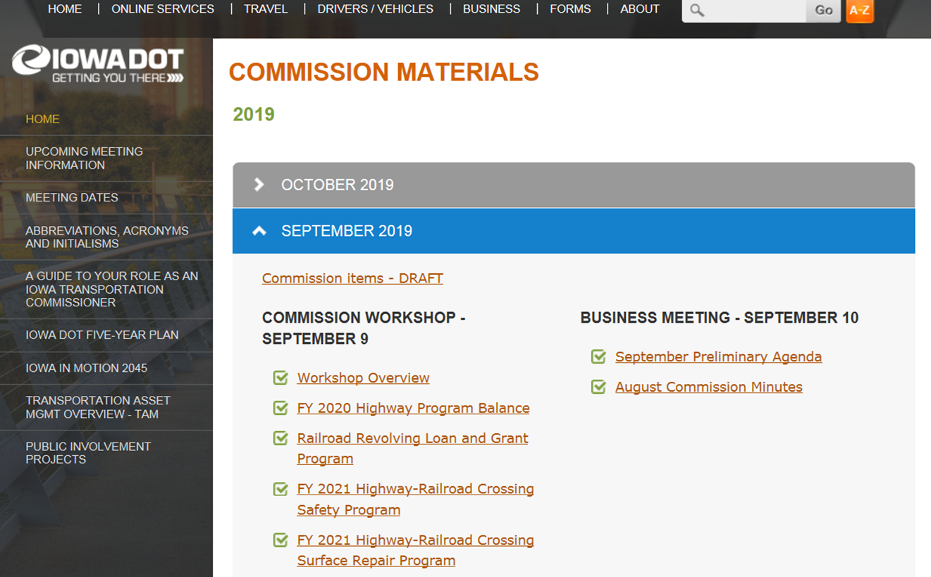
iowadot.gov/itc-materials

Slide 14
Questions?

