Slide 1
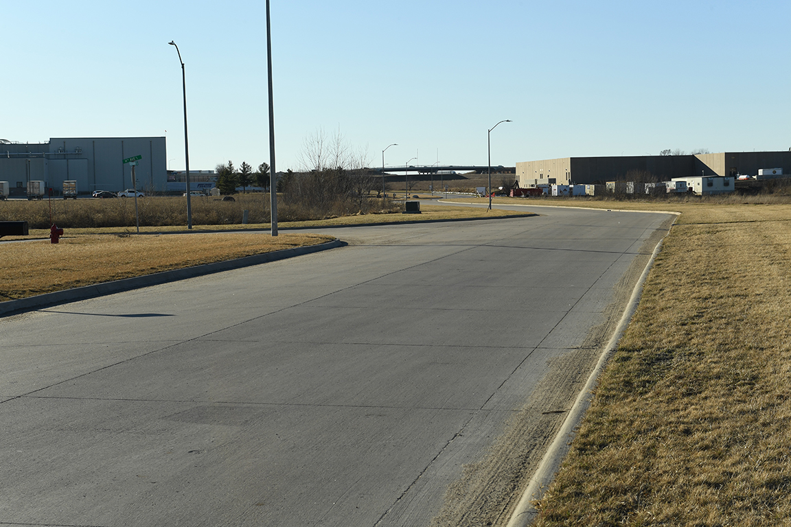

Revitalize Iowa’s Sound Economy Program

Slide 2
Revitalize Iowa’s Sound Economy Program
Created in 1985
Purpose: To promote economic development through roadway improvements.
Eligible development shall have value-adding activities that feed new dollars into the economy
Available to cities and counties through an application program

Slide 3
Available Funding and Application Summary
Available Funding
  Funded annually with dedicated state motor fuel and special fuel tax revenues
Application Summary for SFY2020
  Total number of projects awarded: 3
  Total project costs: $4,345,480
  Total amount awarded: $1,644,750
 | CITY | COUNTY
Average funding generated monthly | $997,556 | $498,778
SFY 2020 current Road Use Tax Revenue (as of 9/3/2019) | $1,968,252.35 | $986,126.19
Current Unobligated Balance (as of 9/3/2019) | $16,058,262.90 | $660,201.69

Slide 4
Local Development Project Evaluation Criteria
Development Potential (35 points)
Economic impact and Cost Effectiveness (20 points)
Local Commitment and Initiative (33 points)
Transportation Need and Justification (4 points)
Local Economic Need (6 points)

Slide 5
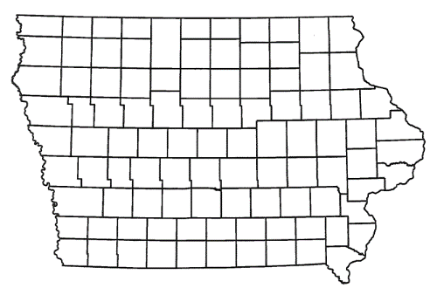
List of Local Development Applications Recommended
PROJECT NAME
SPONSOR
SCORE
TOTAL PROJECT COST
PERCENT PARTICIPATION
RECOMMENDED AMOUNT
Construction of approximately 1,720 feet of Edgewood Street and 1,540 feet of North 8th Avenue. | Marshalltown | 50 | $3,280,684 | 50% | $1,640,342
Reconstruction of approximately 1,145 feet of Bateman Street, 394 feet of 3rd Street and 202 feet of 4th Street. | Perry | 57 | $1,769,406 | 50% | $884,703
Potential improvements to U.S. 65, 32nd Street SW, Grant Street S, Poplar Drive SW, and Interstate 80 ramps. | Bondurant | TBD | TBD | 60% | TBD

Slide 6
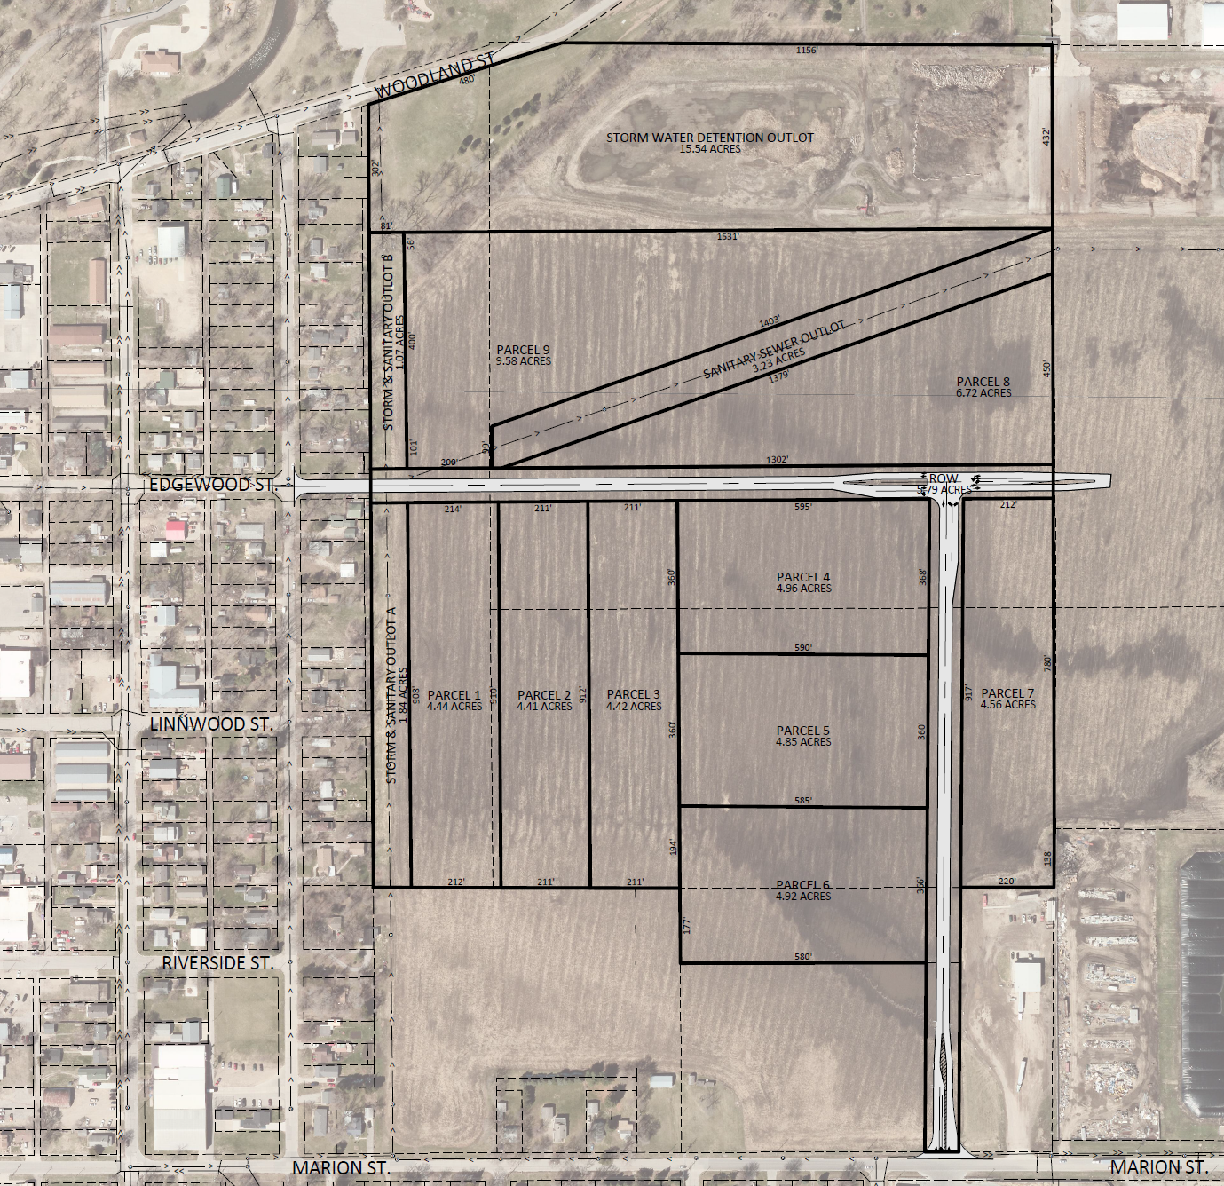
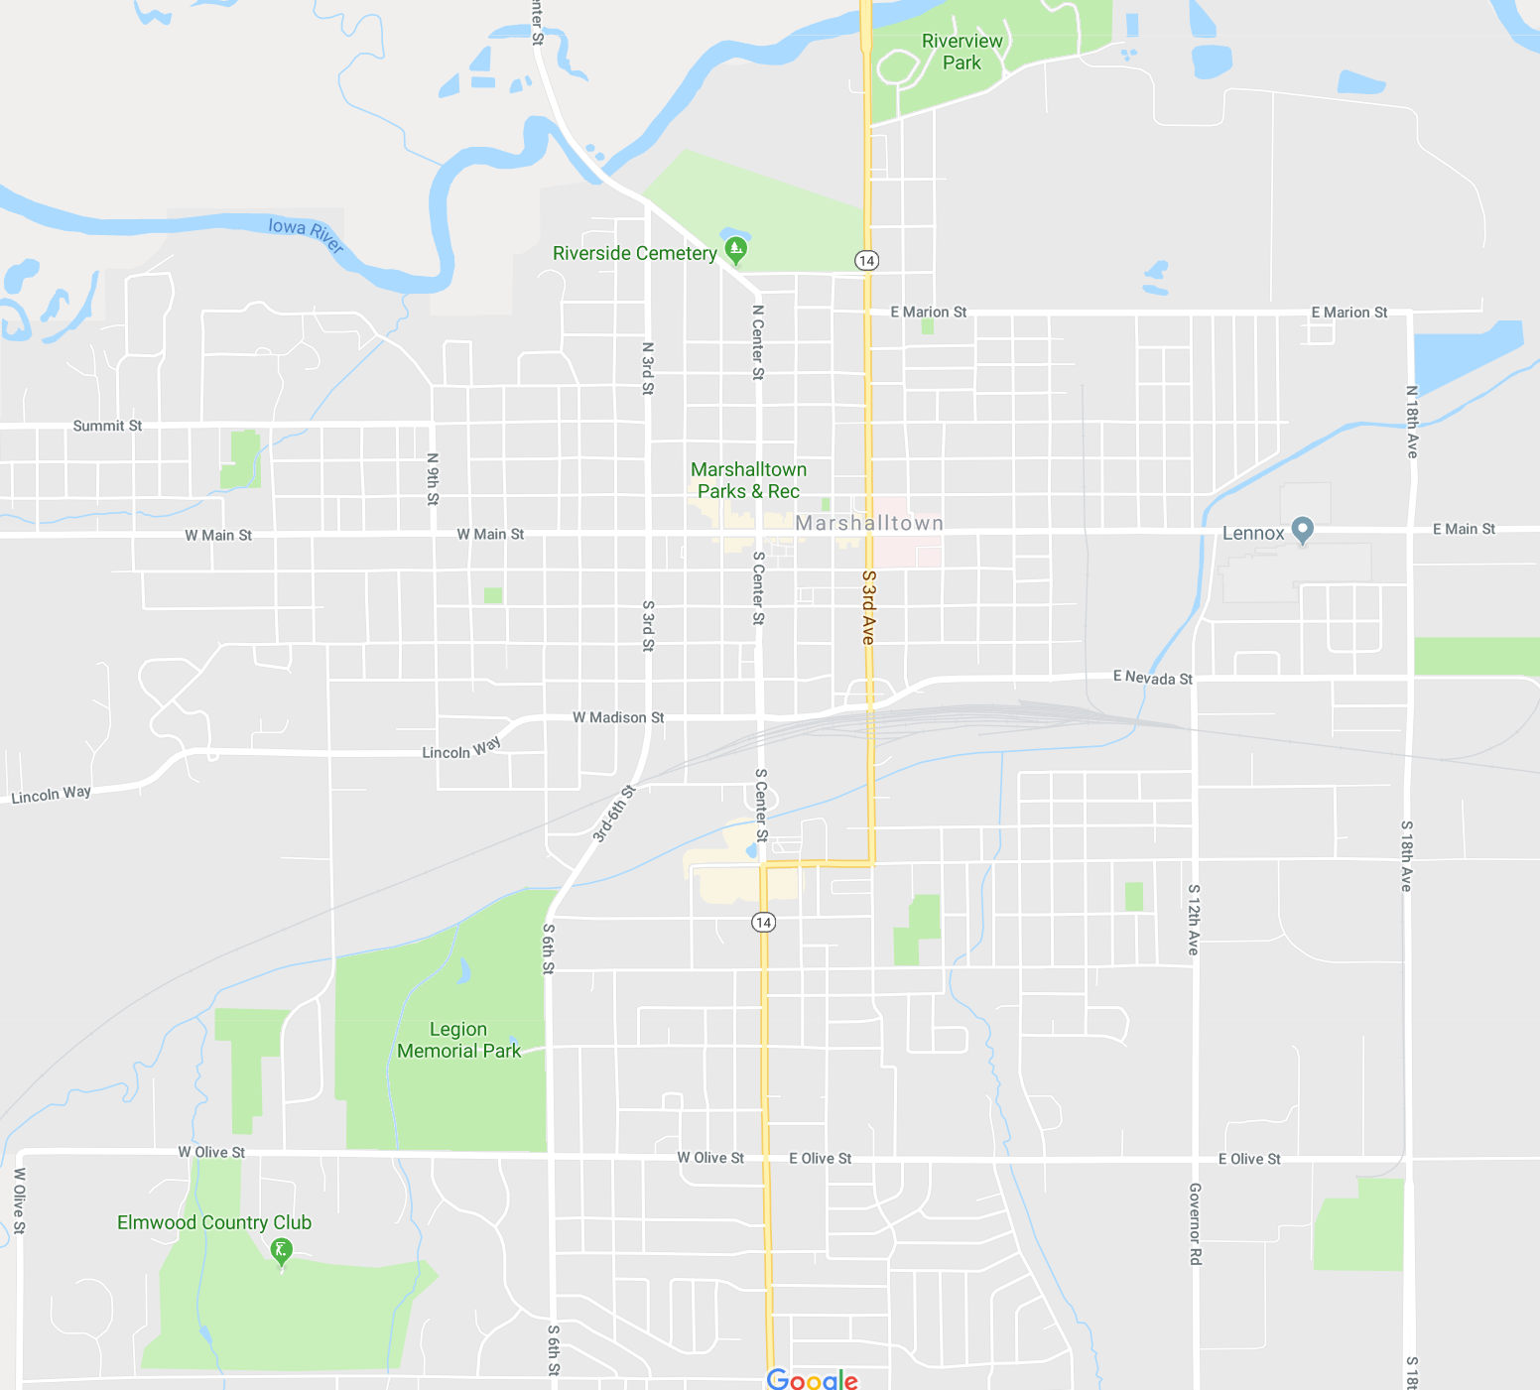
Marshalltown
(Local Development)
Construction of approximately 1,720 feet of Edgewood Street and 1,540 feet of North 8th Avenue located on the northeast side of town. This project is necessary to provide access to nine lots totaling more than 48 acres for industrial purposes.
Total Cost: $3,280,684
Requested: $1,640,342 (50%)

Slide 7
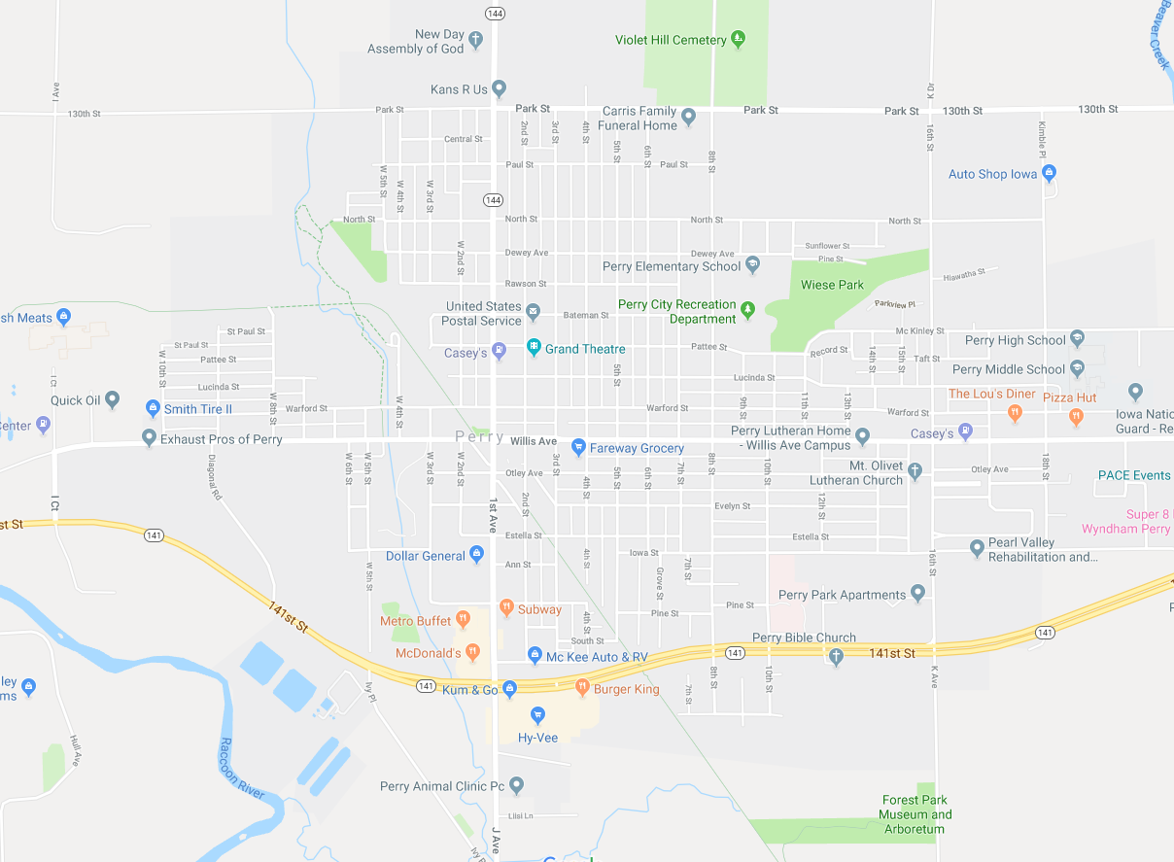
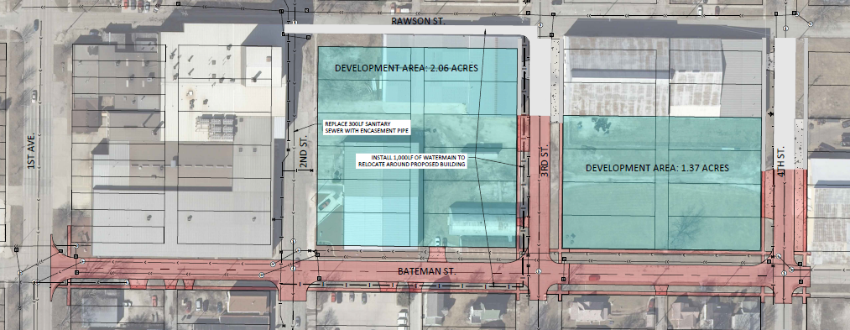
Perry
(Local Development)
Reconstruction of approximately 1,145 feet of Bateman Street, 394 feet of 3rd Street and 202 feet of 4th Street located on the north side of town. This project is necessary to provide improved access to two lots totaling more than three acres for industrial purposes.
Total Cost: $1,769,406
Requested: $884,703 (50%)

Slide 8
Iowa’s Certified Sites – Existing Policy
Max. RISE participation awarded depends on the size of the Certified Site (50-499 acres; up to 60% RISE participation)
Process:
  Iowa DOT recommends commitment of funding to Iowa Transportation Commission (Commission)
  Commission commits funding
  Iowa DOT continues to work through final details of scope & eligible costs with the applicant (or later convert to Immediate Opportunity)
  Iowa DOT recommends modification of funding commitment
  Commission approves modification

Slide 9
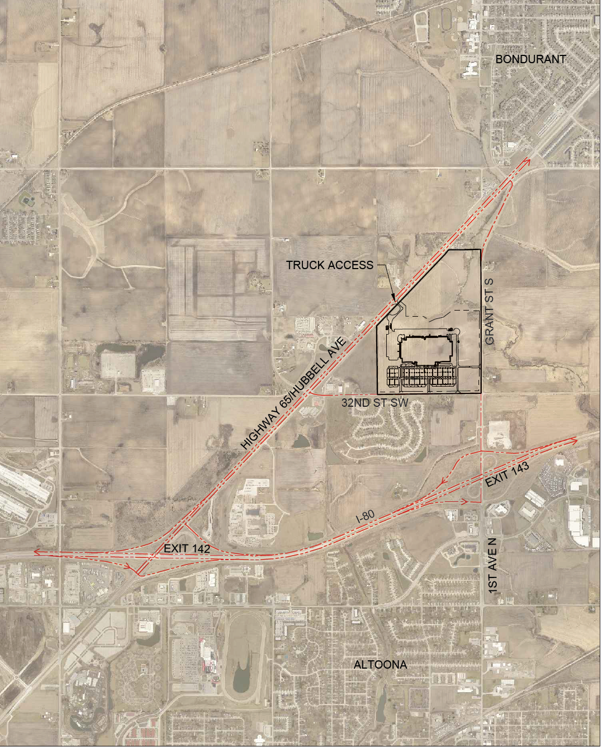
Bondurant
(Local Development)
Potential improvements to U.S. 65, 32nd Street SW, Grant Street S, Poplar Drive SW, and Interstate 80 ramps located on the south side of town. This project is necessary to provide improved access to the Fortner-Eshelman property, a potential Iowa Economic Development Authority certified site of more than 178 acres.
Total Cost: TBD
Requested: TBD (60%)

Slide 10

QUESTIONS?
Craig Markley, Systems Planning Bureau
craig.markley@iowadot.us
515-239-1027

