Slide 1

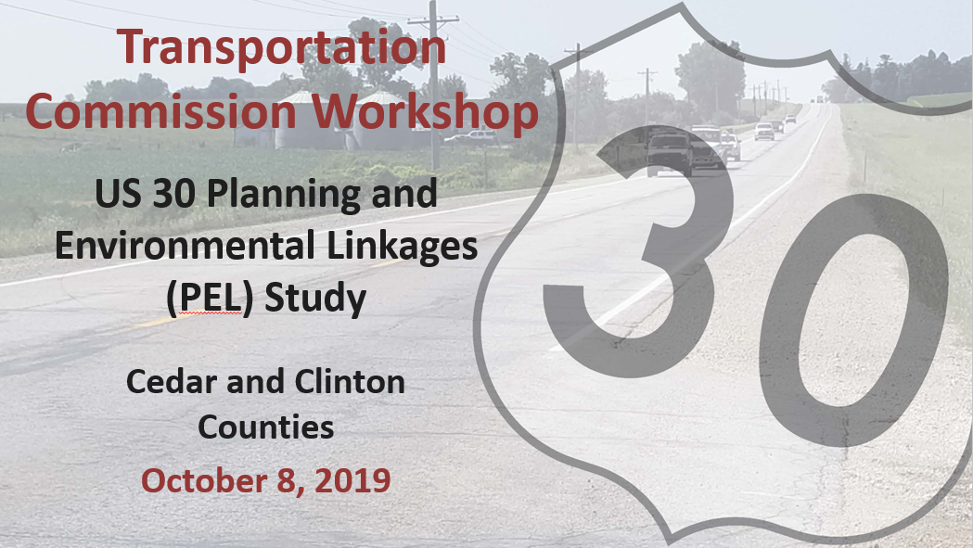
Notes:
The study corridor is approximately 40 miles in length beginning near Charles Avenue just east of Lisbon and ending at 260th Street just west of DeWitt.
This study is a result of collaboration between Iowa DOT and local stakeholders throughout the project corridor.

Slide 2
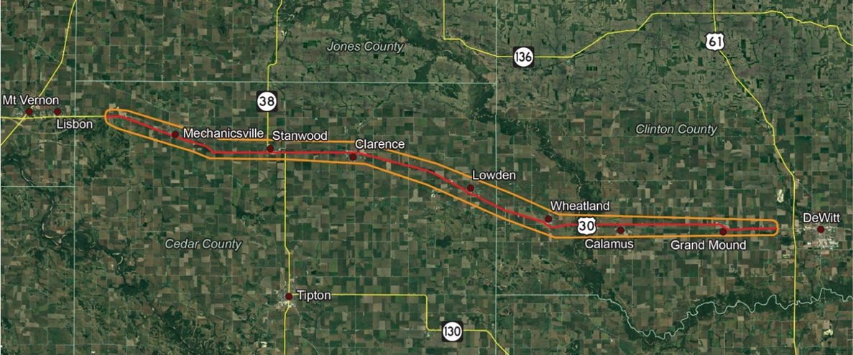
US 30 PEL Study Area
Early planning level study of US 30 between Lisbon and DeWitt
Notes:
The Study Area of this planning study is outlined here. The corridor includes the communities of Mechanicsville, Stanwood, Clarence, Lowden, Wheatland, Calamus, and Grand Mound and a crossing of the Wapsipinicon River.

Slide 3
Goals & Objectives
Goals
Identify the number of travel lanes needed and develop a range of possible improvements that accommodate future corridor needs
Provide recommendations on whether bypasses should be used
Prioritize needs and possible improvement projects
Objectives
Encourage public involvement and stakeholder input
Evaluate safety, mobility, and infrastructure conditions
Establish a vision for the US 30 corridor
Notes:
3 main goals…and 3 main objectives…Through this study, Iowa DOT will establish a vision for future investment along the US 30 corridor which will account for existing safety, mobility, and infrastructure characteristics as well as future needs.

Slide 4
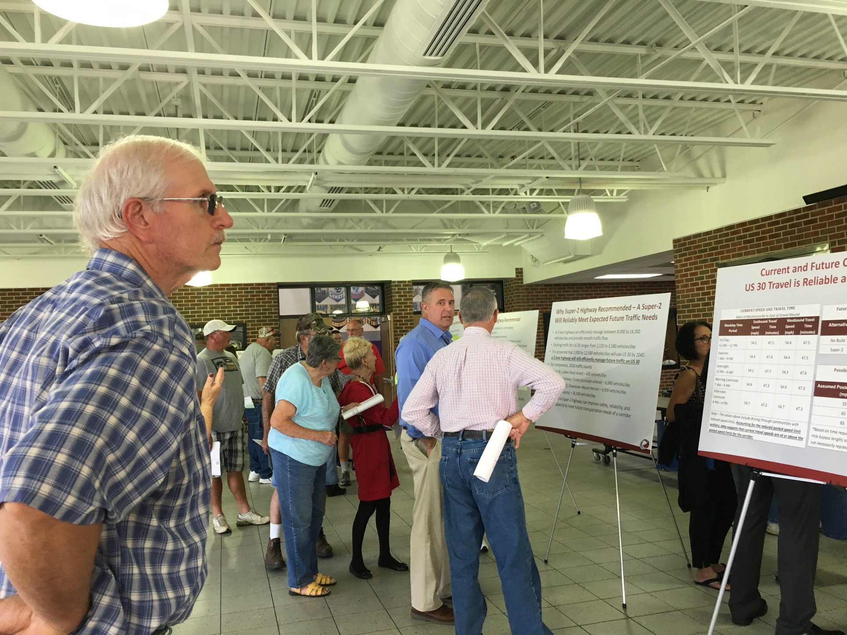
Background
Three public meetings to date
April 2019 (On-line)
Initial technical memos related to existing conditions and safety
June 2019 (In-person)
Corridor sizing and preliminary concepts
272 in attendance
September 2019 (In-person)
Final recommendations
184 in attendance
Notes:
Background:
This project study was a result of collaboration between Iowa DOT and local stakeholders.

Slide 5
PEL Study and the
Project Development Process
A Planning and Environmental Linkages - or PEL Study, allows early planning-level decisions to be carried forward into subsequent projects.
PEL
Study
Environmental Planning
Engineering
Construction*
*There are currently no corridor-wide improvement projects funded
We are Here
Notes:
Really in the early stages of planning…After this comes the environmental field work to determine wat’s really out there in the corridor…then the engineering to design the roadway and bridges… and finally construction… Our consultant will produce a final VISION Document for this study in November which will be distributed to you all.
Iowa DOT does not have projects currently programmed for this corridor, aside from a bridge replacement project and other typical maintenance and rehabilitation work.

Slide 6






PEL Study Steps
May 2018 –
January 2019
February 2019 –
June 2019
Public Involvement
Fall 2019
As funding allows, the next step after the PEL study will be the initiation of the environmental process, which includes more public involvement opportunities
STEP 1
Agency Coordination
Data Collection
Analyze Existing Conditions and Constraints
Crash Analysis
Historical Survey
STEP 2
Vision and Goals
Geometric Analysis
Environmental Analyses
Traffic Study
Improvement Development and Refinement
STEP 3
Identify & prioritize recommended Improvements
Present findings in Vision Document
We are Here
Notes:
This US 30 Study is broken into 3 general “Steps”. The first focuses on data gathering and corridor understanding. The second focuses on what future needs have been identified and how those needs may be addressed. The Study will conclude with a “Vision Document” that will outline and prioritize any identified improvement projects that could be considered in future studies. If any improvement projects to this 40 mile corridor are identified as part of this study, it is likely the improvements will be phased over time.
The US 30 Study will result in a “project roadmap” that will assist Iowa DOT to plan for future needs and balance other construction projects across the transportation system.
The study team is currently wrapping up the Step 2 efforts and are transitioning into activities as shown in Step 3.

Slide 7

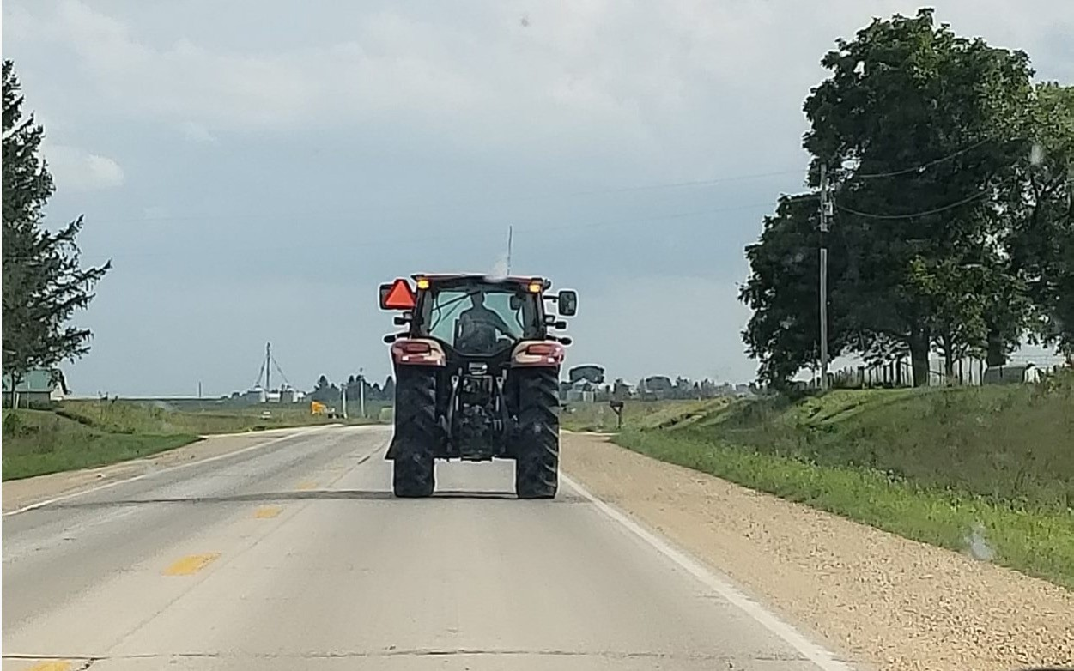

Why Improvements are Recommended
US 30 is a critical roadway to Iowa’s rural economy
Presence of slow-moving farm and agricultural equipment common throughout the year
Vehicle backups can occur
Slow moving trucks and agricultural equipment can be found throughout the US 30 corridor.
Public input supports enhancement of the corridor
Improvement focus
Decrease conflicts with slow-moving vehicles and turning vehicles
Increase safe passing opportunities to promote safer, reliable and consistent travel

Slide 8
Current and Future Conditions
US 30 Travel is Reliable and Consistent
CURRENT SPEED AND TRAVEL TIME West of Mechanicsville to East of Grand Mound
Weekday Time Period | Eastbound Travel |  | Westbound Travel
 | Speed (mph) | Time (minutes) | Speed (mph) | Time (minutes)
Full Day: 12 AM – 11 PM | 54.2 | 47.5 | 54.4 | 47.5
Daytime: 7 AM – 9 PM | 54.4 | 47.4 | 54.4 | 47.5
Overnight: 10 PM – 6 AM | 54.1 | 47.7 | 54.3 | 47.6
Morning Commute: 7 AM – 9 AM | 54.6 | 47.3 | 54.6 | 47.3
Afternoon Commute: 4 PM – 6 PM | 54.7 | 47.2 | 54.7 | 47.3
Note – The values above include driving through communities with reduced speed limits. Accounting for the reduced posted speed limit sections, data suggests that current travel speeds are at or above the posted speed limits for the corridor.
Future (2045) Estimated Travel Speed and Time Compared to Existing Conditions
Alternative | Speed Change (mph) | Travel Time (minutes)
No-Build | -0.2 | +0.3
Super-2 | +1.7 | -0.3
Possible Travel Time Savings With Bypasses (All Communities)*
Assumed Posted Speed Limit (mph) | Est. Travel Time Change (minutes)
55 | 1
60 | 5
65 | 8
*Based on time required to travel a given distance (estimated 42- mile bypass length) at a constant given speed; times are not necessarily representative of a certain number of travel lanes.

Slide 9
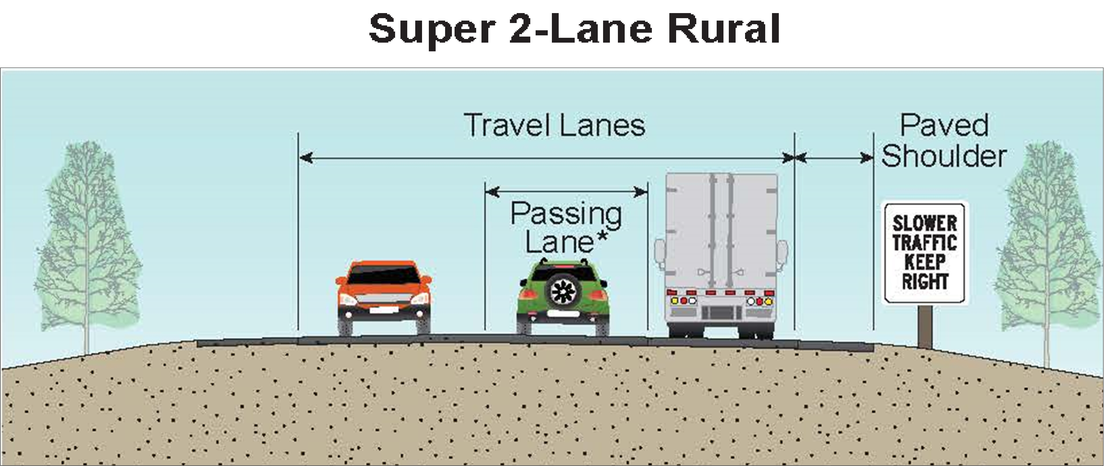

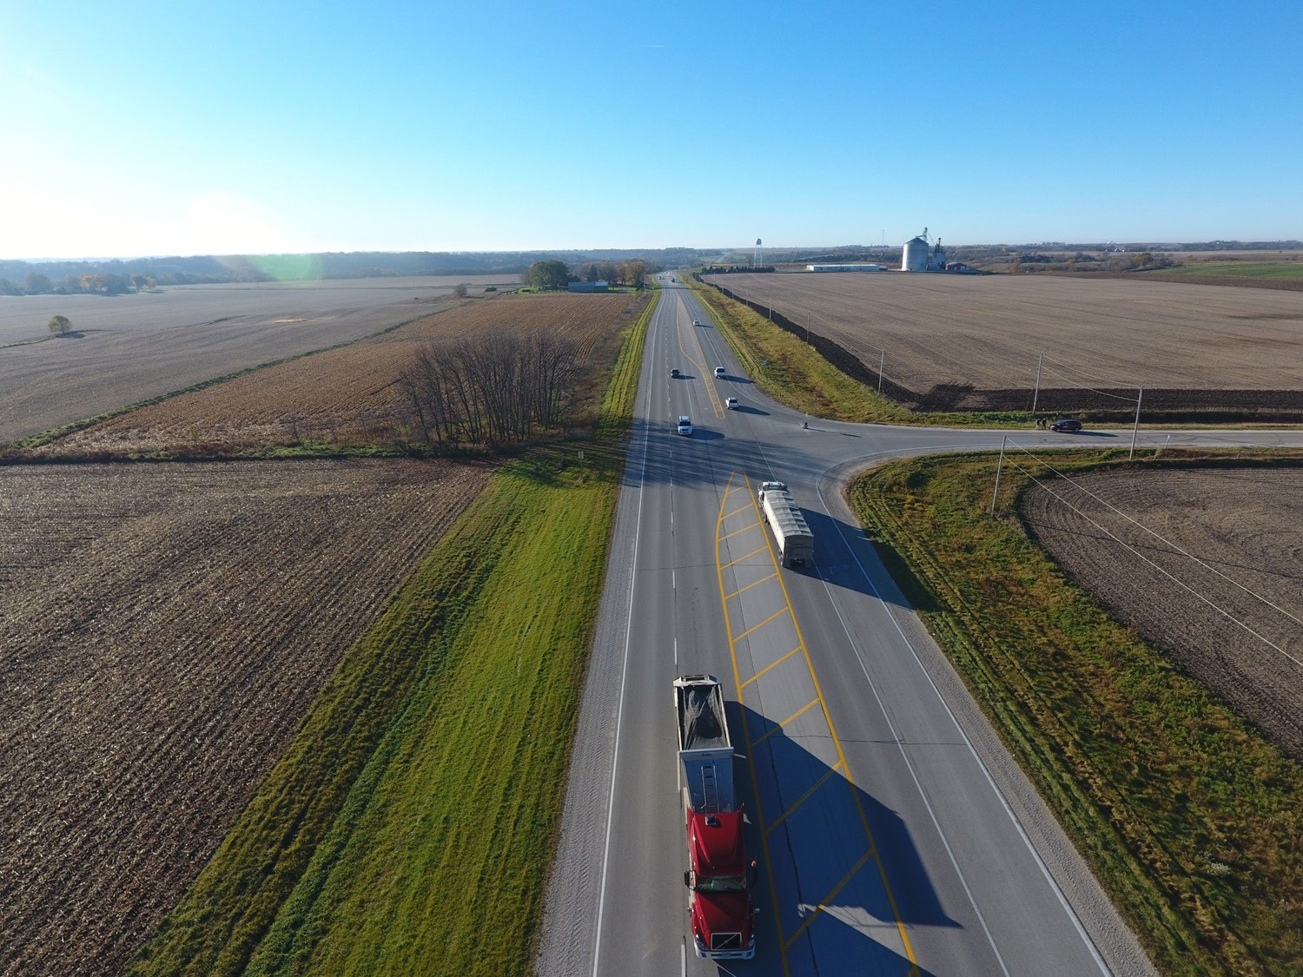
Recommended Roadway Section Super-2 Highway (Between Communities)
U.S. 169 Fort Dodge, IA to Humboldt, IA
*Passing lanes can be in either direction, are non-continuous, and spaced at established intervals along a corridor.
–Improves opportunity to safely pass slower moving vehicles
–Passing lanes where appropriate and needed, generally every 4 to 5 miles
–Typical passing lane length: 0.5-1.75 miles
Notes:
A Super 2, is a two-lane rural highway with characteristics that improve traffic flow and safety performance, most notably through the addition of passing lanes along the corridor in both directions of travel.

Slide 10
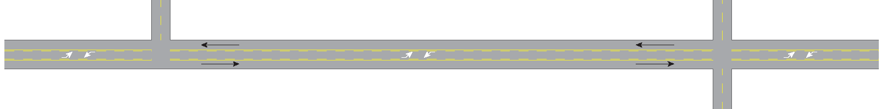

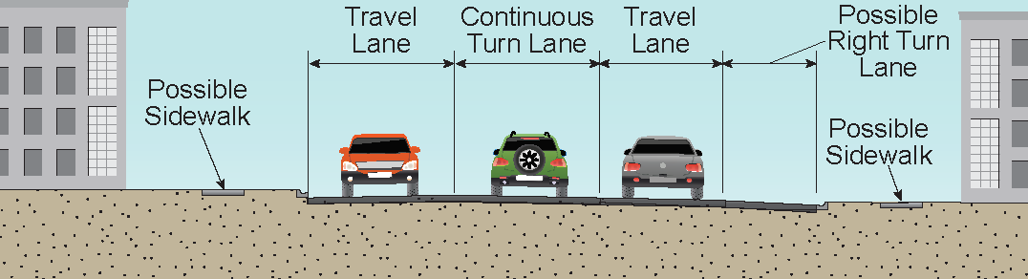
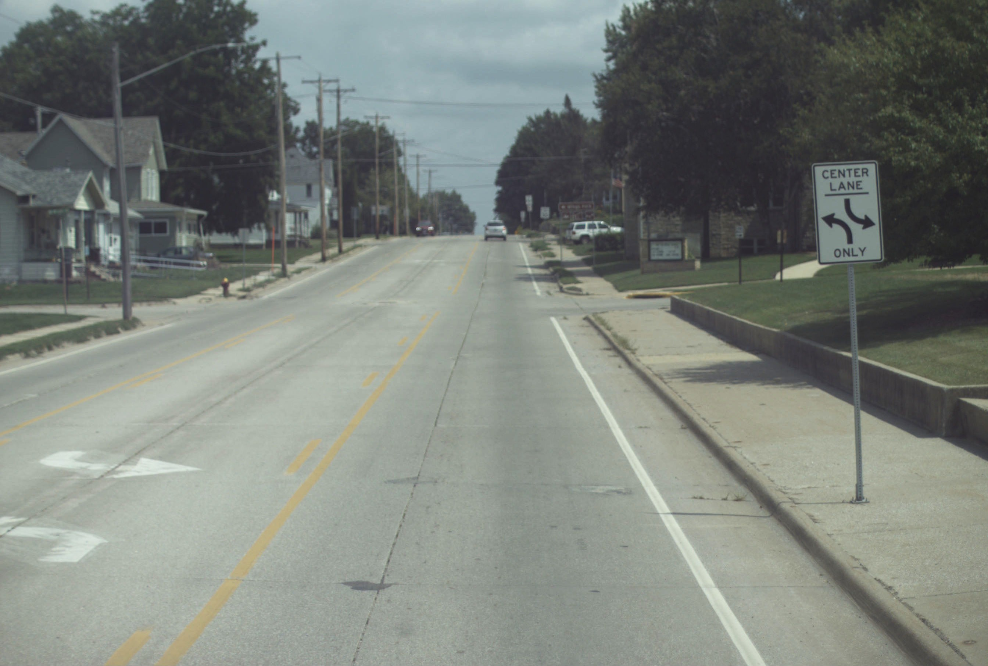

Recommended Roadway Section Super-2 Highway (Through Communities)
–Turn lanes separate turning traffic from US 30 traffic flow
–Reduces travel delays through communities
–Center left turn lane and right turn lanes provided at locations with minimal impact and cost
Example of Center Two-Way Left-Turn Lanes (TWLTL) in Oelwein, Iowa.
Notes:
A Super 2 highway concept may include a two-way-left-turn lane to remove left turning vehicles from the through traffic flow resulting in a less disruptive flow of traffic and delay in town

Slide 11
Why Super-2 Highway Recommended
A Super-2 highway compared to a 4-lane highway
Is a lower cost solution
Is a better return on taxpayer investment
Has less farmland, private property, and natural resource impacts
Affects travel patterns, access to existing businesses, and potential railroad conflicts less
US 30 Super-2 Highway vs. 4-Lane Highway
Construction Cost Difference | When compared to the cost of simply reconstructing an existing 2-lane highway, the additional cost to upgrade to a Super-2 is about 15% to 20% of the cost to upgrade to a 4-lane highway.
Right-of-Way and Farmland Impacts | Super-2 impacts are about 1/3 of the those expected with a 4-lane highway and bypasses
Super-2 highway style improvements can provide significant safety benefits where safety problems exist
US 169 Fort Dodge to Humboldt – 67% crash decrease
US 63 Oskaloosa to New Sharon – 49% crash decrease

Slide 12
Why Super-2 Highway Recommended – A Super-2 Will Reliably Meet Expected Future Traffic Needs
A 2-lane highway can effectively manage between 8,000 to 14,300 vehicles/day and provide smooth traffic flow
Existing traffic for US 30 ranges from 2,220 to 5,580 vehicles/day
It is projected that 3,000 to 12,500 vehicles/day will use US 30 by 2045:
a 2-lane highway will still efficiently manage future traffic on US 30
Transition to a Super-2 highway can improve safety, reliability, and enhance capacity to meet future transportation needs of a corridor

Slide 13





















Economic Considerations
Analysis suggests that adequate highways support economic growth but four-lane expansion will not create economic growth on its own
Economic growth depends on additional drivers
Local Policies
Population growth
Presence of an educated workforce
Proximity to markets
Local economic development policies
Amenities
Educated Workforce
Transportation
Economic Growth
Population Growth
Super-2 highway investments can improve the safety, reliability, and consistency of travel.
Available Amenities
Proximity to Markets

Slide 14
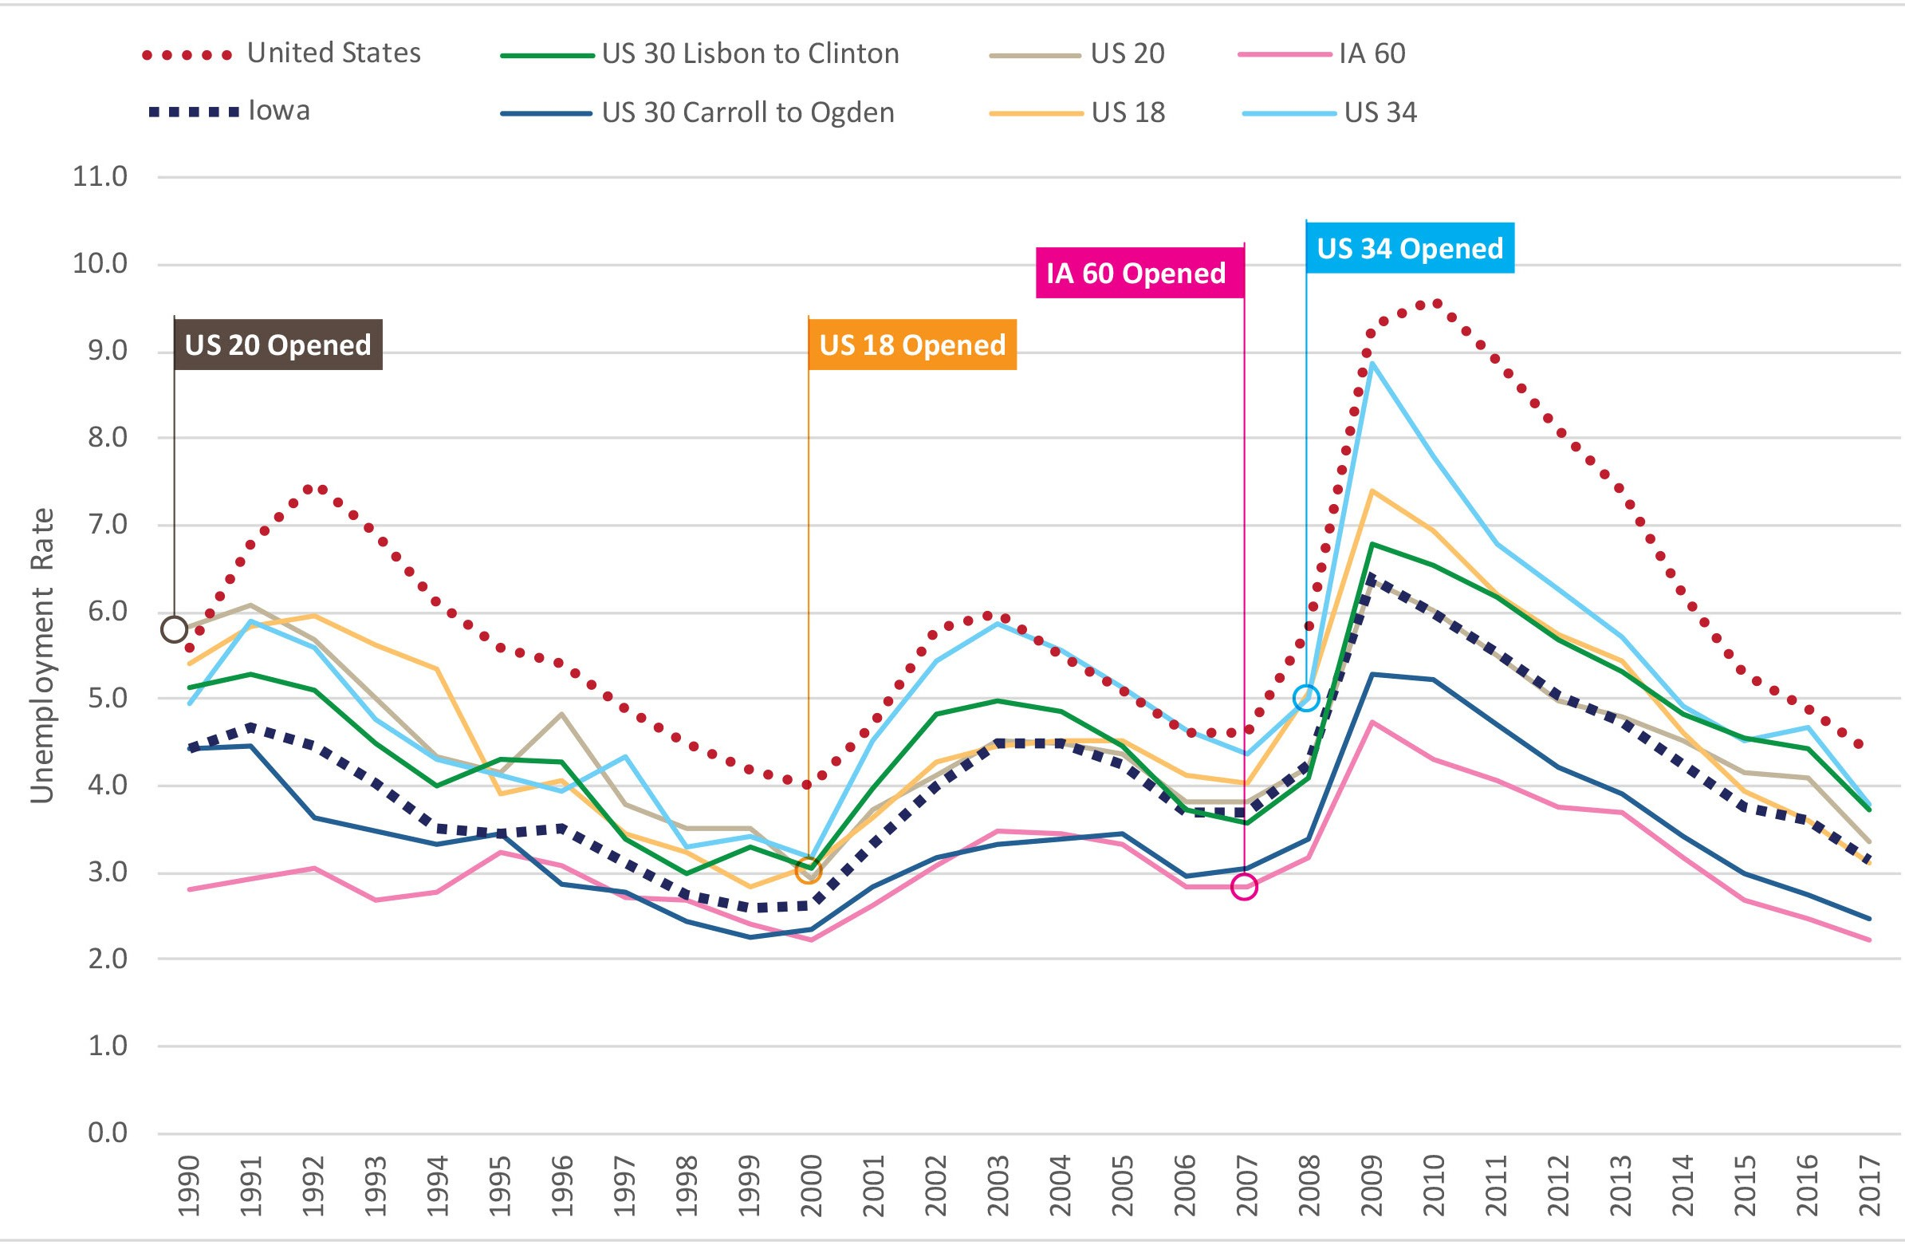
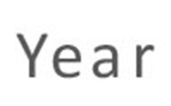
Economic Considerations – Data Trends
Economic performance along 2-lane highway corridors is similar to, or, in some
instances, better than 4-lane highways
Unemployment
4-Lane Highways Represented in the Tables
US 20 – Waterloo to Dubuque
US 18 – I-35 to
Charles City
IA 60 – LeMars to Sibley
US 34 – Ottumwa to Mt. Pleasant
*Income data was studied for a 10-year period before and after highway expansion; these charts reflect the 20 years of before-and-after data studied for each of the 4-lane case study corridors.

Slide 15
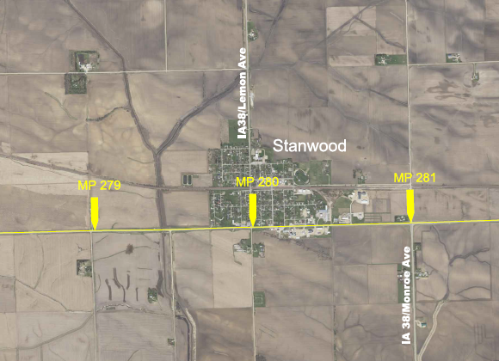
To Bypass Or Not to Bypass?
Bypasses are costly and impactful
Minimal impact expected in communities with Super-2 highway
Following existing US 30 has less impact on farmland and environmental resources
Following existing US 30 does not change local travel patterns or railroad crossing needs
Locations where a shift of US 30 could be considered

Slide 16
Recommendations
Super-2 design is recommended, rather than four-lanes to meet existing and future traffic needs
Bypasses are not recommended as part of this Super-2 configuration
Include passing lanes to improve opportunities to safely pass slower moving vehicles
Two-way left turn lanes and right turn lanes through town to reduce travel delays on US 30

Slide 17
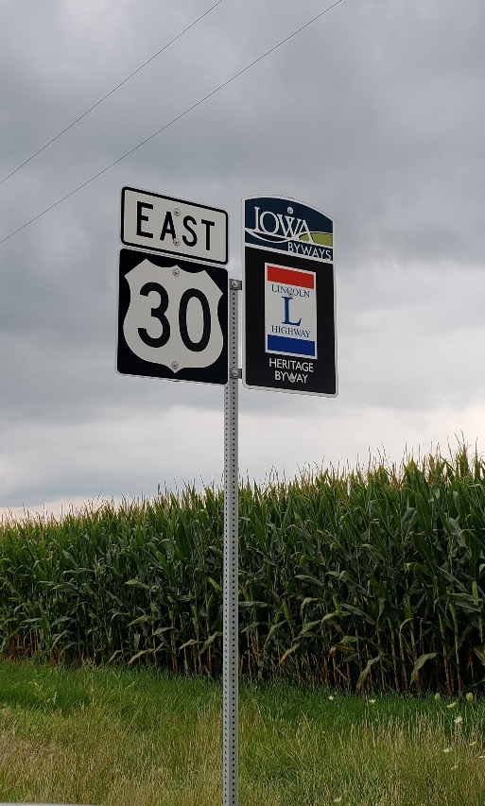
Next Steps
Economic tech memo in October 2019
Vision document in November 2019
PEL Study findings will be incorporated into future environmental and engineering studies.
Notes:
The finding of the study will roll seamlessly into future studies as funding and needs dictate.

Slide 18
