Slide 1
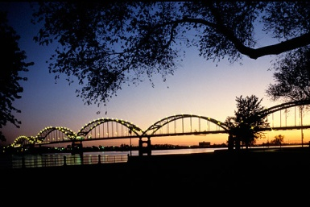
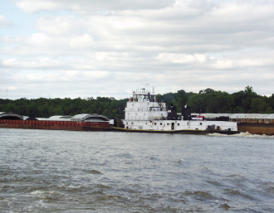
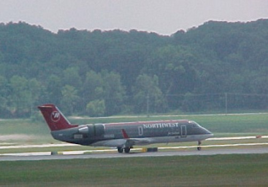
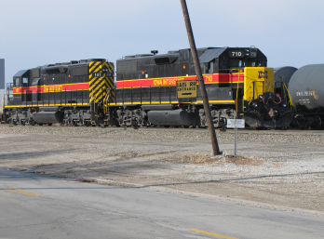
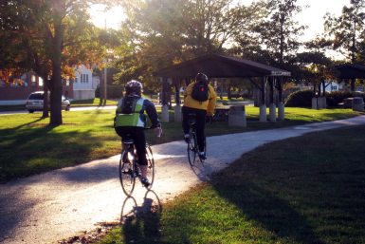
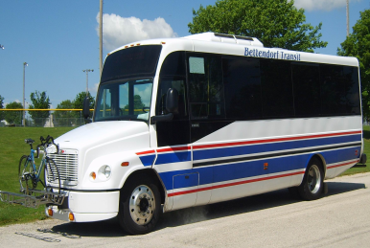
Iowa DOT Commission Presentation
October 13, 2020

Slide 2
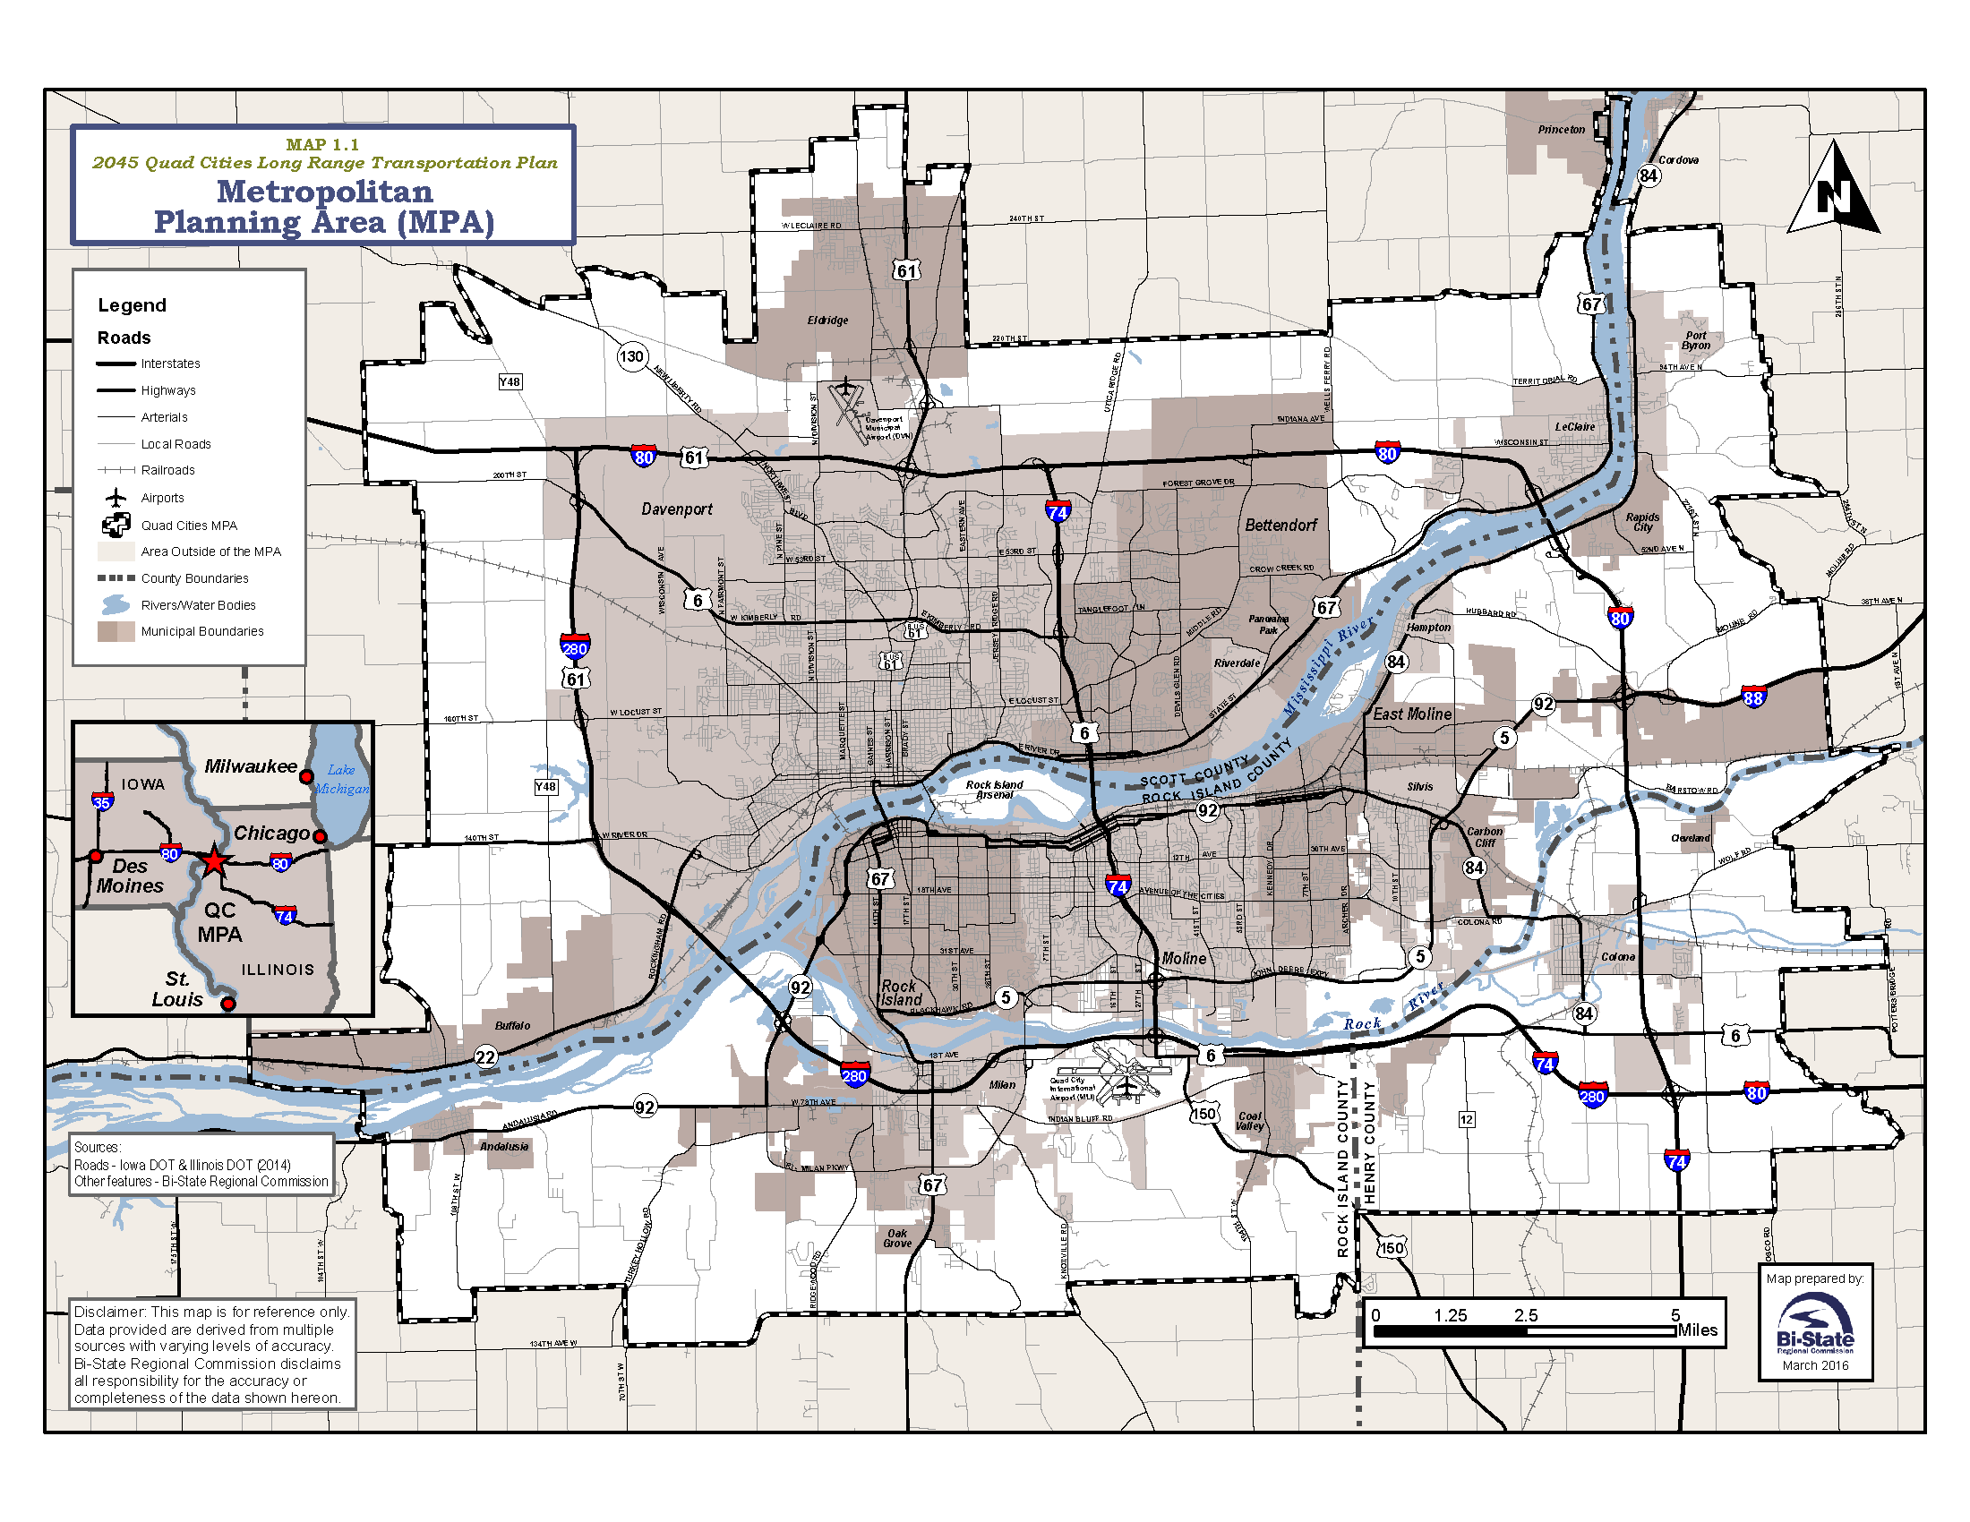

Slide 3
Six-Laning of I-80
Advocating in Long Range Transportation Plans
2018 AADT was 52,500 in Quad Cities,
Some of the Highest Counts in Iowa on I-80
Over 35 % Increase in Traffic Since 2002
One of Busiest Stretches with over 36% Trucks

Slide 4
Interstate 80 System Study in QCA
Studied Condition, Geometry, Operation, Safety & Six-Laning of I-80
21 of 28 Ramps Rated Poor in Safety/Crashes
Crash Rates Expected to Increase
Right Shoulder Rated Poor throughout Study Area
Build Concept: 6-Laning & Removes Left-Hand Exits
West of US 61 AADT Projected to Double by 2045
US 61 to I-74 AADT 50% Projected Increase by 2045
East of I-74 AADT 80% Projected Increase by 2045
Notes:
Complete I-74 Project with Kimberly Road Interchange which provides pedestrian accessibility and rehabilitates pavement and ramps which are in very poor repair. Interstate feasibility analysis which includes studying four potential changes and maybe more identified by the Department. They are six-laning of I-80 ; realigning Kimberly Road I-280 Interchange; extending a north bound lane at the I-74 and I-80 interchange; and the reconstructing I-80 Middle Road Interchange.

Slide 5
I-80 Status
Advocating Initially for Interchanges
I-80 Widening Moving Easterly to West Branch – Suggest Focus on QCA with Higher Traffic
I-80 Bridge
Planning & Environmental Linkage Study Done
Phase I Study RFP Process Underway

Slide 6
Interstate 80 Bridge - 37,800 AADT
17% Growth Forecasted by Bi-State Network Model
Structurally Deficient Design with Poor Shoulders
Periodic Bridge Closures Required for Repairs
WB Ramps at US 67 Interchange Rated Poor for Crashes/Geometry

Slide 7
I-80 at Middle Rd Interchange, IJR Done ~ 39,000 Intersecting AADT
67% Growth Forecasted by Bi-State Network Model
EB & WB I-74 Bridges Over I-80 Rated Poor for Width
EB & WB Entry Ramps Exceed 300/HMVMT (>85 is Poor)
TBK Sports Complex & SE Quadrant Development Drives Need

Slide 8
TBK Bank Indoor and Outdoor Sport Complex
$60 Million Investment, 182 Total Jobs, + $100 Million Commercial
785,000 Visitors Annually, 40 % from Six Surrounding States
Soccer/Basketball/Volleyball/Pickleball/Wrestling/Baseball/Softball

Slide 9
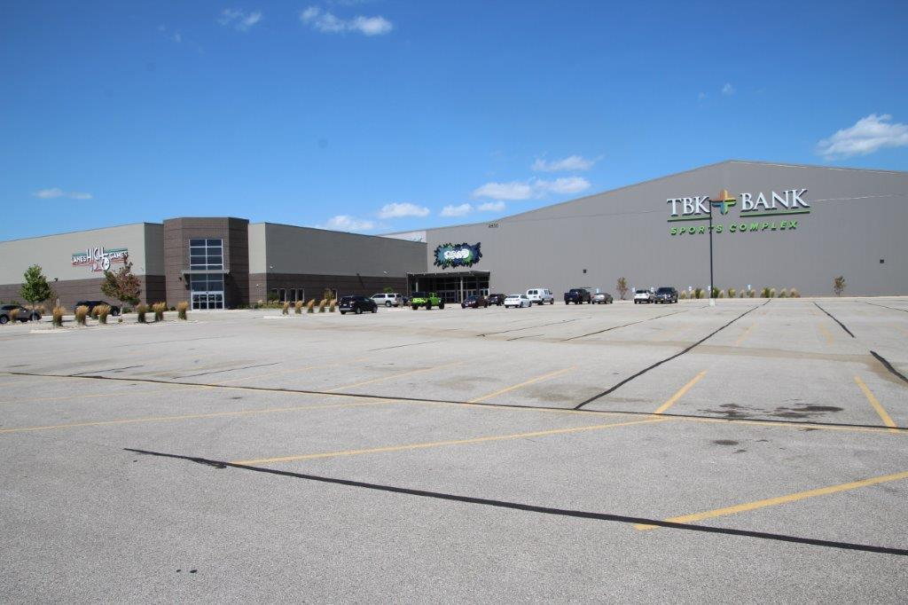
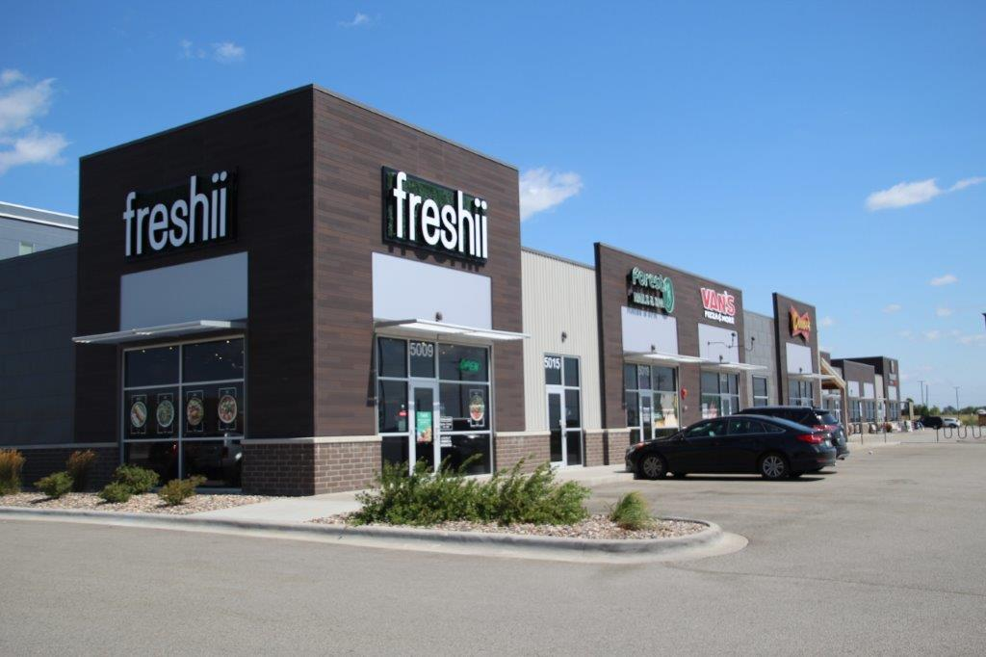
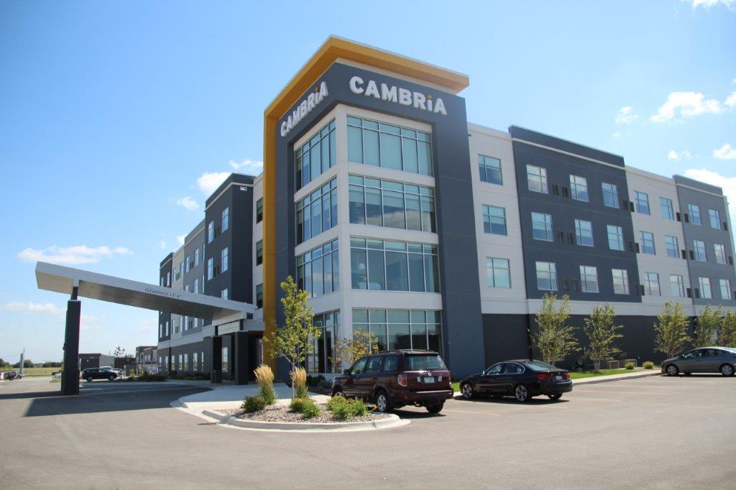
TBK Bank Sports Complex
TBK Bank Sports Complex

Slide 10
Interstate 80 at Interstate 74 Interchange – 62,700 Intersecting AADT
39% Growth Forecasted by Bi-State Network Model
EB & WB I-74 Bridges Over I-80 Rated Poor for Width
3 of 4 Ramps have Poor Crash Rates (136 – 316)
WB I-80 to SB I-74 Flyover Recommended

Slide 11
Interstate 80 at US 61 Interchange ~ 77,000 Intersecting AADT
28% Growth Forecasted by Bi-State Network Model
Inadequate Merging Lanes Contribute to 232/HMVMT Crashes
All Ramp Loops Rated Poor Geometry

Slide 12
Interstate 80 at NW Blvd Interchange - 54,250 Intersecting AADT
23% Growth Forecasted by Bi-State Network Model
3 of 4 Ramps have Poor Crash Rates (86 – 261)
Interchange Reconfiguration to Accommodate Trucks Recommended
Additional Trucks in 2018 - Kraft/Sterilite & Eastern IA Industrial Cent.

Slide 13
Eastern Iowa Industrial Center Development
Expansions: Kraft-Heinz & Sterilite – Over 1245 Jobs
Completed Transload Facility
Road Improvements Funded in Part with RISE

Slide 14
Interstate 80 at 280 Interchange – 61,200 Intersecting AADT
70% Growth Forecasted by Bi-State Network Model
NB & WB Bridges Rated Poor Width
WB I-80 Exit and SB I-280 Should be Removed due to Left Entry

Slide 15
Interstate 280 at Kimberly Rd Interchange
IA DOT 2008 Analysis Identified Realignment Options
Interchanges < 0.5 Miles Apart Below Current Safety Standards

Slide 16
STBG/Safety Project Progress
Veterans Memorial Parkway and Forest Grove Road I-74 to International Drive Widening/Trail and Pedestrian Access – Over $12 Million Project with Over $10 Million in STBG Recently Completed
53rd Street from Elmore to Brady Reconstruction- Over $10 Million Project with $7.8 Million STBG Phase I Underway
River Drive/US 67 Bettendorf/Davenport Safety Study Completed – Considering Mumble Strip

Slide 17
STBG Programmed Projects
FY 21 - Multipurpose Trail Construction Along Brady Street Frontage Road Safety Improvement
FY 21 - Forest Grove Road to Middle Road Reconstruction to Complete Corridor to TBK
FY 23 - 3rd and 4th Streets in Davenport from Telegraph Road to Harrison Resurfacing to Complete Project from River Drive to Brady Street

Slide 18
Future Projects/Unmet Needs
Forest Grove Road from Middle Road to Criswell Street Reconstruction
3rd and 4th Streets Conversion from One-Way to Two-Way and Reconstruction of Respective Intersections with River Drive/67
River Drive from 3rd/4th Streets to Tremont Avenue Elevation/Reconstruction for Flood Resiliency
Round About Installation at Eastern Avenue and Veterans Memorial Parkway
Increase Elevation of Iowa Interstate Railroad over Brady and Harrison Streets

Slide 19
Successful Competitive Highway Bridge Program (CHBP) Appreciated
Utilized Standard IA DOT Standard Bridge Plan
Bundled Municipal County and State Bridges
Allowed Replacement of Deficient Bridges More Quickly
Funded Five Crossings in Scott County with over $2 Million Federal and State Funds

Slide 20
I-74 Project Work Appreciated
Consistent Communication with Project Engineers, PIO’s, District Office Staff, Public
Open to Troubleshooting Issues that Arose
Schedule Rebounded from 2019
Crossing Traffic Maintained 69K in 2019

Slide 21
Thank You! Questions?

