Slide 1
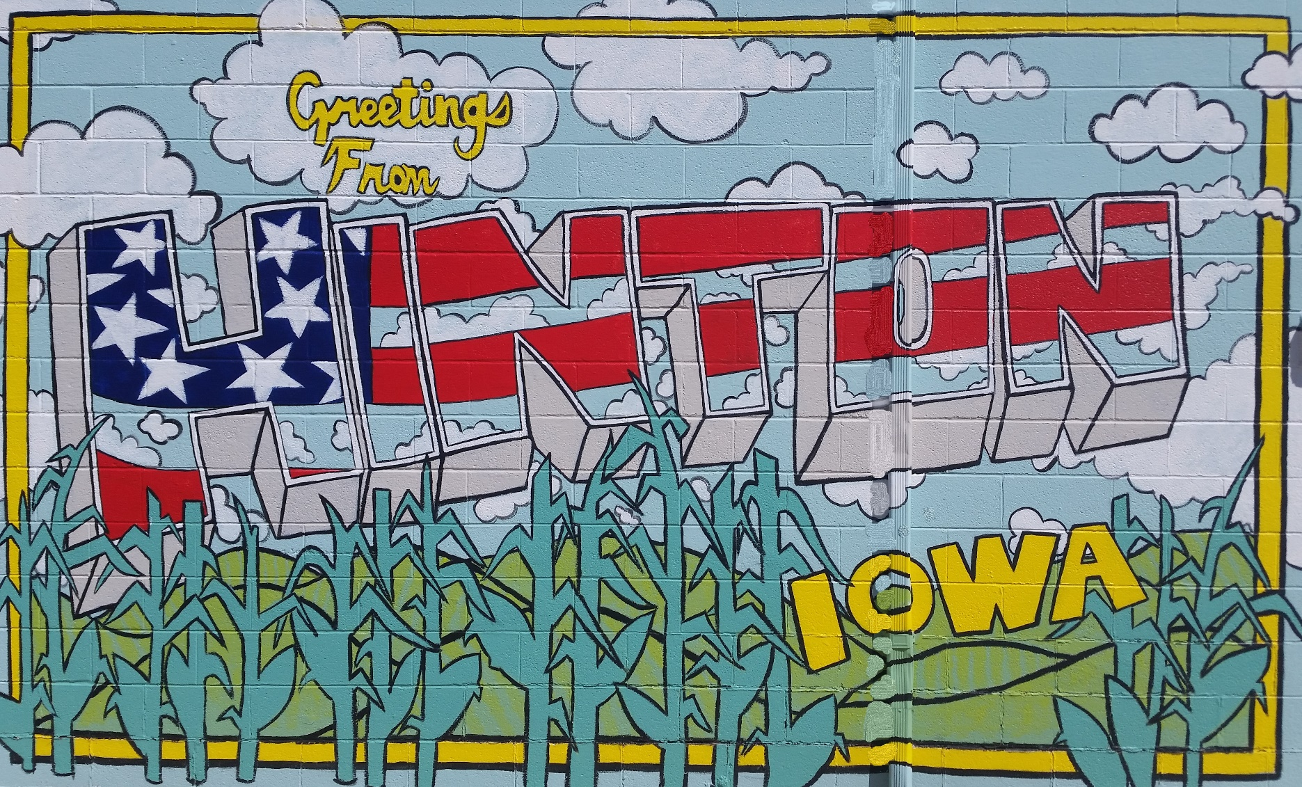
Iowa DOT Commission
Public Input Meeting
October 13, 2020
U.S. Highway 75

Slide 2
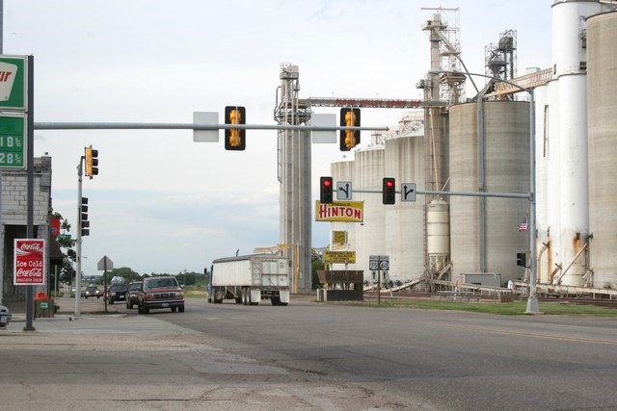
U.S. Highway 75
The City of Hinton requests the Iowa DOT Commission to program funds for the improvement of U.S. Highway 75 through Hinton.

Slide 3
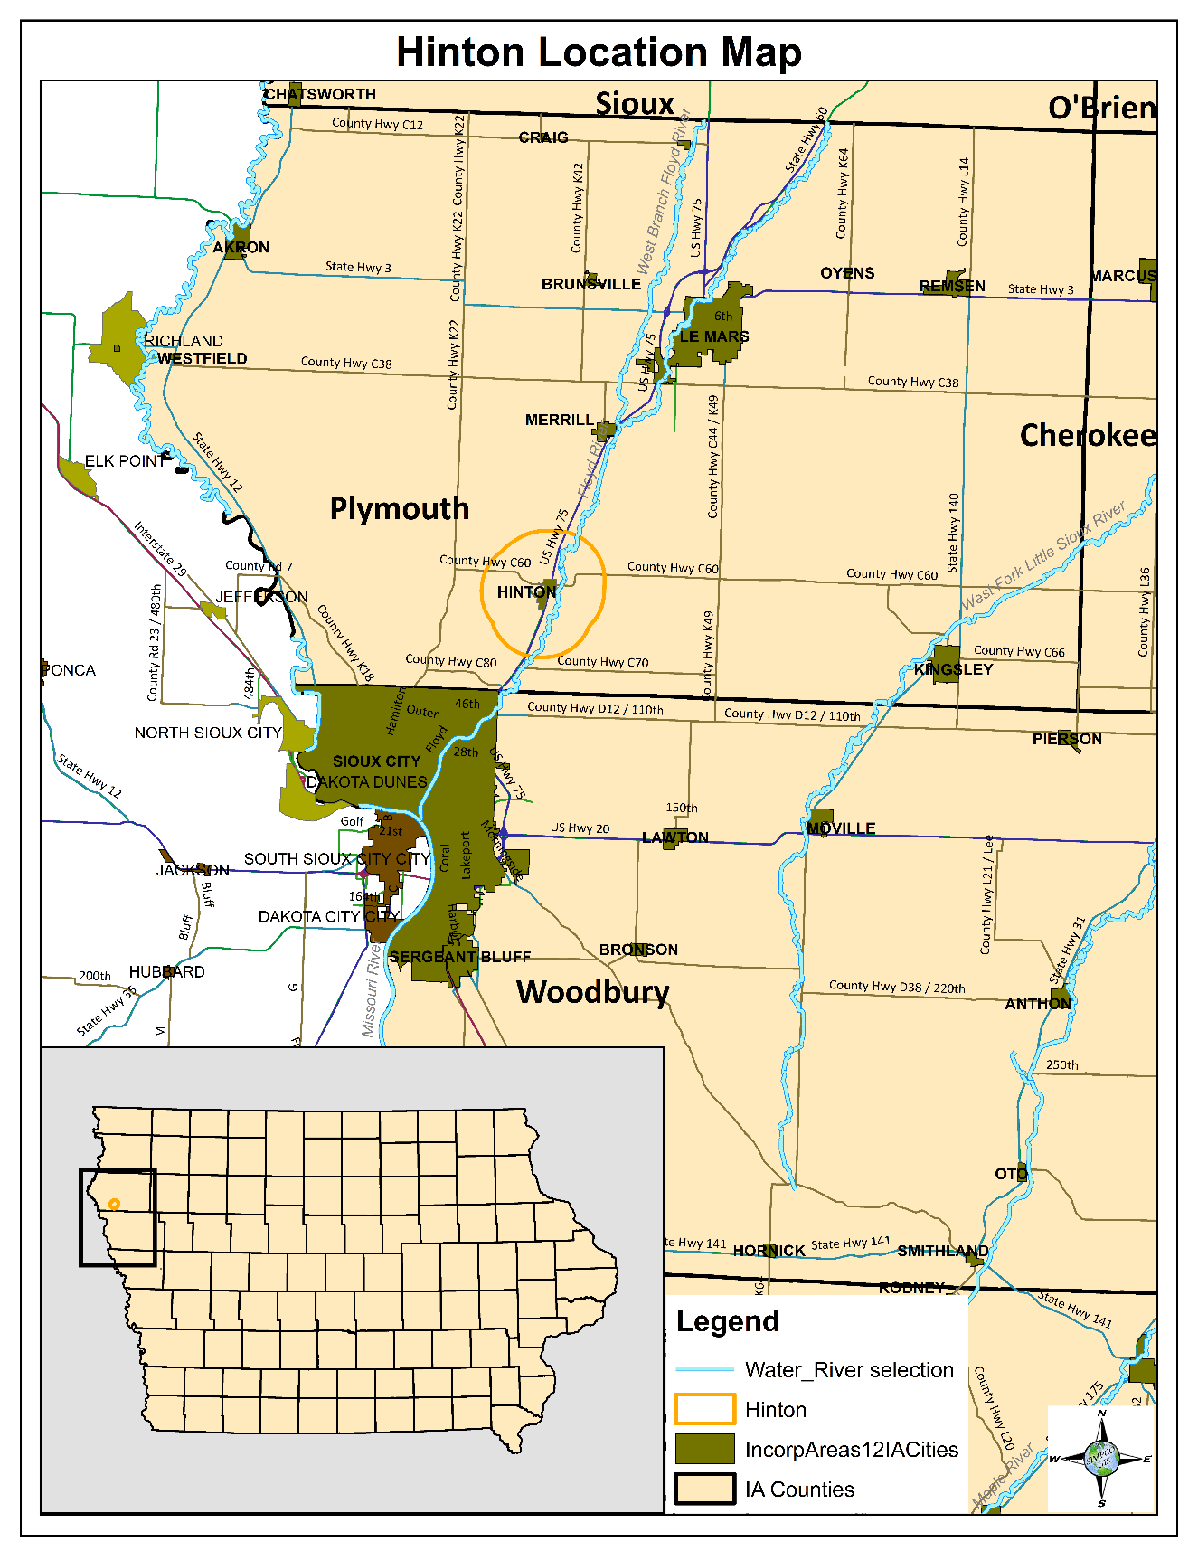
Community Profile: City of Hinton
10 miles northeast of Sioux City.
Located in Plymouth County.
Population 948 (2019 Census estimate).

Slide 4
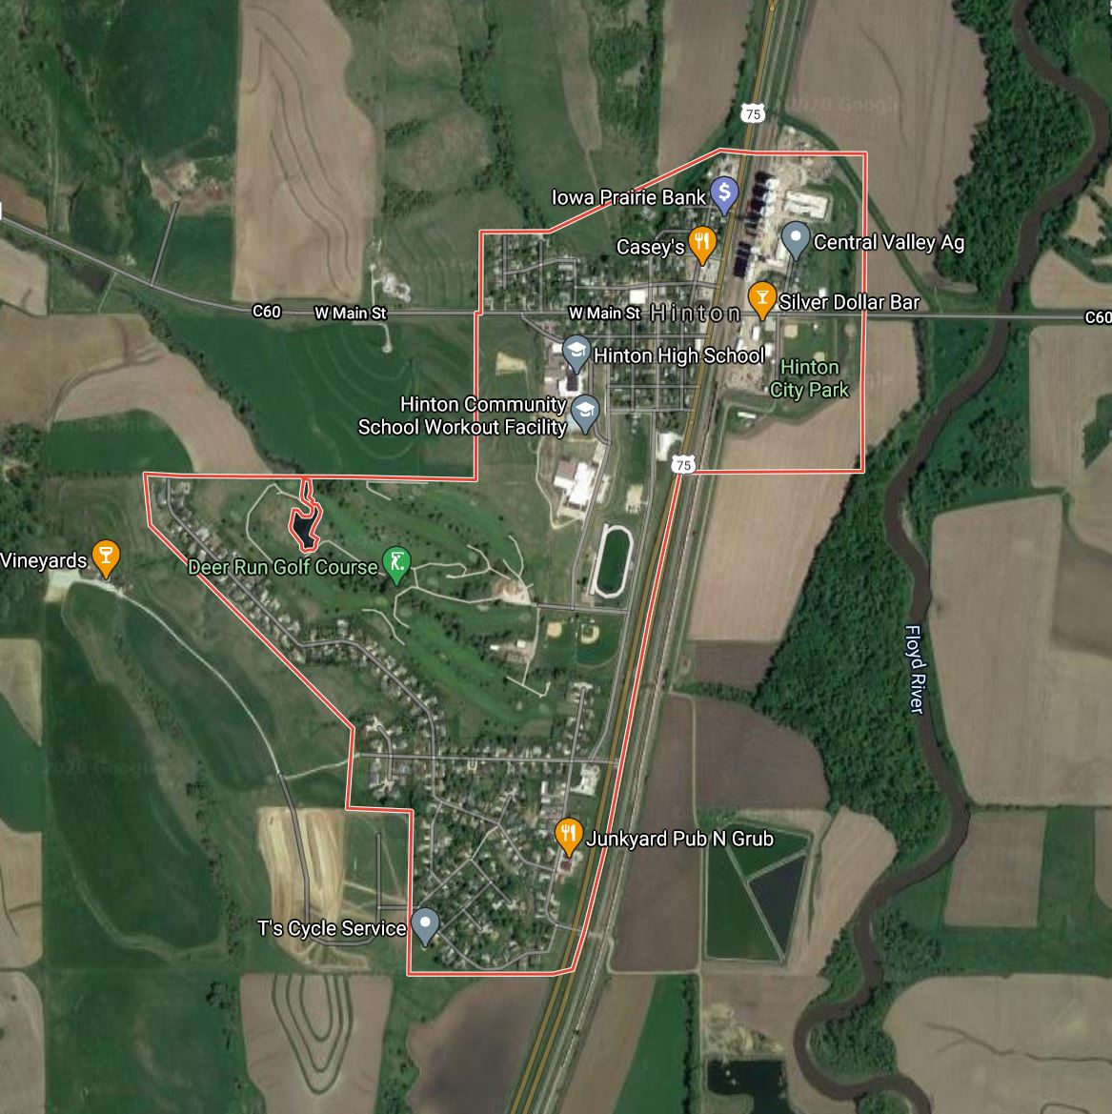
U.S. Highway 75 Current Conditions
U.S. Hwy. 75 is a four-lane divided highway located in the Floyd River Valley.
Construction between Le Mars and Sioux City has been underway since 2017.
Through Hinton, the highway section is undivided. Current concerns with U.S. Hwy. 75 through Hinton include:
Aging Infrastructure
Increased Traffic Volumes
Sidewalk Conditions
Safety Concerns

Slide 5
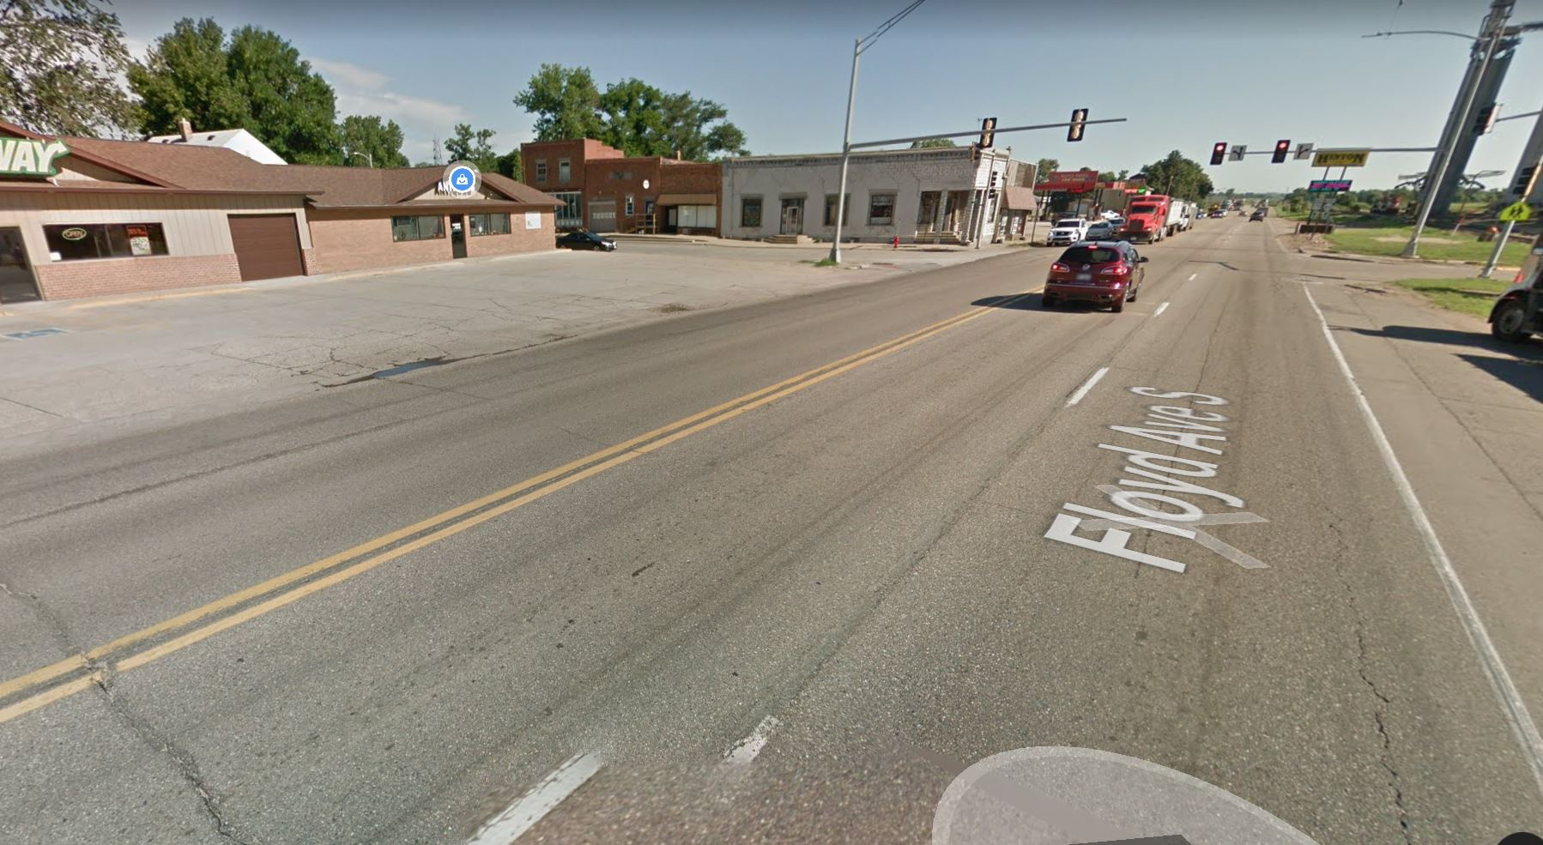
Aging Infrastructure
U.S. Hwy. 75 is the oldest four-laned rural roadway in the state of Iowa.
Not built to modern standards of today
If not improved, the section of highway through Hinton will still resemble what it looked like when built 71 years ago. While north and south of the community the highway is being re-constructed to today’s standards.
Notes:
US 75 was one of the original U.S. Highways to be created in 1926
November 1949: US 75, north side Sioux City to Hinton - oldest rural four-lane segment in Iowa in use as of 2006, but wholly reconstructed and leveled out in 2019

Slide 6
Increased Traffic Volume
Traffic Volume
AADT increased from 9,238 in 1994 to 14,412 in 2019
56% increase in traffic over 26 years

Slide 7
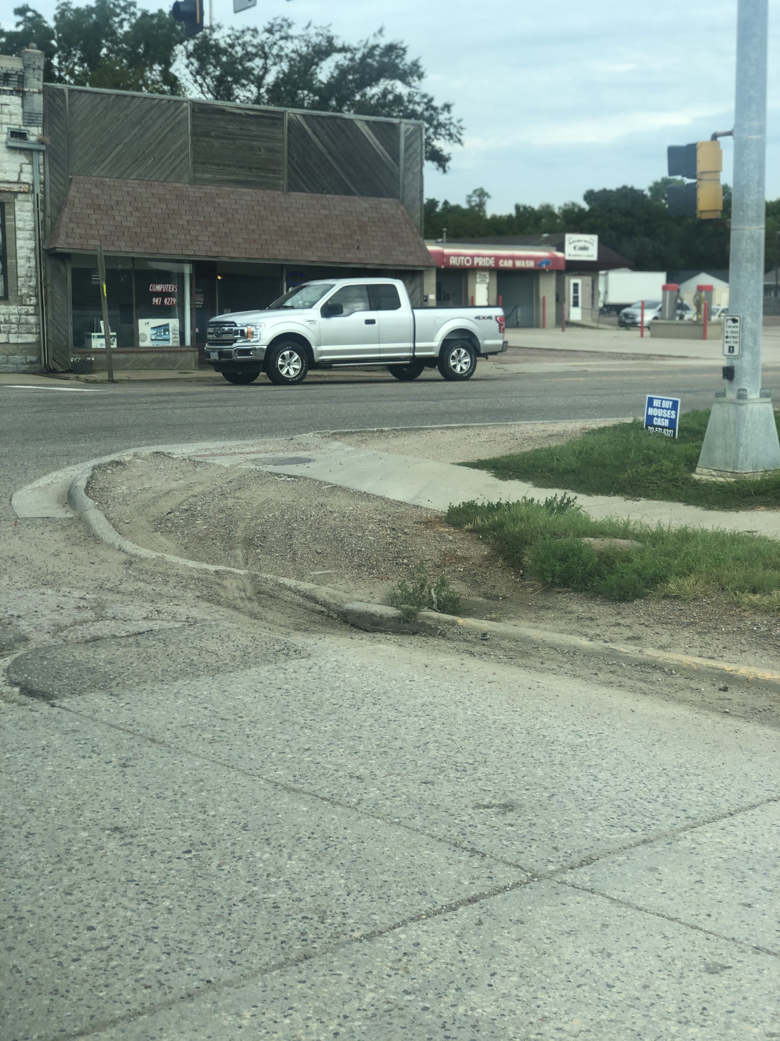
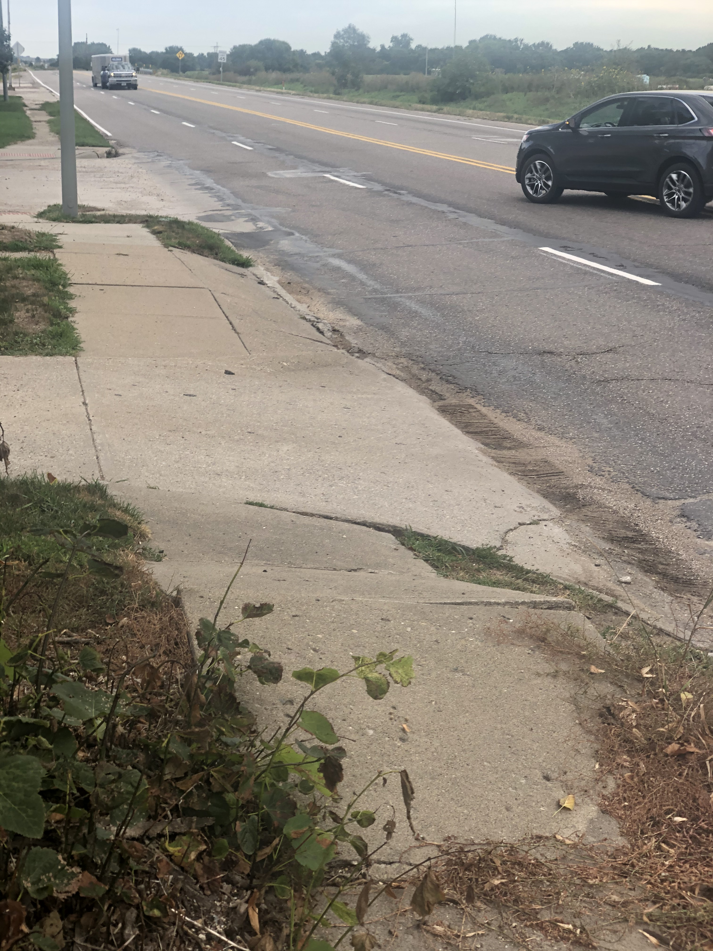
Sidewalk Conditions
Intersection (U.S. Hwy. 75 & C60) has tight geometry that impacts safety and operations.
Turns often encroach on curbs or sidewalk areas.
Crumbling and cracked sidewalks along the highway.
No crosswalk at the intersection of U.S. Hwy 75 & C60 with Main Street to the west of Highway 75 and ballfields to the east of the highway.

Slide 8
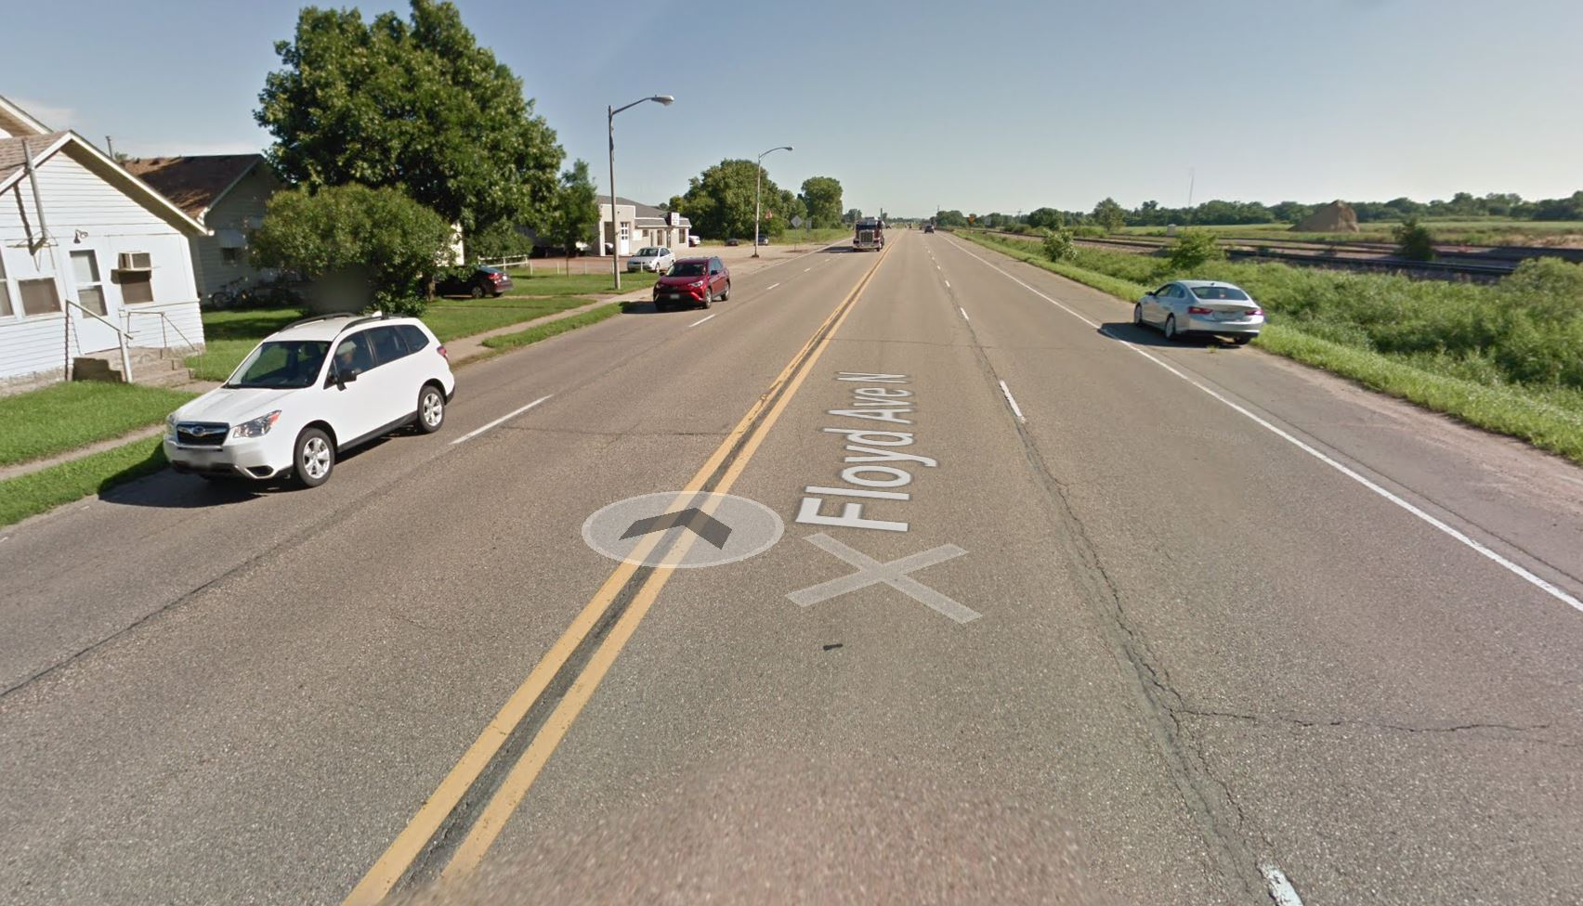
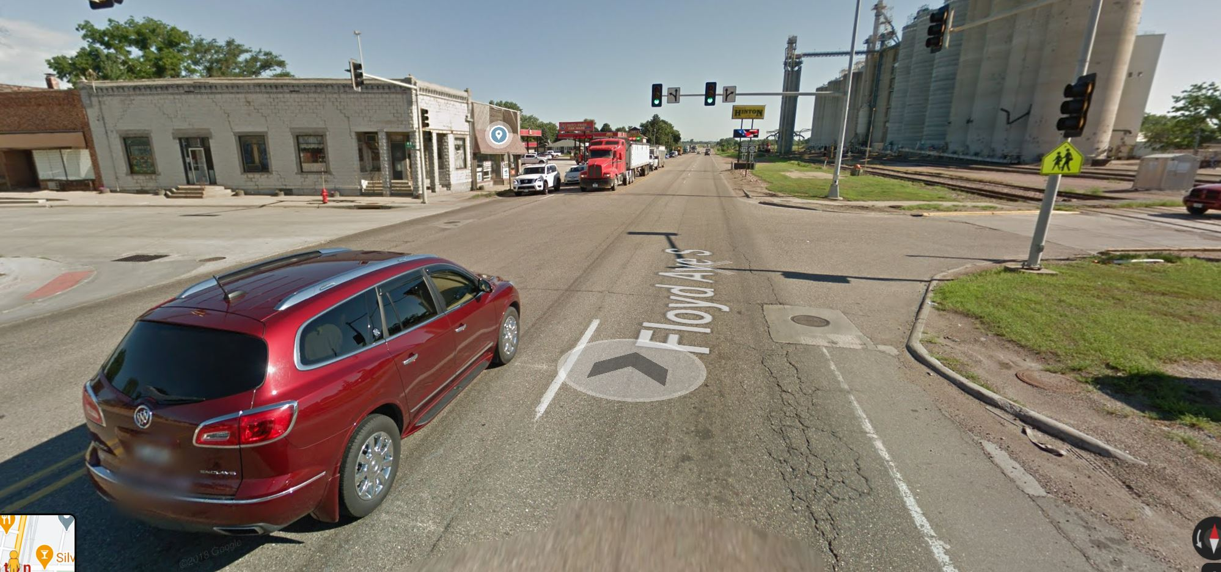
Safety Conditions
Parking along the highway to access businesses.
Tight spacing between railroad and highway.
Crash data at U.S. Hwy. 75 and C60 2015 - 2020:
27 accidents reported.
15 of those involved injuries.
9 crashes involved turning. movements in the intersection
Total property damage $411,008.
Notes:
40% of crashes due to northbound left turn failing to yield

Slide 9
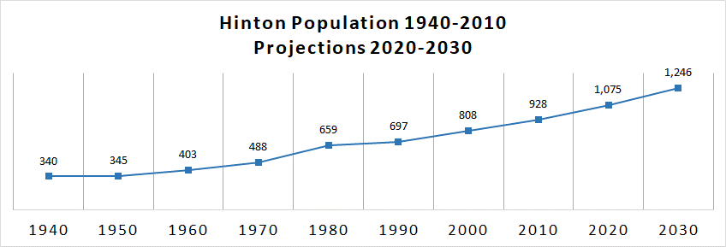
Future Growth
The population in Hinton has seen a study incline since 1940. The current population is estimated at 941 with expected growth to 1,246 by 2030.

Slide 10
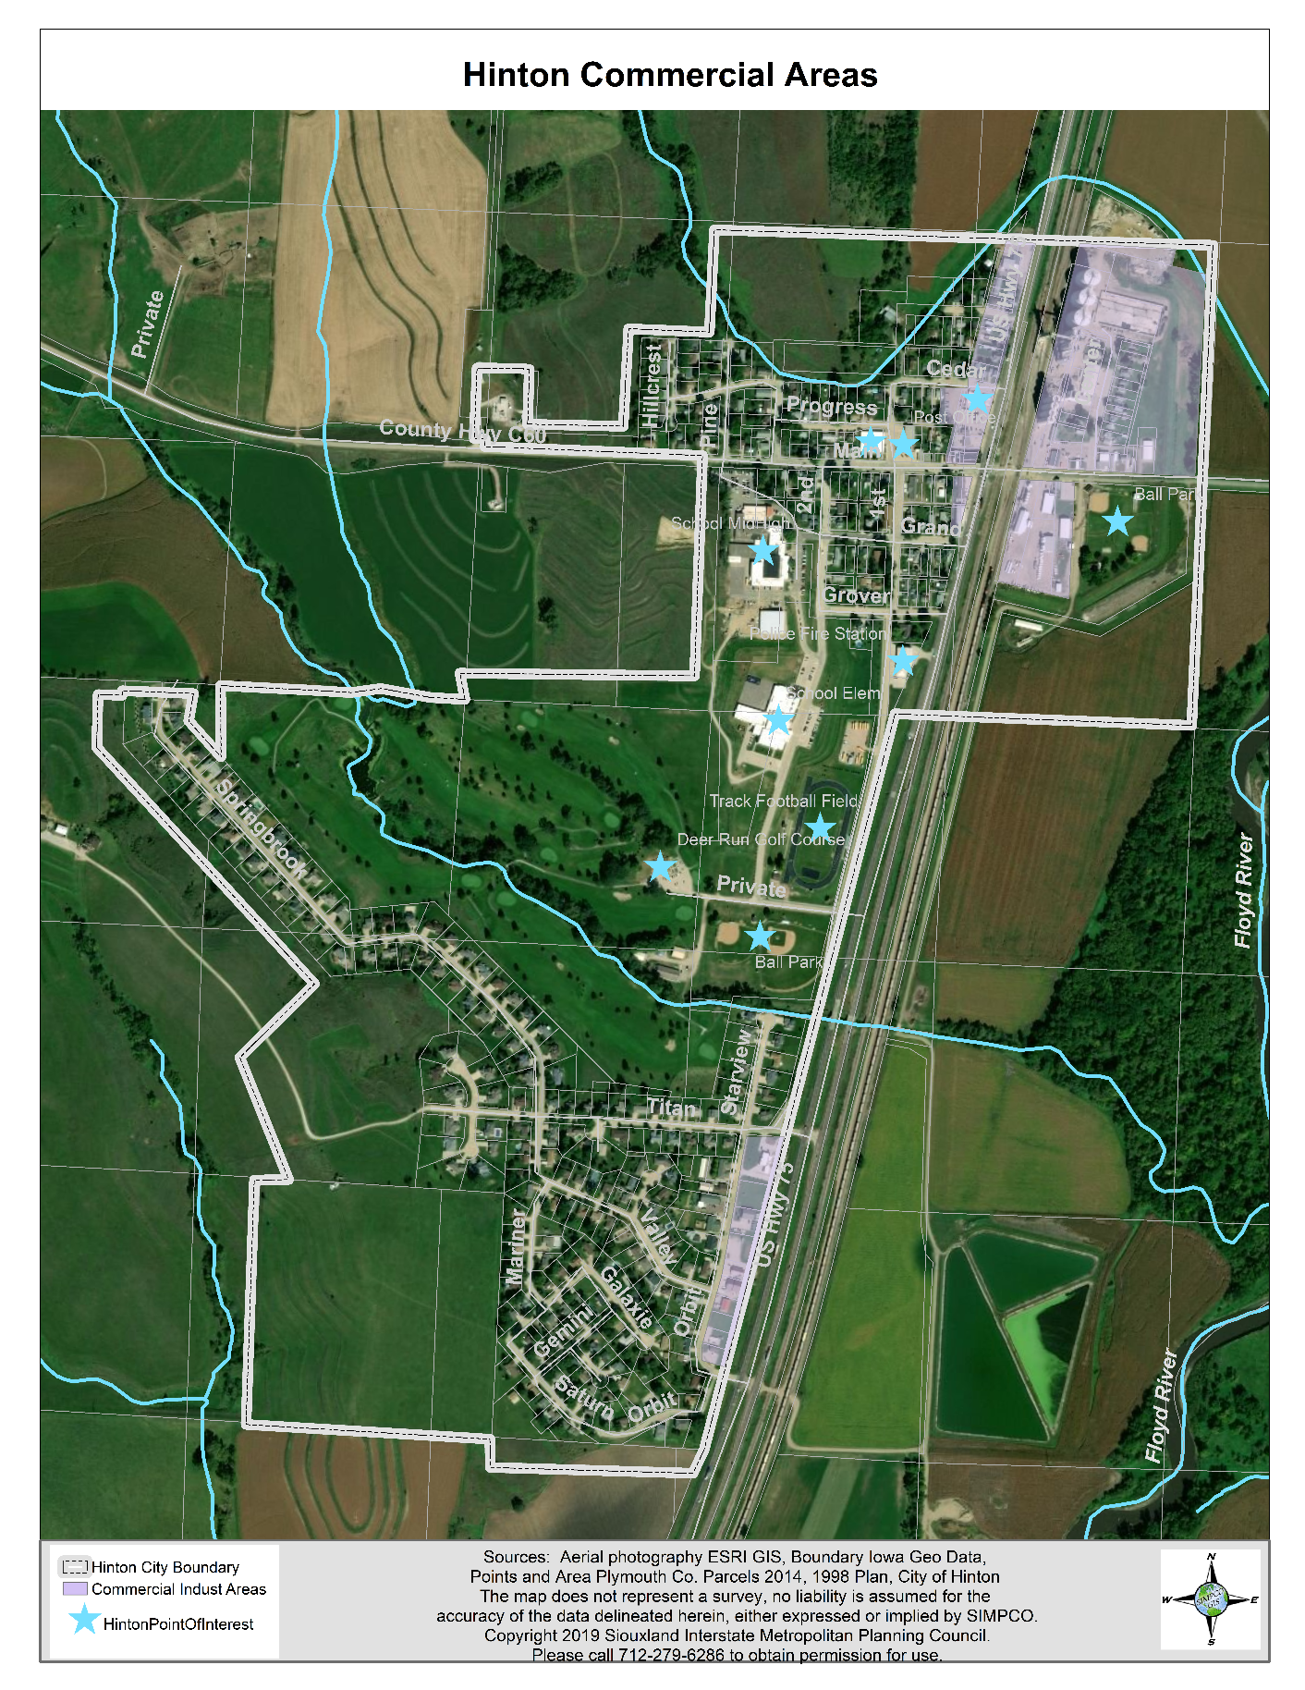
Projected Commercial Growth
The 2019 Comprehensive Plan for the City of Hinton has identified areas of existing and future commercial growth along the U.S. Hwy. 75 Corridor. Road improvements to the corridor will be essential as business growth occurs.

Slide 11
Questions or Comments?
Thank you!
Contact:
Kelly Kreber
Mayor
City of Hinton
kelly.kreber@gmail.com
Michelle Bostinelos
Executive Director
SIMPCO
mbostinelos@simpco.org

