Slide 1
Revitalize Iowa’s Sound Economy Program
Iowa Transportation Commission Workshop
October 12, 2020

Slide 2
Revitalize Iowa’s Sound Economy Program
Created in 1985
Purpose: To promote economic development through roadway improvements.
Eligible development shall have value-adding activities that feed new dollars into the economy
Available to cities and counties through an application program

Slide 3
Available Funding and Application Summary
Available Funding
Funded annually with dedicated state motor fuel and special fuel tax revenues
Application Summary for SFY2021
Total number of projects awarded: 1
Total project costs: $2,130,063
Total amount awarded: $1,065,032
 | CITY | COUNTY
Average funding generated monthly | $970,179 | $485,089
SFY 2020 current Road Use Tax Revenue (as of 8/31/2020) | $1,576,477.13 | $788,238.56
Current Unobligated Balance (as of 8/31/2020) | $9,001,194.3 | $788,238.56

Slide 4
Local Development Project Evaluation Criteria
Development Potential (35 points)
Economic impact and Cost Effectiveness (20 points)
Local Commitment and Initiative (33 points)
Transportation Need and Justification (4 points)
Local Economic Need (6 points)

Slide 5
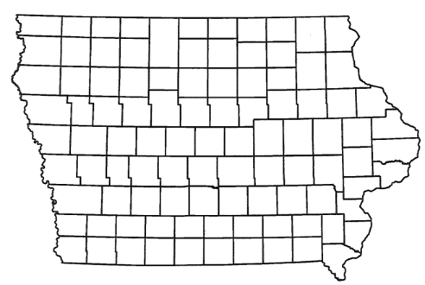
List of Local Development Applications Recommended
PROJECT NAME
SPONSOR
SCORE
TOTAL PROJECT COST
PERCENT PARTICIPATION
RECOMMENDED AMOUNT
Paving of approximately 2,700 feet of Andrew Avenue. | Sioux City | 66 | $1,342,156 | 50% | $671,078

Slide 6
Sioux City
(Local Development)
Paving of approximately 2,700 feet of Andrew Avenue located on the south side of town. This project is necessary to provide improved access to 102 acres for industrial purposes.
Total Cost: $1,342,156
Requested: $671,078 (50%)

Slide 7
QUESTIONS?
Craig Markley, Systems Planning Bureau
craig.markley@iowadot.us
515-239-1027

