Slide 1


U.S. Highway 30 Corridor
Interchange Improvement Project
Presented by: Mayor Brett Barker and
City Administrator Jordan Cook
October 13, 2020

Slide 2
U.S. 30 Interchange Project

Slide 3
U.S. 30 Interchange Project

Slide 4
U.S. 30 Interchange Project
Timeline
  1988 – IDOT and FHWA approved “The Improvement of U.S. 30 in Story County”
  1994 and 1995 – DOT purchase right of way of 65 acres during construction of the 4-lane section from Nevada to Colo.
  2000 – DOT included this project in the 2000 five year plan. Project dropped due to financial considerations.
  2015 – DOT included this project in the five year plan. Project delayed due to local political considerations.
  A Highway 30 Task Force was formed and reported to the Council in 2016.
  The City and other community stakeholders have continued to identify the project as a key strategic priority with transportation funds earmarked by the City.

Slide 5
U.S. 30 Interchange Project
What has happened since?
  Partial project programmed by DOT in five year plan – Overpass
  The City undertook a comprehensive public input process regarding interchange options.
  The City put out multiple written communications
  Multiple public meetings were held with live-streamed online options:
    Q&A Community Coffee with DOT and City staff
    City Council Worksession
    Public Forum
    Council Deliberations
  Extensive written and oral public comment was received.
  In August of 2020, The City Council formally voted 5-1 to support the 2015 DOT Approved Interchange option at Airport Road. Story County submitted letter of support.

Slide 6
U.S. 30 Interchange Project
What is the need?
Significant traffic safety concerns at 3 at-grade intersections with continually increasing traffic counts
Uncertainty along the corridor is a significant inhibitor of growth.
Major investment in Lincoln Highway Industrial Corridor with the Ames Prairie View Industrial Center on the west and Nevada Industrial Park on the east.

Slide 7
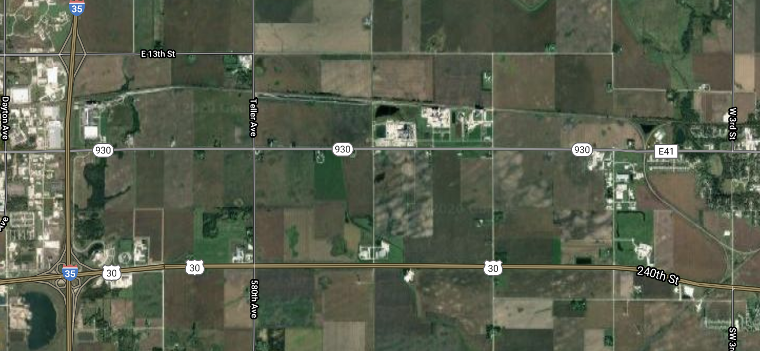
U.S. 30 Interchange Project

Slide 8
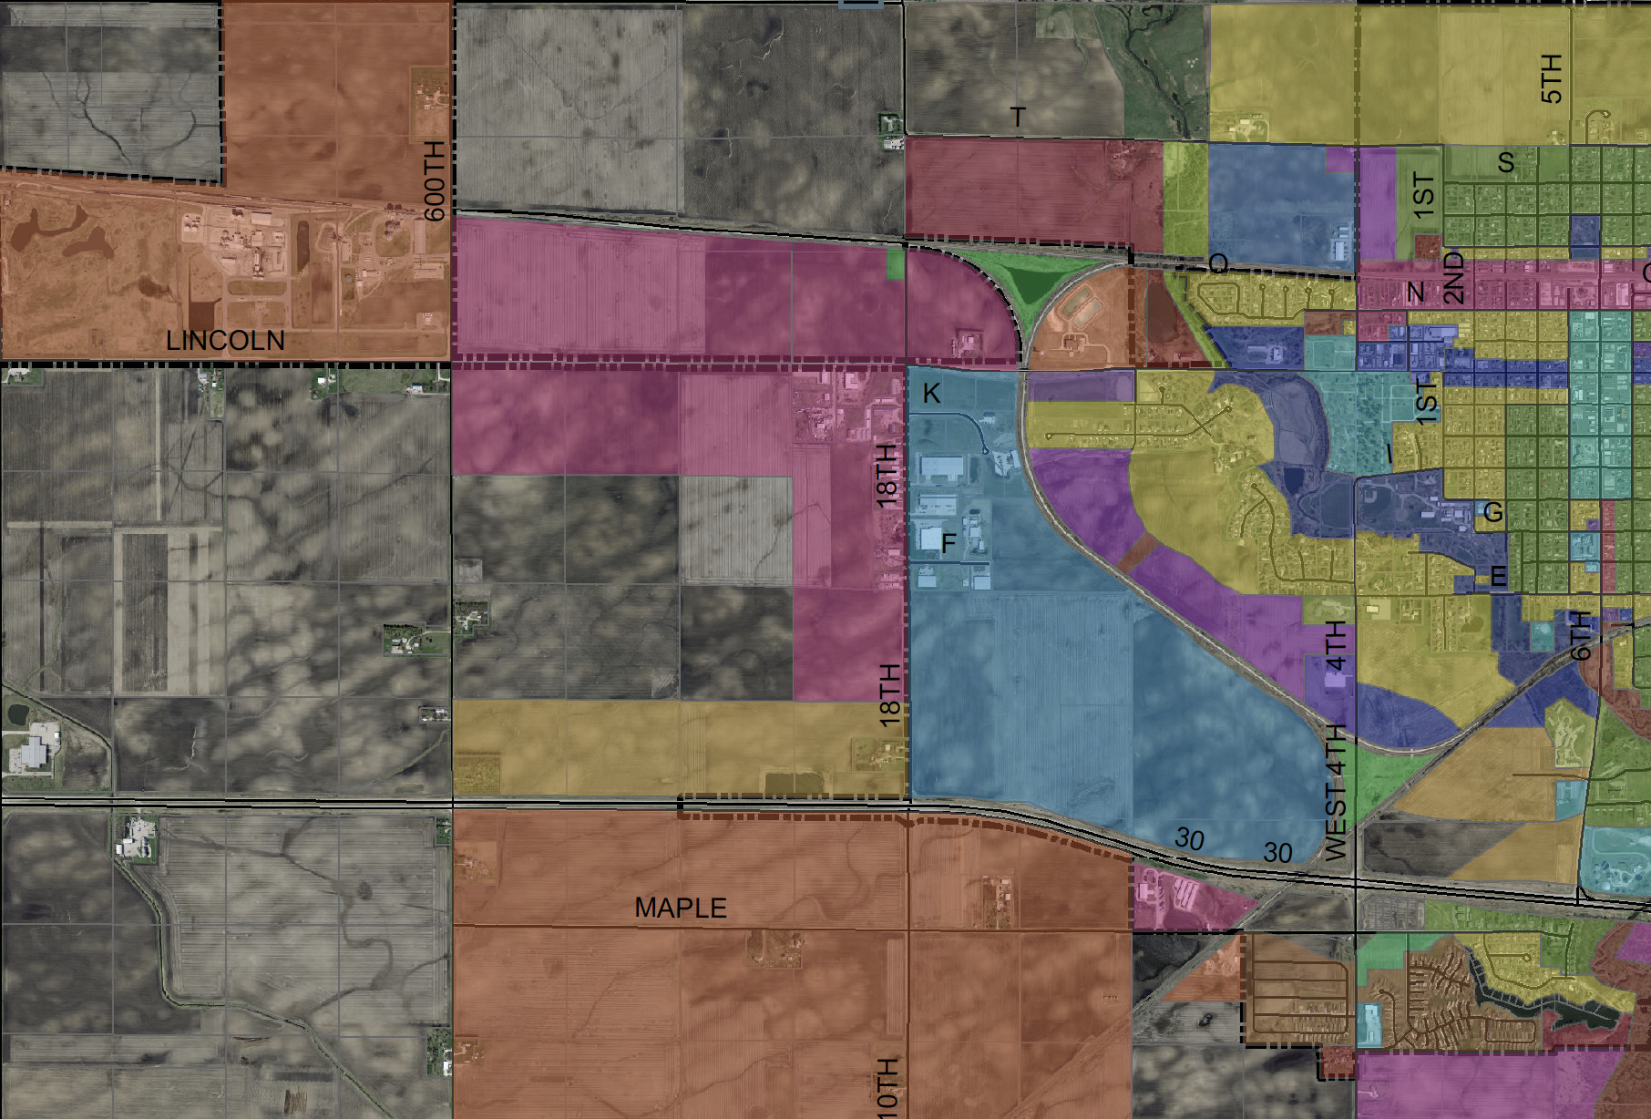
U.S. 30 Interchange Project

Slide 9
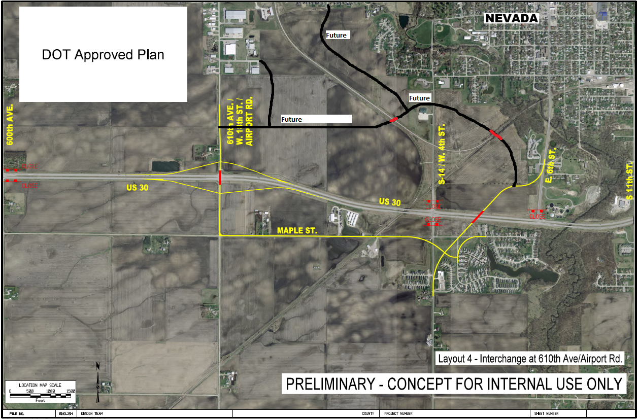
U.S. 30 Interchange Project

Slide 10
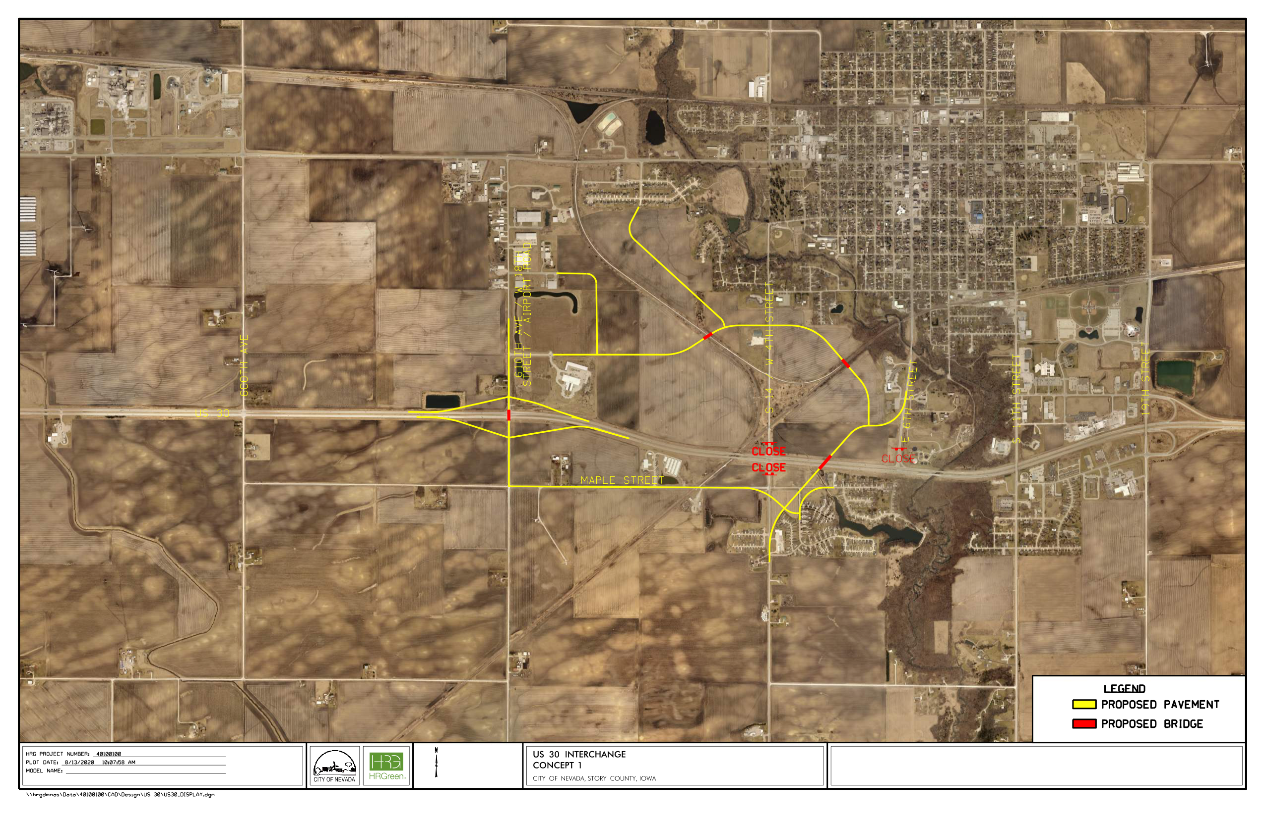
U.S. 30 Interchange Project

Slide 11
U.S. 30 Interchange Project
  Request
  Program the remainder of the US Highway 30 interchange project to coincide with the currently programmed overpass to complete the corridor in Nevada.

Slide 12
U.S. 30 Interchange Project
    Questions or Concerns?
    Contact
  Brett Barker, Mayor Jordan Cook, City Administator
  mayor@cityofnevadaiowa.org jcook@cityofnevadaiowa.org
  1209 6th St
  Nevada, IA 50201
  (515)382-5466

