Slide 1
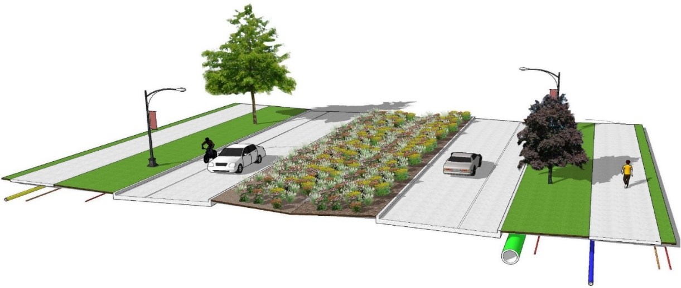
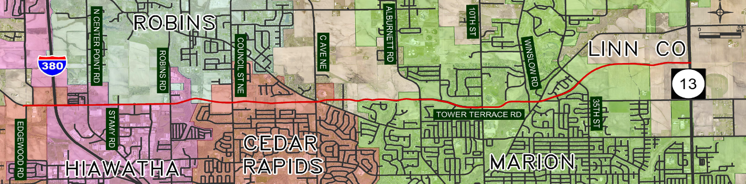

City of Hiawatha delegation
October 13, 2020
Iowa DOT Commission meeting

Slide 2
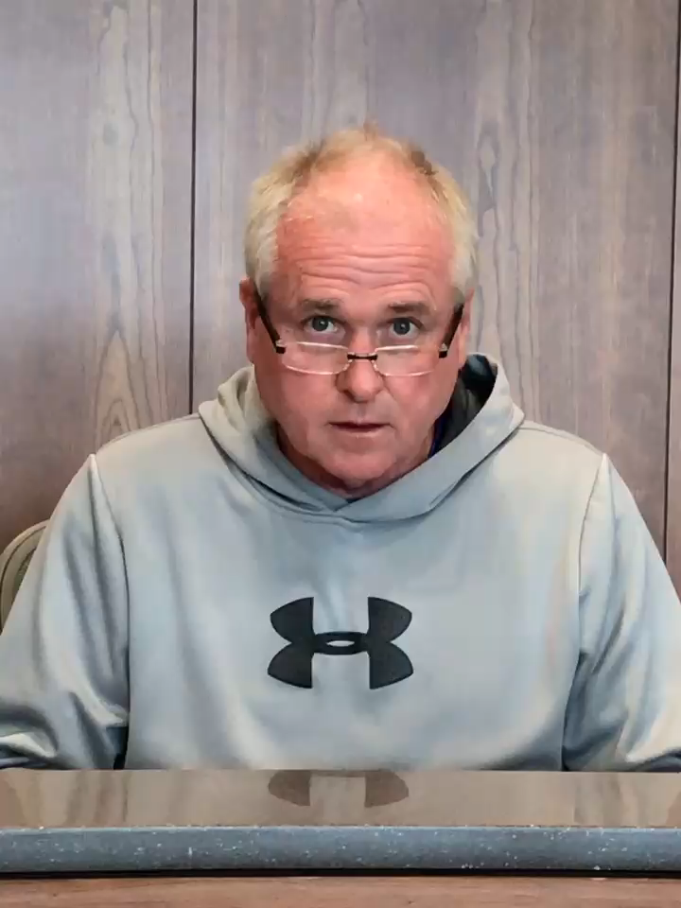
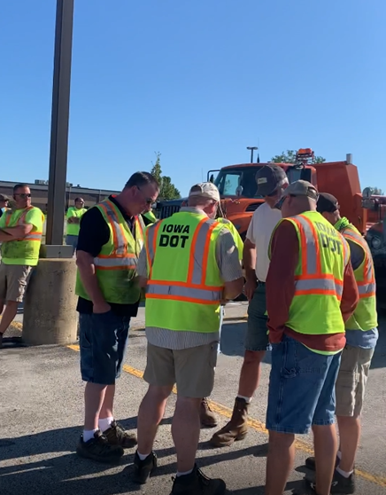
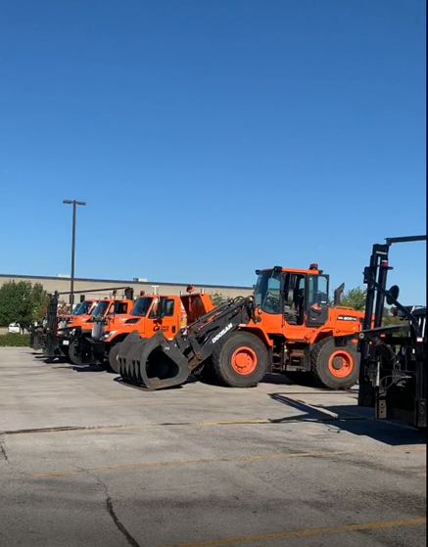
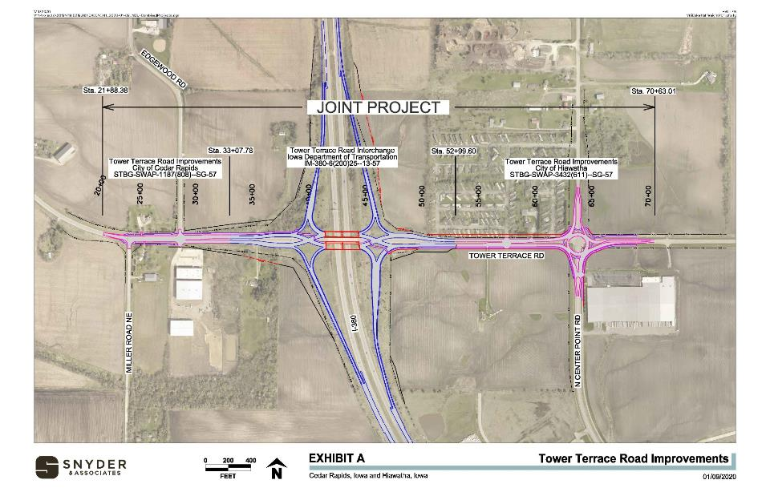
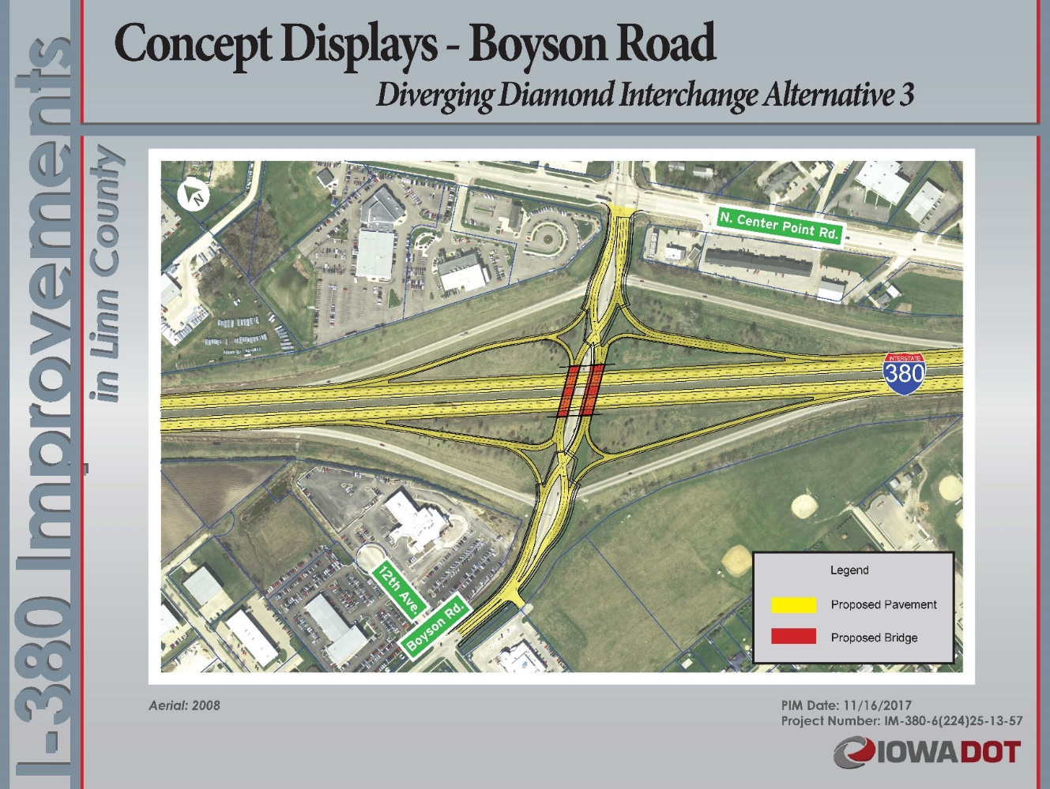
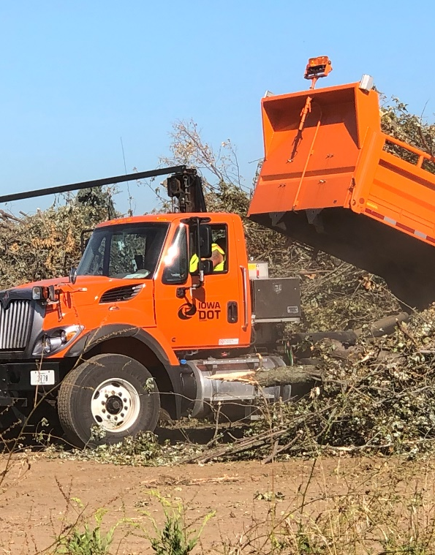
Thank you from Mayor Bill Bennett

Slide 3
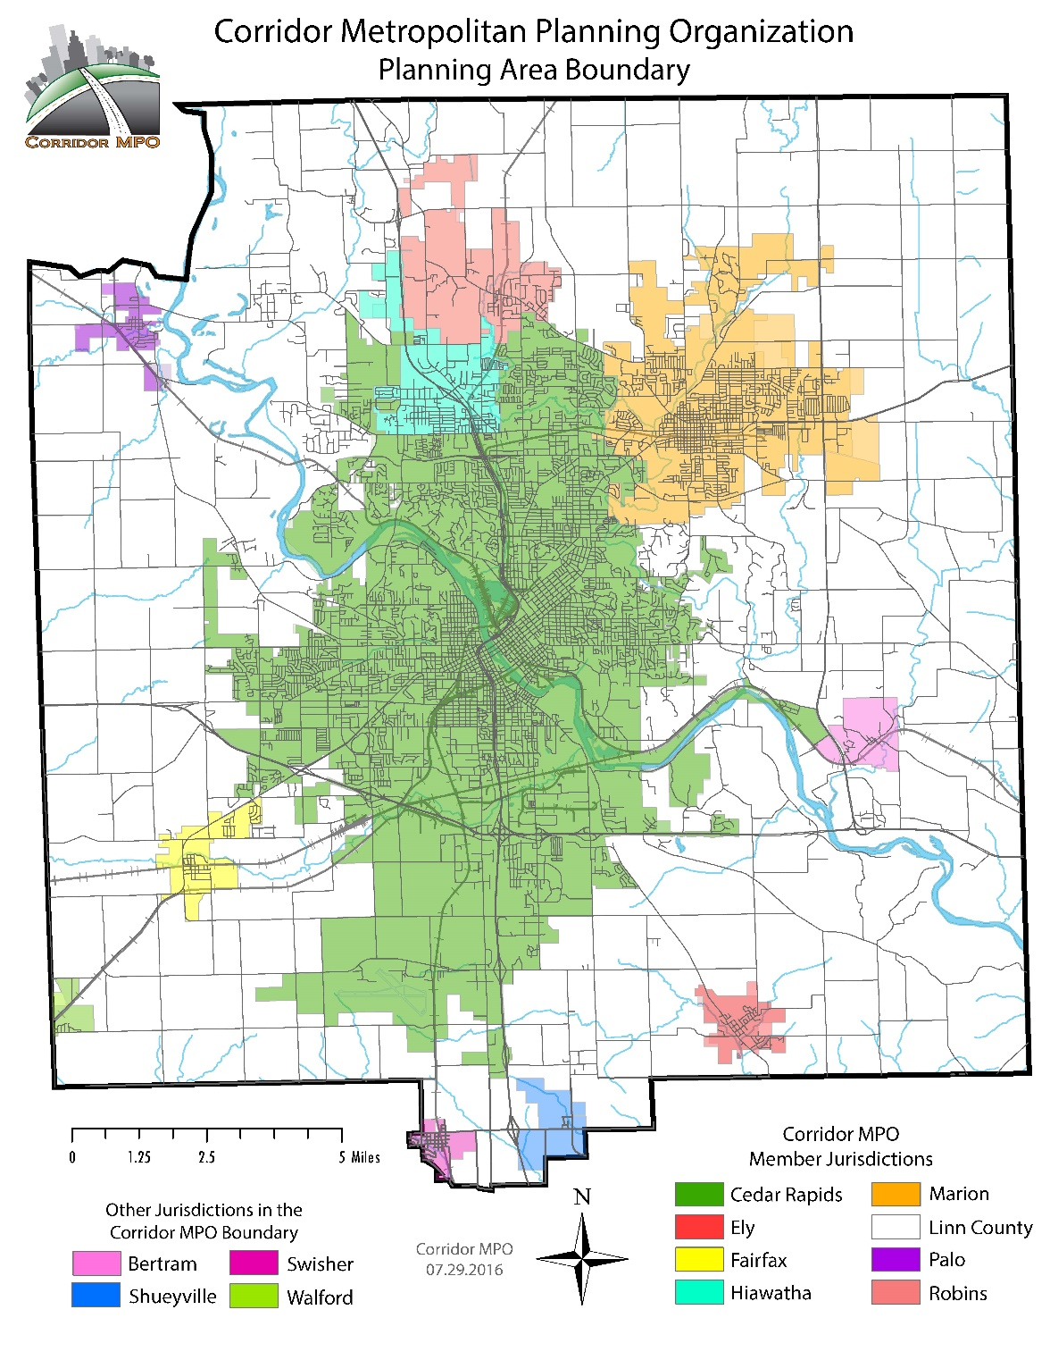
TOWER TERRACE ROAD CORRIDOR
8.3-miles in length
  Edgewood Rd to IA 13
  4.6-miles either constructed or planned
Provide another east/west connection
  IA 100 – 2-3 miles south
  Mt. Vernon Rd – 6 miles south
  US 30 – 9 miles south
Total cost = $90M

Slide 4
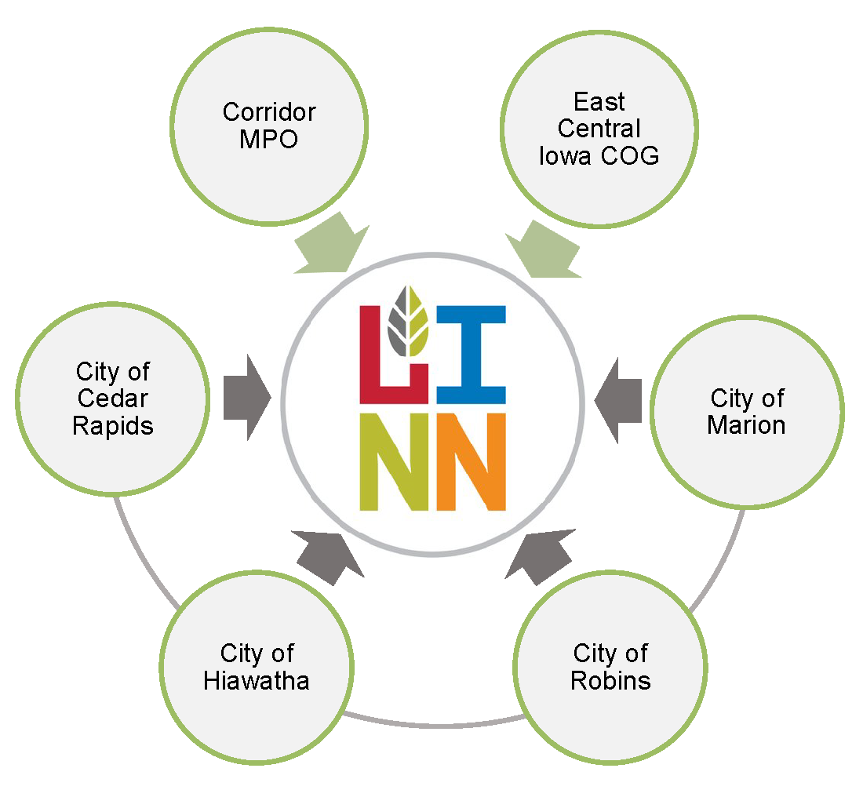
TOWER TERRACE ROAD CORRIDOR
Partnership between
  Linn County (lead)
  Cedar Rapids
  Hiawatha
  Robins
  Marion
Iowa DOT, CMPO, & ECICOG involvement in PMT meetings

Slide 5
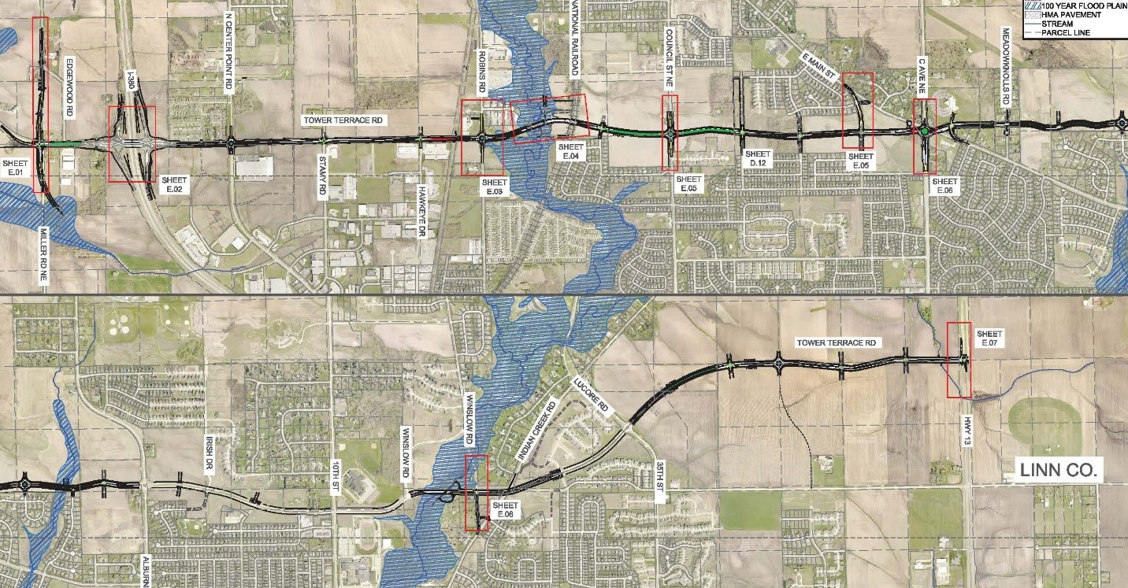
Tower Terrace Road Corridor
3.7 miles remain
Center Point Road to Summerset Extended (Incl. bridges over CNRR and Dry Creek)
Relocated Winslow to Existing Winslow (Incl. bridge over Indian Creek)
Ridge at Indian Creek to Iowa Hwy 13

Slide 6
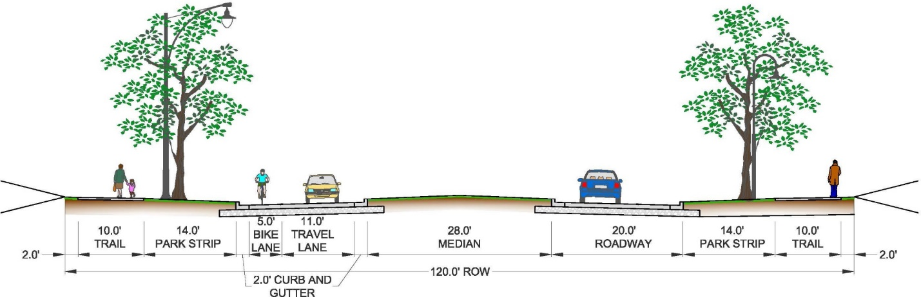
Roadway Cross Section
Two-lane Urban Road with Raised Median and Turn Lanes
Bike Lane in Each Direction
10’ Trail on Both Sides
Future Expansion to Median Side for Four Traffic Lanes and No Bike Lanes

Slide 7
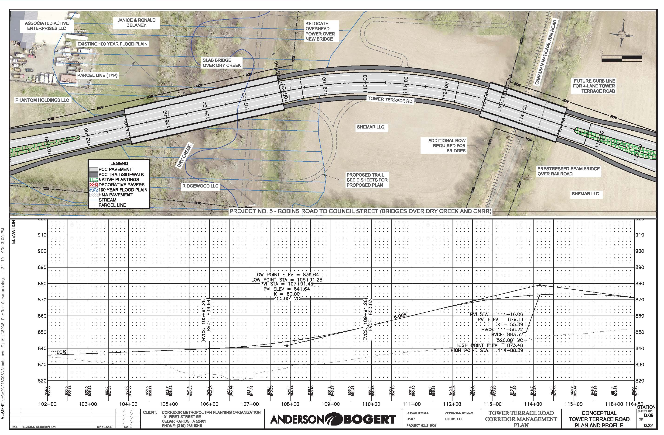
Cost Challenges - Dry Creek and CN Railway Overpass Bridges

Slide 8
BUILD Grant Application
$25M request in 2020
NEPA study in progress
Very large travel time benefits
Trails connection
Partnerships have been key
Funding package proposal

Slide 9
Economic Competitiveness
Travel Time Reductions for the Region = $1.15B over 27 year period

Slide 10

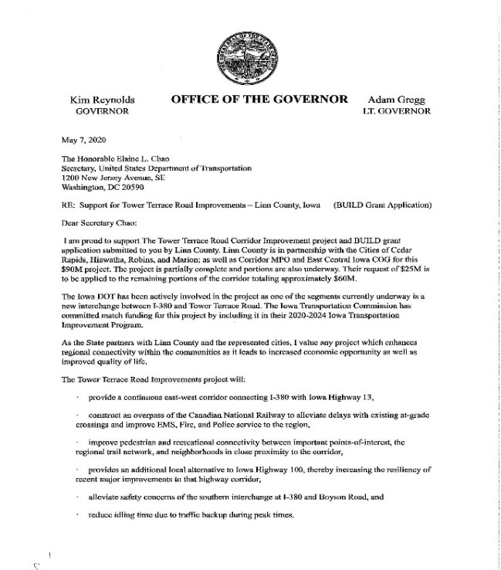
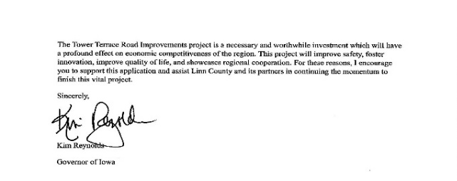
Partnership
Linn County, CR, Hiawatha, Robins, Marion
Governor Kim Reynolds
U.S. Sen Charles Grassley
U.S. Sen Joni Ernst
Iowa Rep Ashley Hinson
Iowa Sen Liz Mathis
Iowa DOT
City of Hiawatha
City of Robins
City of Cedar Rapids
City of Marion
Corridor MPO
East Central Iowa COG
ICR Iowa
Cedar Rapids Metro Economic Alliance
HEDCO
MEDCO
Kirkwood Community College
CCB Packaging, Inc.
Collins Aerospace
Legacy Manufacturing Company
Linn County Rural Electric Coop
Alliant Energy
UPS

Slide 11
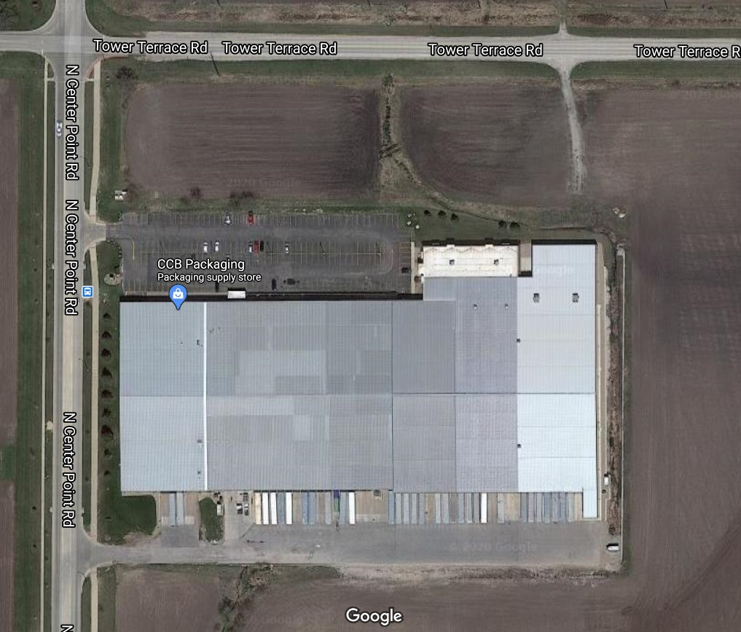
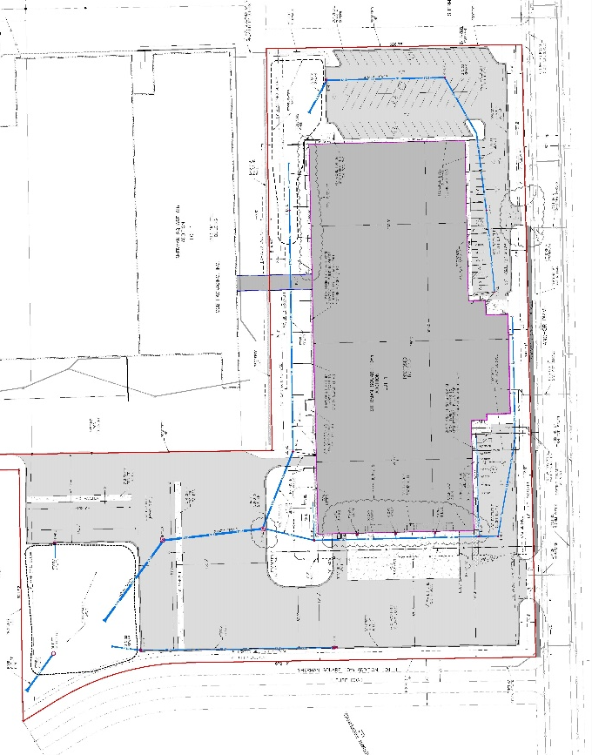
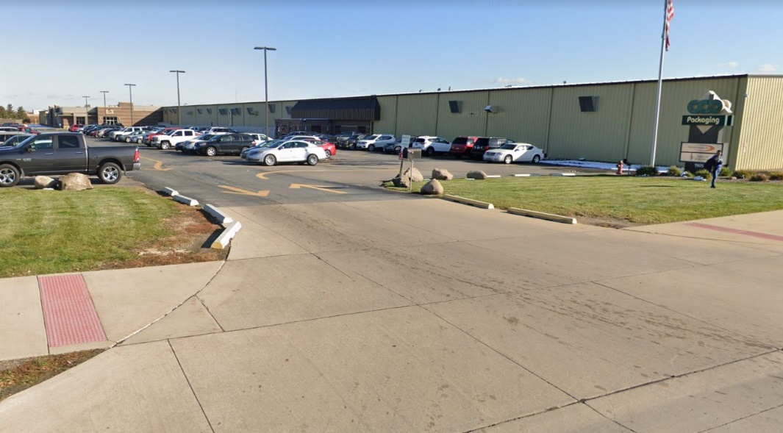

CCB Packaging Expansion
Add 100,000 sf to 260,000 sf building
$6M expansion
Add 10-20 high quality jobs
80 trucks / day

Slide 12
Cost vs Funding Package Proposal
Project Funding | Cedar Rapids | Hiawatha | Robins | Marion | Totals
STBG (80/20) | $2,785,523 | $2,970,823 | $2,979,701 | $5,425,770 | $14,161,816
BUILD (80/20) | $5,145,234 | $6,070,292 | $4,559,779 | $9,224,695 | $25,000,000
RISE (50/50) | $1,799,961 | $2,344,498 | $1,709,742 | $3,365,989 | $9,220,190
TSIP | $0 | $285,465 | $214,535 | $0 | $500,000
U-STEP (55/45) | $0 | $0 | $0 | $400,000 | $400,000
Local | $2,654,227 | $2,940,547 | $1,511,957 | $3,788,044 | $10,894,776
Total Funding | $12,384,945 | $14,611,625 | $10,975,714 | $22,204,498 | $60,176,782
$60.2M Cost for Remaining 3.7 miles
$25.0M BUILD Grant Application
$14.2M STBG (Federal Funds through CMPO)
$10.1M Iowa DOT (RISE, TSIP, U-STEP) *
$10.9M Locals
* May include ICAAP and LIFTS as well due to travel time / emissions reductions and improved freight movement reliability

Slide 13
BUILD Grant – Project Schedule

Slide 14
THANK YOU!

