Slide 1
Revitalize Iowa’s Sound Economy Program
Iowa Transportation Commission Business Meeting
October 12, 2021

Slide 2
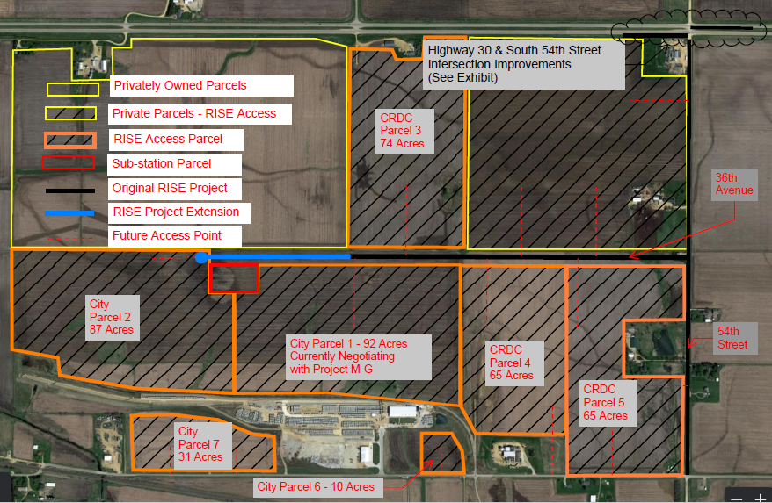
List of Local Development Applications Recommended
ADDED TOTAL COST FOR MODIFICATION
RECOMMENDED RISE AMOUNT FOR MODIFICATION
PROJECT NAME
SPONSOR
SCORE
PERCENT PARTICIPATION
To construct an additional 2,000 feet of 36th Avenue South. (Modification) | Clinton | 61 | $1,200,000 | 60% | $720,000

