Slide 1
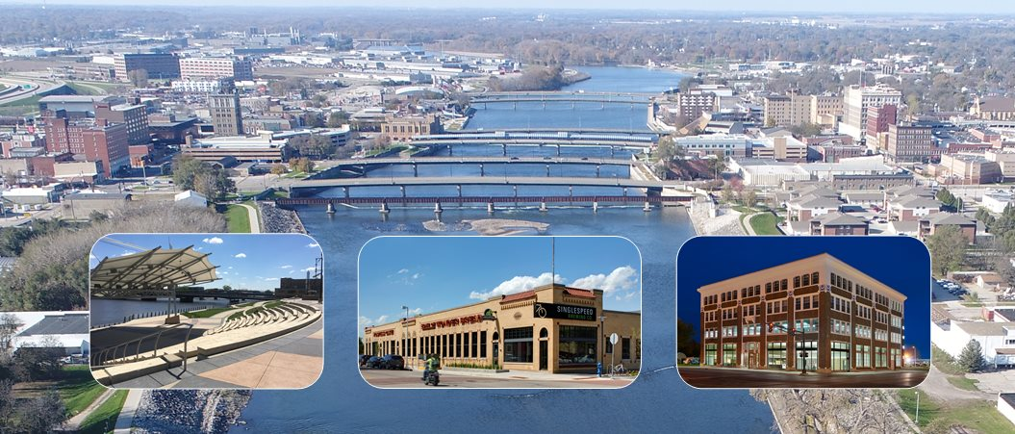
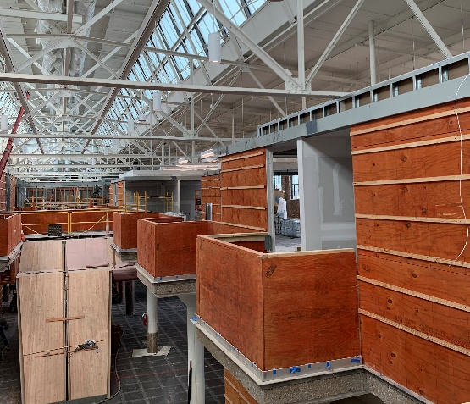
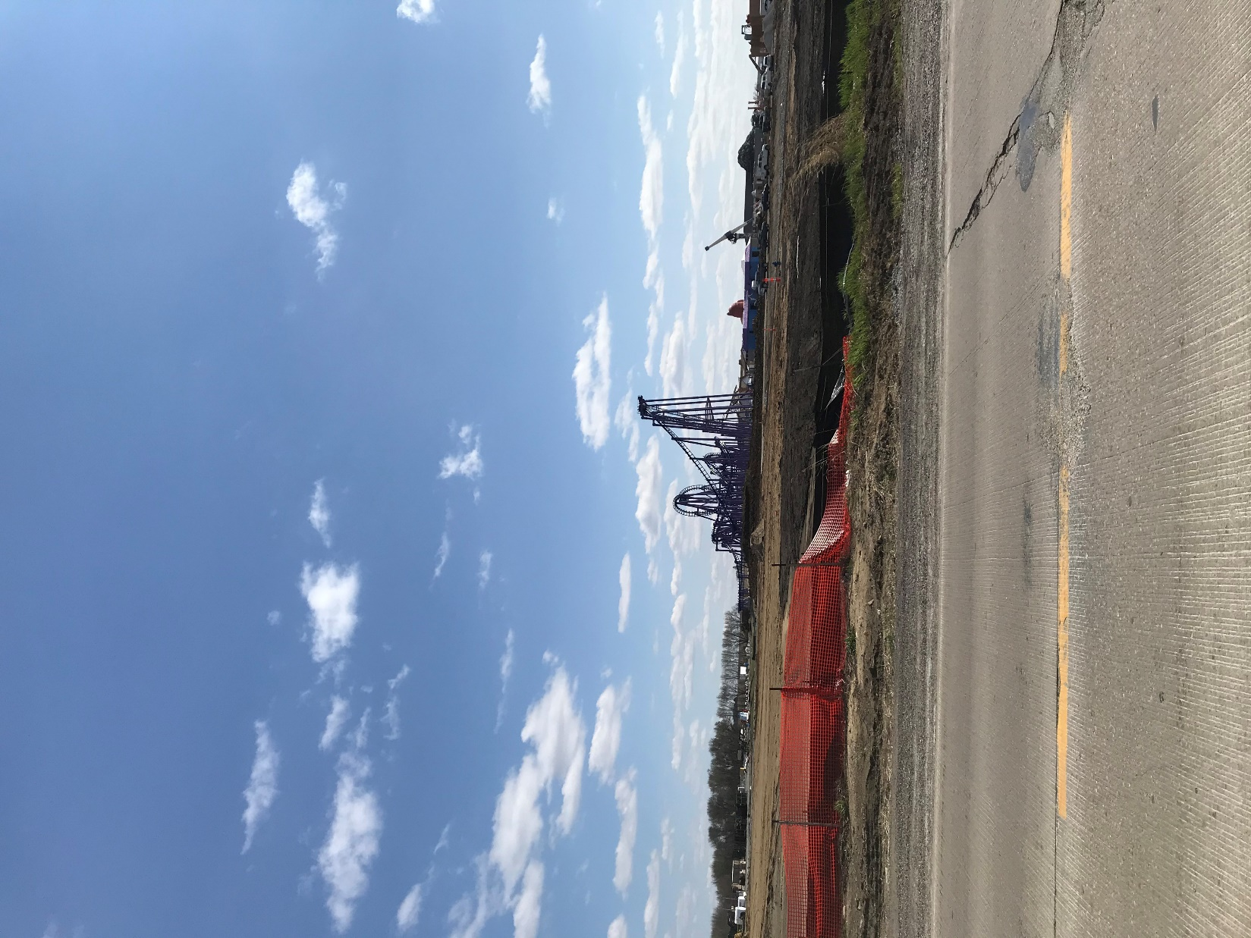
Iowa Department of Transportation October 2021 Presentation

Slide 2
Waterloo Air and Rail Park and Airport area
The City of Waterloo and Iowa Department of Transportation have partnered to create over 32 lots, already bringing over 800,000 sq. ft., over $130 million in private investment, and over 255 new jobs to airport area, through the following projects:
RISE awards for WARP Drive, Hyper Drive, Geraldine Road (3 phases), and MidPort Boulevard (3 phases)
In turn, this growing industrial area and economic activity has brought the development of another 12 lots to be created, another 95,000 sq. ft. of industrial and airport-industry buildings to be constructed in the area, and over $3.8 million in private investment.
The impact continues with current projects being discussed for over $7 million in investment, over 10 new jobs, and over 40,000 sq. ft. planned.
5

Slide 3
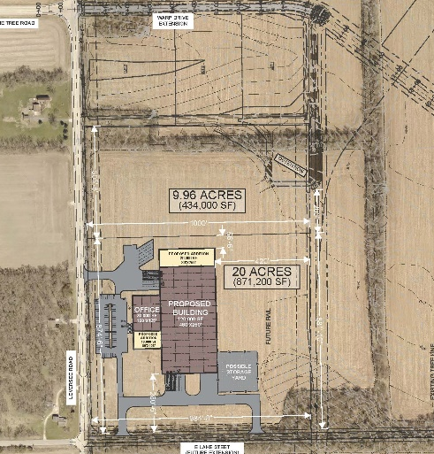
Waterloo Air and Rail Park
The Waterloo Air and Rail Park will have ability for development of sites for rail-related, air-related, and standard truck-related industries, through RISE roads, rail extensions from CN, as well as proximity to Waterloo Regional Airport.

Slide 4
Northeast Industrial Park
The City’s Northeast Industrial Park has seen construction consistently for many years. The City took proactive steps to open additional land to the west of the existing park with new sewer and water main extensions.
ConTrol, a supplier to Deere for container systems, is now building a new 187,000 sq. ft. $11.5 million cross-docking facility to expand their operations in the area.
The City of Waterloo was recently awarded a $468,750 RISE grant to add turn lanes and flatten out Newell Street in this area for better truck movements and traffic safety.
A & T Trucking is building on land for a new $300,000 office and trucking site at Northeast Industrial Park.
Tyson is in process of hiring over 245 employees following their $51 million expansion project at their site on North Elk Run Road.
The City is further platting two new lots in the area for continued small lot availability as well. Interest has already been expressed in these lots.
The City continues to participate with the County, INRCOG, and several smaller municipalities for the preliminary design of the Northeast Arterial Access Study, funded by MPO funds. The project aims to find safer and more efficient paths for heavy truck traffic through the metro area, and specifically to the City’s Northeast Industrial Park area

Slide 5
Northeast Industrial Park
The City of Waterloo ids continuing to work with Evansdale, Raymond, Elk Run Heights, Black Hawk County, and INRCOG for an overall plan for the Northeast Industrial Corridor study and design. This project will increase efforts towards industrial development while working to create safer and more efficient trucking corridors through the smaller communities.
8

Slide 6
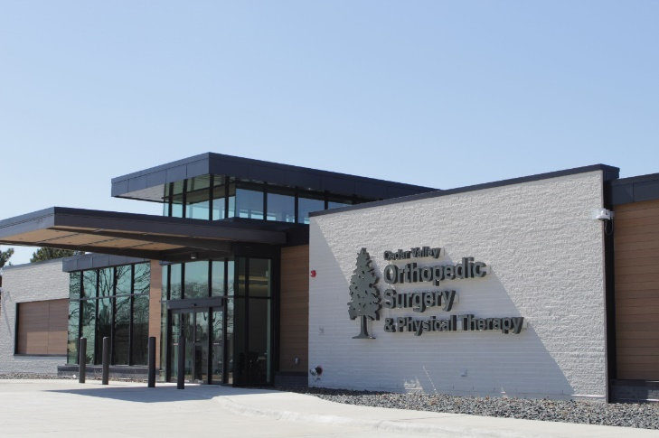
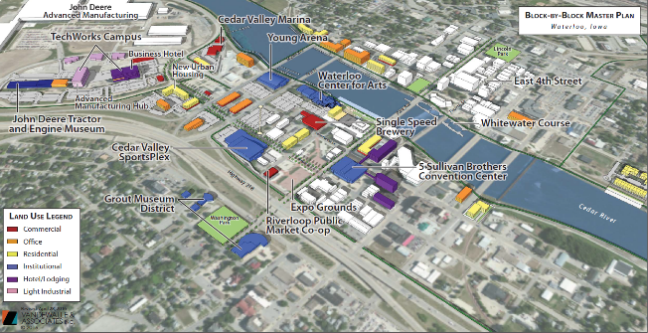
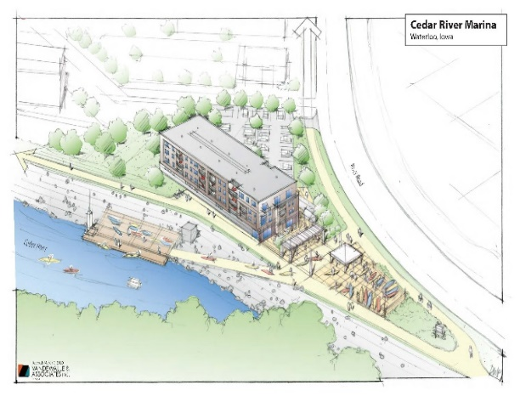
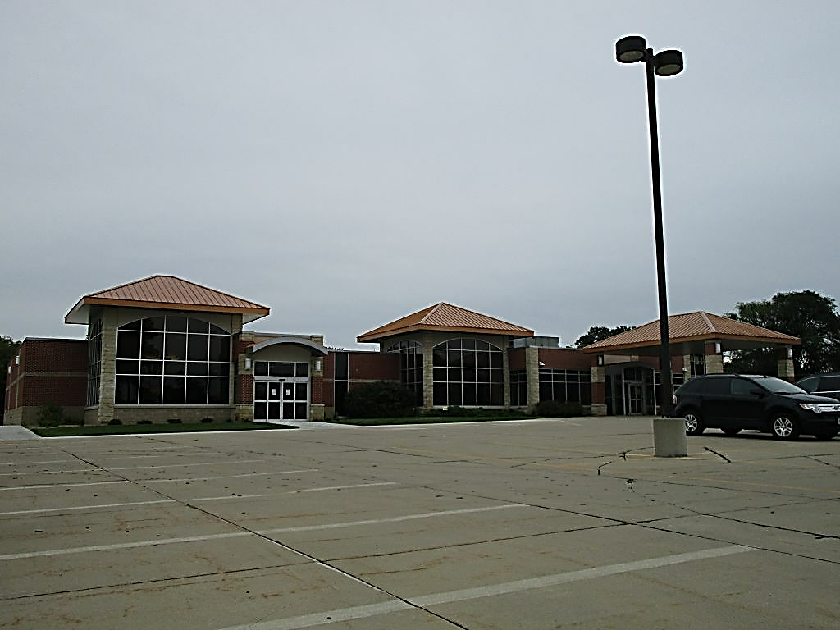
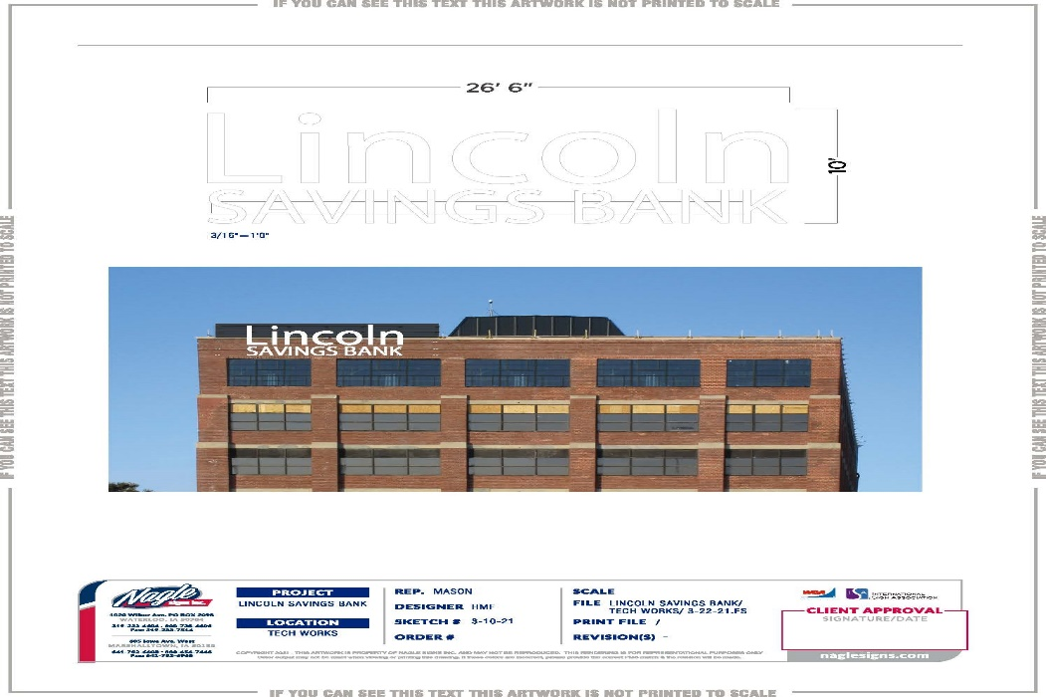
- The Highway 63 corridor through Downtown Waterloo has worked to improve the corridor for residential, it has improved traffic conditions, it has added storm water lift stations, an improved railroad overpass with trail system and greenspace, and over $120 million in private investments: -North Crossing medical and retail improvements, in partnership with Unity Point Hospital -Multiple second floor rehabilitations for urban housing - The Tech Works Campus development with Lincoln Savings Bank, Hawkeye Community College, University of Northern Iowa, Marriot Hotel
Highway 63 Corridor

Slide 7
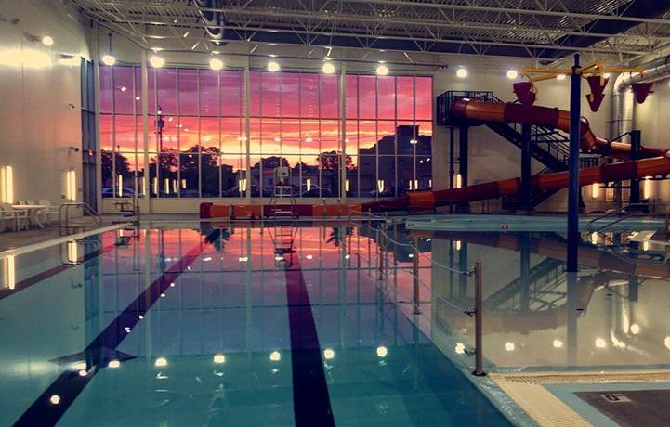
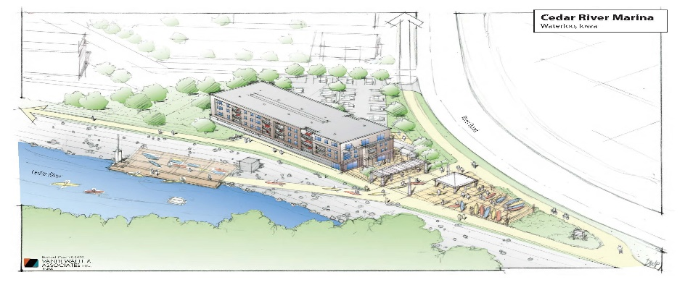
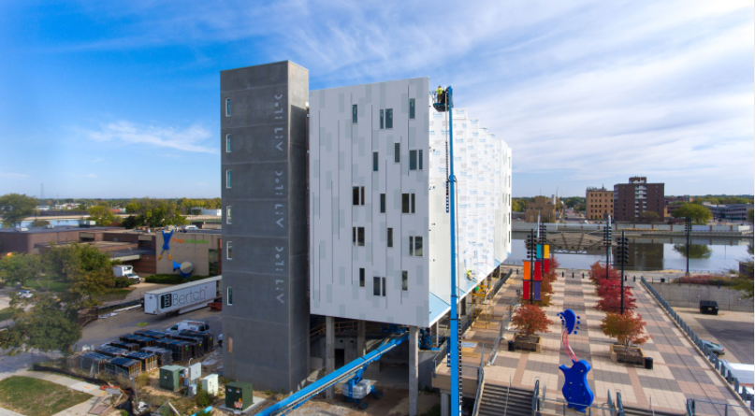
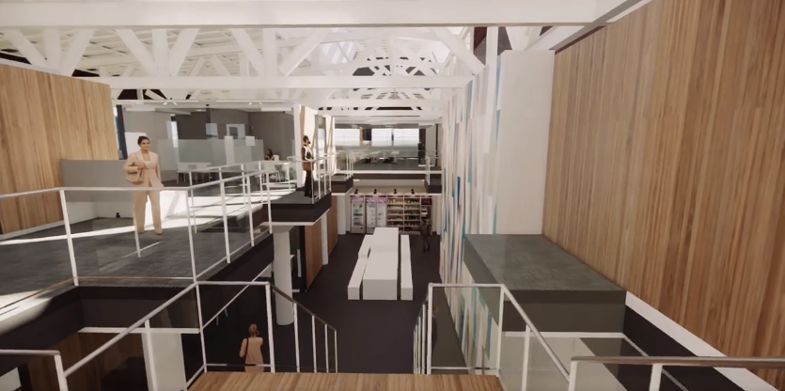
- The Cedar Valley Sportsplex - New riverfront housing in multiple locations along the original Riverfront Renaissance master plan for private investment to follow public investment - coming soon: the Marina, as a part of the IRD
Highway 63 Corridor

Slide 8
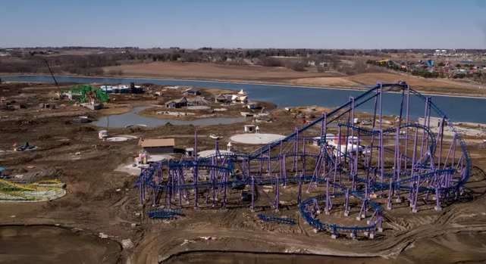
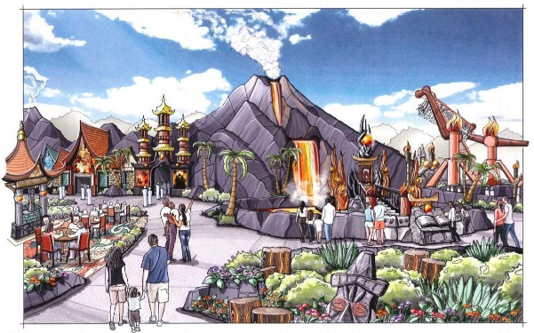
- The $100+ million theme park is under construction, planned for 2022 opening - $3.2 million RISE grant partnership with IDOT for Shaulis Road improvements for drainage, lane configurations, traffic movements, etc. for theme park tourism - City working on La Porte/Hess road improvements from Shaulis Road area to Mitchell Avenue area – RAISE grant application
Lost Worlds Theme Park / La Porte/Hess Corridor

Slide 9
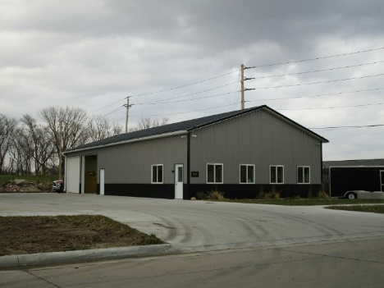
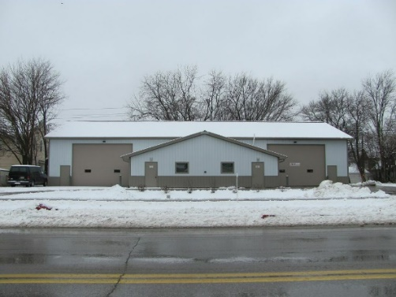
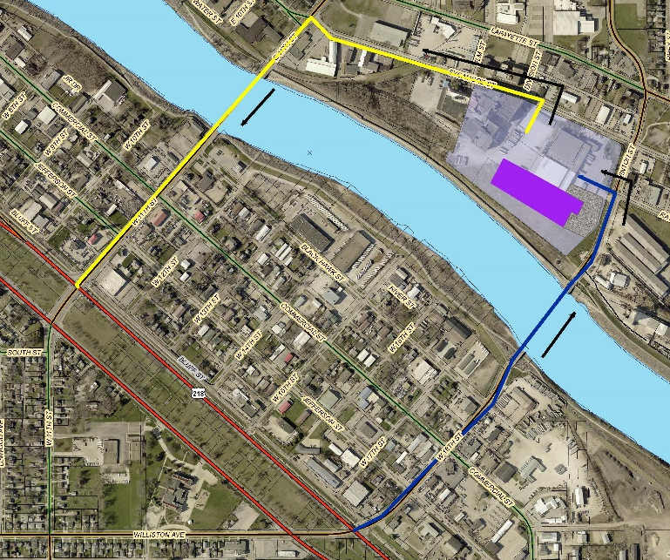
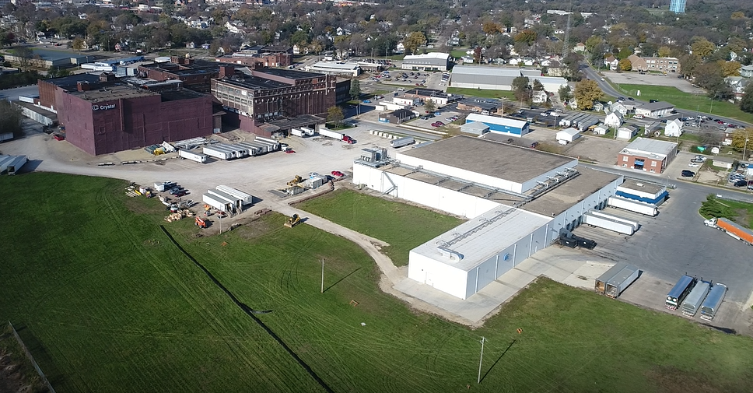
Rath brownfield redevelopment area
The City continues to see good infill development in smaller areas along the Highway 218 corridor from West 7th to the West 18th Street area, with over $2.7 million in smaller lot development.
Over the last 20 years, reinvestment of over $27.8 million in the former "Rath area” through Crystal Distribution expansions, the creation of the Human Services Campus, the small business infill projects, and brownfield redevelopment in riverfront housing. This next expansion by Crystal (Grow Cedar Valley Business of the Year 2020) is a $16 million expansion to continue that positive trend for reclaiming this area from the once bankrupt vacant buildings of Rath Packing.
Many of the smaller lots were acquired by the City using a State Code portion to eliminate blight. So the reinvestment is a huge turnaround from vacant structures to small business sites.

Slide 10
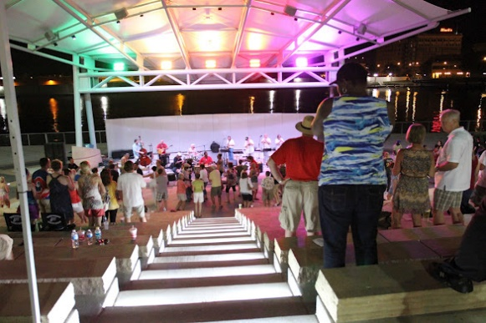

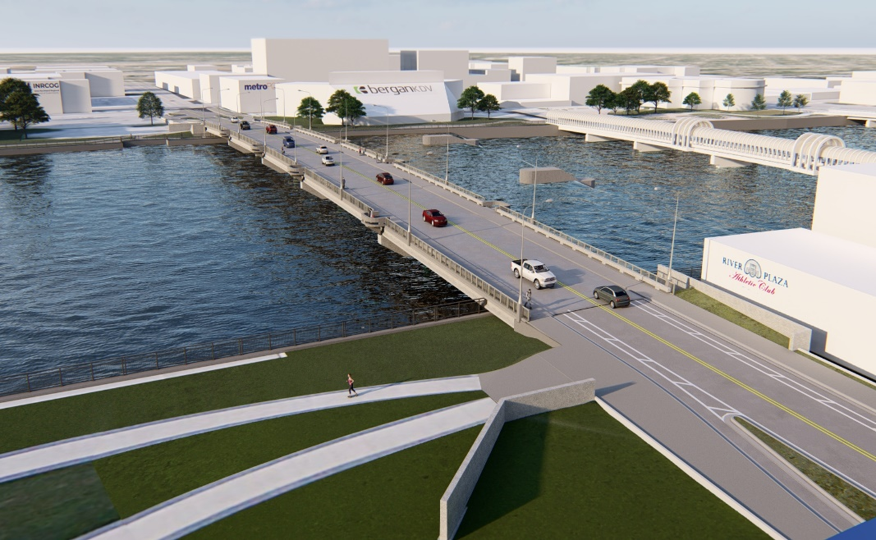
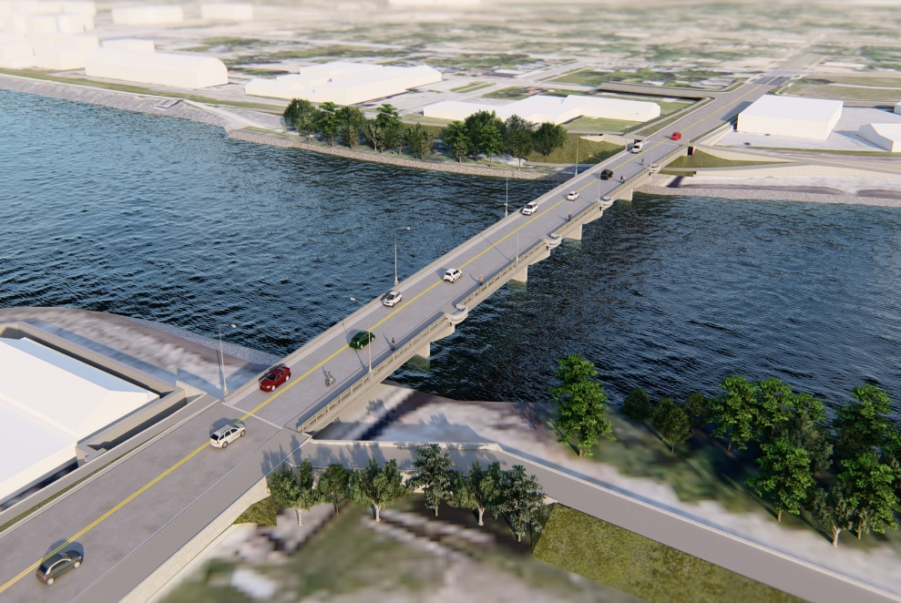
Competitive Bridge grant
The City is proud to be a partner with the State of Iowa for the federal Competitive Bridge grant – bringing $33.44 million to the State of Iowa and $12.5 million to the City of Waterloo for the replacement of the Park Avenue and 11th Street Bridges.
The Park Avenue bridge will continue to play a major part in the Riverfront Renaissance, given its location near the Amphitheatre, riverfront amenities, and Downtown Waterloo development overall.
The 11th Street Bridge will continue to play a major role in bringing new industrial manufacturing and uses to the former Rath Packing Plant brownfield redevelopment area.

Slide 11
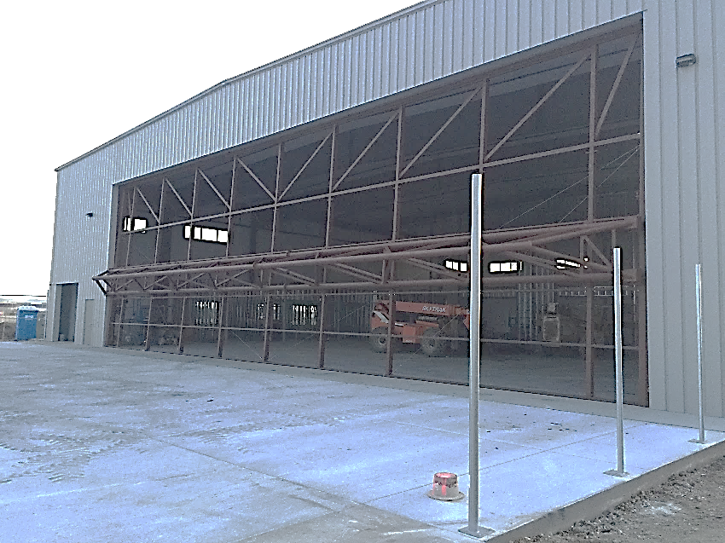
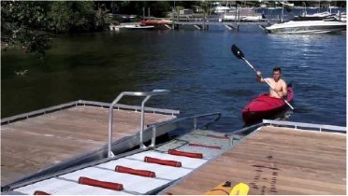
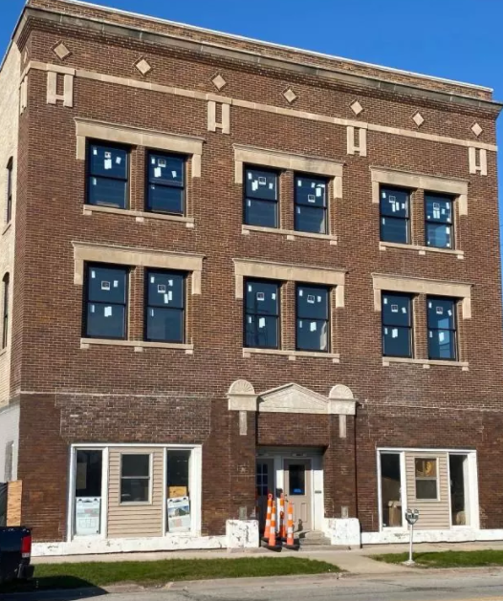
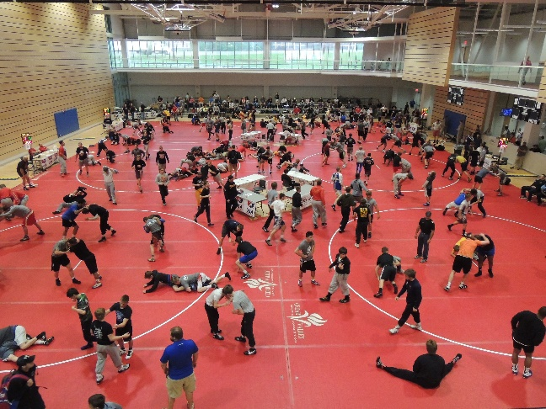
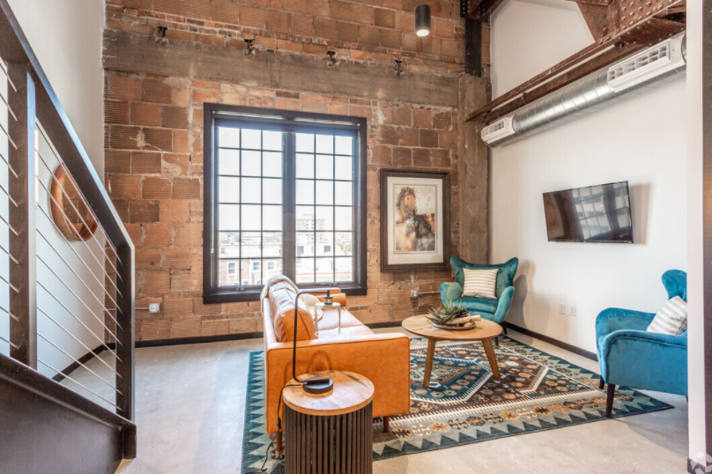
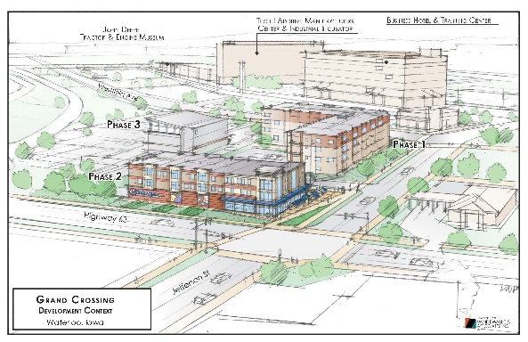
Iowa Department of Transportation October 2021 Presentation
Thank you !!! The IDOT’s continued commitment to the Waterloo community – including improvements underway and recently to Highway 63, 20, 218, I-380, have all played a major role in economic opportunities, projects, and developments within the community.
Sometimes people do not realize the impact on lives through enhancements, trails, water trails, housing improvements due to improved corridors, new business equals new jobs, new families moving here, redevelopment of brownfield sites, new shovel-ready lots and industrial parks, ease of travel for tourism/sports from other communities, and airport investment.
Thanks!!

