Slide 1
COVID-19 Transportation Funding Impact
Transportation Commission Workshop
October 11, 2021

Slide 2
Update
Economic Recovery Index
Travel trends
  US total rail carloads
  Commercial air service passenger counts
  Vehicular traffic
Infrastructure Bill Update and Overview

Slide 3
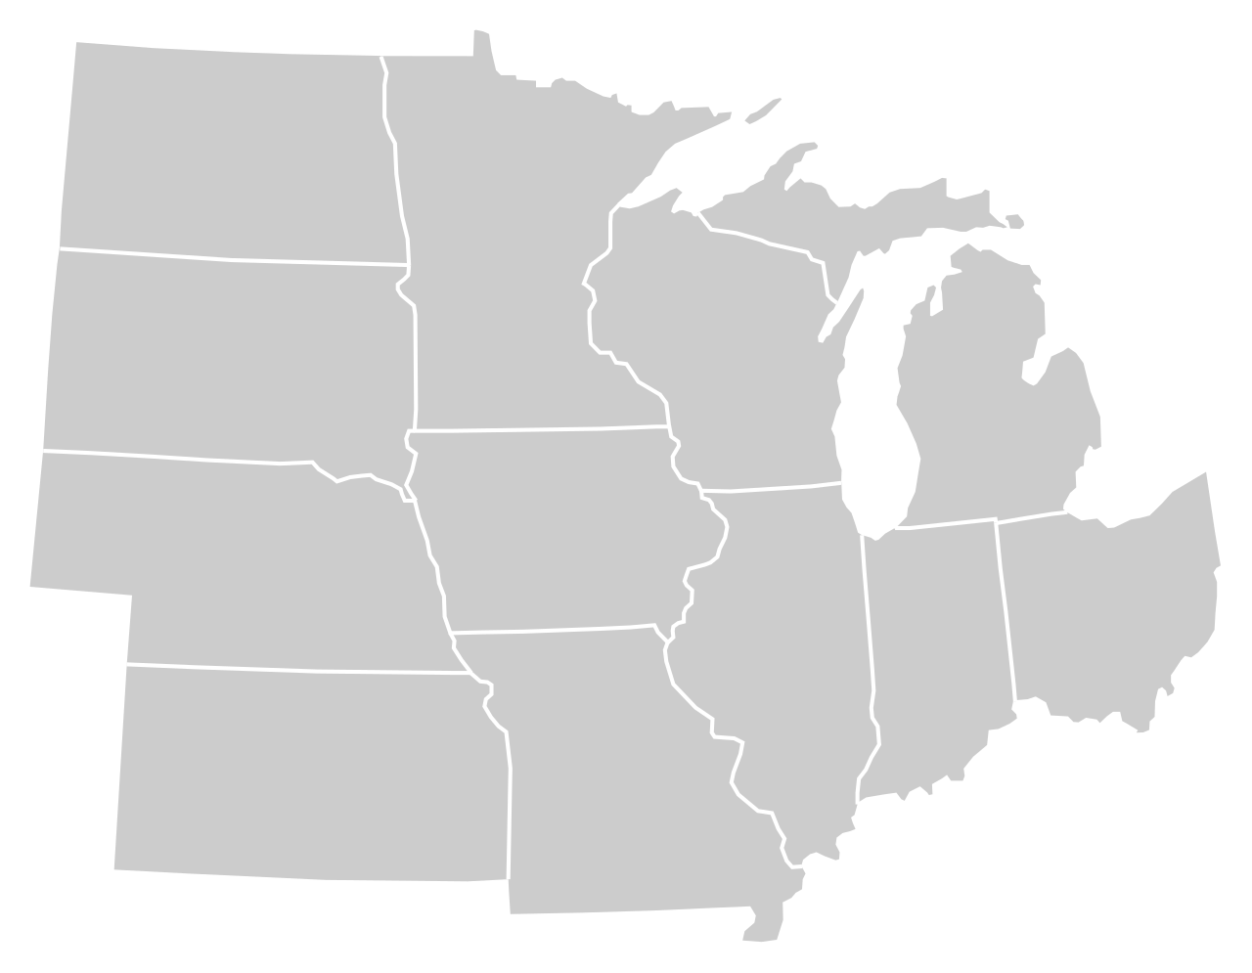
Moody’s/CNN Recovery Index - Midwest
(Pre-Pandemic = 100) As of 10/1/2021
95%
93%
103%
95%
94%
97%
(100% last month)
97%
93%
87%
95%
95%
94%
Nation is at 92% (93% last month)

Slide 5
Monthly Passenger Counts at Iowa’s Eight Commercial Service Airports
(through August 2021)

Slide 6
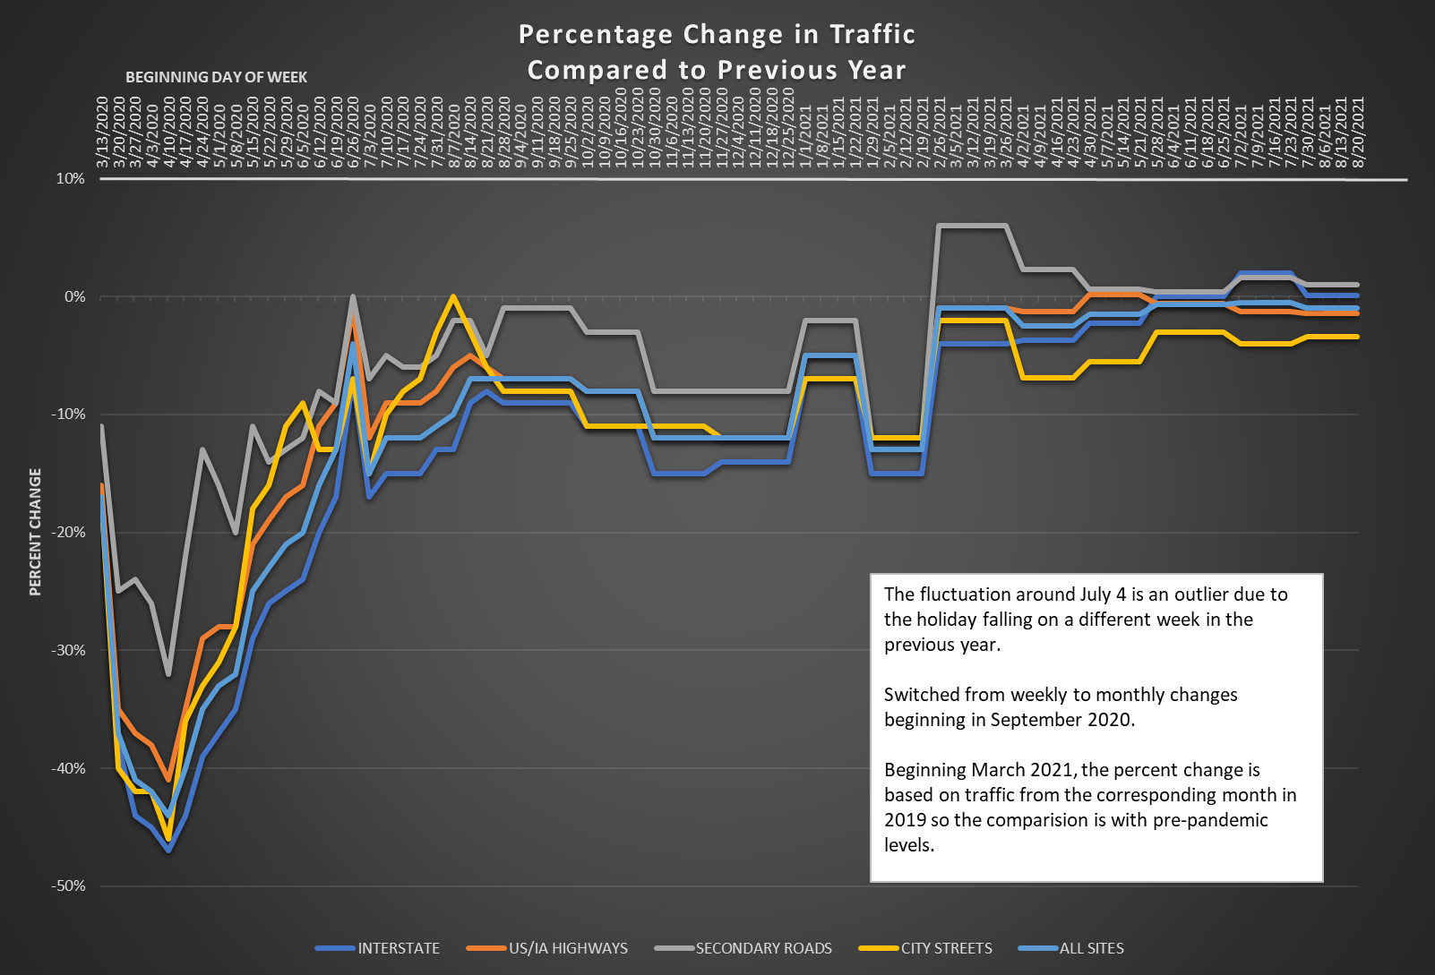

Slide 7

Infrastructure Bill Overview
Infrastructure Investment and Jobs Act (IIJA)
Passed the Senate (69-30)
House did pass prior to the end of the fiscal year
FAST Act extended through Oct. 31, 2021
Includes reauthorization of surface transportation programs for FFY 2022 to FFY 2026.
Includes $550 billion in new funding with half going to transportation

Slide 8
Transportation Impacts
Core programs remain, and several new programs created - especially competitive
Some intended to be permanent, some temporary
Many funding levels likely temporary
Emphasis on GHG reduction, automated vehicles, multimodalism, equity, innovation, etc.

Slide 9
Freight and Multimodal Programs
“National Infrastructure Project Assistance”
  New, competitive for states, MPOs, etc., mega-projects, incl. intermodal
INFRA
  Plus-up and changes to existing program (multimodalism)
RAISE
  Plus-up to existing program
SMART grants
  New-ish, competitive for states, MPOs, transit agencies, etc., technology for safety, efficiency
National Culvert Removal (anadromous fish passage) - new

Slide 10
Other New Programs
Carbon Reduction – new core formula program, wide variety of projects, such as transit
PROTECT – new core formula program, resilience projects (also competitive funds)
Charging and Fueling Infrastructure - new
  Application-based –EV, hydrogen, propane, natural gas
  Formula to states –EV only
Bridges - new
  Competitive – large public bridges and small bridge bundling
  Formula – one-time program for bridges on public roads

Slide 11
Transit Programs
Bus and Bus Facilities formula program – plus-up
Bus and Bus Facilities competitive program – plus-up
Low or No Emission grants – plus-up

Slide 12
Rail Programs
“Railroad Crossing Elimination Program”
  New, competitive for states, MPOs, local govs, etc. for hwy/rail or pathway/rail grade crossings
Consolidated Rail Infrastructure and Safety Improvements (CRISI)
  Plus-up to existing program
Federal-state partnership for intercity passenger rail (was SOGR)
  Plus-up and changes to existing program (new capacity)

Slide 13
Aviation Programs
“Airport Infrastructure Grants”
  new apportioned program, could be used for terminals and certain other projects
“Airport Terminal Program”
  new competitive program mainly for terminal projects

Slide 14
Highway Formula Programs (millions)
Program | 2021 (actual) | 2022 | 2023 | 2024 | 2025 | 2026
National Highway Performance | 307.4 | 365.8 | 373.1 | 380.6 | 388.2 | 395.9
Surface Transportation Block | 157.2 | 177.9 | 181.5 | 185.1 | 188.8 | 192.6
Highway Safety Improvement | 28.1 | 35.8 | 36.6 | 37.5 | 38.3 | 39.2
Rail-Highway Crossings | 5.7 | 5.7 | 5.7 | 5.7 | 5.7 | 5.7
Congestion Mitigation/Air Qual. | 11.8 | 12.3 | 12.6 | 12.8 | 13.1 | 13.3
National Highway Freight | 18.2 | 17.0 | 17.4 | 17.7 | 18.1 | 18.4
Metro Planning | 2.1 | 2.6 | 2.7 | 2.7 | 2.8 | 2.8
State Planning and Research | 10.6
Highway Infra/Bridge | 43.6
Bridge |  | 86.3 | 86.3 | 86.3 | 86.3 | 86.3
Carbon Reduction |  | 15.9 | 16.2 | 16.5 | 16.8 | 17.2
PROTECT |  | 18.0 | 18.4 | 18.8 | 19.1 | 19.5
Total | 584.7 | 737.4 | 750.4 | 763.7 | 777.3 | 791.1
National EV Charging |  | 10.3 | 10.3 | 10.3 | 10.3 | 10.3

Slide 15
Next Steps
Passage of Infrastructure Bill (FAST Act: 12/15)
Iowa DOT review and assessment (FAST Act: 12/15 to 1/16)
Iowa DOT overview to Commission (FAST Act: 2/16)
Stakeholder input
  City/County/RPA/MPO Committee (FAST Act: 3/16)
  All stakeholders (FAST Act: 4/16 to 6/16)
Summary of input to Commission (FAST Act: 7/16)
Recommendations to Commission (FAST Act: 8/16)
Commission action (FAST Act: 9/16)

Slide 16
Questions?

