Slide 1
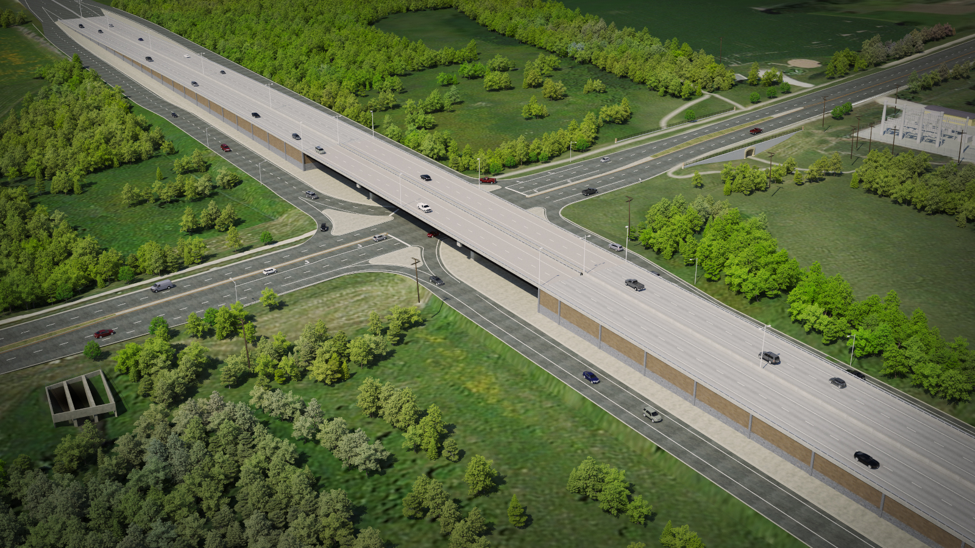

Iowa 58 & Greenhill Road
Chase Schrage
Director of Public Works
City of Cedar Falls

Slide 2
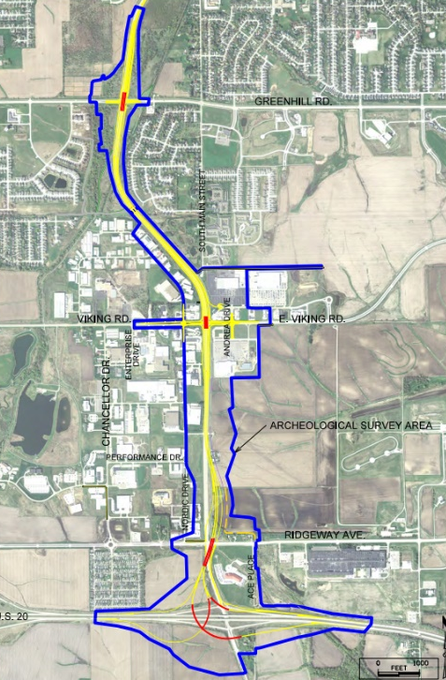
Iowa 58 Overview
Corridor Environmental Analysis (EA) completed and adopted in 2015
Viking Road interchange completed in 2019
  $37 million project
  Funded by the Iowa DOT and Cedar Falls
Interim improvements from US 20 to Ridgeway Avenue in FY 2023
US 20 and IA 58 systems interchange planned in the future
Improvements to Greenhill Road urgently needed

Slide 3
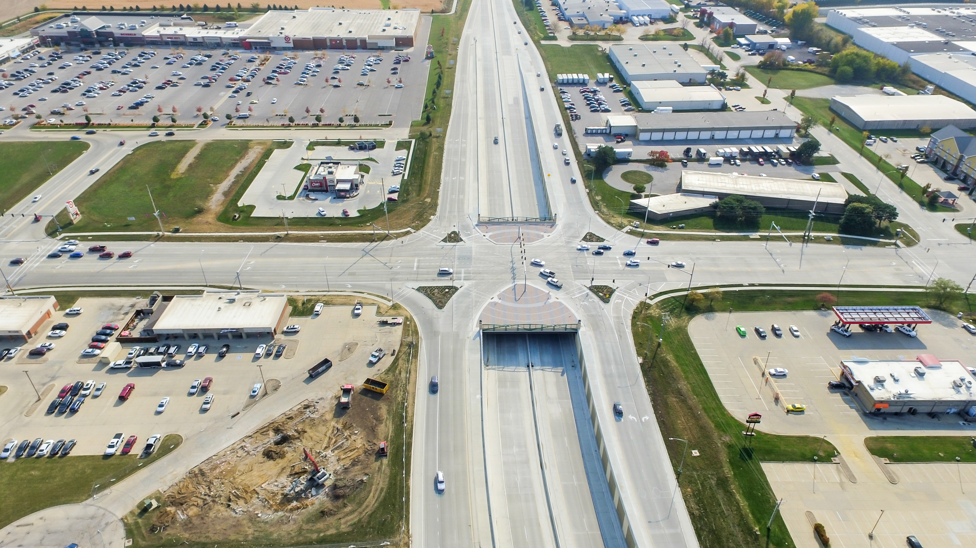
Viking Road Interchange

Slide 4
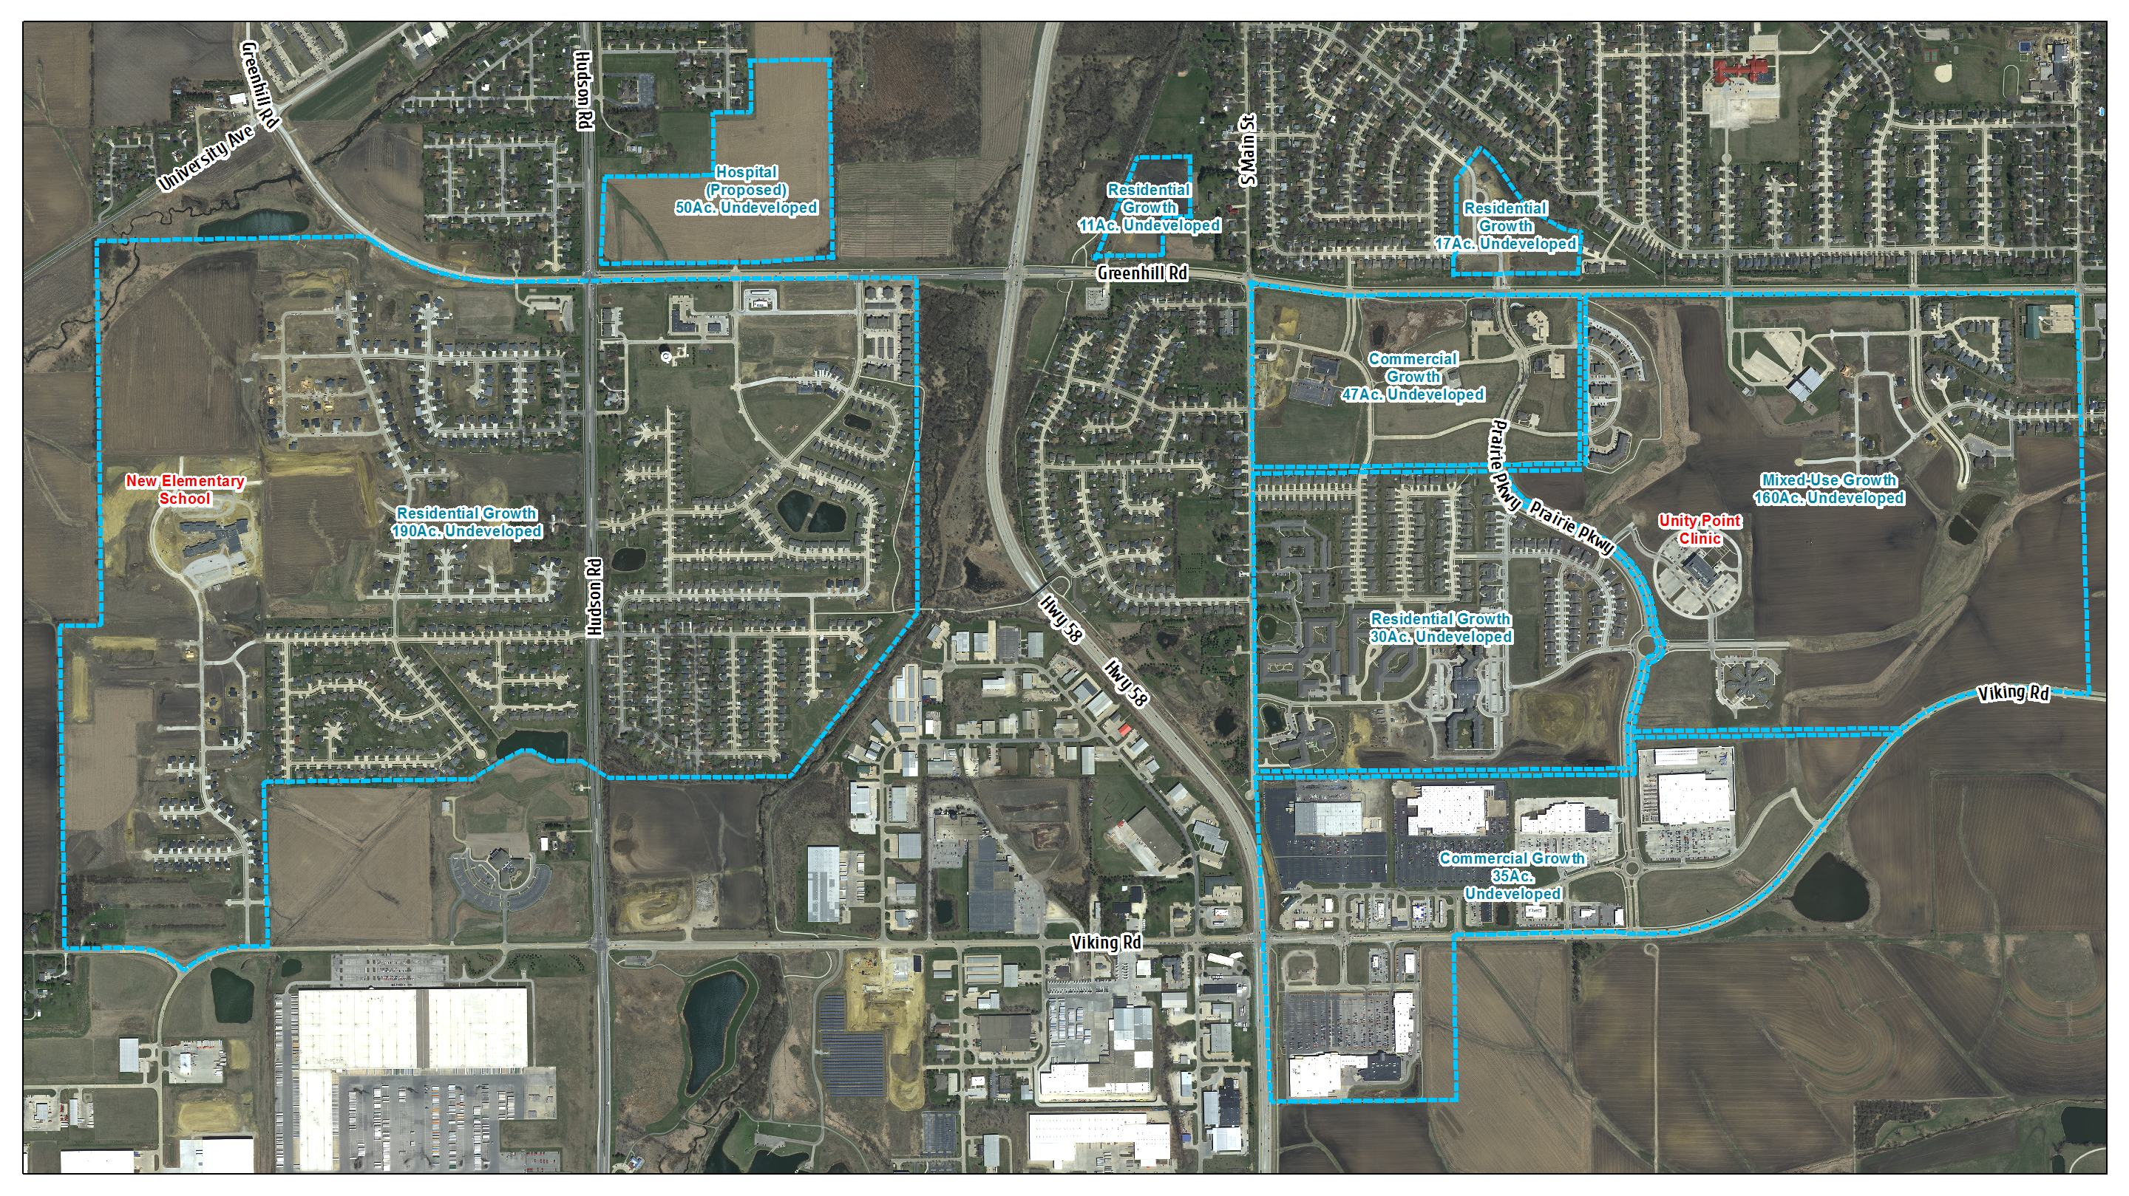
IA 58 Growth
$182 million in new building in five years
Greenhill Village, Prairie Winds & Prairie West, new elementary school, Greenhill Road extension to UNI
Pinnacle Prairie, Unity Point (20-acre, outpatient/urgent care), Western Home Communities, Menards, big-box commercial, strip retail
Over 500 acres remaining for development
50-acre hospital proposed less than ½ mile west of Greenhill Road intersection

Slide 6
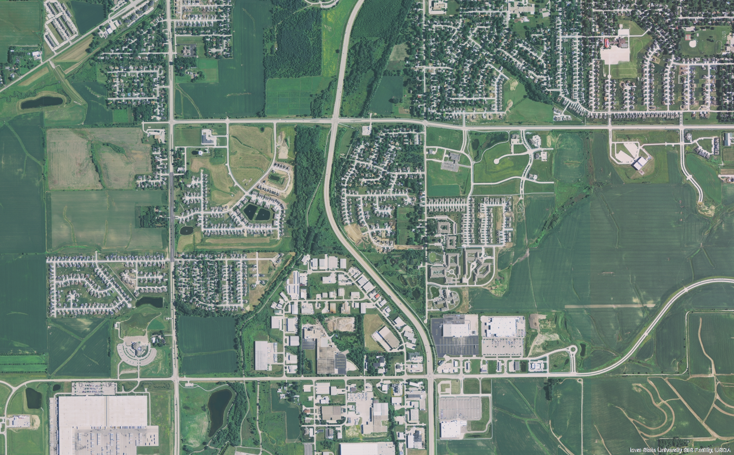
2011
Greenhill Rd
58
Viking Rd

Slide 7
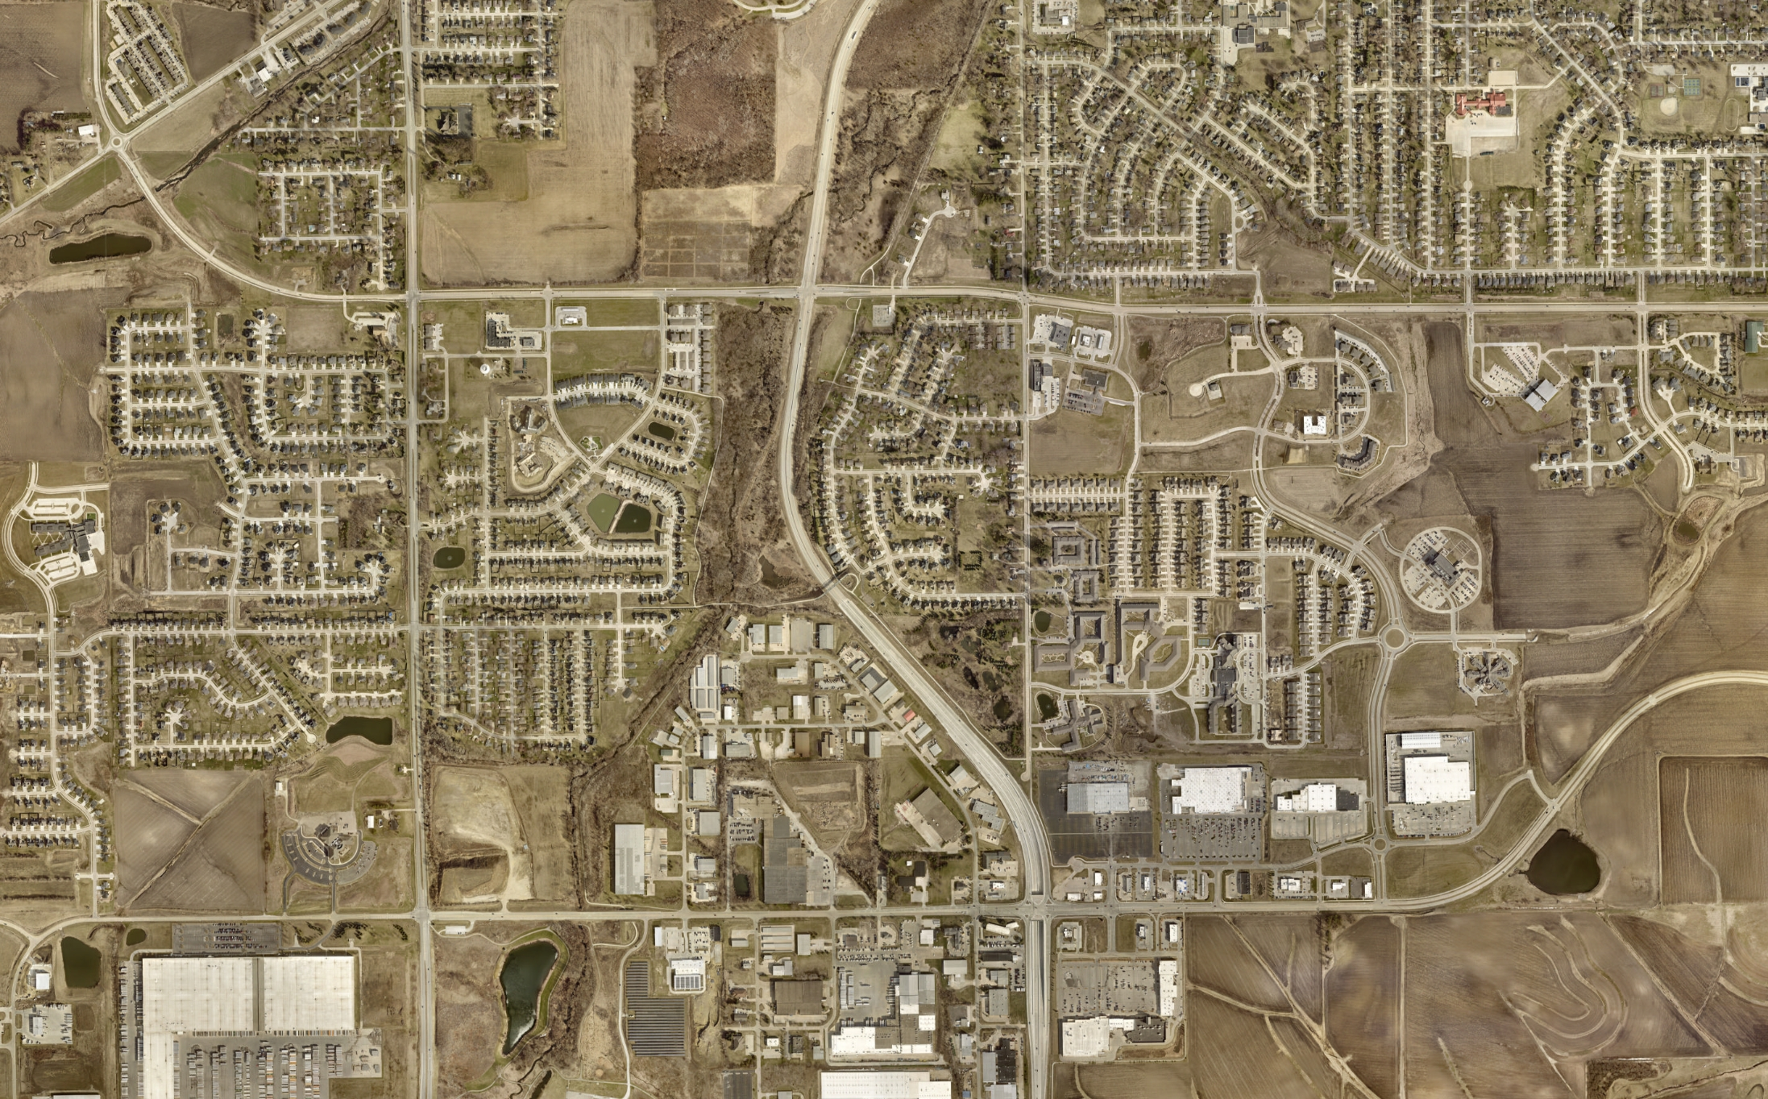
2021
Greenhill Rd
58
Viking Rd

Slide 8
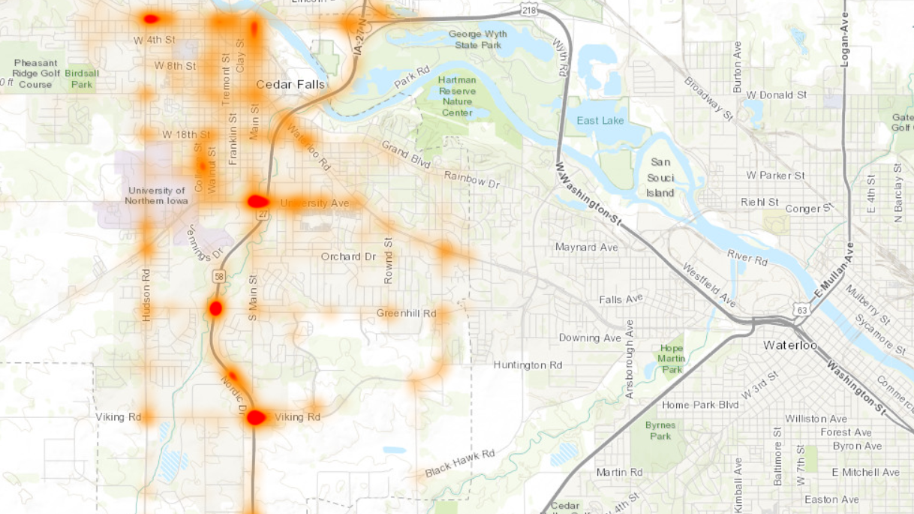
IA 58 and Greenhill Road Intersection
58th worst intersection for fatal and injury crashes
8th worst high-speed traffic signal-controlled intersection for fatal and injury crashes
Since 2011:
  138 crashes
  36 crashes making left turns
  2 fatalities/major injuries
  20 minor injuries
  $928,837 property damage
Crash Density – All Crashes (2011-now)

Slide 9
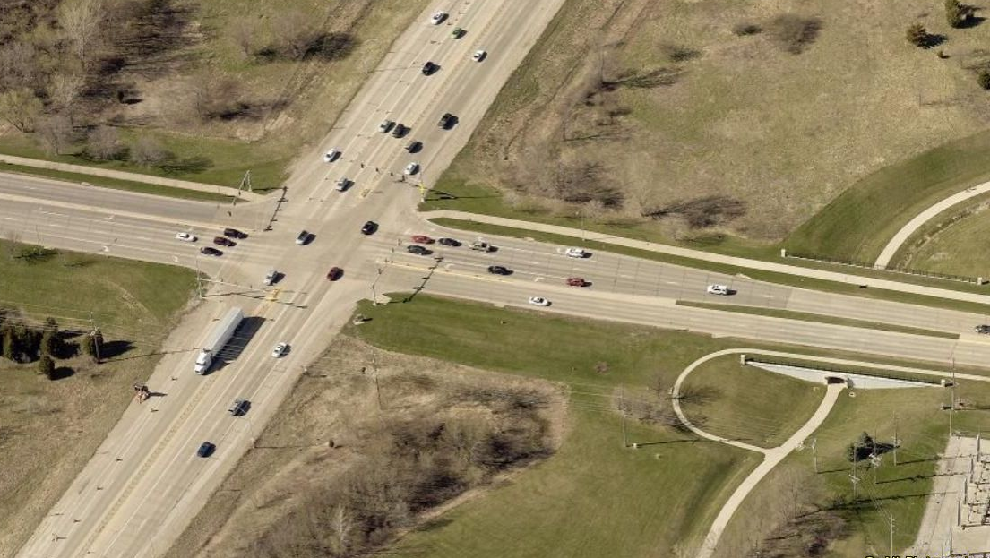
IA 58 and Greenhill Road Intersection
Avenue of the Saints
Critical Urban Freight Corridor in State Freight Plan
Freight bottleneck in
State Freight Plan
40 percent increase in traffic in the past 12 years
2019: 20,000+ AADT
2045: 25,000-30,000 AADT
LOS “D” in 2045

Slide 10
IA 58 and Greenhill Road Single Point Interchange
$36 million construction estimate
  $4M in TIF included in Cedar Falls’ CIP in 2026
Additional state and/or federal funding needed to move forward with this important project
Cedar Falls is willing to partner with the Iowa DOT

Slide 11

IA 58 and Greenhill Road Single Point Interchange
Cedar Falls respectively requests the Transportation Commission program funds for this important project

Slide 12
Thank you!
Chase Schrage
Director of Public Works
City of Cedar Falls

