Slide 1
Highway 150 Coalition

Slide 2
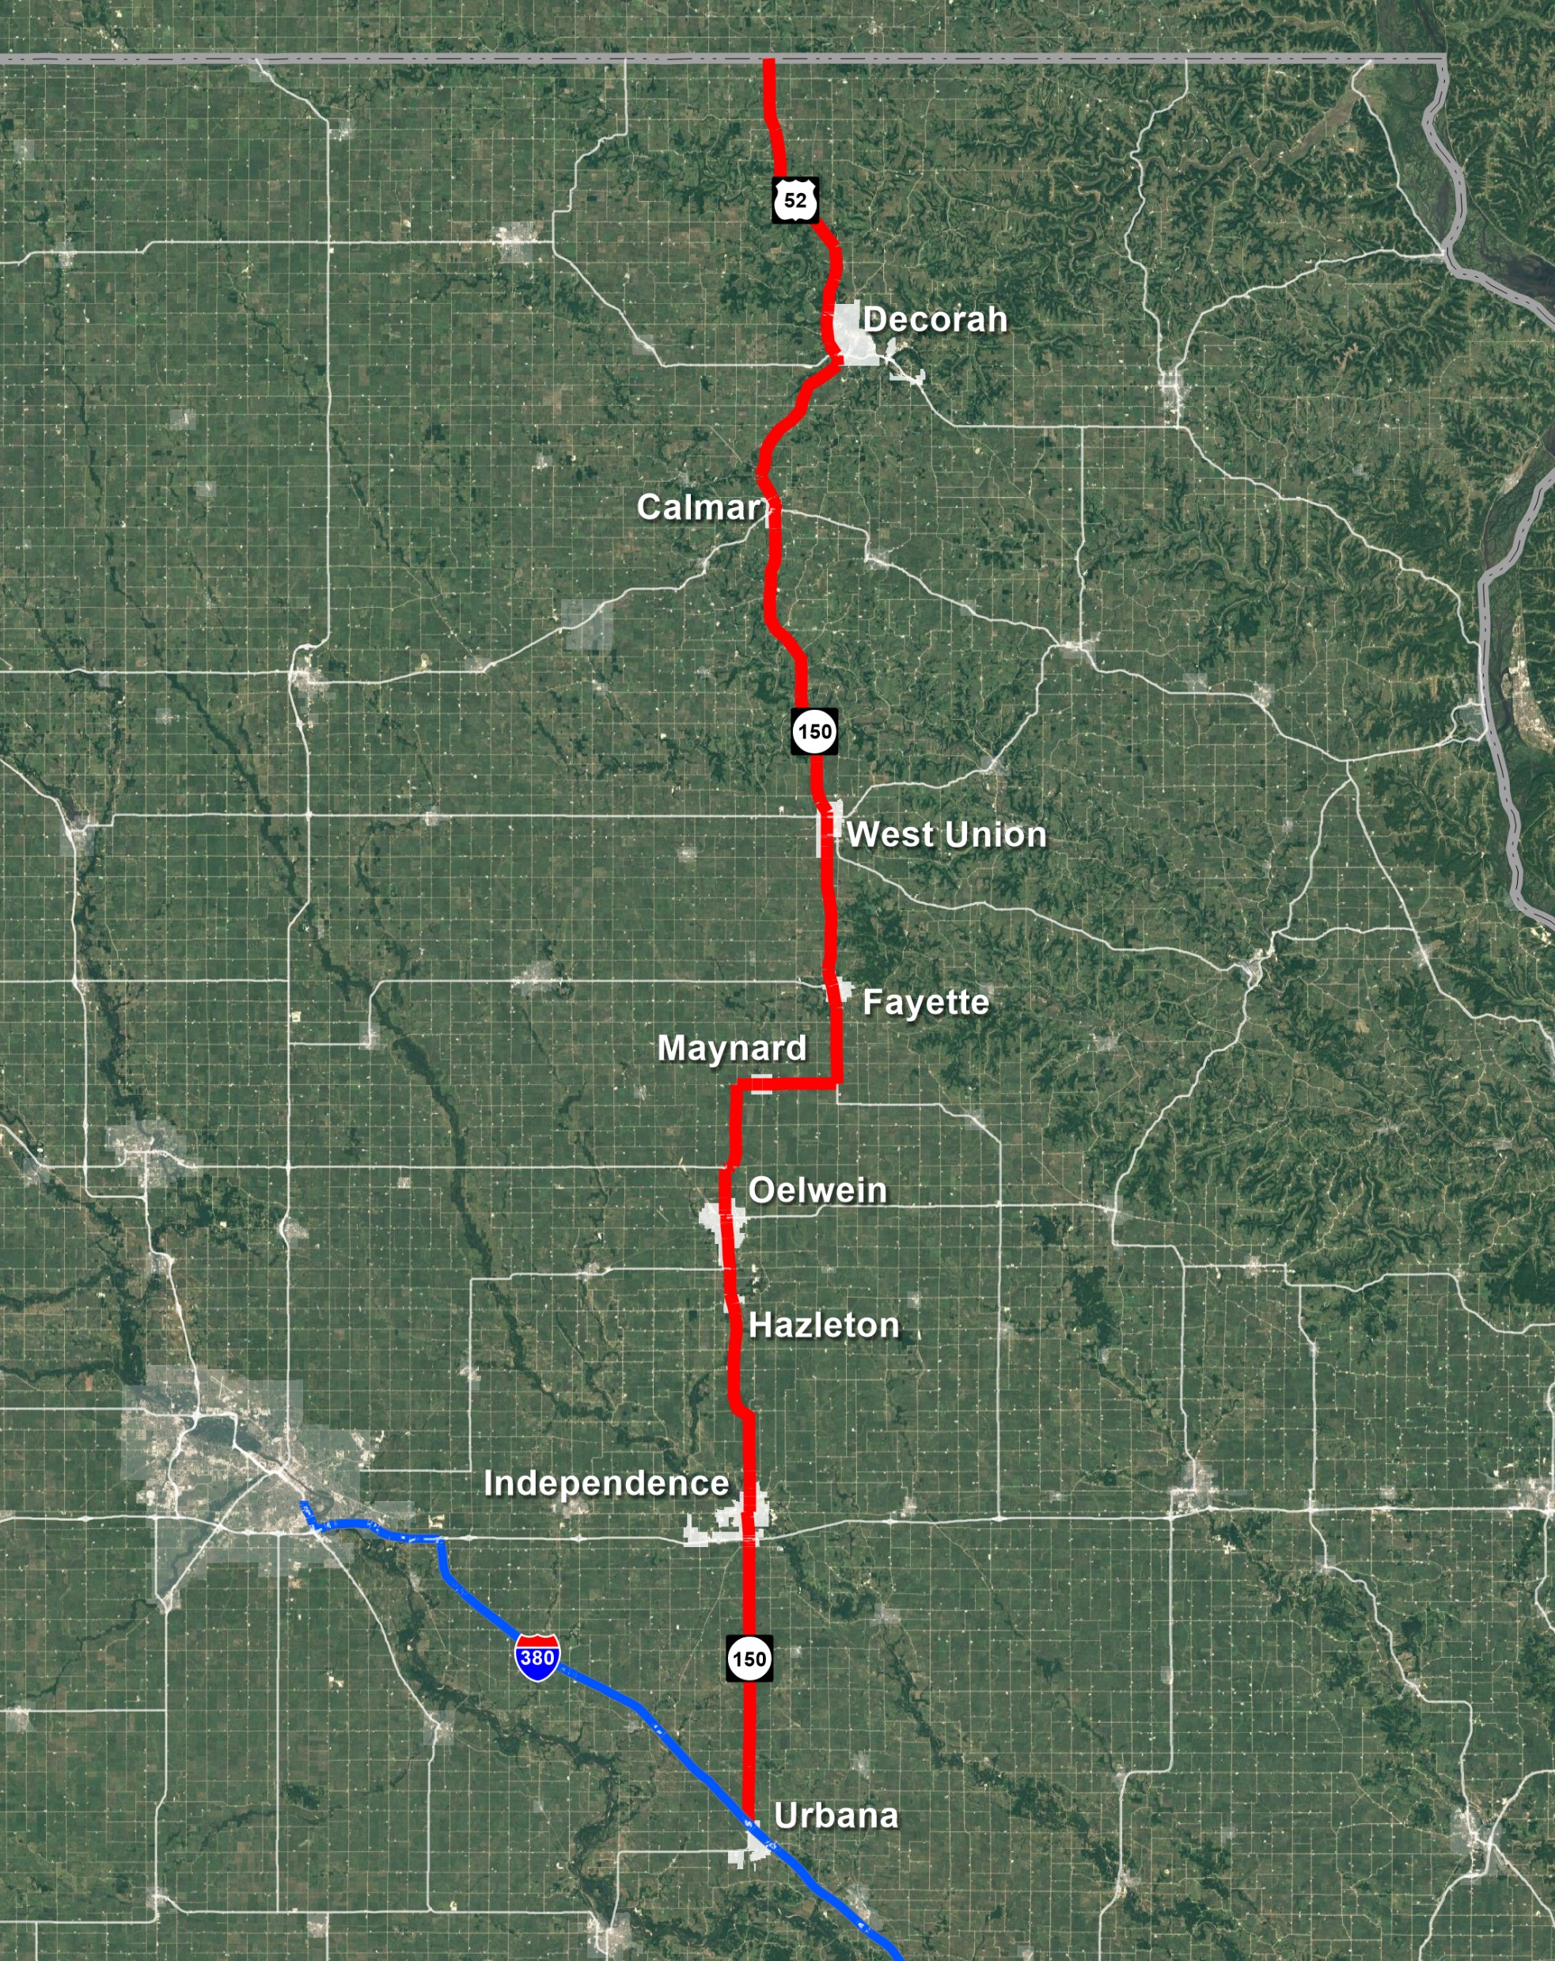
Our Mission
The Highway 150 Coalition’s mission is to bring safety and operational improvements to the Highway 150 corridor, with a particular focus on the City of Independence, a critical point along Highway 150.

Slide 3
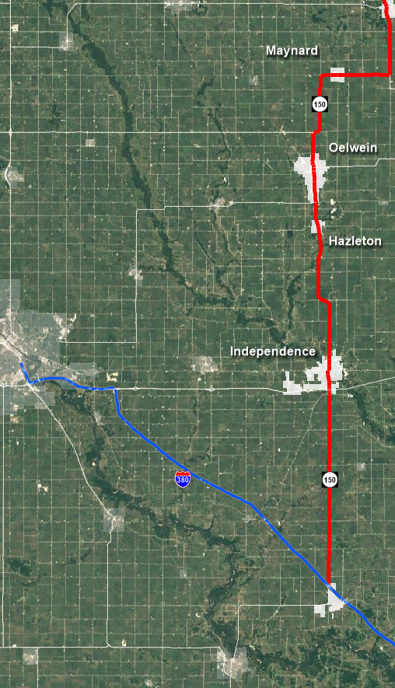
Thank you
The Highway 150 Coalition is excited and grateful for the Planning and Environmental Linkages (PEL) Study from I-380 to Oelwein

Slide 4
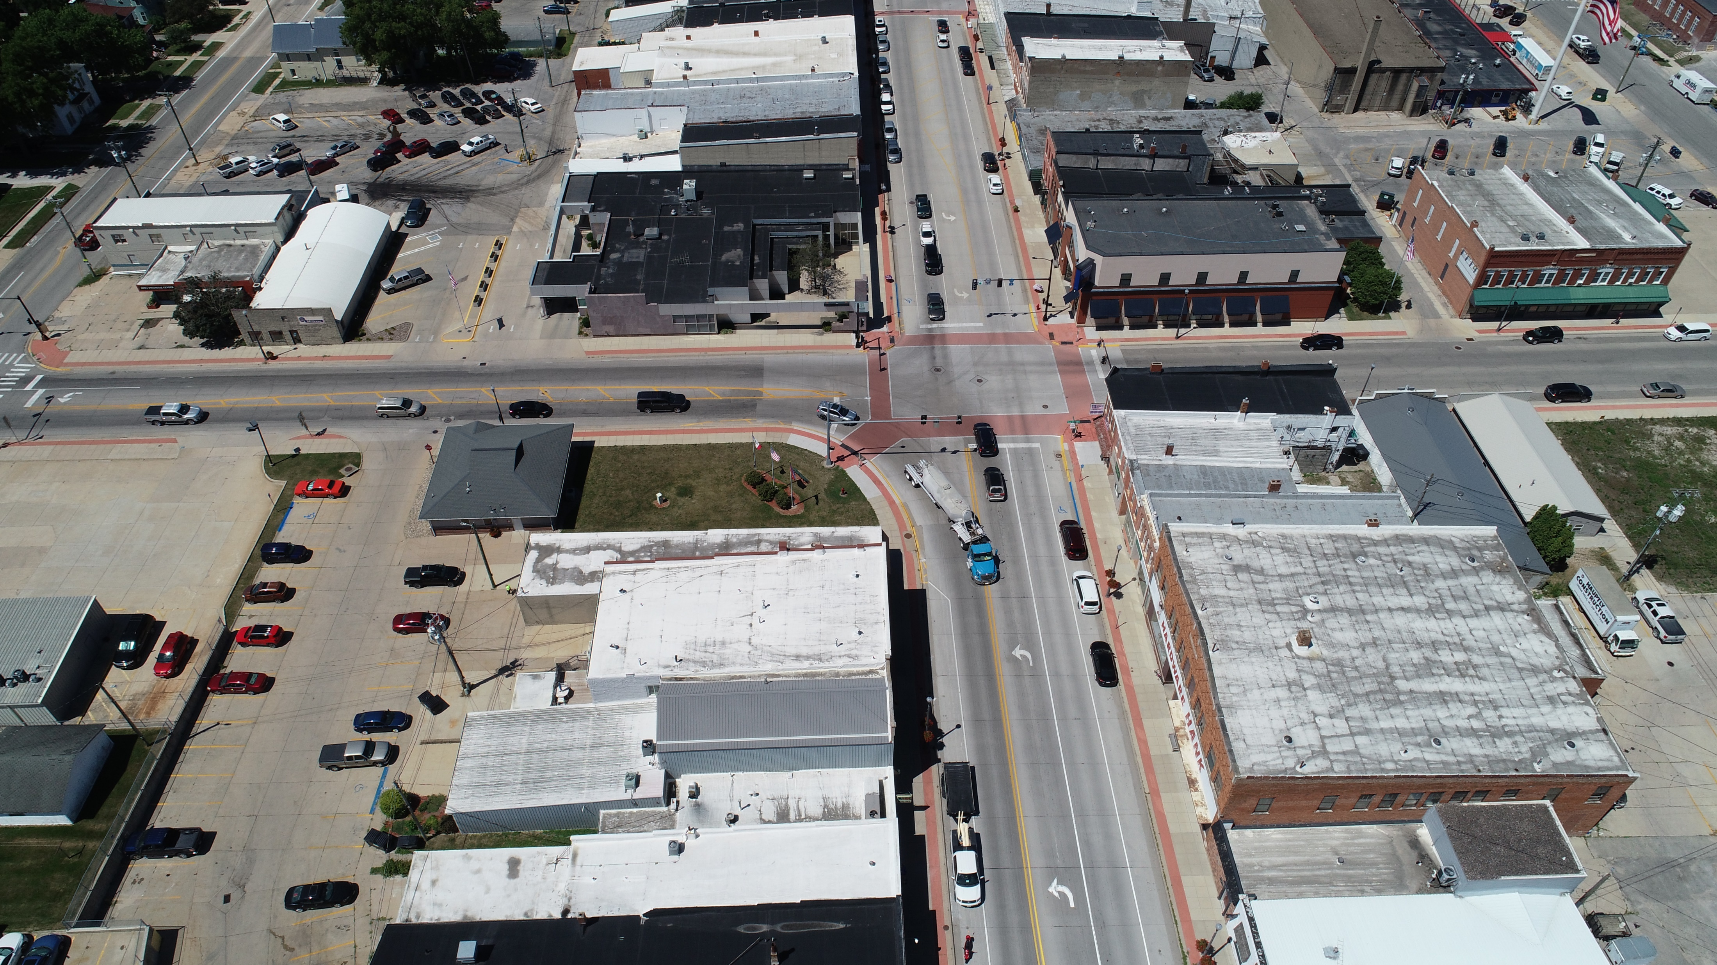
PEL Study
The intersections within this study have issues regarding line of sight, safety and operations of turning lanes, and freight bottlenecks.
We look forward to working with the Iowa DOT and other partners on this important effort.

Slide 5
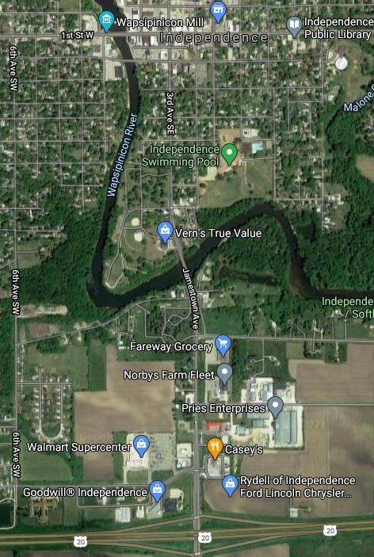
Current Studies on 150
Traffic Engineering Assistance Program (TEAP)
Occurring in Independence in 2021
Speed Study

Slide 6
Freight Bottleneck
The DOT recognizes an improvement is needed for the freight and pavement condition for Independence in their State Transportation Long Range Plan

Slide 7
Economic Activity on Highway 150
Expansion of Pries Manufacturing
Extension of Enterprise Dr.
New Dollar Fresh coming to Highway 150

Slide 8
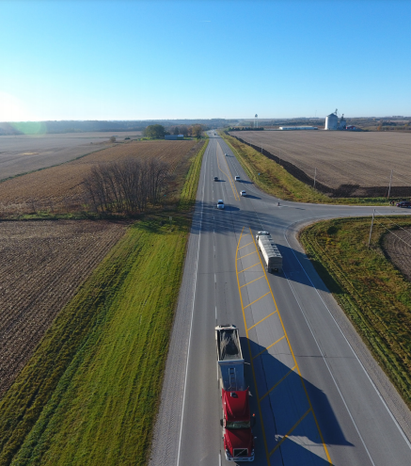
Focus on Super Two
Highway 150 is an excellent candidate for a Super Two
Super-2 design elements limited access, geometric improvements, left and right-turn lanes, acceleration lanes, and climbing/passing lanes
Finding appropriate improvements for Highway 150

Slide 9
Highway 150 Coalition Members
Independence and Buchanan County
Oelwein, Fayette, West Union, and Fayette County,
Decorah and Winneshiek County
Upper Explorerland Regional Planning Commission and Iowa Northland Regional Council of Governments
Iowa DOT Districts 2 and 6

Slide 10
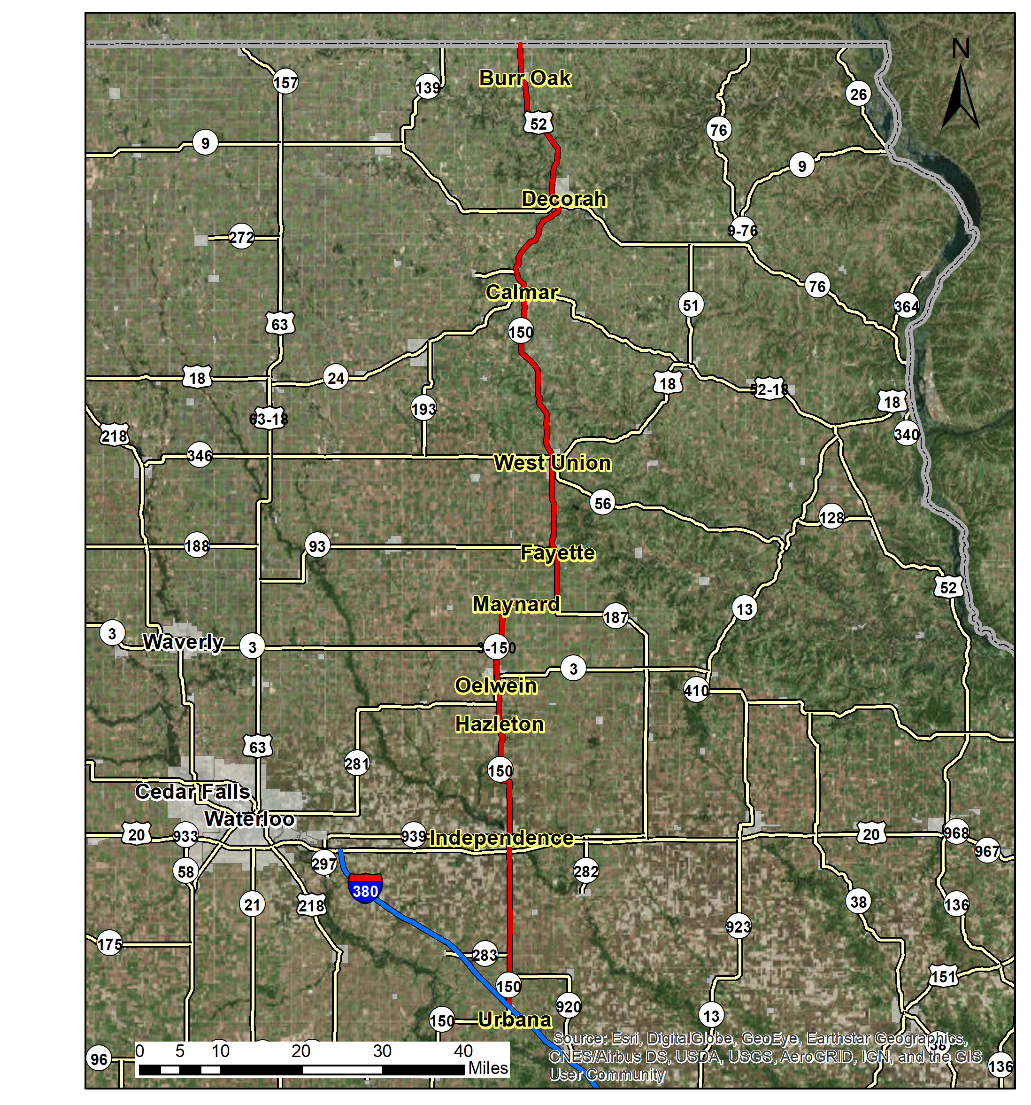
Thank you
The Highway 150 Coalition respectfully requests that the Iowa DOT work toward a super two roadway plan for the Highway 150 corridor to improve safety and efficiency issues.

