Slide 1
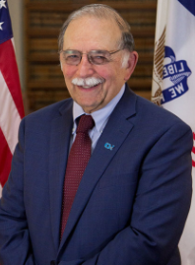
OTTUMWA

Slide 2
Ottumwa City Traffic Proposal
Problem Statement
Solution & Evaluation
Executive Summary
Proposal
Conclusion

Slide 3
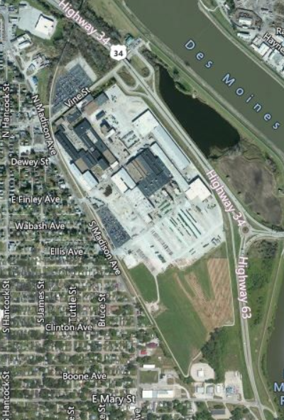
Ottumwa City Traffic Proposal
Problem Statement & Scope
Key Highlights
John Deere Ottumwa
Start of Operations: 1911
Employees: 788
Property Sqft. 5,684,887
Facility Sqft. 1,189,320
The FACTS
Public Safety
Truck / Traffic Flow
Residential Safety
Recreation Safety
Business Support
Public*Private*Support
Policy
City / JDOW Support
Semi Truck traffic 30 per day 600 per month.
Vine street traffic count YD18 2560 Daily YD14 2030 Daily
Vine/Madison Street accidents: TD 66
Property Damage: YD $653,383.00

Slide 4
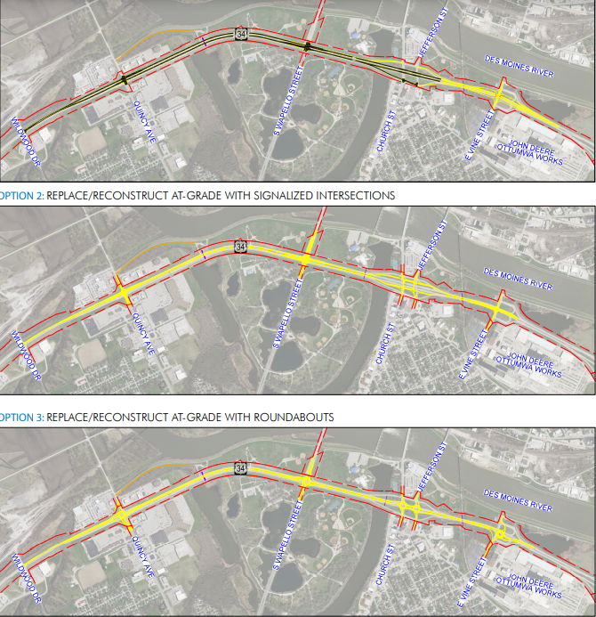
Ottumwa City Traffic Proposal
Solution & Evaluation
Key Highlights
US 34 Concept Overview
Three options
Joint meeting with Ottumwa Engineering
Mayor Tom Lazio
City Administrator Philip Rath
City Engineer Larry Seals
DOT District Leadership
Brenda Sanders
Bob Younie
Hector Torres-cacho
Liz Finarty
Note: Good comments from DOT/City Eng regarding JD involvement

Slide 5
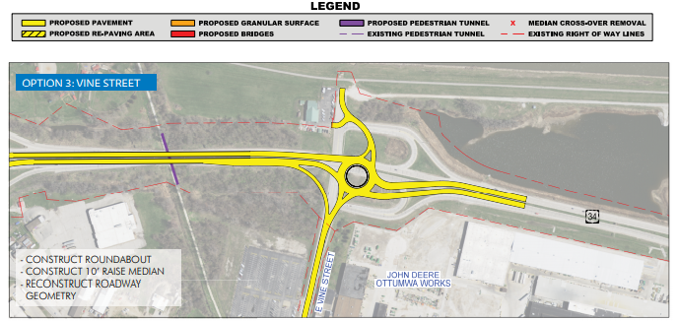
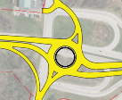
Ottumwa City Traffic Proposal
Proposal
Key Highlights
Policy
City 20-year planning
JDOW 5-year planning
8 Point Goals
Current

Slide 6
Ottumwa City Traffic Proposal
Conclusion
Key Highlights
Safety risk reduction
Future Growth opportunity
Start the HWY 34 construction in Ottumwa

