Slide 1
Revitalize Iowa’s Sound Economy Program
Iowa Transportation Commission Workshop
October 11, 2021

Slide 2
Revitalize Iowa’s Sound Economy Program
Created in 1985
Purpose: To promote economic development through roadway improvements.
Eligible development shall have value-adding activities that feed new dollars into the economy
Available to cities and counties through an application program

Slide 3
Available Funding and Application Summary
Available Funding
Funded annually with dedicated state motor fuel and special fuel tax revenues
Application Summary for SFY2022
Total number of projects awarded: 1
Total project costs: $327,066
Total amount awarded: $261,653
 | CITY | COUNTY
Average funding generated monthly | $905,101 | $452,550
SFY 2022 current Road Use Tax Revenue (as of 9/30/2021) | $3,047,370.62 | $1,523,685.31
Current Unobligated Balance (as of 9/30/2021) | $4,743,001.26 | $1,989,339.79

Slide 4
Local Development Project Evaluation Criteria
Development Potential (35 points)
Economic impact and Cost Effectiveness (20 points)
Local Commitment and Initiative (33 points)
Transportation Need and Justification (4 points)
Local Economic Need (6 points)

Slide 5
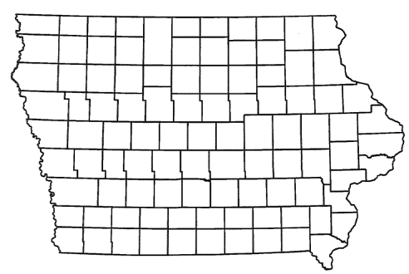
List of Local Development Applications Recommended
ADDED TOTAL COST FOR MODIFICATION
RECOMMENDED RISE AMOUNT FOR MODIFICATION
PROJECT NAME
SPONSOR
SCORE
PERCENT PARTICIPATION
To construct an additional 2,000 feet of 36th Avenue South. (Modification) | Clinton | 61 | $1,200,000 | 60% | $720,000

Slide 6
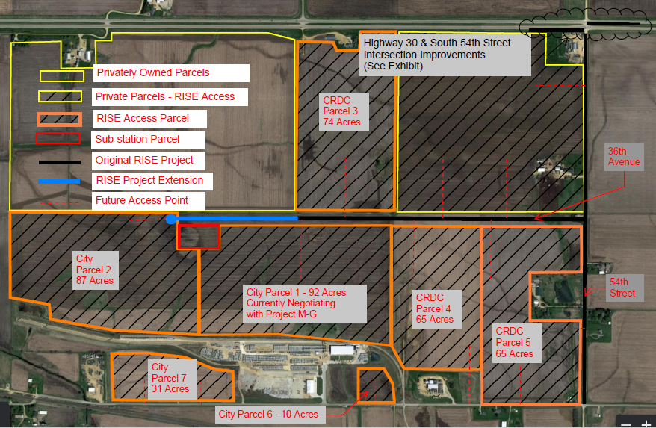
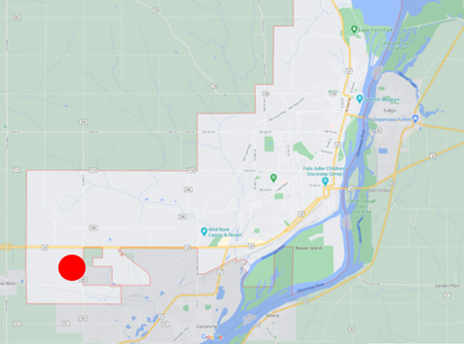
Clinton - Modification
(Local Development)
A modification to the scope and grant award was requested to construct an additional 2,000 feet of 36th Avenue South. This modification is necessary to provide improved access to Lincolnway Industrial Rail and Air Park, an Iowa Economic Development Authority certified site of 345 acres.
Total Added Cost for Modification: $1,200,000
Requested RISE Amount for Modification: $720,000 (60%)

Slide 7
QUESTIONS?
Craig Markley, Systems Planning Bureau
craig.markley@iowadot.us
515-239-1027

