Slide 1
IOWA
2018
Motorcycle Safety Forum
Notes:
1
Background
Organizational Communication
A. Research
B. Group Dynamics
Facilitation:
A. CAC (SMSA)
B. TWG (MSF/NHTSA)
C. RETSDOT (MSF)
D. Military Focus Groups (USAF)
Currently Managing Director
R.D.& D.
PhDs (herding cats)

Slide 3
Mission
To make motorcycling safer and more enjoyable by ensuring access to lifelong quality education and training for current and prospective riders, and by advocating a safer riding environment.
Positive Rider Outcomes
Save Lives
Fuel Dreams
Serious Fun
MSF Copyright

Slide 4
MSF BRC (updated) (2nd QTR 2018)
AK
WA
MT
ND
ME
OR
MN
VT
NH
ID
WI
NY
MA
WY
SD
MI
RI
PA
CT
NV
NE
IA
NJ
UT
IL
IN
OH
DE
CO
WV
VA
MD
CA
KS
MO
KY
TN
NC
AZ
NM
OK
AR
SC
MS
AL
GA
TX
LA
Military Programs
Air Force:
Army:
Coast Guard:
Marines:
Navy:
Special Ops:
FL
Green: Transitioned or are in process of transitioning
Lt. Green: Using MSF’s older BRC and considering transition
Orange: MSF’s older BRC
Dark: Non-MSF Curriculum

Slide 5
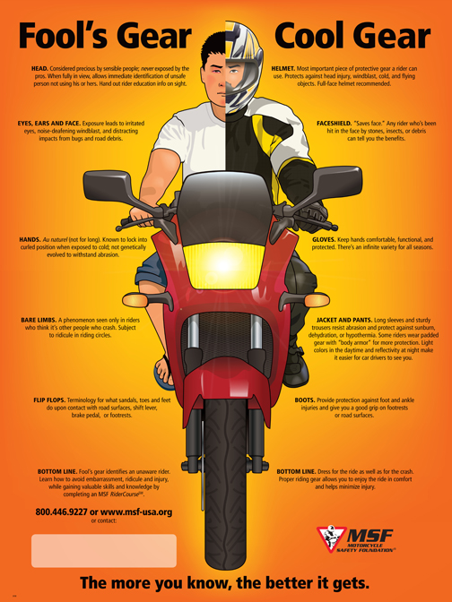
MSF Key Message Points
Get trained and licensed
Wear protective gear
Ride unimpaired
Ride within your limits
Be a lifelong learner

Slide 6
Basic RiderCourse (updated)
Additional content: behavioral aspects, self-assessment, perception
Online component + interactive live classroom
Range-first configuration possible
(2014)
Basic RiderCourse (BRC: 2001)
Principles of Safety, Learning and Motor Skills Development
Input from Invested and Divested Professionals
Experience, Research and Literature Review
RETSDOT Established
Motorcycle RiderCourse: Riding and Street Skills (MRC:RSS 1986)
Motorcycle Accident Cause Factors and
Identification of Countermeasures (Hurt Report)
Motorcycle Rider Course Field Study
1996 Project: RSS 2000
Motorcycle Rider Course (MRC: 1976)
Updated Instructional Objectives
Photographic Analysis
Beginning Rider Course (BRC: 1974)
Motorcycle Task Analysis
2014: 5th Iteration
MSF Copyright

Slide 7
Modern Educational Technology
Deeper Learning That Transfers
Knowledge-sharing Behavior-changing
Rote memorization Guided discovery
One-way information Emotional engagement
Hearing words Novel, memorable activities
Canned presentation Creative activities
Knowledge rituals Executive function
Surface learning Deeper learning
MSF Copyright

Slide 8
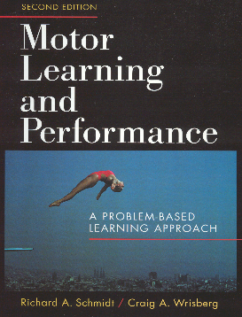
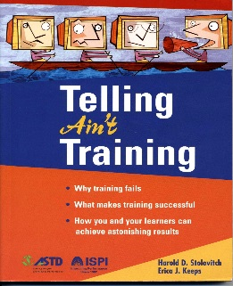
RETS Intellectual Foundations
Research,
Professional
Literature
&
Experience
Safety & Risk
Management
Principles
Adult
Learning
Principles
Motor Skills
Development
Principles
SAM
MSF Copyright

Slide 9
RETS: 2018
Learning-to-Ride
Improving-the-Ride
Specialized Programs
Host-An-Event
Basic RiderCourse (BRC)
Standard
Small Group
Skill Practice
Formal Remedial Training
BRC2
License Waiver
Skill Practice
Returning Rider BRC
3-Wheel Basic RiderCourse
3-Wheel Basic RiderCourse - SW
Scooter Basic RiderCourse
Street RiderCourse 1
Basic Bike Bonding
RiderCourse
Street RiderCourse 2
Advanced RiderCourse
Safe Motorcyclist
Awareness and
Recognition Trainer
(SMART)
Ultimate Bike Bonding
RiderCourse
MSF Circuit RiderCourse
Street RiderCourse 3
Basic eCourse &
Street Strategies eCourse
Introductory Motorcycle
Experience
ScooterSchool: Introduction
to Scooters RiderCourse
Military Motorcycle
RiderCourse
Military SportBike
RiderCourse
DirtBike School: DirtBike BRC
Trail Riding RiderCourse
State Education Programs
Online (Digital) Programs
Intersection –
Motorist Awareness
Share the Adventure –
Group Riding
Street Smart –
Rider Perception
Riding Straight –
Alcohol Awareness
SeasonedRider –
Aging Awareness
Riding Straight –
Marijuana Awareness
Essential Core
Basic RiderCourse
Street RiderCourse 1
Basic Bike Bonding RiderCourse
Expanded Core
Essential Core plus
Street Smart – Rider Perception
Advanced RiderCourse
Street RiderCourse 2
Recommended Core
Expanded Core plus
Ultimate Bike Bonding RiderCourse
MSF Circuit RiderCourse
Copyright MSF

Slide 10
WWW.MSF-USA.ORG

Slide 11
Thank You
Notes:
11
Background
Organizational Communication
A. Research
B. Group Dynamics
Facilitation:
A. CAC (SMSA)
B. TWG (MSF/NHTSA)
C. RETSDOT (MSF)
D. Military Focus Groups (USAF)
Currently Managing Director
R.D.& D.
PhDs (herding cats)

