Slide 1
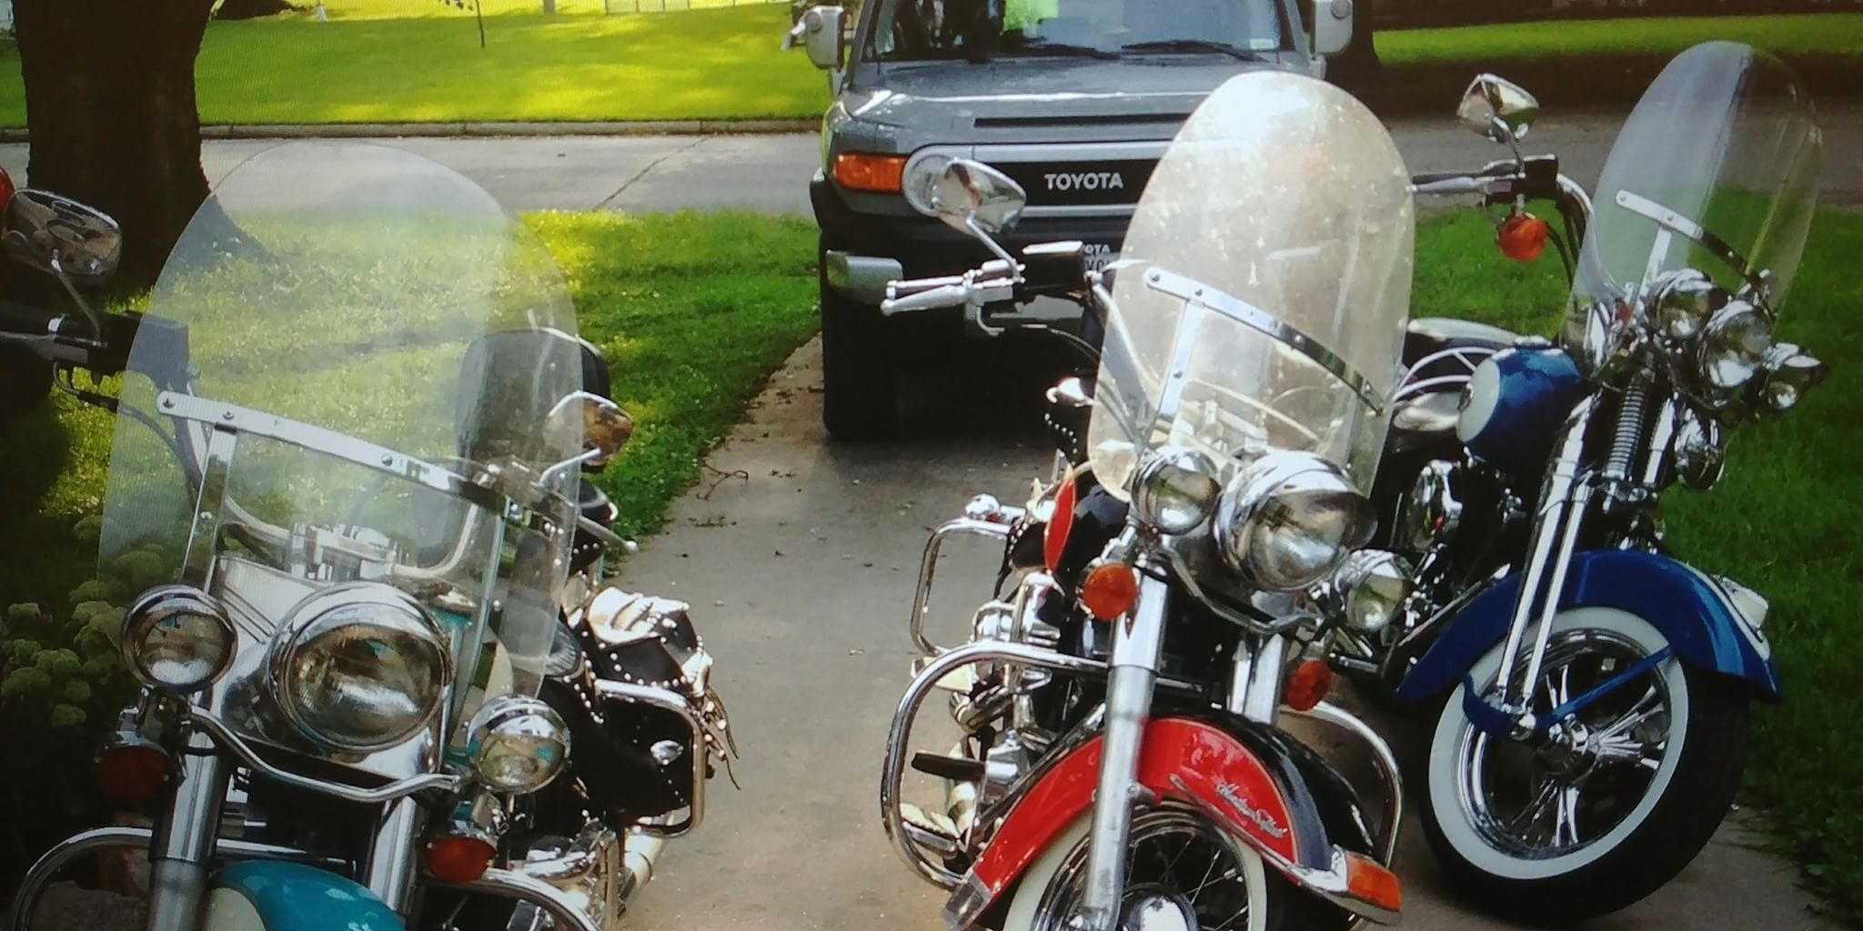
Motorcycle Safety in Iowa
2018 Motorcycle Safety Forum
Bonnie Castillo

Slide 3
Motorcycle Crash data
2015 – 2017 Data
3,067 Motorcycle Crashes
140 Fatalities
686 Serious Injuries
48.6% Single Motorcycle
48.1% Motorcycle/Other Vehicle

Slide 4
Curves
54% of fatal crashes are on curves

Slide 5
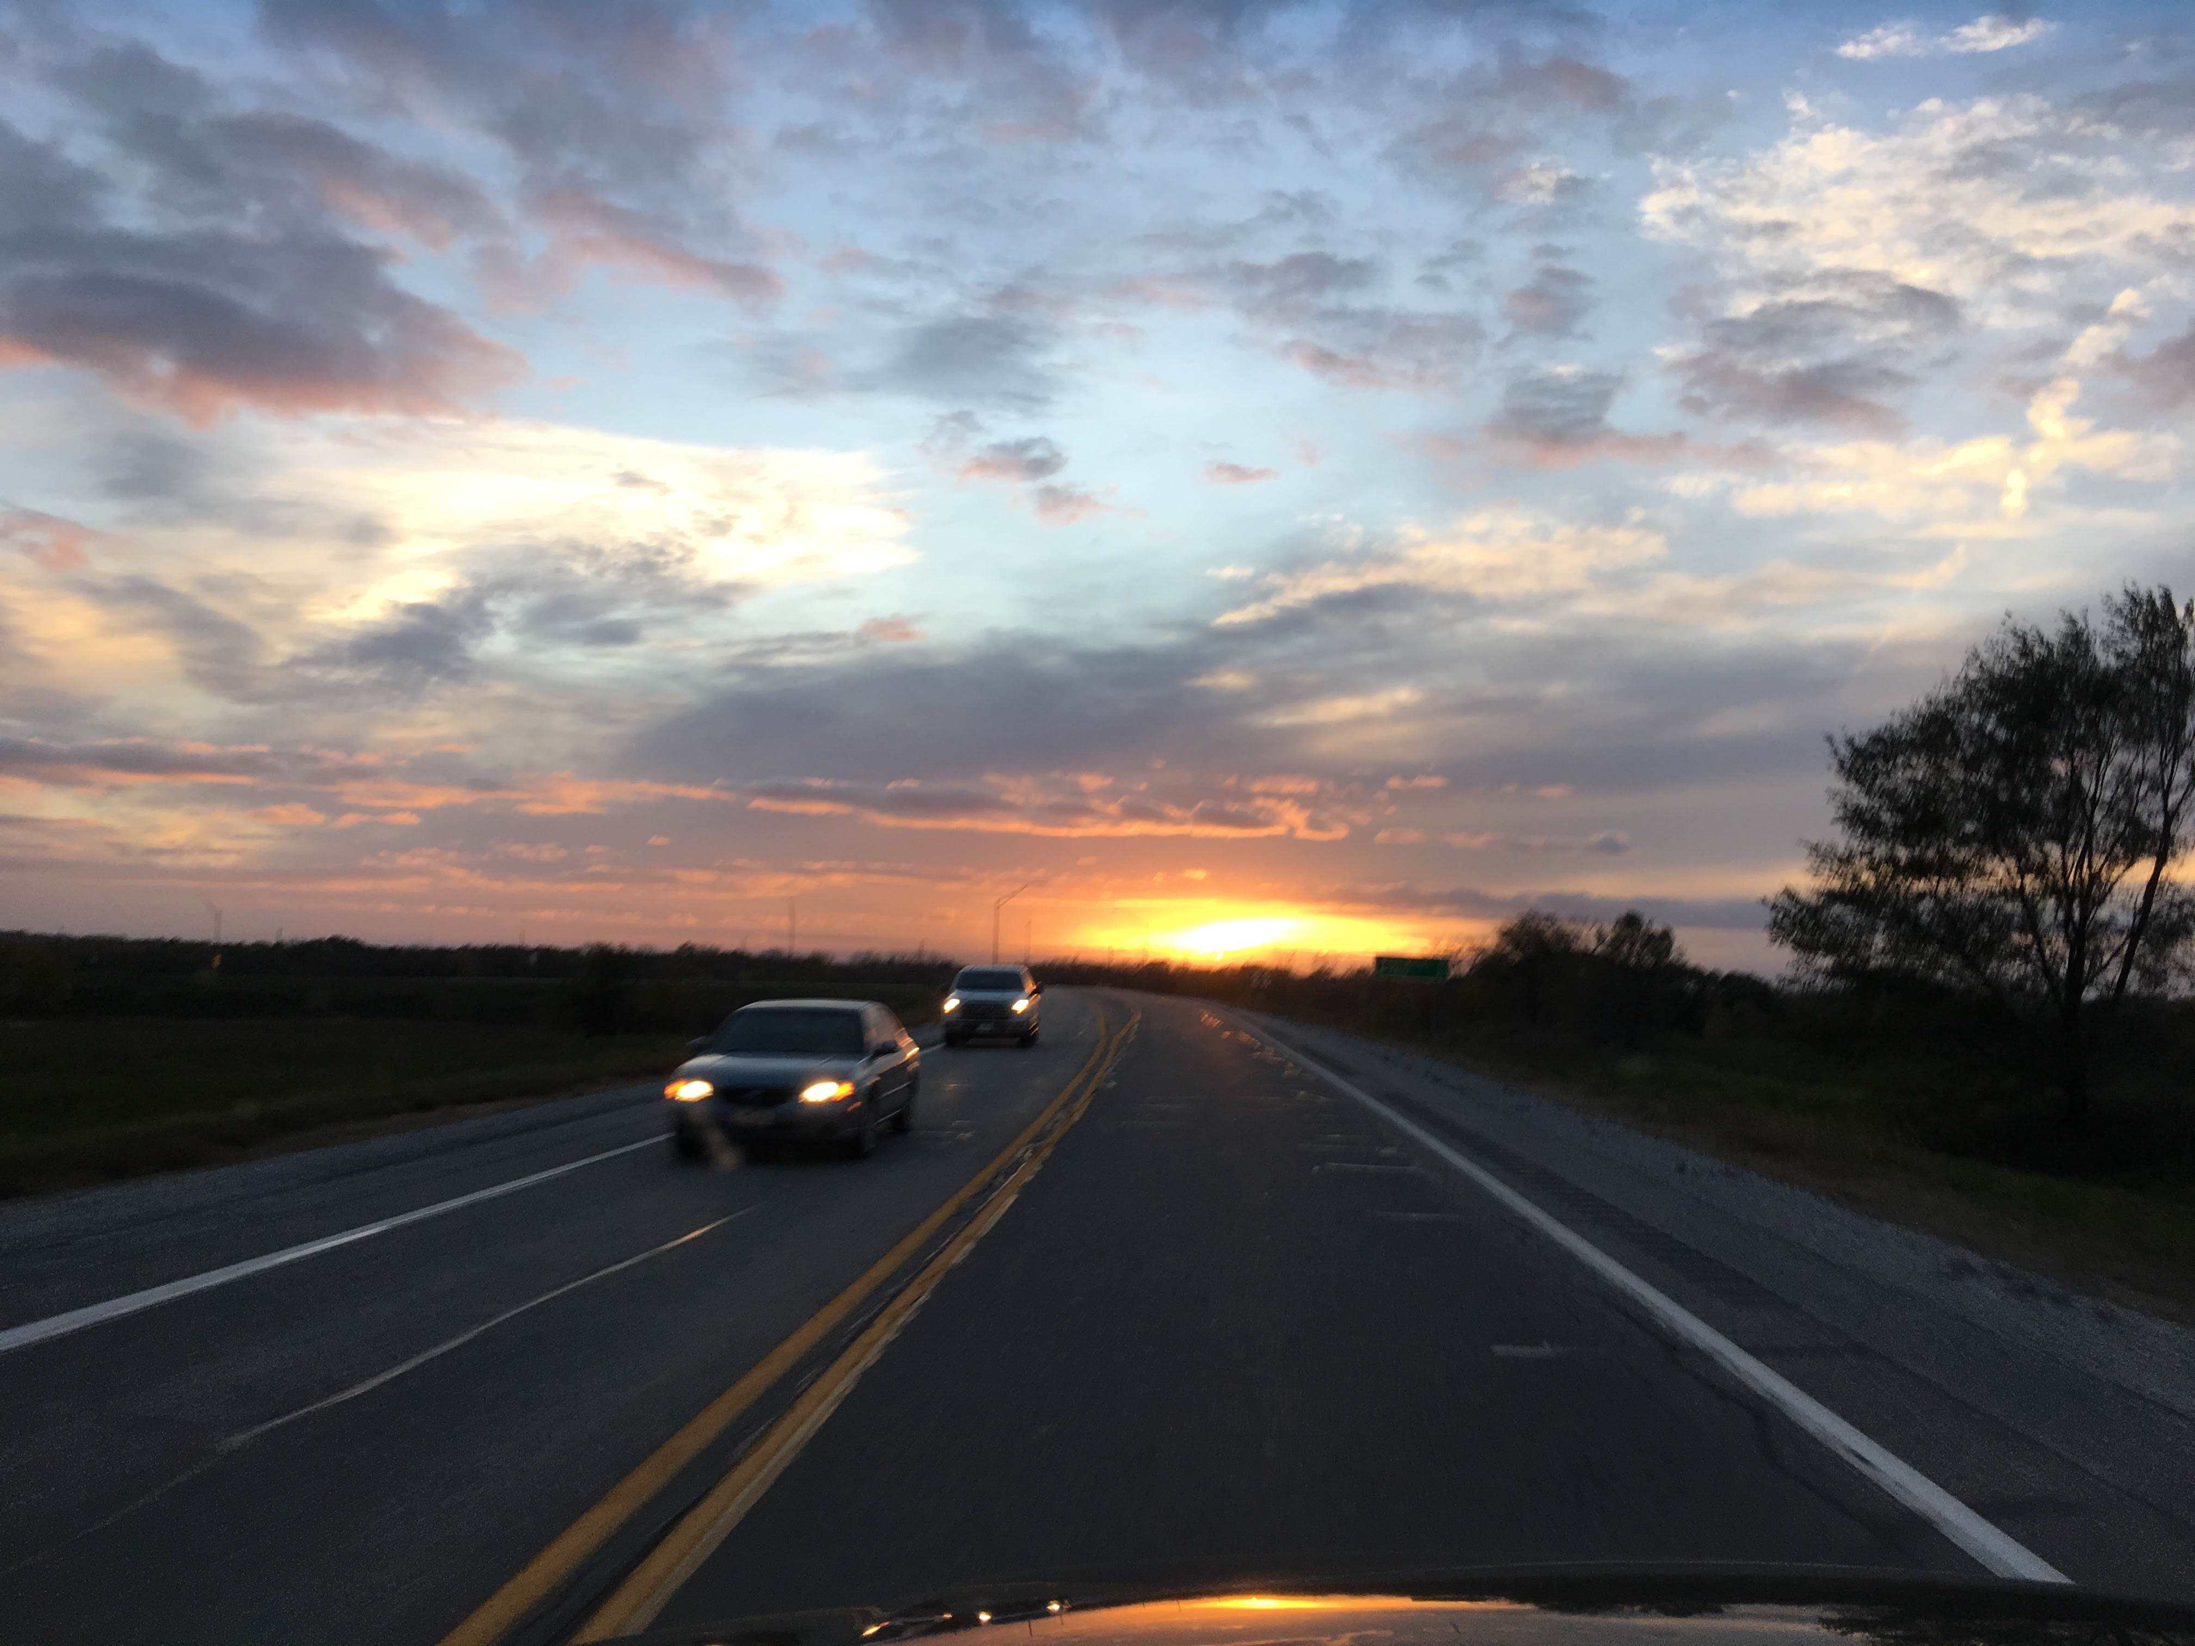
Drugs/Alcohol
15% of single motorcycle crashes involved alcohol or drugs
For comparison, 7% of single vehicle, non-motorcycle crashes involved alcohol or drugs

Slide 6
Age
51% of single motorcycle crashes drivers between age of 40 and 64

Slide 7
2005 – 295 -39
Jon David Jones, 43, of Waukee died October 1, 2005, from injuries received in a motorcycle accident on Interstate 35 south of Osceola.

Slide 8
Motorcycle Crashes with Another Vehicles
For accidents involving another vehicle,
58% of motorcycle drivers had
no improper action

Slide 9
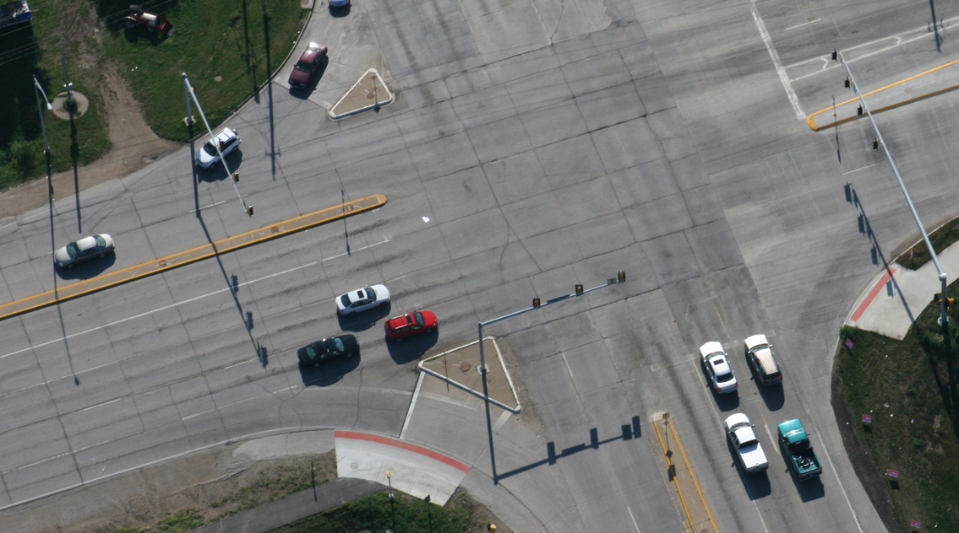
Intersections
32% of non-motorcycles involved are turning left
74% of motorcycles are moving essentially straight

Slide 10
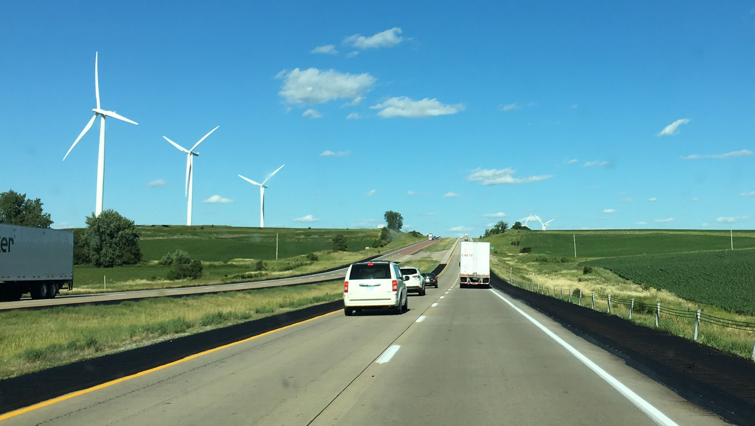
Time
56% of crashes are between Friday and Sunday
1/3 of crashes are between 3 and 6pm

Slide 11
Tool provides:
Interactive
User defined results based on selection
Ability to easily access data
https://reactor.ctre.iastate.edu/index.php/crash/motorcycle-crashes-in-iowa/

Slide 12
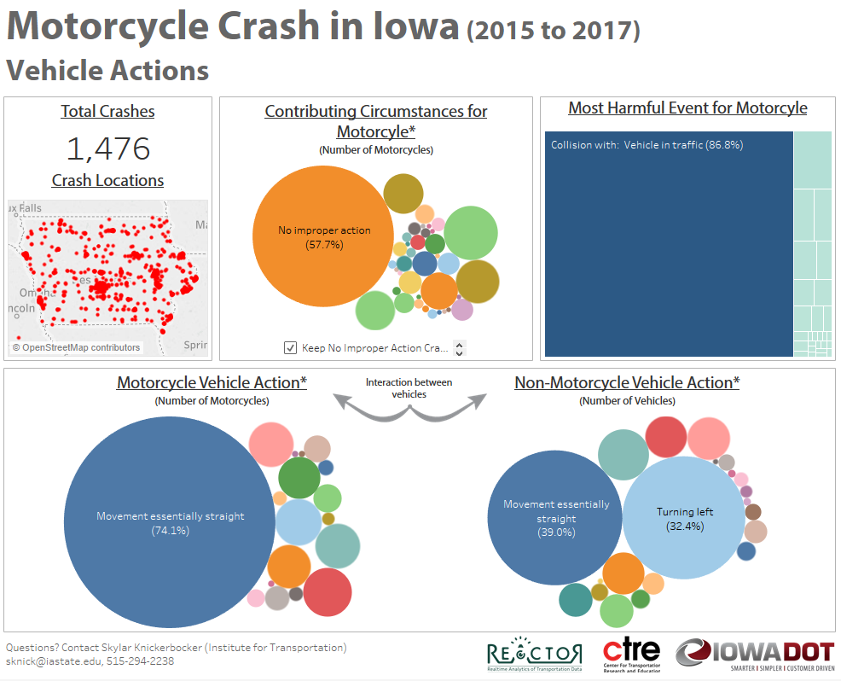
Can use data visualization to make data interactive and user defined
https://reactor.ctre.iastate.edu/index.php/crash/motorcycle-crashes-in-iowa/

Slide 13
Questions

